Slide 1
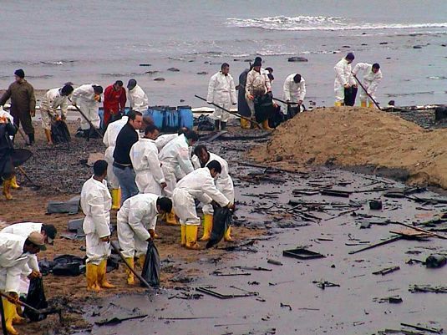
Basic HSE Training for Spill Response, Level 2
May 2010

Slide 2
Level 2 – Contractors and Paraprofessionals

Slide 3
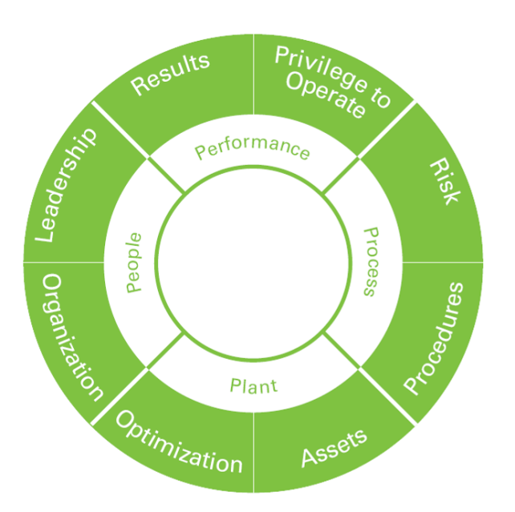
BP’s Priorities
Your Safety is BP’s Top Priority—If it Doesn’t Look Right, Don’t Do It…If it Doesn’t Feel Right, Don’t Do It…If You’re Not Sure, DON’T DO IT!!!
BP values our relationship with our employees, contractors and volunteers. Your assistance in this difficult time is very much appreciated by BP, your Community, the affected States and your Country.
A key component of our safety process is to stop any activity that is not going according to plans or appears to be unsafe.
Training, Planning and Safe Work is the Key to Safety

Slide 4
Training Objectives
The intent of this training is to provide basic awareness level information for contractors and paraprofessionals helping to clear shoreline areas with minimal contact to petroleum.

Slide 5
Site Safety Plans (SSP)
BP has developed an Incident Management Plan for ‘Oil Spill Response’ Key points of this plan that you should know:
Only appropriately trained individuals will be engaged in crude oil clean-up activities
  There are many tasks required to support an oil spill response that do not require people to clean up oil
  The hazards associated with crude oil are listed on page one of this plan and include the following:
    Benzene
    Hazardous Vapors
    Dust and Particulates
  Shoreline recovery and decontamination contractors are listed in this plan
  Untrained personnel will not be asked, nor should they engage in oil clean-up activities in this emergency

Slide 6

Slips, Trips and Falls
Slips are the result of a loss of friction between the boot/shoe and walking surface
Most slips and trips are the result of inattention to where the individual is walking
The worst outcome of a slip or trip is a fall; Falls are the worst possible outcome.
Methods of preventing slips and trips—’Eyes on Path’ do not walk when you are not focusing on where you are walking—DO NOT WALK BACKWARDS!!
Wear the appropriate footwear with adequate tread and a non-slip sole
Use handrails whenever going up and down stairs
Do not carry objects that block your vision of
where you are walking

Slide 7
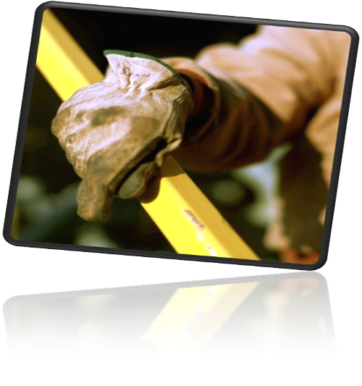
Hand and Finger Protection
Hand and finger Injuries are the most common injuries for most work activities
Risk identification is the key to prevention
Identifying and avoiding contact with sharp objects, crude oil exposure, and pinch points between objects are the primary means to prevent injury
Hand protection must be worn when performing jobs that expose the hands to:
  Absorption of harmful substances
  Cuts or lacerations
  Abrasions
  Punctures
  Chemical or thermal burns
  Harmful temperature extremes
Choosing the correct gloves for the job can prevent serious injury.

Slide 8
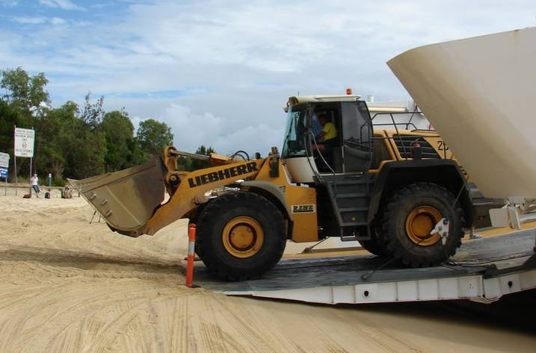
Heavy Equipment Operations (Mechanical Energy)
Working with and around heavy equipment has specific risks that must be identified in the JSEA
These include any and ALL of the following:
  Difficulty in operator seeing persons on the ground
  Loud engine noises preventing operator and personnel on ground from hearing voices
  Many pieces of heavy equipment do not have back up alarms and may not see you — STAY ALERT!!
Insure that all safety equipment on the equipment is operational
  Seatbelts
  Rearview/Sideview Mirrors
  Emergency Brakes
  Windshield/Cabin Windows
  Steps/Ladders
Notes:
8

Slide 9

Personal Protective Equipment
Personal Protective Equipment (PPE) is always a secondary means to protect people
PPE consists of such things as eye and face protection, chemical aprons, chemical gloves, face shields, hard hats, Tyvek coveralls, rubber boots, etc.
Proper fit of these items is essential for them to work properly
When dealing with chemicals, it is absolutely essential to select the correct PPE for the job. These should be selected by a qualified individual and should be worn by properly trained personnel
PPE will be provided to you before you begin your work
assignment, either by your employer or by your volunteer
coordinator at the shore base

Slide 10
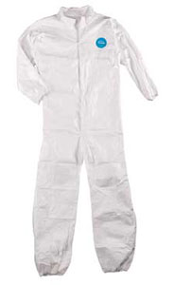
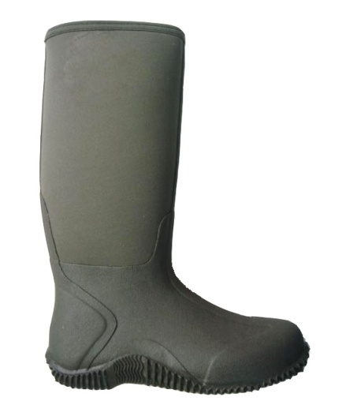
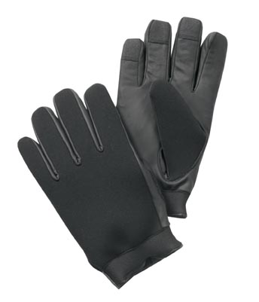
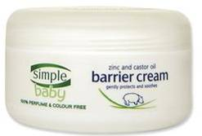
Skin Protection
Sun exposure may produce long-term heath risks.
Use protective means such as sun blocks, long-sleeved shirts, and hats/hard hats, to protect the skin
Use of Tyvek suits, Nitrile or Neoprene gloves, Rubber or Neoprene boots, Barrier Creams, etc. are means to protect yourself from chemical exposure—
  Use them if you are assigned duties that may bring you in contact with oil
  Use of Tyvek suits in high humidity and heat environment may increase the risk of heat stress

Slide 11
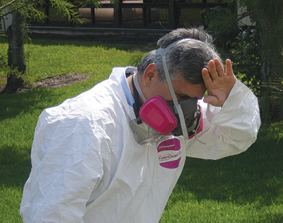
Heat Stress & Symptoms
When the body is unable to cool itself by sweating, several heat-induced illnesses, such as heat stress or heat exhaustion and the more severe heat stroke can occur, and can result in death
Heat Exhaustion
Headaches, dizziness, lightheadedness or fainting
Weakness and moist skin
Mood changes such as irritability or confusion
Upset stomach or vomiting
Heat Stroke
Dry, hot skin with no sweating
Mental confusion or losing consciousness
Seizures or convulsions
Notes:
Factors Leading to Heat Stress
High temperature and humidity, direct sun or heat
Limited air movement
Physical exertion, poor physical
condition, some medicines
Inadequate tolerance for hot
workplaces

Slide 12

Preventing Heat Stress
Know signs/symptoms of heat-related illnesses; monitor yourself and coworkers
Block out direct sun or other heat sources
Use cooling fans/air-conditioning; rest regularly
Drink lots of water; about 1 cup every 15 minutes for heavy work
Wear lightweight, light colored, loose-fitting clothes
Avoid alcohol, caffeinated drinks, or heavy meals
WHAT TO DO
Contact Supervisor
While waiting for help to arrive:
  Move the worker to a cool, shaded area
  Loosen or remove heavy clothing
  Provide cool drinking water
  Fan and mist the person with water

Slide 13

Heat and an Old Pickup Truck
Radiator of truck is like your Skin – fluid circulating all the time to the surface to cool you. What happens if your radiator is not full of fluid? Truck over heats and stops.
Fan of truck is like the air movement at your location. What happens if the belt breaks and the fan stops? Truck over heats and stops.
Speed you’re operating your truck is like how fast you’re working. What happens if you keep driving your truck at high rate of speed without stopping? Truck gets hot and it’s hard on the engine.
Water pump of truck is like your heart. It keeps
circulating fluid. Except the heart is a variable
speed pump. As your body gets hotter, your
heart beats faster to circulate more fluid to
the surface, but you must have enough air
movement for evaporation.

Slide 14
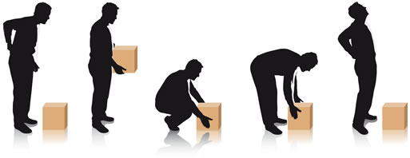
Safe Lifting and Manual Handling
Overexertion and improper lifting can result in serious back injuries
Proper body position when lifting
  Bend at the knees, not at the waist
  Keep the “load” close to your body
  Tighten your abdominal muscles
  Never lift anything above your waist that weighs more than 25 lbs; Any item that weighs more than 50 lbs requires 2 people;
  Any item that weighs more than 50 lbs should only be lifted after a risk assessment and plan are developed
Do not twist at the waist when lifting,
turn your body
Know your limitations! If you have had
any previous back problems—
Don’t lift it!!

Slide 15
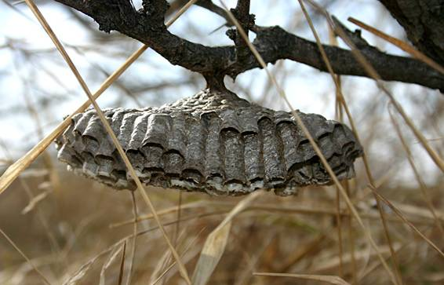
Environmental Hazards
Environmental hazards include potentially harmful plants, animals, insects, etc.
People react differently to insect stings, poison oak/ivy, jellyfish, etc. If you have a known sensitivity— Do not risk exposure to these creatures!!!
Animals such as alligators and insects such as Red Wasps are indigenous to the deep south.
  Be aware that they may be in the area you are assigned to and include them in your risk assessments

Slide 16
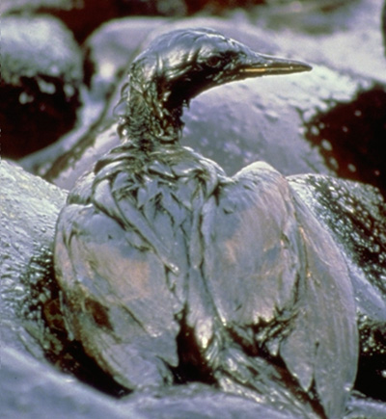
Injured or Dead Wildlife
Only trained wildlife personnel will handle distressed or dead wildlife. If you discover wildlife, do not attempt to capture or pick it up.
LIVE OILED WILDLIFE: Immediately contact the Wildlife Hotline at (866) 557-1401with the following information:
  Location
  Time
  Number of Animals Observed
  Your Name
  Company or Agency Affiliation
DEAD WILDLIFE: Do not attempt to pick it up.
Contact Wildlife Hotline (866) 557-1401
for instructions
  If the animal is confirmed to be dead,
  make a note of the location
16

Slide 17
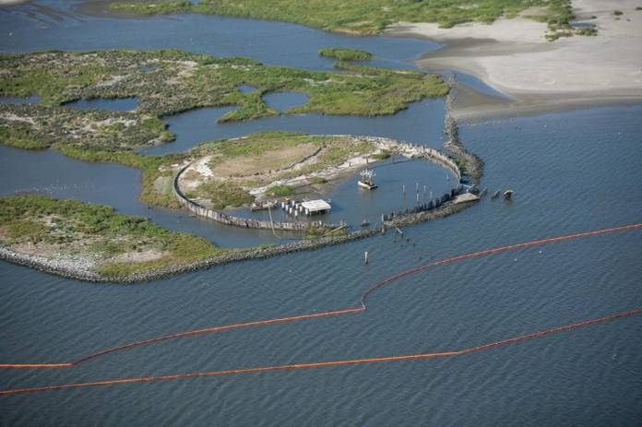
Weathering of Oil
This Spill Has Occurred at Sea Making the Spilled Oil Subject to Time and Distance ‘Weathering’ Before Impacting Shoreline
Weathering of Oil Occurs Rapidly at First and Slows Down over Time as Light and Medium Hydrocarbon Chains are Evaporated or Dissolved Away by Sunlight, Waves, and Winds
‘Probably’ is | ‘Probably’ Have | ‘Probably’ will
Very Slow to Flow | Very Low to No Evaporation | No Longer Dissolving
Not Pourable | No Potential to Burn | No Longer Be Releasing Volatile Constituents
Barely Buoyant | Water Mixed In – Emulsified (Think Mayonnaise)

Slide 18
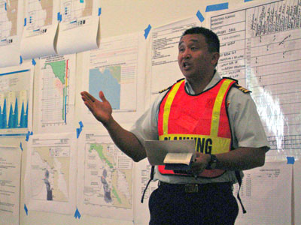
JSEA – Basic Process
The JSEA (Job Safety and Environmental Analysis) process breaks a job into key steps that are agreed upon and analyzed by the personnel who will perform the work
  Each key step will identify and evaluate the process and HSE hazards and risks involved
  Each key step will identify the controls needed to eliminate, substitute, control, and mitigate the hazards
Draft and similar, prior JSEAs, and operating procedures can
assist the risk defining processes
The work site must be inspected by a competent person prior to conducting the Risk Assessment
All personnel participating in the work must be represented in the JSEA process
18
Notes:
18

Slide 19
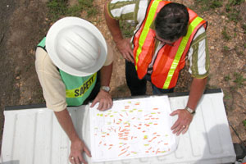
JSEA Basic Requirements, continued
All equipment used in performing work must be fit for purpose
Develop contingency plans based on potential emergency situations and identified work
Risk Assessments consider these measures in the following order:
    Elimination
    Substitution
    Control
    Mitigation
19
Notes:
19

Slide 20
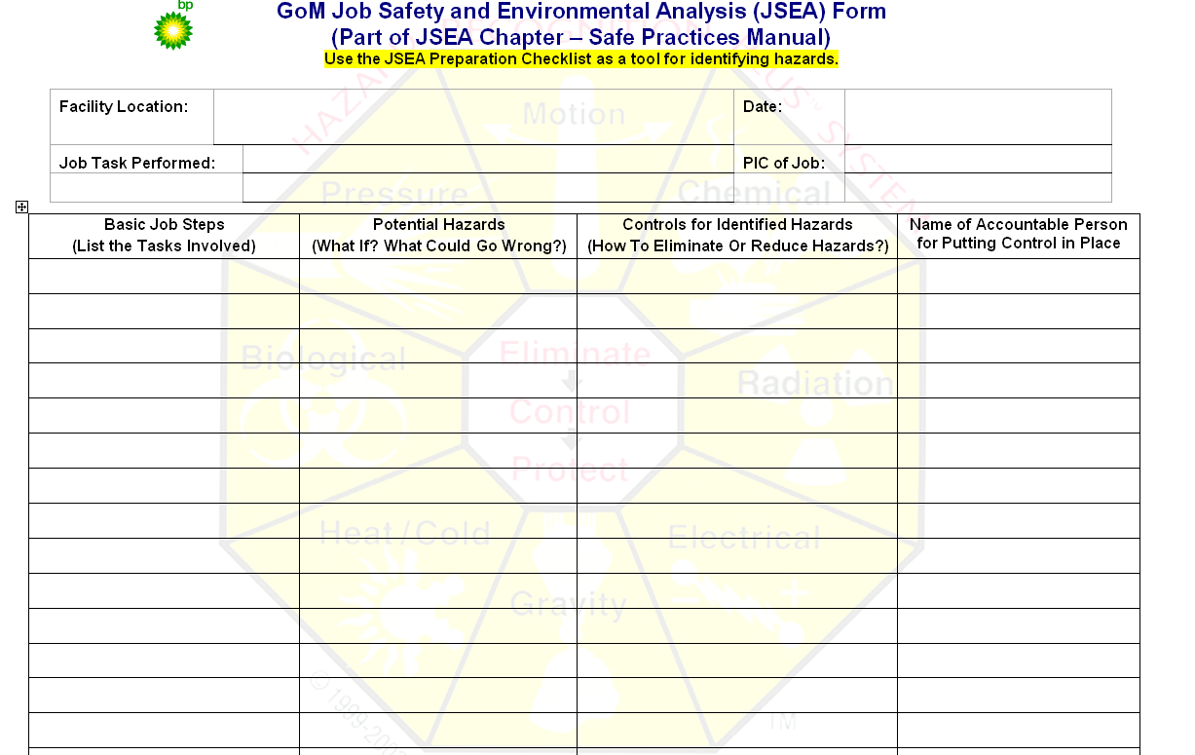
JSEA Form
20
Notes:
20

Slide 21
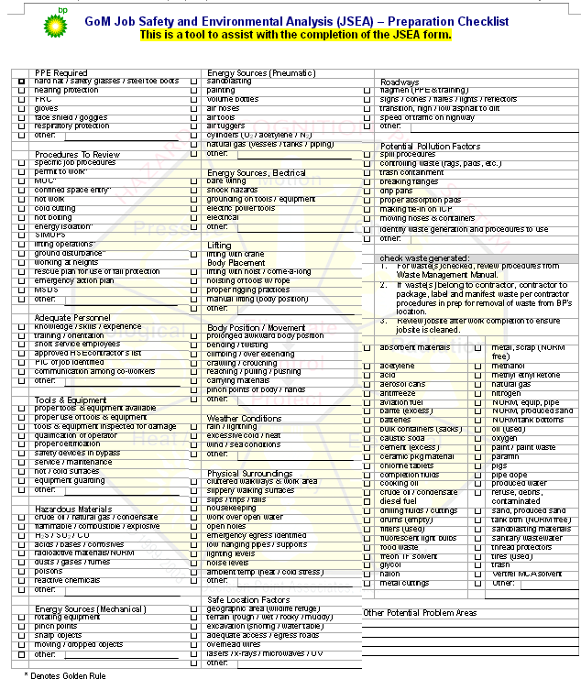
JSEA Form
21
Notes:
21

Slide 22
Chemical Hazards
Known hazards of crude oil include the chemical compounds of :
  Benzene
  Polyaromatic Hydrocarbons (PAH)
  Sulfur
Common routes of exposure include:
  Skin contact
  Contact with mucous membranes such as eyes and mouth
Less common routes of exposure:
  Ingestion
  Injection
Keys to chemical safety are:
  Minimize or eliminate contact with crude oil
  Wear the appropriate PPE
  Use proper techniques when removing PPE and dispose of them according to site safety plans
  If you are exposed, use proper decontamination procedures to remove crude oil from the skin
  If contact is made with the eyes, mouth or other mucous membranes, flush with copious amounts of potable water and report to your medical officer at your Operations Shore Base

Slide 23

Reporting Incidents
IMMEDIATELY REPORT ANY
INCIDENT OR INJURY
Notification is required for all incidents and/or injuries, regardless how minor or insignificant they may appear Notify your immediate supervisor or volunteer coordinator Notify your BP Contact
23
Notes:
23
Relevant External 3rd Party Inquiries:

Slide 24

Stop the Job
‘Stop the Job’ or ‘Stop Work’ authority is granted to everyone involved in this effort
If conditions or your plan changes—Stop the Job!
If you “think” that there is a hazard or unsafe condition during the job—Stop the Job!
If someone who was not involved in planning joins work that is in progress—Stop the Job!
Stopping the Job should not be seen as a negative; It may be the last opportunity to prevent an incident
After you Stop a job, regroup and talk through the concern to resolve the issue before resuming

Slide 25
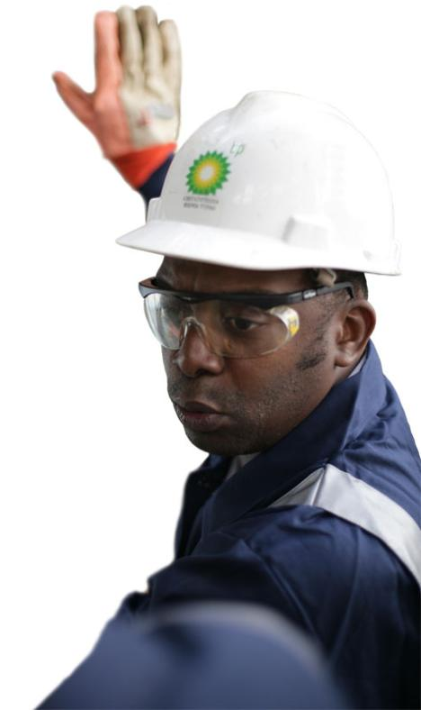
Stop the Job
Remember…
    If it doesn’t look right…Stop the Job!
      If your plan has changed…Stop the Job!
        If it just doesn’t feel right….
        Stop the Job!!

Slide 26
THANK YOU FOR
JOINING US
What questions do you have?
May 2010
Notes:
26

Slide 27

Certificate of Completion
Please continue to the next lesson, press run, and print the completion certificate that appears.
Please bring this certificate with you to the response site to confirm that you have completed the required training.
27

