Slide 1
Avian Protection Plan What Your Coop Needs to Know FLORIDA ELECTRIC COOPERATIVES ASSOCIATION 2016 OPERATIONS & SAFETY CONFERENCE Patti Metro May 12, 2016

Slide 2
Introduction
Review of NRECA 2016 Resolutions
Sharing of Laws Protecting Birds
Review of Available Resources
Discussion of Avian Power Line Interaction Committee (APLIC) APP Guidelines

Slide 3
Resolutions
Endangered Species
Achieve federal cost sharing provisions
Educating the membership
Support legislative solutions that would balance rural electric cooperative interests with species protection
Seek legislation to clarify that electrocution, contacts, or collisions by avian species do not qualify as an intentional “taking” of protected avian species
Fish, Wildlife, and Avian Mitigation
Work to ensure that rules and requirements respecting fish, wildlife, and avian mitigation are clear, reasonable, consistent, and cost-effective

Slide 4
Why are We Talking About Birds?
Birds are in decline nationwide
Mortality Source | Annual US Avian Mortality
Cats | 2.4 billion
Building Windows | 600 million
Power Lines – Collision | 25 million
Communication Towers | 6.6 million
Power Lines – Electrocution | 5.6 million
Wind Turbines | 174,000
Automobiles | (200 million)

Slide 5
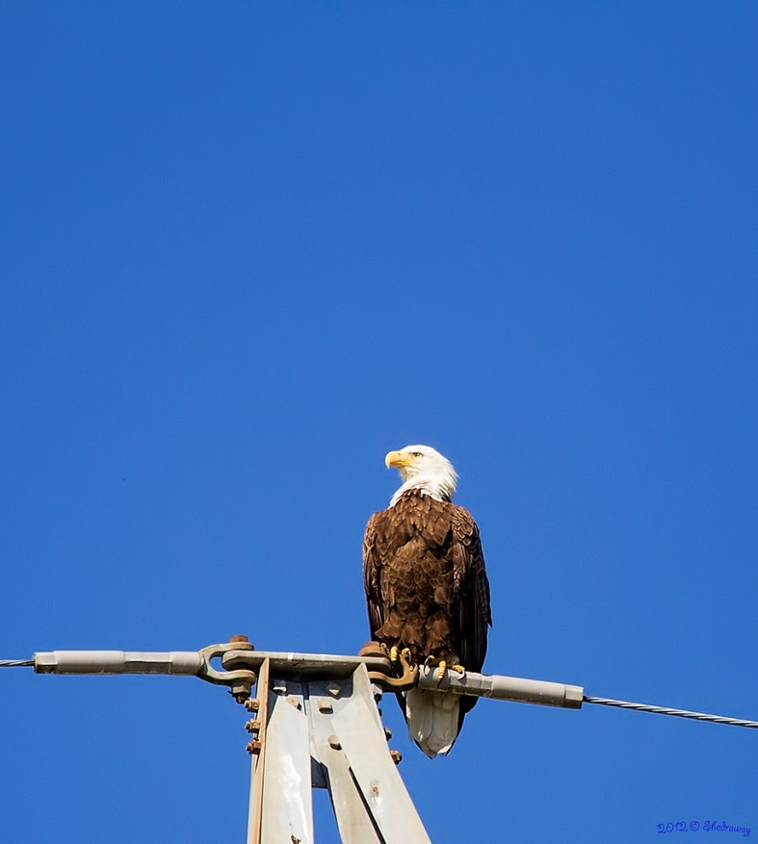
Laws that Protect Birds
Migratory Bird Treaty Act –Protects 1,026 avian species
Bald and Golden Eagle Protection Act – Provides protection for Bald and Golden Eagles
Endangered Species Act – Protects bird species listed under the act as threatened or endangered
Notes:
Our focus will be the Migratory Bird Treaty Act

Slide 6
Migratory Bird Treaty Act
Enacted in 1918
Implements four international treaties
Cornerstone for protection of migratory birds
Prohibits the taking or killing of native species
Notes:
Four International Treaties:
Canadian Convention of 1916, as amended in 1996
Mexican Convention of 1936, as amended in 1972
Japanese Convention of 1972, as amended
Russian Convention of 1976

Slide 7
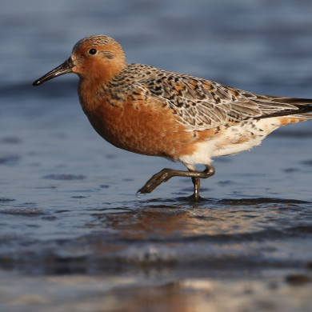
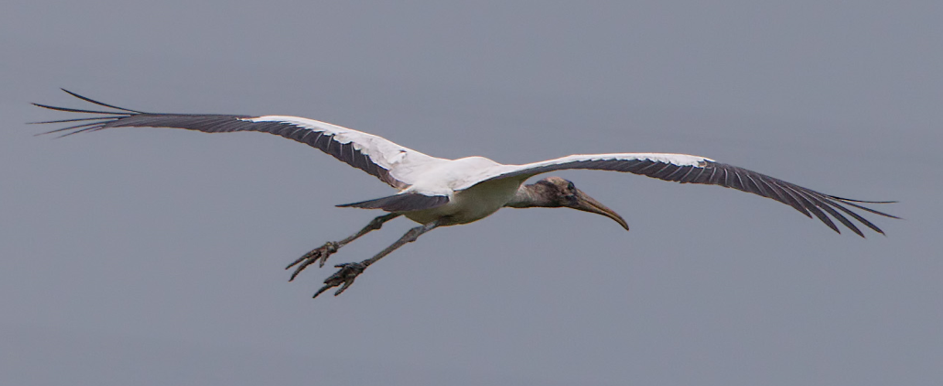
Responsibilities Under MBTA
Prohibits Take of Migratory Birds
“…at any time, by any means, or in
any manner…any migratory bird, [or]
any part, active nest or egg of any
such bird…”
Notes:
MBTA makes it illegal for anyone to take, possess, import, export, transport, sell, purchase, barter, or offer for sale, purchase, or barter, any migratory bird, or the parts, nests, or eggs of such a bird except under the terms of a permit issued by FWS.

Slide 8
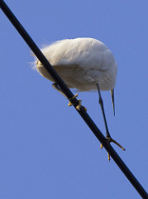
Responsibilities Under MBTA
What is “take”?
Take is defined in regulations:
“…pursue, hunt, shoot, wound,
kill, trap, capture or collect…”
Permits that are compatible with
the treaties are available for
“intentional” take.

Slide 9
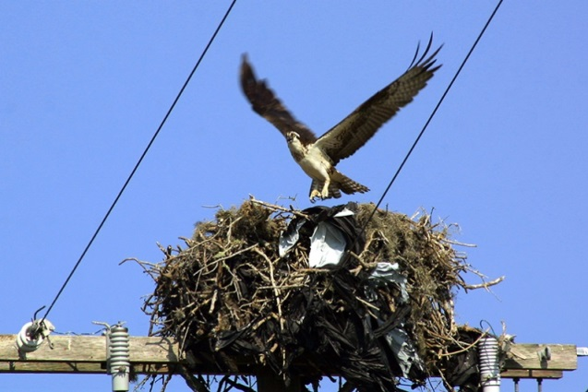
What Is Covered by MBTA?
50 CFR 10.13
What is protected?
Native species covered by one of the four treaties
Regardless of whether they are migratory or resident
What is not protected?
Any species NOT native to the US
Also, native…
Upland game birds: Grouse, quail, turkey…
Some Hawaiian forest birds
Notes:
MBTA currently covers 1,026 species.
Generally speaking, the MBTA protects all birds occurring in the U.S. in the wild except for house (English) sparrows, European starlings, rock doves (pigeons), any recently listed unprotected species in the Federal Register and non-migratory upland game birds.

Slide 10
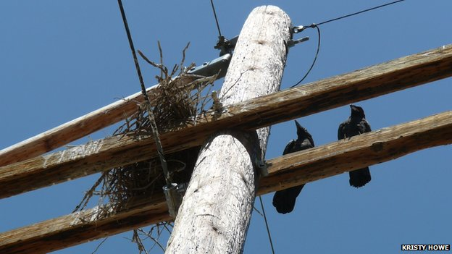
What Is the Risk for Co-ops?
MBTA is a strict liability statute, meaning that
proof of intent, knowledge, or negligence is
not an element of an MBTA violation.
Co-ops are at risk for
prosecution under MBTA
for migratory bird takes.

Slide 11
Violation Implications - MBTA
Individual: Fines up to $15,000 and/or imprisonment for up to six months for a misdemeanor, and up to $250,000 and/or imprisonment for up to two years for a felony.
Organization: Fines may be doubled
Penalties increase greatly for offenses involving commercialization and/or the sale of migratory birds and/or their parts
Notes:
A violation of the MBTA by an individual can result in a fine of up to $15,000
and/or imprisonment for up to six months for a misdemeanor, and up to $250,000 and/or imprisonment for up to two years for a felony. Fines may be doubled for organizations. Penalties increase greatly for offenses involving commercialization and/or the sale of migratory birds and/or their parts.

Slide 12
Violation Implications - BGEPA
Bald and Golden Eagles are afforded additional legal protection
Fines of up to $100,000 and/or imprisonment for up to one year
Additional provisions
Second or subsequent conviction: penalties may be imposed of up to $250,000 fine and/or two years imprisonment
Notes:
Under authority of the Bald and Golden Eagle Protection Act (16 U.S.C. 668-
668d; BGEPA), bald and golden eagles are afforded additional legal protection. Penalties for the “take” of an eagle may result in a fine of up to $100,000 and/or imprisonment for up to one year. The BGEPA has additional provisions wherein the case of a second or subsequent conviction of the BGEPA, penalties may be imposed of up to $250,000 fine and/or two years imprisonment.

Slide 13
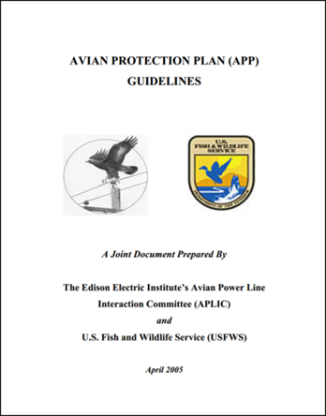
What Can You Do?
Consider developing an Avian Protection Plan (APP)
“Toolbox” utilities can use to create its specific program @ www.aplic.org & www.fws.gov

Slide 14
Resources

Slide 15
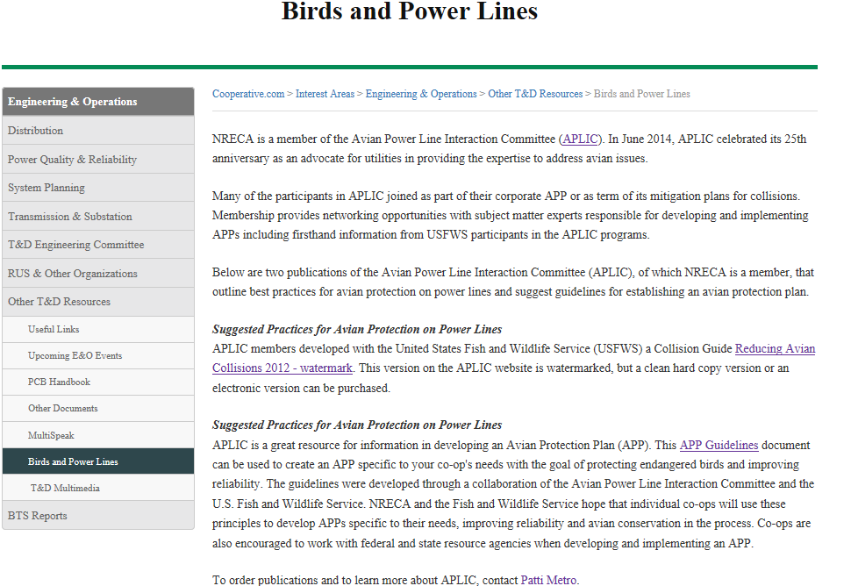
NRECA – cooperative.com
https://www.cooperative.com/interest-areas/engineering/resources/pages/birds-and-power-lines.aspx

Slide 16
Avian Power Line Interaction Committee
Develops and provides educational resources
Identifies and funds research
Develops and provides cost-effective management options
Serves as the focal point for avian interaction utility issues

Slide 17
APLIC APP Guidelines
(Slide content revised version of November 2015 APLIC Workshop)

Slide 18
Background
Developed through cooperative efforts between agencies and utilities
Stemmed from a previous Memorandum of Understanding (MOU) between agencies and utilities
2005 - released jointly-developed (USFWS and APLIC) national APP Guidelines

Slide 19
APP - General Concepts
Voluntary
Different based on risk, needs, scale, etc.
Intended to guide avian program
Common themes to all APPs→ reduce bird mortality and improve service reliability
Not intended to be project-specific (e.g., each new line does not require an APP)
“Living documents” – modified and refined over time to improve effectiveness

Slide 20
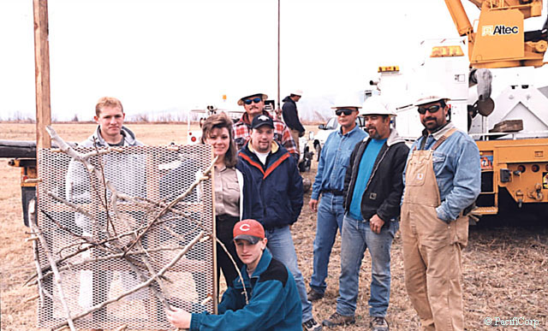
Principles
Corporate Policy
Training
Permit Compliance
Construction Design Standards
Nest Management
Avian Reporting System
Risk Assessment Methodology
Mortality Reduction Measures
Avian Enhancement Options
Quality Control
Public Awareness

Slide 21
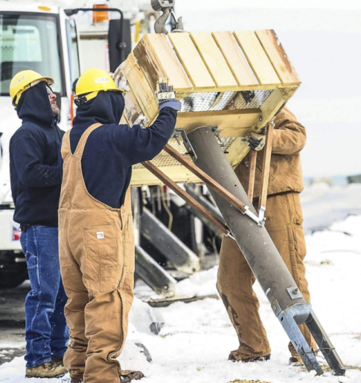
Implementation – Components of Success
Management support
Agency involvement
Engineering and biological expertise
Funding
Documentation
Accountability and employee awareness
Involvement and endorsement of employees

Slide 22
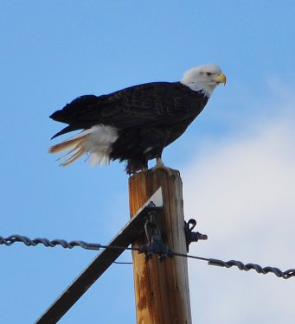
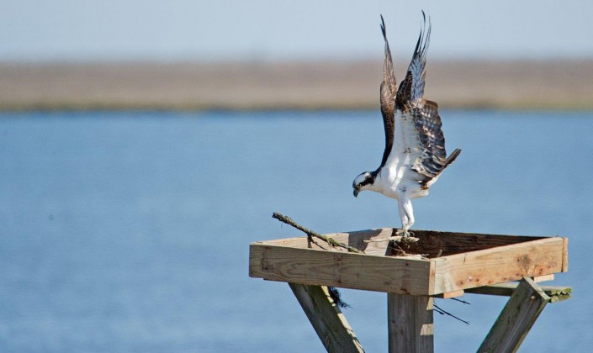
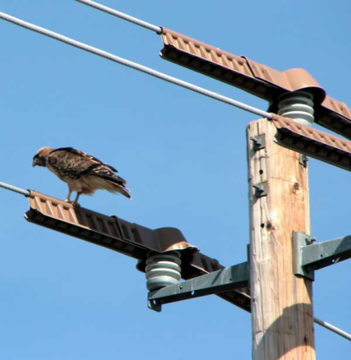
Implementation – Considerations
Size of territory
Avian species in area
Frequency of avian/power line interactions
© Howie Williams

Slide 23
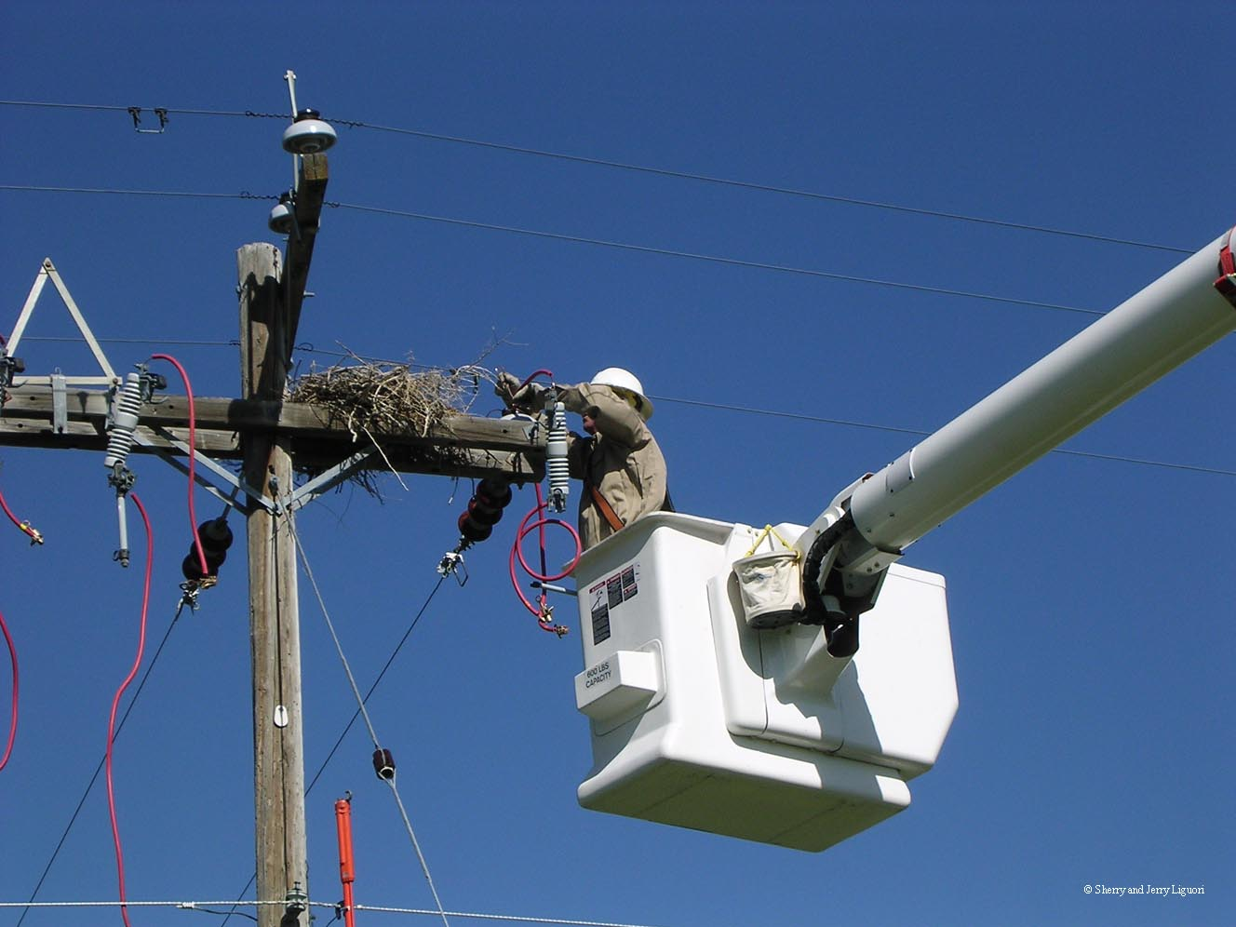
Implementation – Benefits
Reduced bird mortality
Improved service reliability
Favorable public perception
Positive working relationships with agencies

Slide 24
Patti Metro Manager, Transmission & Reliability Standards PH 703.907.5817 CELL 571.334.8890 patti.metro@nreca.coop

