Slide 1
Danny L. Raines cusp
Affiliate instructor, Georgia Tech Research Institute, OSHA Outreach, Region IV
Electrical Safety Instructor at Southern Crescent Technical College
47 years in electrical utility industry
Member American Society of Safety Engineers (ASSE)
Advisory Board member and contributing writer for Incident Prevention magazine, Tree Care Industry Association, Inc.
Professional Witness for the electrical utility industry
Program Developer/Instructor/Facilitator for CUSP test review and prep

Slide 2

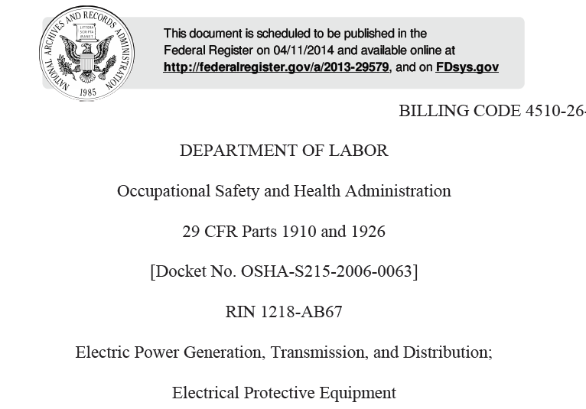

Slide 3
The Revised Standard
2014 Changes to 29 CFR 1910.269 Generation, Transmission and Distribution and
29 CFR 1926 Subpart “V” Construction Performance Standards

Slide 4
Background
1974: Subpart V standards for construction of electric transmission and distribution lines
1994: 1910.269 standard for “operation and maintenance” that applies to electric power generation.
The revised proposal came out in 2005 and since then there have been public hearings, comments, etc.
Notice of release of New Rule 4/1/2014 ( Rule imbedded in with Preamble total of1607 Pages)
Extensions 10/31/14 to 12/31/14 and finally 2/17/15
The Construction, Operation and Maintenance are now all the same

Slide 5
Significant Rule Changes
(a) Defined Skills Training
(a) Transfer of information: Host to Contract Employers
(g)Fall Protection Systems
(l) Required Arc Rated Clothing
(l) Minimum Approach Distance and Tables
(n) and (q) System Protective Grounding

Slide 6
Changes in Language: Implied
1910.269(q)(2)(vi) Load ratings of stringing lines, pulling lines, conductor grips, load-bearing hardware and accessories, rigging, and hoists may not be exceeded.
1910.269(q)(2)(vii) Pulling lines and accessories shall be repaired or replaced when defective.
1910.269(q)(2)(viii) Conductor grips may not be used on wire rope, unless the grip is specifically designed for this application

Slide 7
Changes in Language: Objective
  1910.269(q)(2)(vi) The employer shall ensure that employees do not exceed load ratings of stringing lines, pulling lines, conductor grips, load-bearing hardware and accessories, rigging, and hoists.
  1910.269(q)(2)(vii) The employer shall repair or replace defective pulling lines and accessories.
  1910.269(q)(2)(viii) The employer shall ensure that employees do not use conductor grips on wire rope unless the manufacturer specifically designed the grip for this application

Slide 8
Training
(a)(2)(i)
The degree of training shall be determined by the risk to the employee for the hazard involved.
(a)(2)(ii)(C)
The minimum approach distances specified in this section corresponding to the voltages to which the qualified employee will be exposed and the skills and techniques necessary to maintain those distances,
(a)(2)(vii)
The employer shall ensure that each employee has demonstrated proficiency in the work practices involved before that employee is considered as having completed the training required by paragraph (a)(2) of this section.

Slide 9
Qualified Employee 269(a)(2)(viii)
The employer shall ensure that each employee has demonstrated proficiency in the work practices involved before that employee is considered as having completed the training required by paragraph (a)(2) of this section.
Note 1 to paragraph (a)(2)(viii):
Though they are not required by this paragraph, employment records that indicate that an employee has successfully completed the required training are one way of keeping track of when an employee has demonstrated proficiency.

Slide 10
29 CFR 1910.269(a) (2)(viii)
The employer shall ensure that each employee has demonstrated proficiency in the work practices involved before that employee is considered as having completed the training required by paragraph (a)(2) of this section.
Note 1 to paragraph (a)(2)(viii):
Though they are not required by this paragraph, employment records that indicate that an employee has successfully completed the required training are one way of keeping track of when an employee has demonstrated proficiency.

Slide 11
Note 2 to paragraph (a)(2)(viii):
For an employee with previous training, an employer may determine that that employee has demonstrated the proficiency required by this paragraph using the following process:
(1) Confirm that the employee has the training required by paragraph (a)(2) of this section,
(2) Use an examination or interview to make an initial determination that the employee understands the relevant safety-related work practices before he or she performs any work covered by this section, and
(3) Supervise the employee closely until that employee has demonstrated proficiency as required by this paragraph.

Slide 12
Addition to “Qualified Employee” definition
(a)(2)(ii)(E) The recognition of electrical hazards to which the employee may be exposed and the skills and techniques necessary to control or avoid these hazards.

Slide 13
Host Employers and Contract Employers
(1926.950(c) and 1910.269(a)(3)
Basic communication rules based on OSHA's 1999 Multi Employer Citation Policy
New OSHA Standard described the means, methods and expectation of the communications
Intention that creating, exposing, correcting and controlling employers at multiemployer worksites will exercise their respective responsibilities to ensure that affected employees are protected as required by the standard.
Employers share responsibility for working conditions and OSHA compliance at multiemployer worksites (systems)

Slide 14
29 CFR 1910.269(a)(3) Information transfer
(i) Before work begins, the host employer shall inform contract employers of:
(A) The characteristics of the host employer's installation that are related to the safety of the work to be performed and are listed in paragraphs (a)(4)(i) through (a)(4)(v) of this section;
Note to paragraph (a)(3)(i)(A): This paragraph requires the host employer to obtain information listed in paragraphs (a)(4)(i) through (a)(4)(v) of this section if it does not have this information in existing records.

Slide 15
1910.269(a)(3)(i)(B)
Conditions that are related to the safety of the work to be performed, that are listed in paragraphs (a)(4)(vi) through (a)(4)(viii) of this section, and that are known to the host employer;
Note to paragraph (a)(3)(i)(B): For the purposes of this paragraph, the host employer need only provide information to contract employers that the host employer can obtain from its existing records through the exercise of reasonable diligence.

Slide 16
1910.269(a)(3)(i)(C)
Information about the design and operation of the host employer's installation that the contract employer needs to make the assessments required by this section; and
Note to paragraph (a)(3)(i)(C): This paragraph requires the host employer to obtain information about the design and operation of its installation that contract employers need to make required assessments if it does not have this information in existing records.
1910.269(a)(3)(i)(D) Any other information about the design and operation of the host employer's installation that is known by the host employer, that the contract employer requests, and that is related to the protection of the contract employer's employees

Slide 17
29 CFR 1910.269(a)(3)(ii)
Contract employers shall comply with the following requirements:
1910.269(a)(3)(ii)(A) The contract employer shall ensure that each of its employees is instructed in the hazardous conditions relevant to the employee's work that the contract employer is aware of as a result of information communicated to the contract employer by the host employer under paragraph (a)(3)(i) of this section.
1910.269(a)(3)(ii)(B) Before work begins, the contract employer shall advise the host employer of any unique hazardous conditions presented by the contract employer's work.
1910.269(a)(3)(ii)(C) The contract employer shall advise the host employer of any unanticipated hazardous conditions found during the contract employer's work that the host employer did not mention under paragraph (a)(3)(i) of this section. The contract employer shall provide this information to the host employer within 2 working days after discovering the hazardous condition.

Slide 18
Host Employers and Contract Employers
(1926.950(c) and 1910.269(a)(4)(i)
269(a)(3)(iii): Contract employer and the host employer shall coordinate their work rules and procedures so that each employee of the contract employer and the host employer is protected as required by this section.

Slide 19
1910.269(a)(4) Existing characteristics and conditions
before work on or near the lines or equipment is started. Such characteristics and conditions include, but are not limited to:
The nominal voltages of lines and equipment,
The maximum switching-transient voltages,
The presence of hazardous induced voltages,
The presence of protective grounds and equipment grounding conductors,
The locations of circuits and equipment, including electric supply lines, communication lines, and fire-protective signaling circuits,
The condition of protective grounds and equipment grounding conductors, the condition of poles, and
Environmental conditions relating to safety
Incident Energy (PPE Arc Rating or HRC)
Available Fault current at work locations

Slide 20
1910.269(b): First Aid Training
(1) First-aid training now includes CPR but not AED.
For field work involving two or more employees at a work location, at least two trained persons shall be available.
However, for line-clearance tree trimming operations performed by line-clearance tree trimmers who are not qualified employees, only one trained person need be available if all new employees are trained in first aid within 3 months of their hiring dates.

Slide 21
From the Preamble………..
Under the new provision, each employer has independent responsibility for complying with the final rule. In addition, the Agency stresses that a contract employer must comply with the final rule even though a host employer may try to impose work rules that would cause the contract employer to violate OSHA’s rules.
Contract employer is not relieved of its duty to comply with the final rule by following a work rule imposed by the host employer.

Slide 22
Transfer of Information Documentation
OSHA notes that final paragraph (c)(1) does not require the host employer to report any information to the contract employer in writing;
Host/Contractor should document method of informational transfer….

Slide 23
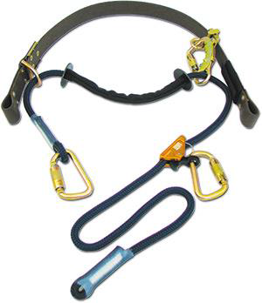
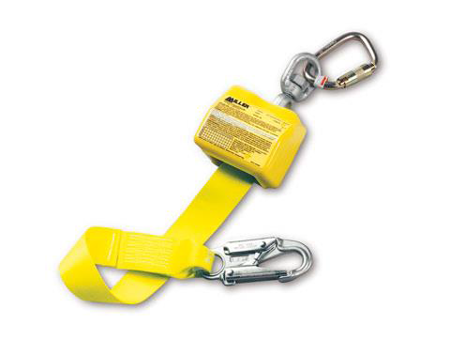
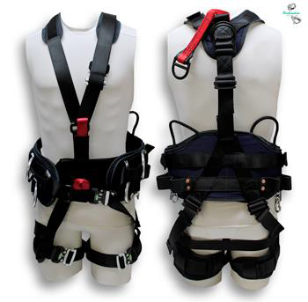
Fall Protection: 1910.269(x) & 1926.968
OSHA has defined the three basic types of fall protection as follows:
Fall Restraint System: A system that prevents the user from falling any distance;
Work Positioning System: A system rigged to allow an employee to be supported on an elevated vertical surface and work with both hands free while leaning; and
Personal Fall Arrest Equipment: System used to arrest an employee in a fall from a working level.

Slide 24
Fall Protection
  All workers are covered
  Eliminated “Free Climbing”
  Qualified Worker cannot fall more than 2 feet (poles and structures)
  Unqualified Worker shall be protected at heights > 4’ or more until “qualified”
  Aerial Lifts: Fall restraint system, or Personal fall arrest system
  Fall protection is infeasible or creates greater hazard
  Congested pole (only while in the congested area)

Slide 25
Personal protective equipment (g)(1)
(1) General. Personal protective equipment shall meet the requirements of Subpart I of this part.
Note to paragraph (g)(1) of this section: Paragraph (h) of § 1910.132 sets employer payment obligations for the personal protective equipment required by this section, including, but not limited to, the fall protection equipment required by paragraph (g)(2) of this section, the electrical protective equipment required by paragraph (l)(3) of this section, and the flame-resistant and arc-rated clothing and other protective equipment required by paragraph (l)(8) of this section.

Slide 26
29 CFR 1910.269(g)(iii)
Body belts and positioning straps for work-positioning equipment shall meet the following requirements:
(A) Hardware for body belts and positioning straps shall meet the following requirements:
(1) Hardware shall be made of drop-forged steel, pressed steel, formed steel, or equivalent material.
(2) Hardware shall have a corrosion-resistant finish.
(3) Hardware surfaces shall be smooth and free of sharp edges.
(B) Buckles shall be capable of withstanding an 8.9-kilonewton (2,000-pound-force) tension test with a maximum permanent deformation no greater than 0.4 millimeters (0.0156 inches).
(g) (2)(iii)(C) D rings shall be capable of withstanding a 22-kilonewton (5,000-pound-force) tensile test without cracking or breaking.

Slide 27
Note to paragraph (g)(2)(iii)
When used by employees weighing no more than 140 kg (310 lbm) fully equipped, body belts and positioning straps that conform to American Society of Testing and Materials Standard Specifications for Personal Climbing Equipment, ASTM F887-12e1, are deemed to be in compliance with paragraph (g)(2)(iii) of this section.

Slide 28
29 CFR 1910.269(g)(2)(iv)(C)(3)(iii)
Until March 31, 2015, a qualified employee climbing or changing location on poles, towers, or similar structures need not use fall protection equipment, unless conditions, such as, but not limited to, ice, high winds, the design of the structure (for example, no provision for holding on with hands), or the presence of contaminants on the structure, could cause the employee to lose his or her grip or footing.
On and after April 1, 2015, each qualified employee climbing or changing location on poles, towers, or similar structures must use fall protection equipment and work-positioning systems shall be rigged so that an employee can free fall no more than 0.6 meters (2 feet).

Slide 29
Note 2 to paragraphs (g)(2)(iv)(C)( 2) and (g)(2)(iv)(C)(3):
Until the employer ensures that employees are proficient in climbing and the use of fall protection under paragraph (a)(2)(viii) of this section, the employees are not considered “qualified employees” for the purposes of paragraphs (g)(2)(iv)(C)(2) and (g)(2)(iv)(C)(3) of this section.
These paragraphs require unqualified employees (including trainees) to use fall protection any time they are more than 1.2 meters (4 feet) above the ground.

Slide 30
29 CFR 1910.269(g)(2)(iv)(C)(3)
Note 1 to paragraphs (g)(2)(iv)(C)(2): These paragraphs apply to structures that support overhead electric power transmission and distribution lines and equipment. They do not apply to portions of buildings, such as loading docks, or to electric equipment, such as transformers and capacitors.
Subpart D of this part contains the duty to provide fall protection associated with walking and working surfaces.
Despite the reference to Subpart D in 1910, 1926.501(b)(1) would apply ….
1926.501(b)(1) (Subpart M Fall Protection)
"Unprotected sides and edges." Each employee on a walking/working surface (horizontal and vertical surface) with an unprotected side or edge which is 6 feet (1.8 m) or more above a lower level shall be protected from falling by the use of guardrail systems, safety net systems, or personal fall arrest systems.

Slide 31
Fall Protection Systems
The rule now clarifies that; unless the snaphook is a locking type and designed specifically for the following connections, snaphooks on work-positioning equipment may not be engaged:
  (1) Directly to webbing, rope, or wire rope
  (2) To each other
  (3) To a D ring to which another snaphook or other connector is attached
  (4) To a horizontal lifeline
  (5) To any object that is incompatibly shaped or dimensioned in relation to the snap hook
  Note: If manufacturer permits 2 Snap Hooks in “D” Rings

Slide 32
1910.269(g)(2)(iv)(C)(1)
Each employee working from an aerial lift shall use a fall restraint system or a personal fall arrest system. Paragraph (c)(2)(v) of § 1910.67 does not apply.

Slide 33
29 CFR 1910.269(l)(2)(i) MAD
Employer shall establish minimum approach distances no less than the distances computed by Table R-3 for ac systems or Table R-8 for dc systems.
No later than April 1, 2015, for voltages over 72.5 kilovolts, the employer shall determine the maximum anticipated per-unit transient overvoltage, phase-to-ground, through an engineering analysis or assume a maximum anticipated per-unit transient overvoltage, phase-to-ground, in accordance with Table R-9.
The employer shall make any engineering analysis conducted to determine maximum anticipated per-unit transient overvoltage available upon request to employees and to the Assistant Secretary or designee for examination and copying.

Slide 34
Note to paragraph (l)(3)(ii):
See Appendix B to this section for information on how to calculate the maximum anticipated per-unit transient overvoltage, phase-to-ground, when the employer uses portable protective gaps to reduce maximum transient over voltage
TOVs: Breaker Operations, Pre strike and Re strike, closing of Capacitor Banks, etc.

Slide 35
CFR 1910.269(l)(3)(iii)
The employer shall ensure that no employee approaches or takes any conductive object closer to exposed energized parts than the employer's established minimum approach distance, unless:
(A) The employee is insulated from the energized part (rubber insulating gloves or rubber insulating gloves and sleeves worn in accordance with paragraph (l)(4) of this section constitutes insulation of the employee from the energized part upon which the employee is working provided that the employee has control of the part in a manner sufficient to prevent exposure to uninsulated portions of the employee's body),
(B) When installing insulation for purposes of paragraph (l)(4)(i)(A) of this section, the employee installs the insulation from a position that does not expose his or her upper arm to contact with other energized parts.

Slide 36
29 CFR 1910.269(l)(3)(ii)
When an employee uses rubber insulating gloves or rubber insulating gloves and sleeves as insulation from energized parts (under paragraph (l)(3)(iii)(A) of this section), the employer shall ensure that the employee:
(l)(4)(ii)(A) Puts on the rubber insulating gloves and sleeves in a position where he or she cannot reach into the minimum approach distance, established by the employer under paragraph (l)(3)(i) of this section; and
(B) Does not remove the rubber insulating gloves and sleeves until he or she is in a position where he or she cannot reach into the minimum approach distance, established by the employer under paragraph (l)(3)(i) of this section.

Slide 37
29 CFR 1910.269(l)(5)(ii)
When an employee performs work near exposed parts energized at more than 600 volts, but not more than 72.5 kilovolts, and is not wearing rubber insulating gloves, being protected by insulating equipment covering the energized parts, performing work using live-line tools, or performing live-line bare hand work under paragraph (q)(3) of this section, the employee shall work from a position where he or she cannot reach into the minimum approach distance, established by the employer under paragraph (l)(3)(i) of this section.

Slide 38
29 CFR 19101.269(l)(8)
Protection from flames and electric arcs.
(i) The employer shall assess the workplace to identify employees exposed to hazards from flames or from electric arcs.
(ii) For each employee exposed to hazards from electric arcs, the employer shall make a reasonable estimate of the incident heat energy to which the employee would be exposed

Slide 39
Notes to 29 CFR 1910.269(l)(8)(ii)
Note 1: Appendix E to this section provides guidance on estimating available heat energy. The Occupational Safety and Health Administration will deem employers following the guidance in Appendix E to this section to be in compliance with paragraph (l)(8)(ii) of this section. An employer may choose a method of calculating incident heat energy not included in Appendix E to this section if the chosen method reasonably predicts the incident energy to which the employee would be exposed.

Slide 40
Notes to 29 CFR 1910.269(l)(8)(ii)
Note 2 to paragraph (l)(8)(ii): This paragraph does not require the employer to estimate the incident heat energy exposure for every job task performed by each employee. The employer may make broad estimates that cover multiple system areas provided the employer uses reasonable assumptions about the energy-exposure distribution throughout the system and provided the estimates represent the maximum employee exposure for those areas.
For example, the employer could estimate the heat energy just outside a substation feeding a radial distribution system and use that estimate for all jobs performed on that radial system.

Slide 41
Hazard of Electrical Arc
Under the new rule. employees are required to be protected from exposures exceeding 2 cal/cm2 and must wear arc protective equipment to prevent burns. (1.2 Cal/cm2 can cause a 2nd burn per NFPA 70 E)
Employer needs to establish arc hazard risk categories for the workplace and provide protection for the whole body (arms and legs). Arc Rated FR is now PPE and furnished by employer…

Slide 42
Arc Rated FR Now PPE
Paragraph (l)(8)(v) of § 1910.269 generally requires protective clothing and other protective equipment with an arc rating greater than or equal to the employer's estimate of available heat energy.
Untreated cotton is usually acceptable for exposures of 2 cal/cm² or less.
If the exposure is greater than that, the employee generally must wear flame-resistant clothing with a suitable arc rating in accordance with § 1910.269(l)(8)(iv) and (l)(8)(v)
ASTM 1506 FR Rating (Vertical Flame Test/Self Extinguishing Materials)
Arc Thermal Protective Value (ATPV) used to determine Hazard Risk Category

Slide 43
Hazard of Electrical Arc
Does not require arc rated gloves when in rubber gloves with protectors or feet when heavy leather boots are worn
Arc Rated face shield is now required when the calculated exposure is greater than 9 cal/cm2 for single phase exposures in air or greater than 5cal/cm2 for multiphase exposures.
2012 NESC Tables 410.1 may be used as a guide to type PPE for voltage levels

Slide 44
Arc Rated FR is Required
(iv) The employer shall ensure that the outer layer of clothing worn by an employee, except for clothing not required to be arc rated under paragraphs (l)(8)(v)(A) through (l)(8)(v)(E) of this section, is flame resistant under any of the following conditions:
(A) The employee is exposed to contact with energized circuit parts operating at more than 600 volts,
(B) An electric arc could ignite flammable material in the work area that, in turn, could ignite the employee’s clothing,
(C) Molten metal or electric arcs from faulted conductors in the work area could ignite the employee’s clothing,
(D) The incident heat energy estimated under paragraph (l)(8)(ii) of this section exceeds 2.0 cal/cm2.
Note, the molten metal condition (C) is not required for insulated conductors

Slide 45
Protection of Body From Arcs
(v) This protective equipment shall cover the employee’s entire body, except as follows:
A) Arc-rated protection is not necessary for:
  the employee’s hands when the employee is wearing rubber insulating gloves with protectors or
  if the estimated incident energy is no more than 14 cal/cm2, heavy-duty leather work gloves with a weight of at least 407 gm/m2 (12 oz/yd2),
(B) Arc-rated protection is not necessary for the employee’s feet when the employee is wearing heavy-duty work shoes or boots,

Slide 46
Arc Protection Not Required:
(C) Employee’s head when the employee is wearing Class “E” head protection , if the estimated incident energy is less than 9 cal/cm2 for exposures involving single-phase arcs in open air or 5 cal/cm2 for other exposures,
(D) The protection for the employee’s head may consist 8 cal/cm2 if the estimated incident-energy exposure is less than 13 cal/cm2 for exposures involving single-phase arcs in open air or 9 cal/cm2 for other exposures, and
E) Exposures involving single-phase arcs in open air, the arc rating for the employee’s head and face protection may be 4 cal/cm2 less than the estimated incident energy.

Slide 47
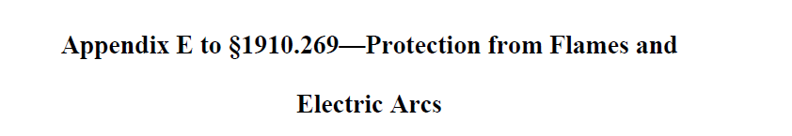
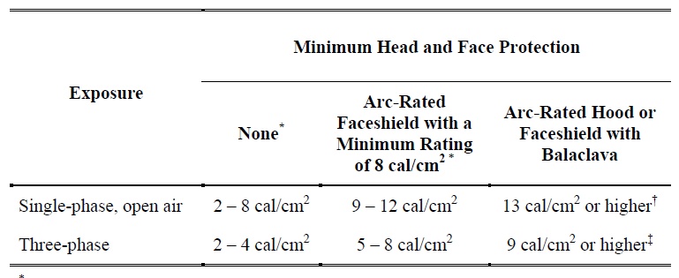

Slide 48
Appendix “E” Table 6
TABLE 6-INCIDENT HEAT ENERGY FOR VARIOUS FAULT CURRENTS, CLEARING TIMES, AND VOLTAGES OF 4.0 TO 46.0 KV: RUBBER INSULATING GLOVE EXPOSURES INVOLVING PHASE-TO-GROUND ARCS IN OPEN AIR ONLY * † ‡
Voltage range (kV) ** | Fault current (kA) | Maximum clearing time (cycles)
 |  | 4 cal/cm² | 5 cal/cm² | 8 cal/cm² | 12 cal/cm²
4.0 to 15.0 ............................................................................ | 5 | 46 | 58 | 92 | 138
 | 10 | 18 | 22 | 36 | 54
 | 15 | 10 | 12 | 20 | 30
 | 20 | 6 | 8 | 13 | 19
15.1 to 25.0 .......................................................................... | 5 | 28 | 34 | 55 | 83
 | 10 | 11 | 14 | 23 | 34
 | 15 | 7 | 8 | 13 | 20
 | 20 | 4 | 5 | 9 | 13
25.1 to 36.0 .......................................................................... | 5 | 21 | 26 | 42 | 62
 | 10 | 9 | 11 | 18 | 26
 | 15 | 5 | 6 | 10 | 16
 | 20 | 4 | 4 | 7 | 11
36.1 to 46.0 .......................................................................... | 5 | 16 | 20 | 32 | 48
 | 10 | 7 | 9 | 14 | 21
 | 15 | 4 | 5 | 8 | 13
 | 20 | 3 | 4 | 6 | 9

Slide 49
Minimum Approach Distance (MAD) 1926.960(c)(1)
Highly technical and controversial
OSHA expects employers to calculate MAD – Utility Specific
OSHA provides alternative tables but they are VERY conservative
Multi-Phase exposure
  If phases not being worked on are covered and isolated, the exposure is that of one phase

Slide 50
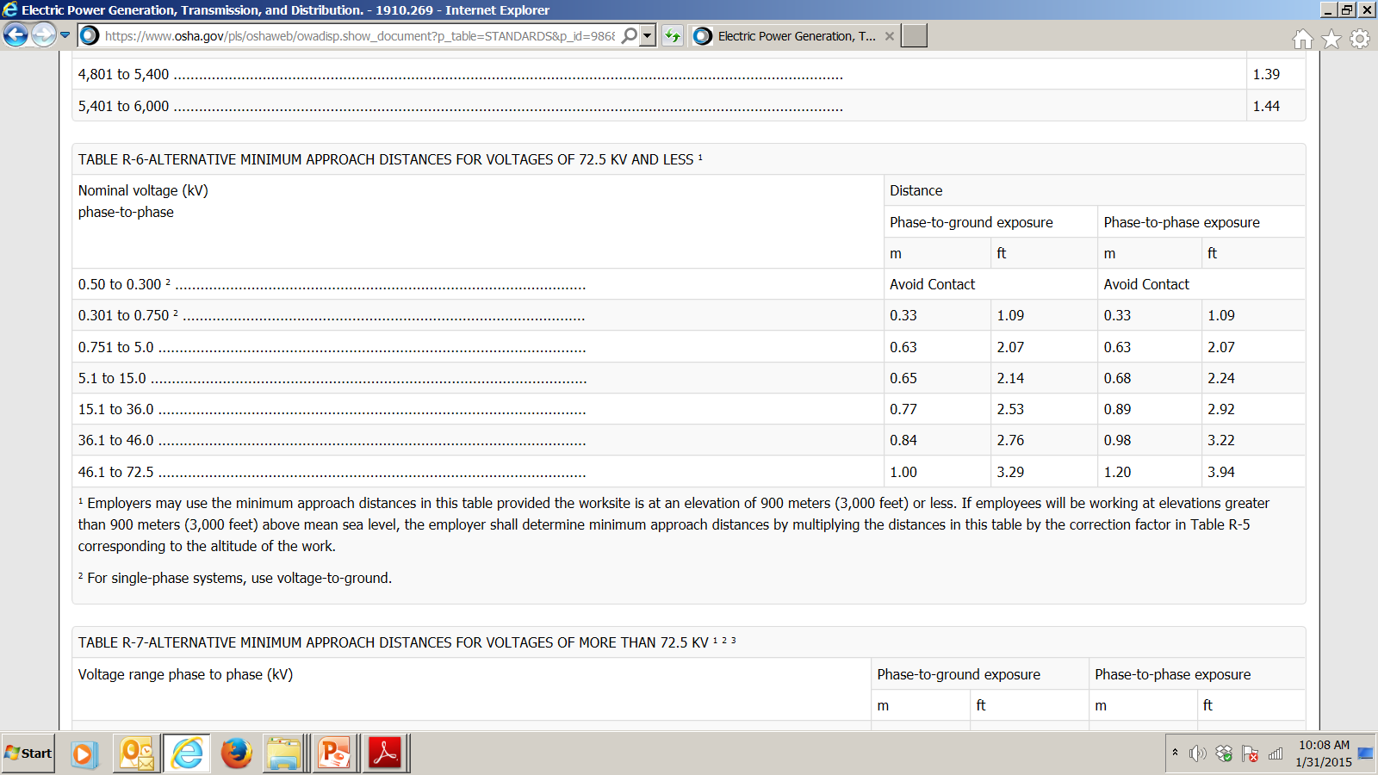
Alternative Table 6

Slide 51
Alternate Table 6
              Phase to Ground Phase to Phase
50-300 Volts: Avoid Contact Avoid Contact
301-750 Volts: 1.09’ (13”) 1.09’ (13”)
751- 5,000 Volts: 2.07’ (25”) 2.07’ (25”)
5-15 kV: 2.14’ (26”) 2.24’ (26”)
15.1-36 kV: 2.53’ (30”) 2.92’ (35”)
36.1-46 kV: 2.76’ (33”) 3.22’ (39”)
46.1-72.5 kV: 3.29’ (39”) 3.74’ (45”)

Slide 52
>72.5 kV MAD Changes
(ii) No later than April 1, 2015, for voltages over 72.5 kilovolts, the employer shall determine the maximum anticipated per-unit transient overvoltage, phase-to-ground, through an engineering analysis or assume a maximum anticipated per-unit transient overvoltage, phase-to-ground, in accordance with Table R-9.

Slide 53
> 72.5 kV (MAD)
For voltages over 72.5 kv, OSHA expects employers to determine their own MADs. The standard provides equations for engineering departments to use to calculate the appropriate MADs. A risk factor of 1 in 1000 probability of “spark over” must be used.
In the standard, OSHA uses a maximum transient overvoltage (TOV) that is greater than current industry accepted values.
Employers will determine their own TOV values rather than using the higher TOV value OSHA used.
OSHA has provided a non-mandatory Appendix “B” that includes MAD tables for various values of maximum TOV.

Slide 54
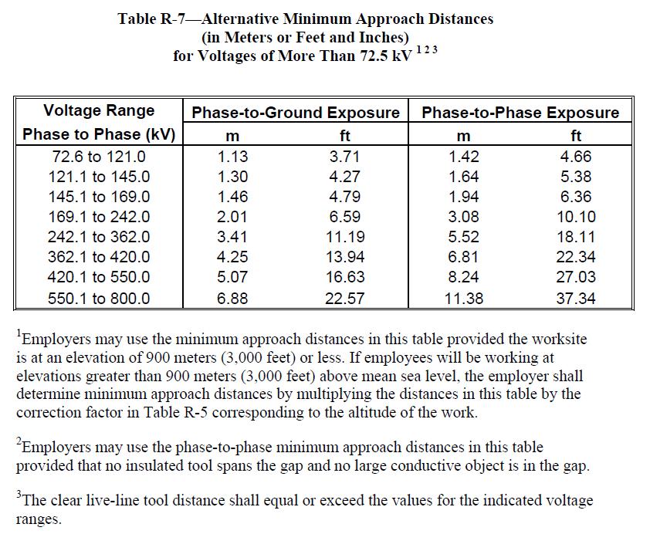

Slide 55
29 CFR 1910.269(l)(12)
Opening and closing circuits under load.
(i) The employer shall ensure that devices used by employees to open circuits under load conditions are designed to interrupt the current involved.
(ii) The employer shall ensure that devices used by employees to close circuits under load conditions are designed to safely carry the current involved.

Slide 56
De-Energizing for the Protection of the Employee: 269(m)
If a system operator is in charge of the lines or equipment and their means of disconnection, the employer shall designate one employee in the crew to be in charge of the clearance and shall comply with all of the requirements of paragraph (m)(3) of this section in the order specified.
If two or more crews will be working on the same lines or equipment, then
The crews shall coordinate their activities under paragraph (m) of this section with a single employee in charge of the clearance for all of the crews and follow the requirements of paragraph (m) of this section as if all of the employees formed a single crew, or
(B) Each crew shall independently comply with paragraph (m) of this section and, if there is no system operator in charge of the lines or equipment, shall have separate tags and coordinate de-energizing and re-energizing the lines and equipment with the other crews.

Slide 57
New Note to 269(n)(1)
Note to paragraph (n)(1): This paragraph covers grounding of generation, transmission, and distribution lines and equipment when this section requires protective grounding and whenever the employer chooses to ground such lines and equipment for the protection of employees.

Slide 58
29 CFR 1910.269 Grounding
(n)(3) Equipotential zone. Temporary protective grounds shall be placed at such locations and arranged in such a manner that the employer can demonstrate will prevent each employee from being exposed to hazardous differences in electric potential.
(n)(4) Protective grounds shall have an impedance low enough so that they do not delay the operation of protective devices in case of accidental energizing of the lines or equipment
Note to paragraph (n)(3): Appendix C to this section contains guidelines for establishing the equipotential zone required by this paragraph. The Occupational Safety and Health Administration will deem grounding practices meeting these guidelines as complying with paragraph (n)(3) of this section.
Note to (n)(4): The Institute of Electrical Engineers Guide for Protective Grounding of Power Lines, IEEE Std 1048-2003, contains guidelines for selecting and installing protective grounding equipment.

Slide 59
System Grounding 1910.269(n)
(5) “Testing.” test lines and equipment and verify the absence of nominal voltage before employees install any ground on those lines or that equipment.
(n)(6)(i) The employer shall ensure that, when an employee attaches a ground to a line or to equipment, the employee attaches the ground-end connection first and then attaches the other end by means of a live-line tool.
600 volts or less, the employer may permit the employee to use insulating equipment other than a live-line tool (gloves) if the employer ensures that the line or equipment is not energized at the time the ground is connected or disconnecting if the employer can demonstrate that each employee is protected from hazards that may develop if the line or equipment is energized.

Slide 60
29 CFR 1910.269(p)(4)
(i): Mechanical equipment (Derrick Trucks and Cranes) shall be operated so that the minimum approach distances, established by the employer under paragraph (l)(3)(i) of this section, are maintained from exposed energized lines and equipment.
Insulated portions of Di-electric booms acceptable

Slide 61
1910.269(q)(2)(iv) Change
Before employees install lines parallel to existing energized lines, the employer shall make a determination of the approximate voltage to be induced in the new lines, or work shall proceed on the assumption that the induced voltage is hazardous.
Unless the employer can demonstrate that the lines that employees are installing are not subject to the induction of a hazardous voltage or
Unless the lines are treated as energized, temporary protective grounds shall be placed at such locations and arranged in such a manner that the employer can demonstrate will prevent exposure of each employee to hazardous differences in electric potential.

Slide 62
Overhead Lines (q)
Note 1 to paragraph (q)(2)(iv):
If the employer takes no precautions to protect employees from hazards associated with involuntary reactions from electric shock, a hazard exists if the induced voltage is sufficient to pass a current of 1 milliampere through a 500-ohm resistor. If the employer protects employees from injury due to involuntary reactions from electric shock, a hazard exists if the resultant current would be more than 6 milliamperes.
Note 2 to paragraph (q)(2)(iv): Appendix C to this section contains guidelines for protecting employees from hazardous differences in electric potential as required by this paragraph.

Slide 63
Work Boots (1910.136)
OSHA has removed the requirement for electrical workers to use electrically rated boots which was a primary form of protection. (Protect the affected employee from an electrical hazard, such as a static-discharge or electric shock hazard, that remains after the employer takes other necessary protective measures.
Di-Electric Boots or over shoes are now a secondary protection

Slide 64
Information Transfer
CFR 1926.968) with the information, other than information on maximum switching-transient voltages, required by 29 CFR 1910.269(a)(3)(i)(A) and 29 CFR 1926.950(c)(1)(i).
Until June 30, 2015, no citations will be issued to contract employers (as defined at 29 CFR 1910.269(x) and 29 CFR 1926.968) under the information-transfer provisions at 29 CFR 1910.269(a)(3) and 29 CFR 1926.950(c).

Slide 65
Job Briefing
Until April 30, 2015, no citations will be issued under 29 CFR 1910.269(c)(1)(i) or 29 CFR 1926.952(a)(1), which require the employer to provide the employee in charge of the job with all available information that relates to the determination of existing characteristics and conditions.

Slide 66
Minimum Approach Distances
The standards give employers until April 1, 2015, to comply with revised minimum approach distances for voltages of 5.1 kilovolts and more. See 29 CFR 1910.269 (Table R-3, Note 4) and 29 CFR 1926.960 (Table V-2, Note 4).
Until January 31, 2016, for voltages of 169.1 kilovolts and more: (i) no citations will be issued under 29 CFR 10.269(l)(3)(ii) or 29 CFR 1926.960(c)(1)(ii), which require the employer to determine the maximum anticipated per-unit transient overvoltage

Slide 67
and (ii) OSHA will accept compliance with the minimum approach distances in Table 6 or Tables 10 to 13 in Appendix B to 29 CFR 1910.269 as compliance with 29 CFR 1910.269(l)(3)(i) and 29 CFR 1926.960(c)(1)(i). If peer-reviewed guidance regarding the calculation of maximum transient over voltages is not available before May 1, 2015, OSHA will extend this policy as necessary to give employers time to read and implement such guidance when it becomes available.

Slide 68
Until January 31, 2016, for voltages of 72.6 to 169.0 kilovolts, no citations will be issued under
29 CFR 1910.269(l)(3)(ii) or 29 CFR 1926.960(c)(1)(ii), which require the employer to determine the maximum anticipated per-unit transient overvoltage, provided the employer assumes a maximum anticipated per-unit transient overvoltage, phase-to-ground, of 3.0 per unit.
If peer-reviewed guidance regarding the calculation of maximum transient over voltages is not available before May 1, 2015, OSHA will extend this policy as necessary to give employers time to read and implement such guidance when it becomes available.

Slide 69
Estimates of Available Heat Energy
Until March 31, 2015, no citations will be issued under 29 CFR 1910.269(l)(8)(ii) or 29 CFR 1926.960(g)(2), which require the employer to make a reasonable estimate of the incident heat energy exposures faced by each employee exposed to electric arc hazards.

Slide 70
Flame Resistant Clothing
Under 29 CFR 1910.269(l)(8)(iv)(A) through (l)(8)(iv)(C) and 29 CFR 1926.960(g)(4)(i) through (g)(4)(iii), employers generally must ensure that the outer layer of clothing worn by an employee is flame resistant under certain conditions.
Before April 1, 2015, no citations will be issued under 29 CFR 1910.269(l)(8)(iv)(A) through (l)(8)(iv)(C) or 29 CFR 1926.960(g)(4)(i) through (g)(4)(iii) for a failure to wear flame-resistant pants when employees are wearing 11- ounce or heaver weight cotton pants.

Slide 71
Arc-rated Protection
The standards give employers until April 1, 2015, to comply with 29 CFR 1910.269(l)(8)(v) or 29 CFR 1926.960(g)(5), which generally require employers to ensure that each employee exposed to hazards from electric arcs wears protective clothing and other protective equipment with an arc rating greater than or equal to the estimated heat energy to which he or she would be exposed.

Slide 72
Arc-rated Protection
Until August 31, 2015, no citations will be issued under 29 CFR 1910.269(l)(8)(v) or 29 CFR 1926.960(g)(5) because an employer failed to provide protective clothing or equipment rated higher than 8 cal/cm2.

Slide 73
Fall Protection in Aerial Lifts
Until March 31, 2015, no citations will be issued under 29 CFR 1910.269(g)(2)(iv)(C)(1), which requires employees working from aerial lifts to use fall restraint systems or personal fall arrest systems, to any employer performing line-clearance tree-trimming work covered by 29 CFR 1910.269, provided that the employer ensures that each employee uses a body belt and lanyard attached to the boom or basket of the aerial lift.

Slide 74
Fall Protection in Aerial Lifts
From March 31 to December 31, 2015, no citations will be issued under 29 CFR
1910.269(g)(2)(iv)(C)(1) to any employer performing line-clearance tree-trimming work covered by 29 CFR 1910.269 provided that the employer is actively testing the use of fall restraint systems in the type of bucket at issue in some or all of its affected aerial lifts and provided the employer ensures that each employee not protected by a fall restraint system or a personal fall arrest system uses a body belt and lanyard attached to the boom of the aerial lift.

Slide 75
Fall Protection: Poles, Towers
Under 29 CFR 1910.269(g)(2)(iv)(C)(2) and (3) and 29 CFR 1926.954(b)(3)(iii)(B) and (C), employers generally must ensure that employees in elevated locations more than 1.2 meters (4 feet) above the ground on poles, towers, or similar structures use a personal fall arrest system, work-positioning equipment, or fall restraint system, as appropriate.
(The standards provide that until March 31, 2015, qualified employees climbing or changing location on poles, towers, or similar structures do not need to use fall protection equipment unless conditions could cause the employee to lose his or her grip or footing.)

Slide 76
Fall Protection: Poles, Towers
Until May 31, 2015, no citations will be issued under 29 CFR 1910.269(g)(2)(iv)(C)(2) or (3) or 29 CFR 1926.954(b)(3)(iii)(B) or (C) to employers complying with the fall protection requirements in the version of 29 CFR 1910.269(g)(2)(v) that was in effect on April 11, 2014.

Slide 77
Underground Installations/Work in Manholes and Vaults
Until February 28, 2015, no citations will be issued under 29 CFR 1910.269(t)(5) through (t)(7) or 29 CFR 1926.965(f) through (h), which address the movement of cables and protection against faults in underground electrical installations, provided the employer is in compliance with the requirements for underground electrical installations in the version of 29 CFR 1910.269(t)(5) through (t)(7) that was in effect on April 11, 2014.

