Slide 1
RESAP Discussion
Clearwater, FL
May 13, 2015
FECA Operation & Safety Conference

Slide 2
Assessing Safety Leadership Styles

Slide 3

Where does your leadership engagement stand?
Generally do care
Typically doubts their involvement adds value
Typically delegates safe performance to others
Focuses almost exclusively on outcomes
Rarely attends safety events
Conversations typically center around cost, production, customer service, political issues, etc.
Time allocation to safety is limited, lacks confidence to enter the trenches
Rarely understands the real status of safety performance
Constantly reacting to negative incidents
“Bank Walker”
Notes:
“Bank Walker”
Generally cares
Typically doubts involvement adds value
Usually fully delegates safe performance to others
Usually focuses also exclusively on outcome indicators
Rarely understands the status of real safety performance
Typically reacting to negative incidents
Rarely attends safety events
Conversations typically center around cost, production, schedule, customer services, and pressing political issues
Time allocation to safety is limited and lacks confidence to enter the trenches…
“Wader” – sincerely cares (where most of our co-ops are)… dabbles in safety performance, occasionally attends employee safety and safety committees meetings, is unsure of where to direct attention and what specific actions to take that would affect performance… generally stays on the fringe with occasional conversations about safety, usually constantly reacting incidents… usually the best that can be achieved is average performance…
: All in” – Allots specific time to safety performance, continually asks safety related questions equal to other key performance areas… sets the expectations for safety performance and follows up to keep a pulse on progress… constantly draws attention to safety

Slide 4









Distracted Leadership
Co-op Employees
Senior Leader

Slide 5

Where does your leadership engagement stand?
Sincerely cares
Unsure of where to direct attention and what specific actions to take
Generally assumes people know what to do “they just need to take ownership”
Dabbles in safety activities but unsure of what to do
“Wader”
Generally stays on the fringe with occasional conversations about safety
Typically reacting to negative incidents
The best that can be achieved is average performance
Notes:
“Wader”
sincerely cares (where most of our co-ops are…)
unsure of where to direct attention and what specific actions to take that would affect performance
Generally assumes people know what to do in safety performance, they just need to take ownership
dabbles in safety performance - occasionally attends employee safety and safety committees meetings,
generally stays on the fringe with occasional conversations about safety
Typically constantly reacting to negative incidents
usually the best that can be achieved is average performance (performance plateaus)…

Slide 6

Where does your leadership engagement stand?
Allots specific time to safety performance (visible activities)
Blocks out time with direct reports to review safety performance
Has the confidence to enter the trench
Continually asks safety related questions equal to other key performance areas
Sets the expectations and follows up
Focuses upstream to avoid reacting downstream
Constantly looks for opportunities to recognize great safety performance
Instills safety in key business processes
“All In”
Notes:
All in
Allots specific time to safety performance, visible activities
Blocks out time with direct reports to review safety performance
Continually asks safety related questions equal to other key performance areas
Sets the expectations for safety performance and follows up to keep a pulse on progress
Constantly looks for opportunities to recognize great safety performance and…
Draw attention to safety with emphasis in sustaining processes

Slide 7
Where does your leadership engagement stand?
“Wader”
“Bank Walker”
“All In”
Notes:
“Bank Walker”
Generally cares
Typically doubts involvement adds value
Usually fully delegates safe performance to others
Usually focuses also exclusively on outcome indicators
Rarely understands the status of real safety performance
Typically reacting to negative incidents
Rarely attends safety events
Conversations typically center around cost, production, schedule, customer services, and pressing political issues
Time allocation to safety is limited and lacks confidence to enter the trenches…
“Wader” – sincerely cares (where most of our co-ops are)… dabbles in safety performance, occasionally attends employee safety and safety committees meetings, is unsure of where to direct attention and what specific actions to take that would affect performance… generally stays on the fringe with occasional conversations about safety, usually constantly reacting incidents… usually the best that can be achieved is average performance…
: All in” – Allots specific time to safety performance, continually asks safety related questions equal to other key performance areas… sets the expectations for safety performance and follows up to keep a pulse on progress… constantly draws attention to safety

Slide 8
The Leaders Personal Value for Safety
Co-op Employees
Senior Leader

Slide 9
Understanding Your Safety System and Continuously Improving it

Slide 10
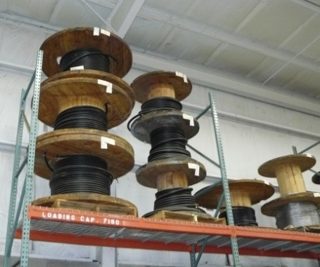
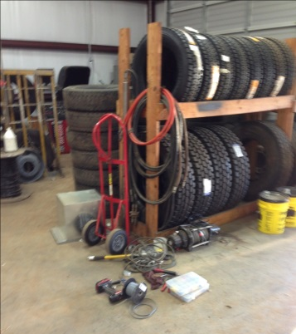
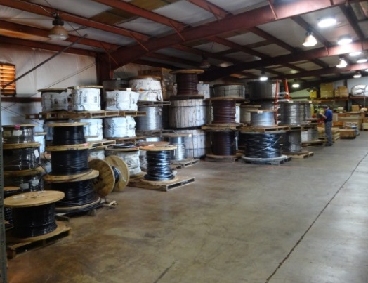
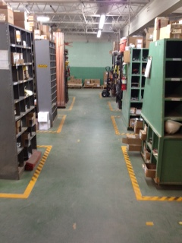
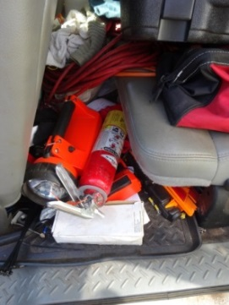
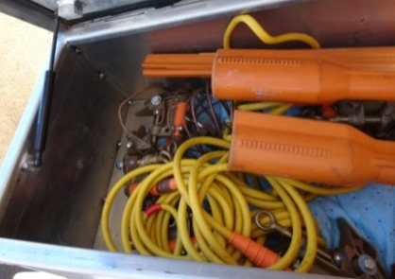
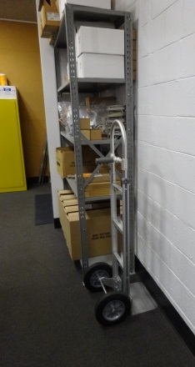
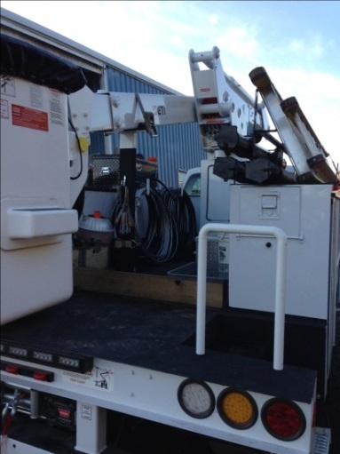
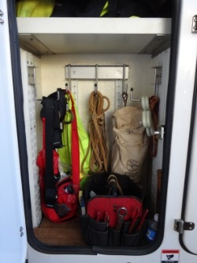
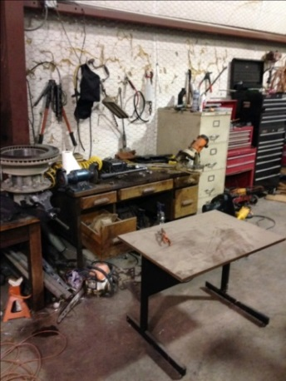
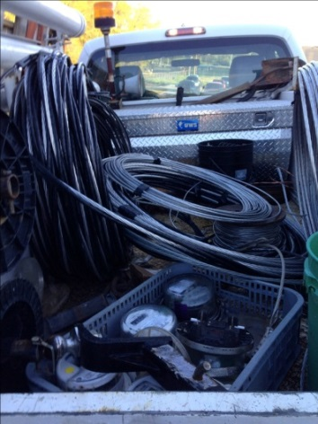
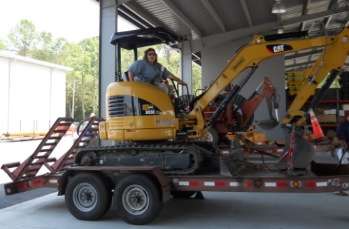
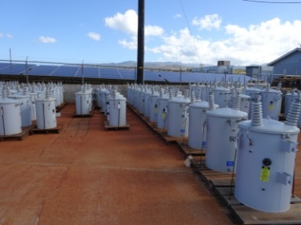
What are your perceptions about these two sets of observations?

Slide 11
What are your perceptions about these two sets of observations?

Slide 12
What are your perceptions about these two sets of observations?

Slide 13
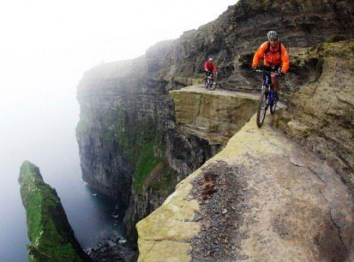
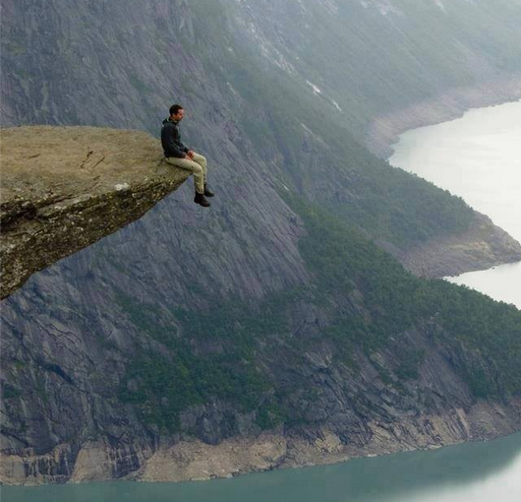


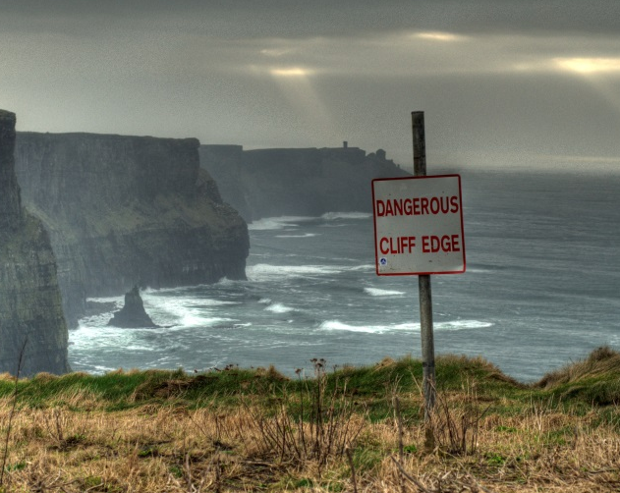
What do you see / hear? – How close to edge do you live?

Slide 14
2015 Safety Summit Showcase Initiative

Slide 15


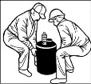

Understanding the System:
Roles & Responsibilities
Key System Elements
Safety System
Safety Improvement Plan
Priority Initiatives
Responsibilities
Schedule
Follow up
Exposure
Safety Culture
Notes:
Stress the importance of understanding the current state of performance (RESAP onsite assessment can be an valuable input into this understanding) and how the SIP is a critical means to incrementally move your desired state of performance

Slide 16
Where are your greatest improvement opportunities?

Slide 17
Possible Exposures
Driving while texting or talking
Smart phone distraction during work or walking
No seatbelts
No or ineffective job briefings
Inconsistent safety work practices between crews or personnel
Poor execution of clear safety responsibilities
Poor housekeeping
Poor traffic control
Improper rigging
Improper lifting or handling of loads
Slips, trips or falls
Short cuts – use of gloves / sleeves, eye protection, grounds, cover, etc.
Improper exit or enter into vehicles or equipment
Hostile members
Theft / robbery
Ergonomics / poor posture
Poor equipment / vehicle setup
Fatigue
Vehicle accident
Extreme weather
Accuracy of system maps

Slide 18
Key Elements of Safety System - Examples
Safety Meetings
Safety Committee
Safety / Craft Training
Incident Investigation Process
Rewards & Recognition
New Employee Orientation
Promotion & Transfer Policies
Performance Reviews
Safety Rules & Procedures
Safety Communications & Activities
Inspection / Observation Processes
Environmental Controls (Hazardous Material)
Employee Suggestion / Hazard Reporting
Electrical Testing Processes
Housekeeping
Vehicle Maintenance & Repair

Slide 19
Application Process
Future Plans & Direction

Slide 20
Application Summary Matrix

Slide 21
Key Safety Component Checklist
Key Safety System Component Checklist (Application)
 | RESAP Appl |  |  | Co-op Accountability
# | Sect | Quest | Safety System Key Components | Responsibility | Date Last Performed | Frequency* (if applicable)
1 | 4 | 4.6 | Safety Committee Meetings/Minutes
2 | 4 | 4.18 | New Employee Safety Orientation process
3 | 4 | 4.22 | Substation Inspection
4 | 4 | 4.23 | Overhead Line Inspection
5 | 4 | 4.24 | Underground Inspection
6 | 5 | 5.3 | Board of Directors - Cooperative Safety Policy
7 | 5 | 5.5 | Safety/Loss Control Report and review
8 | 6 | 6.4 | Accident Investigation training
9 | 7 | 7.2 | Vehicle Accident Investigation
10 | 7 | 7.4 | Accident Investigation
11 | 7 | 7.6 | First Report of Injury/Illness
12 | 9 | 9.3 | Safety Rule Manual distribution and documentation
13 | 9 | 9.4 | Formal review of the system's safety rules
14 | 9 | 9.6 | First Aid and CPR Training
15 | 9 | 9.9 | Pole Top Rescue Training
16 | 9 | 9.11 | Bucket Rescue Training
17 | 9 | 9.13 | Competent Person Training (trenching and shoring)
18 | 9 | 9.17 | Inside employee safety meetings
19 | 9 | 9.18 | Outside employee safety meetings
20 | 10 | 10.9 | Staking sheets (safety emphasis with job planning)
21 | 10 | 10.1 | Documented employee safety suggestions
22 | 11 | 11.2 | Hazard Recognition training
23 | 11 | 11.4 | Hazardous Recognition reporting process
25 | 12 | 12.3 | Student/community electrical safety demonstrations
26 | 13 | 13.1 | Regulated waste/substances evaluated and documented
27 | 13 | 13.3 | Chemical and small spill handling cleanup procedures
28 | 13 | 13.4 | Spill Prevention Control and Countermeasure Plan
29 | 13 | 13.6 | PCB (polychlorinated by phenols) spill cleanup procedures
30 | 13 | 13.9 | Underground storage tanks reviewed for compliance (state and federal)
31 | 13 | 13.12 | Chemical Hazard Communication Training
32 | 13 | 13.14 | Employee trained in use of ROW chemicals (state certification card)
33 | 15 | 15.9 | Dielectric inspection form/report
34 | 15 | 15.12 | Electrical testing of personal protective grounds
35 | 15 | 15.14 | Inspection/testing of vehicle grounds
36 | 15 | 15.17 | Dielectric testing of cover-up material
 |  |  | * Designate frequency as applicable (per month, quarter, year, 3 year review period, 5 year, etc.)
Notes:
142 questions on the 2014 Application

Slide 22
What is our legal burden?
Duty of Care
Co-op acts reasonably to:
Ensure compliance
Ensure safety of employees

Slide 23
Questions or Comments?
Bud Branham
bud.branham@nreca.coop
(561) 670-3502

Slide 24
“Speak Up – Listen Up”
Implementation Review

Slide 25
Principles to Consider for Implementation
Effectiveness is more important than efficiency
Effectiveness is more important that timeliness
Engaging the top leaders is the most critical factor for effective implementation
Offering training to frontline employees within a co-op is probably the most effective method
Class size is an important factor in gaining class participation
Customize the content for the allowable time but avoid diluting the core concepts
The program contains a lot of content, it was created to be flexible, adjust for the needs of the audience
Avoid splitting up the Speak Up and Listen Up track

