Slide 1
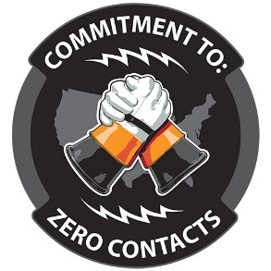
2021–2022 Employee & Public Contacts
S.A.F.E App Update
Nathan L Worsham, CLCP

Slide 2
Employee Electrical Contacts
*Updated 1.4.23
Notes:
A high of 27 in 2016. In 2021, nationwide employee contacts reached 18, including 7 SIF events and 1 fatality.
Although national counts are lower than past years, severity of events are higher.

Slide 3
Employee Contact Data
 | 2019 | 2020 | 2021 | 2022
Contacts | 16 | 18 | 18 | 18
Serious Injuries (Fatalities) | 4(0) | 3(1) | 8(1) | 6(0)
Outage/Restoration Work | 3 | 0 | 3 | 2
Updated 1.4.23
Notes:
AS OF 8/30/22
2019 2020 2021 2022 YTD
Contacts 16 18 18 13
Serious Injuries (Fatalities) 4(0) 3(1) 8(1) 5(0)
Outage/Restoration 3 0 3 2

Slide 4
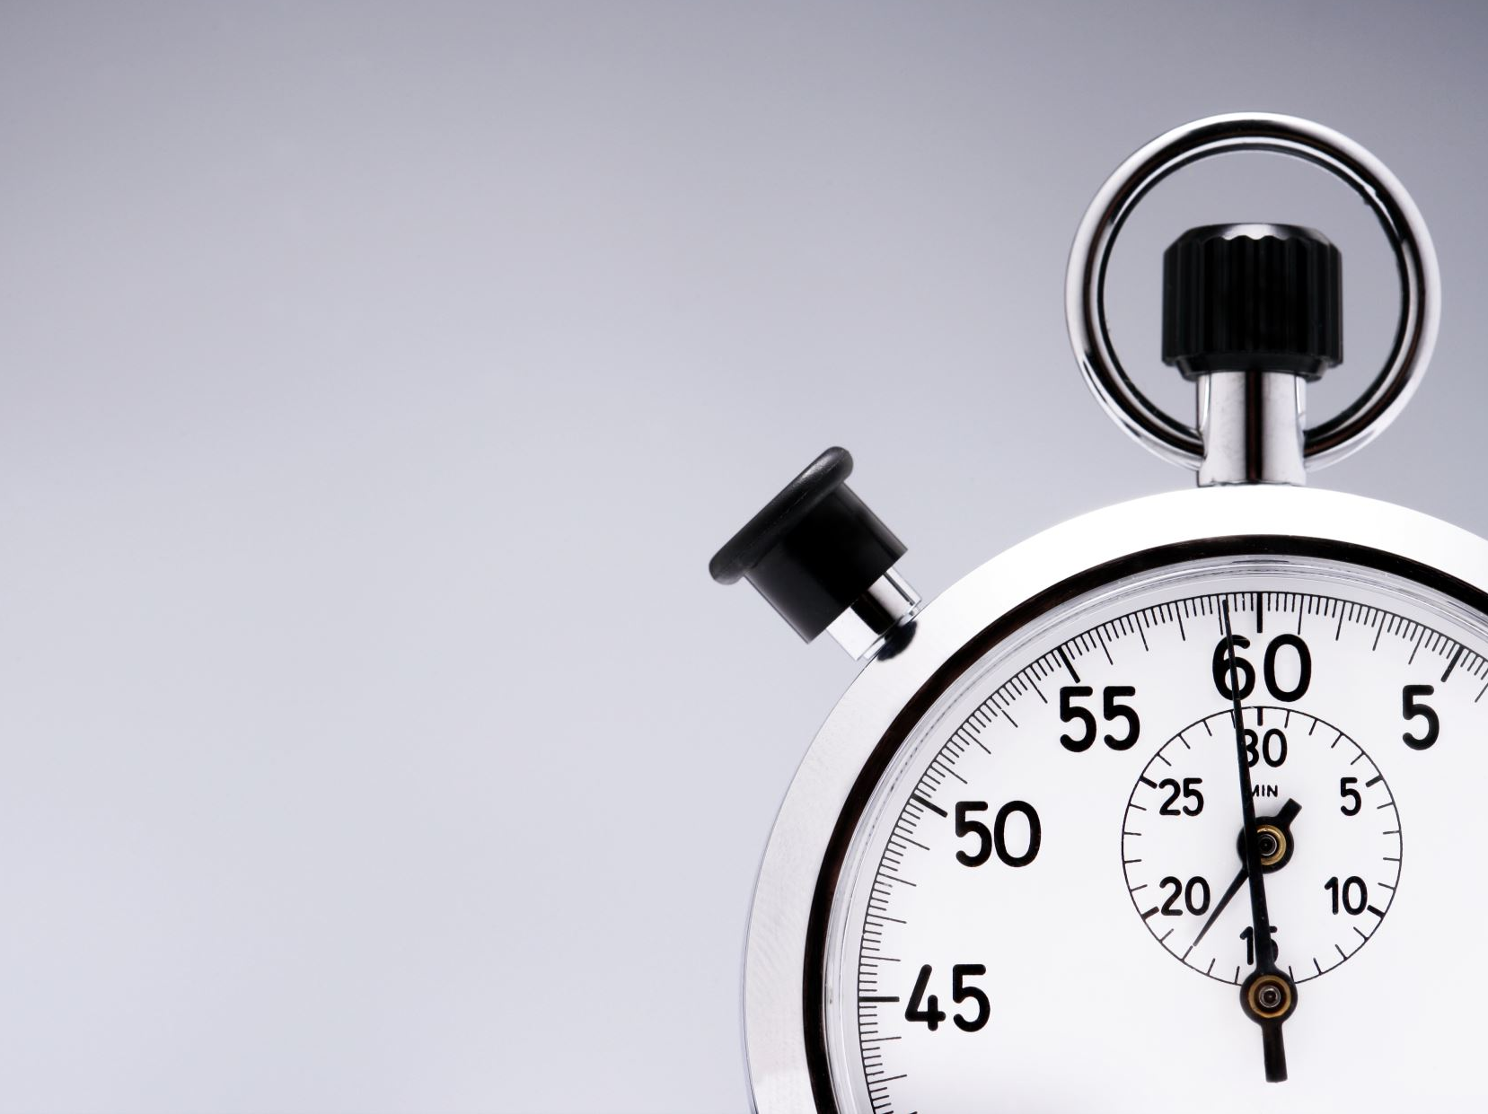
Average age fluctuates, but years of service trending younger
Current trends indicate that the average age of an employee involved in a contact occurs in the mid to high 30’s, but years of service is trending younger than in previous years.
1.4.23

Slide 5
Age and Experience
2021
2022
Age Range: 24 – 60
Average Age: 37.2
Years of Service: .5 – 37
Average Years of Service: 9.8
Age Range: 24 – 58
Average Age: 33.3
Years of Service: .5 – 37
Average Years of Service: 6.8

Slide 6
Contacts by Job Description
2021
2022
Lineman
11
Apprentice Lineman
1
Locater
1
Serviceman
1
Meter Tech
1
Foreman
2
Equipment Operator
1
Lineman
6
Apprentice Lineman
3
Foreman
2
Serviceman
2
Meter Tech
1
Sub Tech
2
Electrician
1
1.4.23

Slide 7
*Updated 1.4.23
Notes:
Maintenance = pole change, line relocation, meter change out and etc.
Outage = restoration/repair tasks
Construction = building new line

Slide 8
*Updated 10.4.2022

Slide 9
*Updated 1.3.23

Slide 10
2021 Employee Contacts
Observations
11 OHD/Primary Incidents
Employee installing guy wire – contact primary
Pole change-out - claw contacted primary
Installing PPG’s
Fiber drop - ungrounded
Inspecting damaged pole – contact w/ lightning arrester
Handling wire contacting live wire
Outage restoration (wire down & backfeed)
Moving phases on pole
Replacing pole – working from bucket
Changing a switch bracket
Notes:
Overhead Primary
Repairing downed primary line
Repairing downed primary line
Applying cover-up on energized conductor
Replacing broken cut-out in substation
Made contact with broken energized jumper
Making connection to yard light
Taking armor rod off neutral, one phase energized
Tying in phase, made contact with different potential
Installing overhead splice on energized conductor
Installing Duplex, contacted primary on transformer
Made contact with top of lightning arrestor, assumed line was de-energized
Working from bucket
ROW
Cut limb on energized line
Removing limb that was hanging over primary
Underground Primary
Brushed up against a de-energized elbow
Made contact with URD elbow probe

Slide 11
2021 Employee Contacts
Observations
URD/Primary Incidents
2 Contact with energized elbow
1 Contact with energized cabinet
1 Locating URD cable
1 Replacing CT in cabinet -assumed it was de-energized
Notes:
Overhead Primary
Repairing downed primary line
Repairing downed primary line
Applying cover-up on energized conductor
Replacing broken cut-out in substation
Made contact with broken energized jumper
Making connection to yard light
Taking armor rod off neutral, one phase energized
Tying in phase, made contact with different potential
Installing overhead splice on energized conductor
Installing Duplex, contacted primary on transformer
Made contact with top of lightning arrestor, assumed line was de-energized
Working from bucket
ROW
Cut limb on energized line
Removing limb that was hanging over primary
Underground Primary
Brushed up against a de-energized elbow
Made contact with URD elbow probe

Slide 12
2021 Employee Contacts
Observations
Substation Incidents
1 Painting steel and made contact with an energized switch.
1 Bypassing regulator when the switch broke and fell to the ground.
Notes:
Overhead Primary
Repairing downed primary line
Repairing downed primary line
Applying cover-up on energized conductor
Replacing broken cut-out in substation
Made contact with broken energized jumper
Making connection to yard light
Taking armor rod off neutral, one phase energized
Tying in phase, made contact with different potential
Installing overhead splice on energized conductor
Installing Duplex, contacted primary on transformer
Made contact with top of lightning arrestor, assumed line was de-energized
Working from bucket
ROW
Cut limb on energized line
Removing limb that was hanging over primary
Underground Primary
Brushed up against a de-energized elbow
Made contact with URD elbow probe

Slide 13
OH/Substation Incidents
2022 Employee Contacts
Observations
Unloading Poles in a Substation
Pole Changeout
Replacing Downed Line – Lightning
Transformer testing in a Substation
Rotating Power
Installing Bird Guard in a Substation

Slide 14
2022 Employee Contacts
Observations
UG Incidents
Irrigation Pump Panel
URD Maintenance
Disconnecting UG Leads
UG Fault Finding

Slide 15
2022 Employee Contacts
Observations
Meter/Misc. Incidents
Meter Loop Install
Testing CT switch
Filtering Breaker Hose

Slide 16
2022 Employee Contacts
Updated 1.4.23

Slide 17
Employee Contacts - Observations
Clearance & Lockout/Tagout procedures application
Review PPE requirements & application
Qualified designated observer in place
Notes:
Major reasons for electric contacts

Slide 18
Public Electrical Contacts
National Count 137
National Count 130
National Count 126
National Count 115
National Count 114
National Count 112
*Updated 1.5.2023
Notes:
High of 137 in 2018, 126 in 2020

Slide 19
Public Electrical Contact Fatalities
National Count 28
National Count 25
National Count 18
National Count 21
National Count 18
National Count 10
1.5.23
Notes:
99 total fatalities between 2016-2020. High of 28 in 2018, 10 in 2019

Slide 20
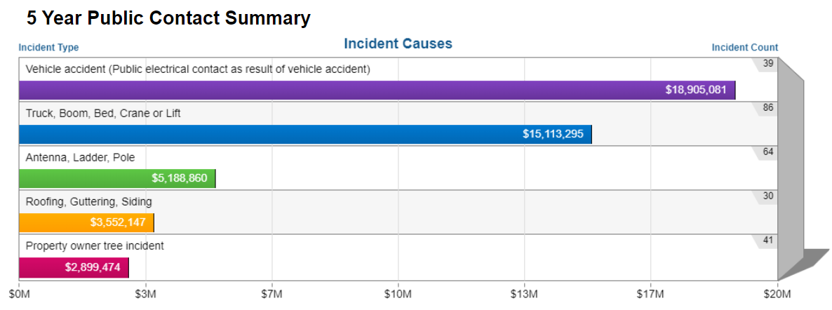
2018 -2022 Public Contacts
1.5.2023
Notes:
Public Contact Causes Sum Total Incurred Claim Count Fatality Count
Other $6,170,897 89 15
Truck, Boom, Bed, Crane or Lift $1,507,383 77 12
Antenna, Ladder, Pole $7,560,607 61 17
Contractor Other $599,182 57 5
Independent Contractor - Line Work $2,804,686 52 11
Farm / Irrigation Equipment $2,180,718 48 10
Property owner tree incident $4,750,341 45 6
UG Dig-in $131,893 42 2
Vehicle accident $3,791,730 27 11
(Public electrical contact as result of vehicle accident)
Aircraft Wire Strike $6,969,051 23 7
Roofing, Guttering, Siding $4,578,202 23 5

Slide 21
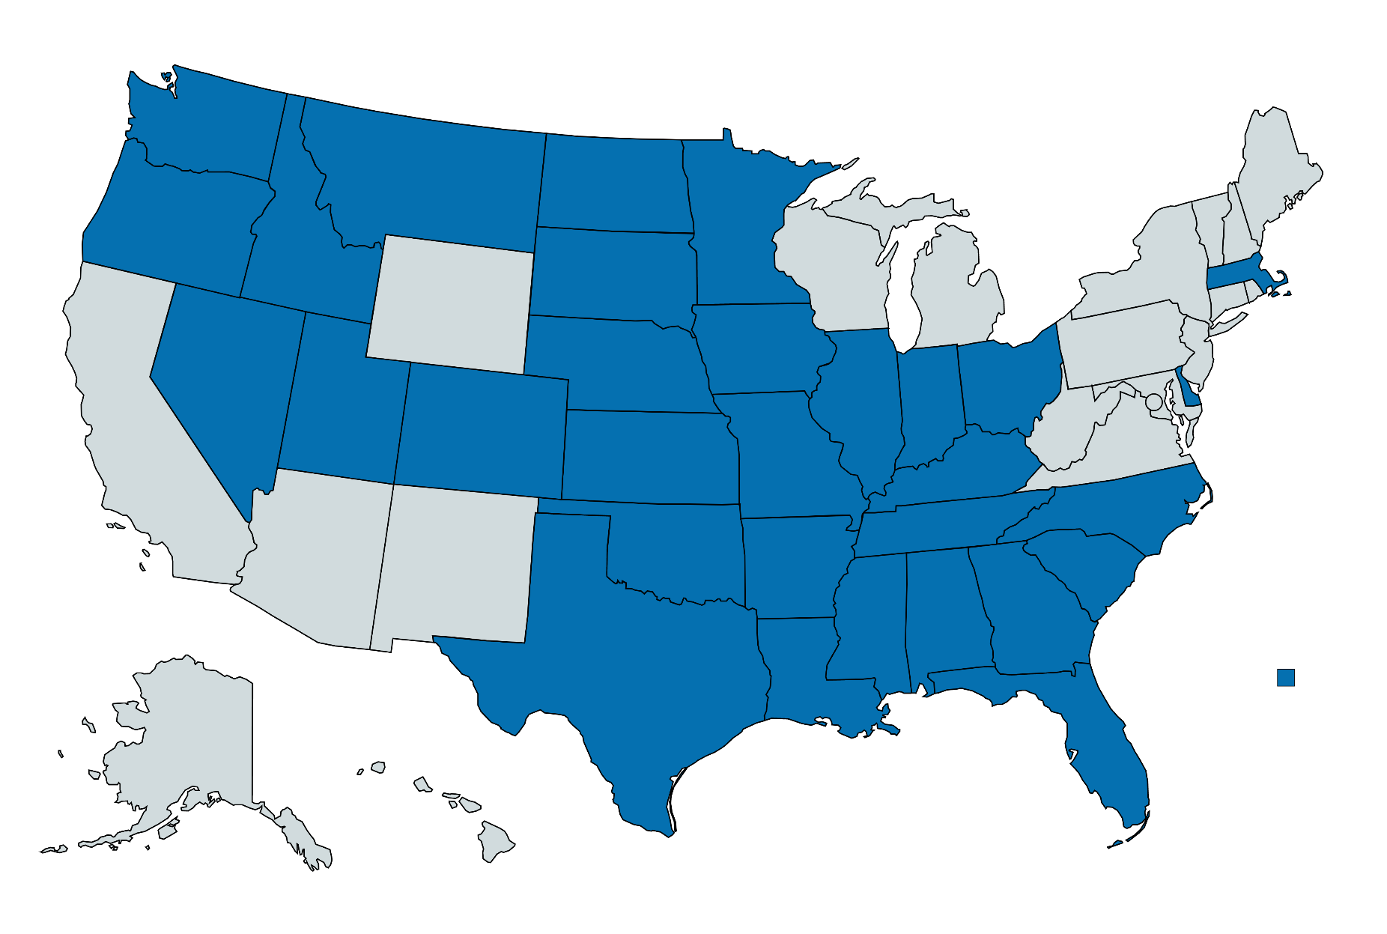
2022 Public Contacts
2
1
3
2
1
1
1
2
1
4
5
1
2
3
4
3
2
1
9
6
4
8
9
2
3
4
2
11
8
6
10
8/31/2022

Slide 22
Public Contact Causes

Slide 23
Public Contacts
Observations
Good ROW, Overhead and Underground Inspection Programs
Hazard Recognition Program
Review Contractors Limits of liability
Public Awareness and Education Program
Notes:
Things to concentrate on to help prevent public contacts

Slide 24
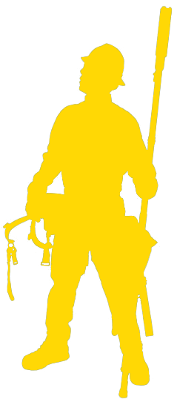
S.A.F.E. App Update
S.A.F.E. App numbers – 2022
Cooperatives Submitting Briefings: 350
Line workers with SAFE app credentials: 12,816
Total Job Briefing submissions: 282,015
1.5.23

Slide 25
S.A.F.E. App Update
S.A.F.E. App numbers – 2022
 | 2021 | 2022
Jobsite Observations | 9,543 | 12,126 | 22% ↑
Vehicle/Trailer Inspections | 132,052 | 175,708 | 25% ↑
Hazard Recognition | 2,812 | 3,305 | 15% ↑

Slide 26
S.A.F.E. App What’s New?
S.A.F.E. APP UPDATE V1.4.6
Documents:
NESC Crane Clearance Charts 2023
Employee Serious Injury Information Card
New Forms:
Vehicle Incident Report
Facilities Inspection Form
Power Quality Checklist (Voltage Complaint)

Slide 27
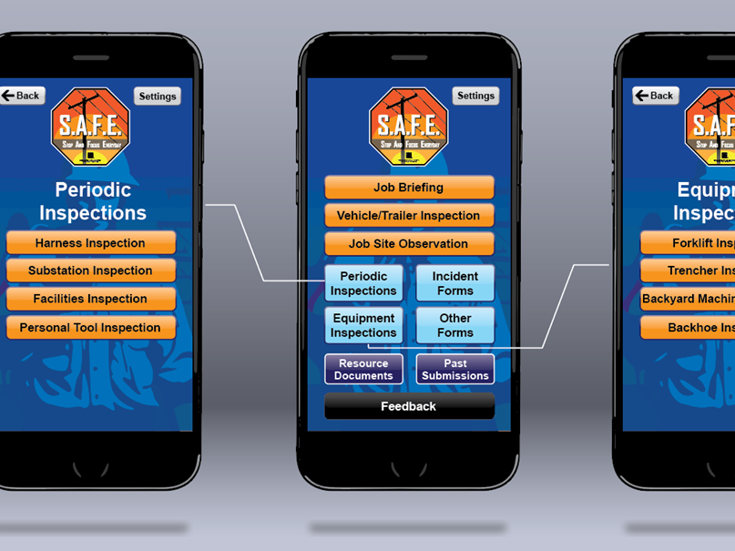
So What’s Next??
Dig-In Form
Substation Inspection
Forklift Inspection
Equipment Inspections
Spill/Avian Report
More!

Slide 28
How Do We Make It Better?
Hit that feedback button!
Your voice matters!
Most of the changes have come from your comments!
We truly do value your feedback!

Slide 29
https://www.tiktok.com/t/ZTRKpWp
Fc/?t=1

Slide 30
THANK YOU & BE SAFE!

