Slide 1

2012 FECA Operations & Safety Conference
Martha Duggan
Senior Principal, Regulatory Affairs
NRECA
May 17, 2012

Slide 2
Today’s Agenda
Transportation
  FMCSA
Safety
  OSHA
Emergency Preparedness
  FEMA
Notes:
Intro self,

Slide 3

Transportation – Hand-held Cell Phone Ban
Final Rule effective January 3, 2012.
Prohibits a CMV driver from using “at least one hand to hold a mobile telephone to conduct a voice communication or to reach for or dial a mobile telephone”.
Does not apply to hands free operation of cell phones.
Does not apply to two-way or CB radio.
One touch to initiate, answer or terminate a call is allowed.
  Phone must be within “the driver’s reach while [the driver] is in the normal seated position with the seatbelt fastened”.
Utility drivers NOT classified as emergency responders (i.e. fire and police).
FMCSA Section 390.23 allows for exemptions
during declared emergencies.
Interstate vs. Intrastate
  Timing will vary by state

Slide 4
Transportation –
Commercial Driver’s License and Commercial Learner’s Permit
Learner’s Permit:
  Must be 18 years old to obtain one
  Knowledge test (same for CDL)
  Must hold for 14 days before applying for CDL
  Requires background driving record check
Commercial Driver’s License
  Knowledge and hands on testing
  Proof of citizenship or lawful permanent residency
  Verification of SSN
Effective Date
  States must comply by 7/8/2014

Slide 5
Transportation –
Medical Certification
Medical Certification
Final Rule published by FMCSA, December 2008
Registry
Online
States
to be in compliance by 1/30/2012
Check with your state DMV or equivalent for the details
National registry of certified docs
Final Rule April 2012
Effective May 2014, medical certification must be performed by a doctor listed on the registry
Sleep Apnea
Medical advisory committees’ recommendations published “inadvertently” in April
Will be re-published later this year.

Slide 6

Transportation
Entry Level Driver Training
Federal Motor Carrier Safety Administration has missed its May 2011 goal for a final rule
Expect in final rule:
Training requirements
  at accredited institution
  Both classroom and behind-the-wheel
Applicability:
  N/A for drivers holding CDL during 3 years before effective date of rule

Slide 7
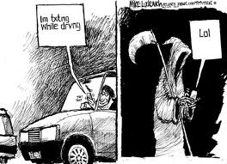
Transportation –
Driving While Texting

Slide 8
Transportation
Unified Carrier Registration
  Now being enforced on vehicles that:
    Operate in interstate commerce OR
    Weigh over 10,000 lb gross weight OR
    Are designed to transport 11 or more passengers
  Enforcement:
    Registration fees set by federal government
    Fines for violation set by state government
  Exceptions:
    Governor declaring emergency may exempt out-of-state utility vehicle
    State authorities should be able to advise on exemptions prior to emergency declaration

Slide 9


OSHA – Injury and Illness
Protection Program – “I2P2”
  Proactive, comprehensive program
    34 states already have some form of I2P2 program
  Key Elements:
  Stakeholder meetings in 2010, SBREFA Panel goal 2Q2012, now in limbo
  Internal NRECA Work Group
Management Leadership | Worker Participation
Hazard Identification & Assessment | Hazard Prevention and Control
Education & Training | Program Evaluation & Improvement

Slide 10
OSHA – Recent Activity
Request for Information on Backover Injuries and Fatalities
    OSHA seeks comments on 45 questions
    Comments due June 27, 2012
    Let me know if you want to help – I will need guidance and data!
GAO Report “Better OSHA Guidance Needed on Safety Incentive Programs” dated April 2012.
Subpart V – still not at OMB, per OSHA

Slide 11
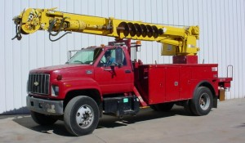
OSHA – Cranes & Derricks
Digger Derrick exclusion from Cranes and Derricks rules
Settlement under which OSHA will not enforce Cranes and Derricks rules against DD operators engaged in electrical construction work
Final Rule reflecting Settlement has not yet been published
Other parts of the rule continue to apply
To train or not to train?
Obligations as owner of facilities

Slide 12
OSHA: Harmonizing GHS and HazCom

Slide 13
OSHA – monitoring:
Combustible Dust
  Stakeholder meetings three years running
  SBREFA panel originally expected December 2011- has now been moved to “Long Term Items” in OSHA’s regulatory agenda.
  Combustible dust mentioned in GHS rule
Record Keeping
  The proposed rule requires report to OSHA, within eight hours, all work-related fatalities and all work-related in-patient hospitalizations (vs. old rule = hospitalizations of 3 or more employees); and within 24 hours, all work-related amputations.
  OSHA extended comment period to October 28, 2011

Slide 14
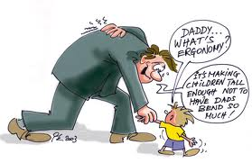
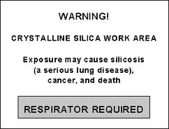
OSHA – monitoring (cont’d):
Ergonomics
  Proposal to add a line to OSHA 300 log to identify musculoskeletal injuries
  OSHA’s most recent budget prohibits it from implementing
Crystalline Silica
  Publication date of proposed rule “unclear” per OSHA
  Proposed rule at OMB for review

Slide 15

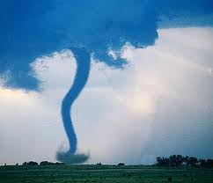
Emergency Preparedness
Issues
FEMA funding
Budget has been proposed for this fiscal year
Limited federal resources = more pressure to deny requests
DOCUMENT, DOCUMENT, DOCUMENT!!
Expect a rulemaking on debris removal in 2012
Resources
An Electric Cooperative’s Introduction to FEMA
Mutual Aid Agreement (blank)
List of signatories to Mutual Aid Agreement
FEMA Guides

Slide 16





Questions or Comments?
Thank You!
Martha Duggan
Senior Principal, Regulatory Affairs
National Rural Electric Cooperative Association
Martha.Duggan@NRECA.coop
Office: 703.907.5848
Mobile: 202.271.4395

