Slide 1

2014 RESAP Update
Clearwater, FL
May 12, 2014
Rural Electric Safety Achievement Program

Slide 2
2014 Plans & Priorities

Slide 3
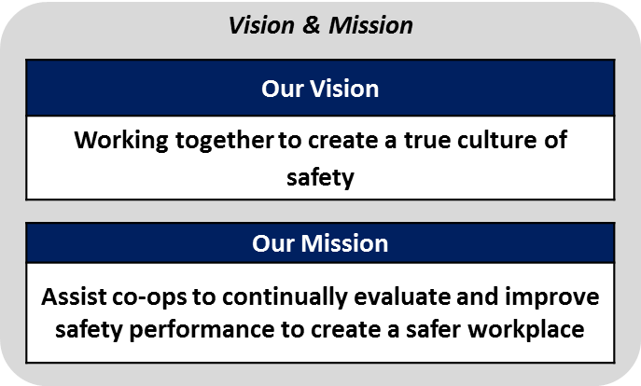
RESAP Strategic Road Map
Supporting Strategies

Slide 4
2014 Strategic Initiatives
Implement “Speak Up, Listen Up” training through statewide assn.
Conduct Safety Leadership Summit and Leading Practices Showcase (April 2015 – Indianapolis, IN)
Improve effective use of safety improvement plans
Include SIP assessment within onsite observation process
Update the existing online system to better meet program needs
Improve the use of the onsite application within the current process

Slide 5
“Speak Up – Listen Up” development & implementation plan

Slide 6
Speak Up Listen Up – Program Purpose
Assist leaders in establishing a structured approach for safety communication
Engage employees in constantly recognizing safe performance that reduces the risk of injury
Instill confidence and courage in employees to address safety performance
Strengthen overall safety culture

Slide 7
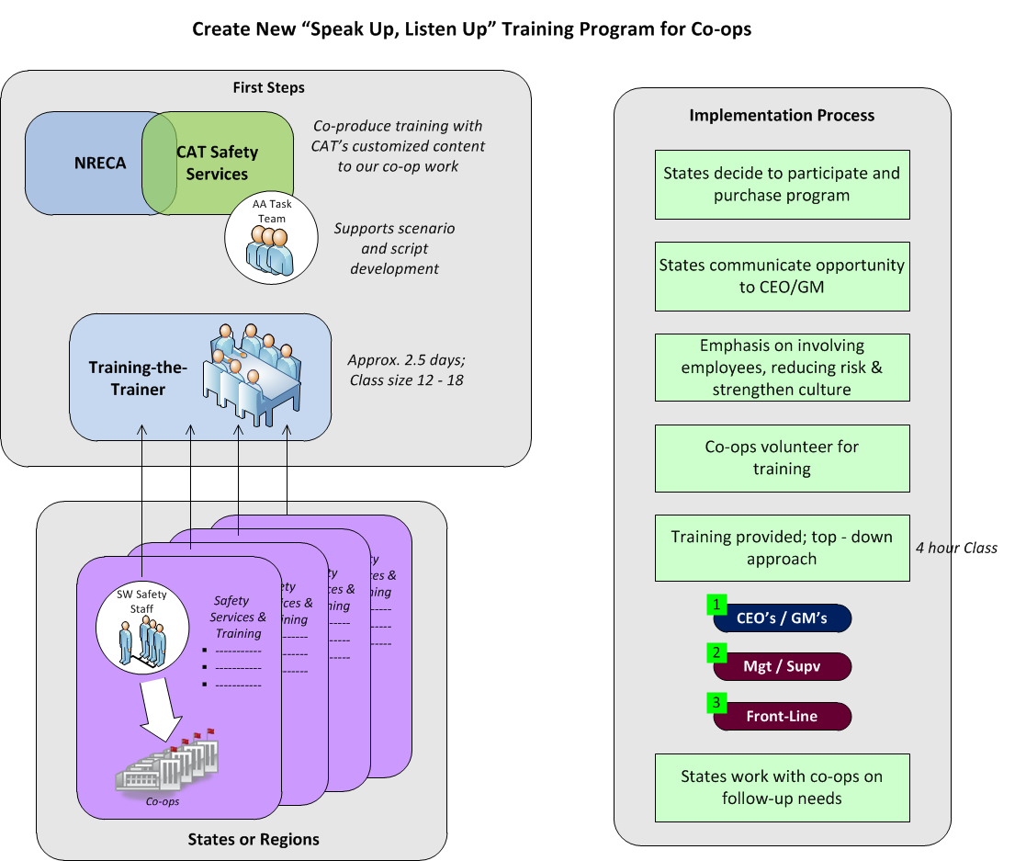

Slide 8
Speak Up Listen Up Implementation Schedule
Production Planning & Scenario Development
Production Shoot
May 16th – 21st
Editing & Content Completion
Training-the-Trainer
2 or 3 Sessions
Sept 30th, 2013
Mar 31st
Mar 31th, 2015
Sept 30th
Nov 19th – May 9th
May 26th – Aug 1st
Aug 25th – Sept 29th
Oct 6th – Feb 1st
Feb 1st – Apr 30th
Jan 1st, 2014
Jun 30th, 2014
Jan 1st, 2015
Possibly Start Training in some States
Training-the-Trainer
1 or 2 Sessions

Slide 9
2015
Safety Leadership Summit

Slide 10

Safety Leadership Summit
JW Marriott in Indianapolis, IN
April 14 – 17, 2015
Pre-conference sessions on the 14th
Co-op entries for the Leading Practice Showcase will begin in July

Slide 11
Leading Practices Showcase Examples

Slide 12
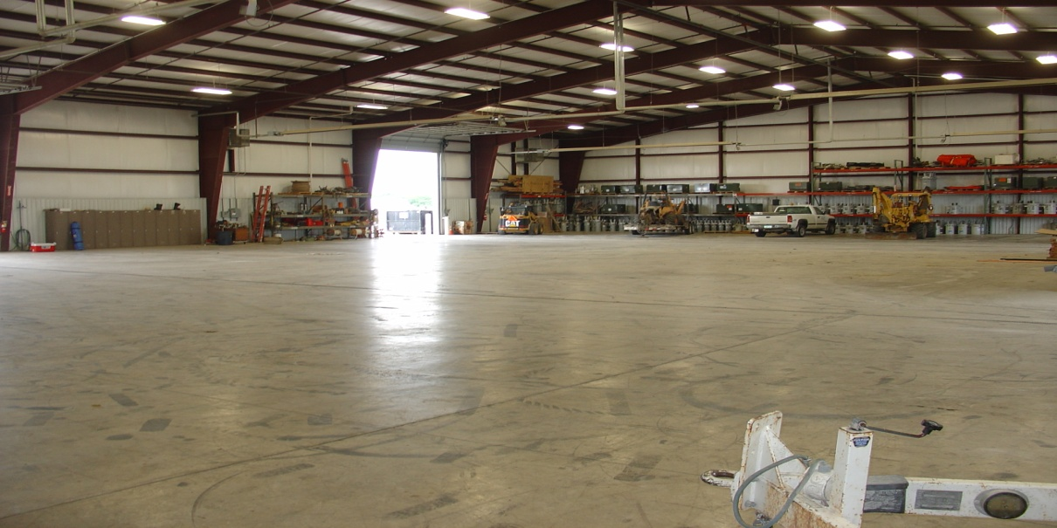
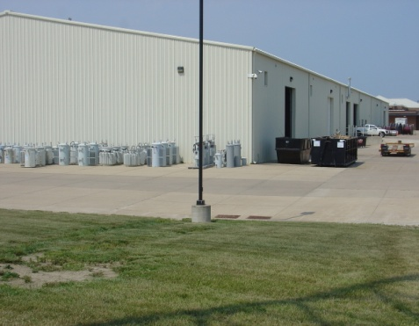
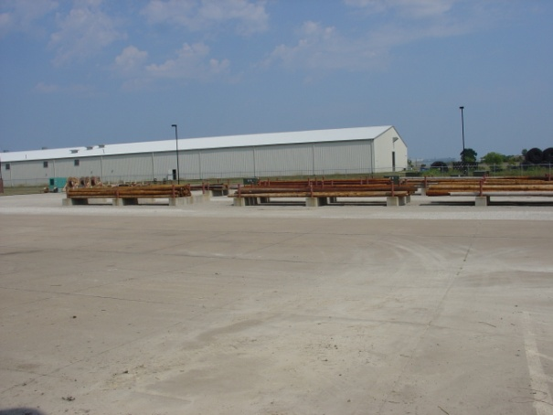
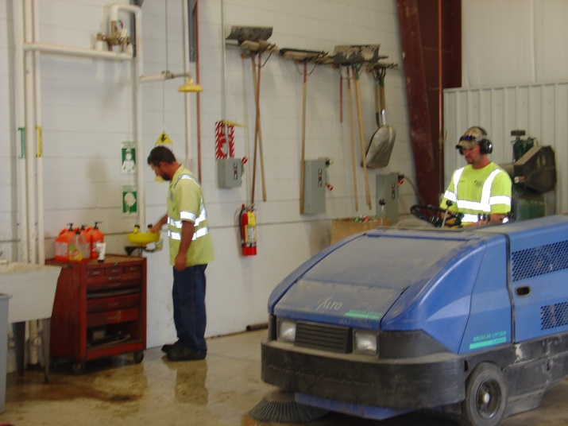

“Tidy Friday” – A creative way to create employee ownership
The Issue
Housekeeping tasks were not being completed regularly – only prior to RESAP observations
Safety hazards were increasing due to improper housekeeping and organization
What we did
The Safety Committee and management identified areas that required attention on a regular basis.
Employees were assigned specific duties to be completed every Friday.
Regular feedback is provided to recognize great consistent performance.
The Results
Employees take great pride and ownership
Employees take greater care of their equipment and work place on the off days
Creates positive teamwork
Employees have a clear understanding of expectations
Our co-op is maintained in a orderly fashion on a consistent basis
12

Slide 13
Sumter Electric Cooperative

Slide 14
Online System Pilot and
Development Project

Slide 15
Online System Development Plan
Tablet Pilot Project
  Alabama, Iowa and Michigan
Online System Development Effort with NRECA IT staff
Field ID National Discount Agreement

Slide 16
Leading Practice for
Process Implementation

Slide 17
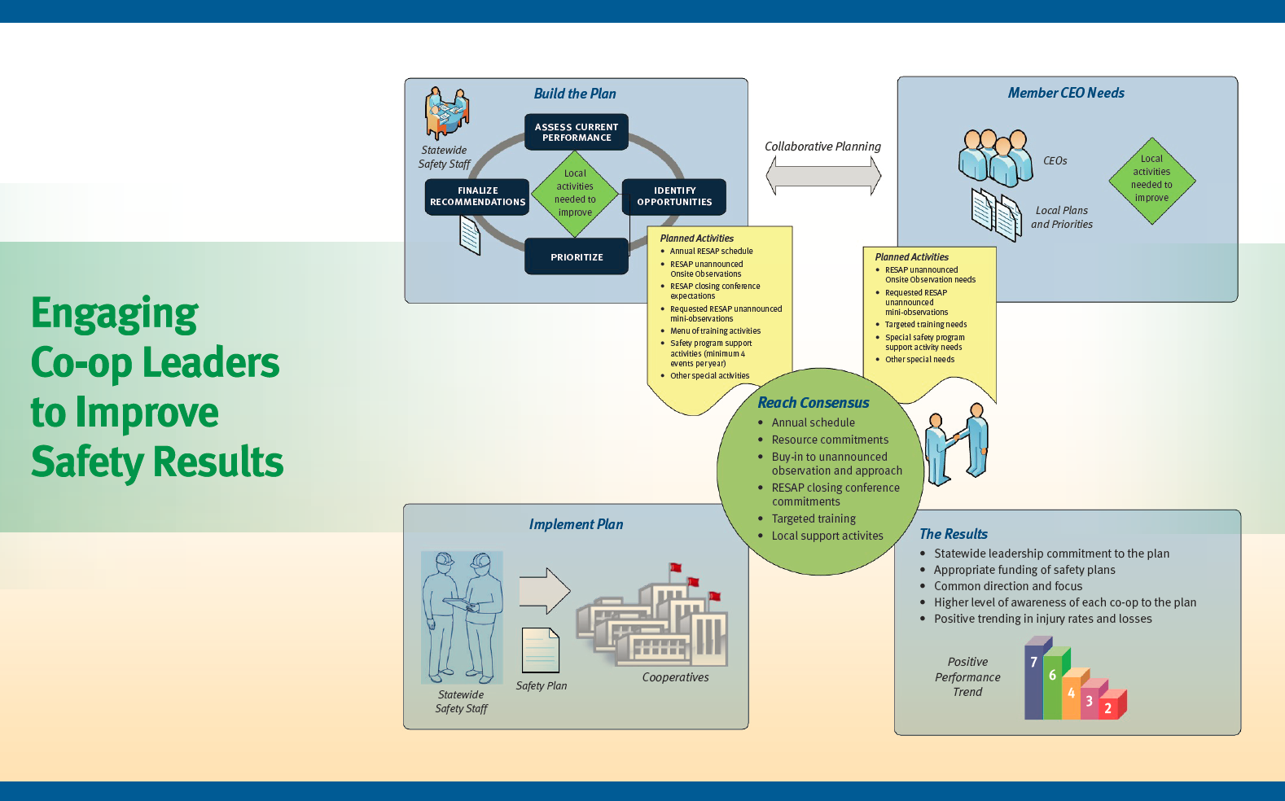
North Carolina Association of EC

Slide 18
Onsite Survey Changes

Slide 19
Onsite Observation Form Sections
2013 Table Of Contents
1. Observation Guidelines
2. System and Team Leader Identification
3. Common Facility Safety Equipment and Issues
4. Warehouse, Maintenance, & Covered Storage
5. Pole Yard and Outside Storage
6. Administration and Other Office Areas
7. General Vehicles (Under 10,000 lbs. GVWR)
8. Diggers, Buckets, etc. (over 10,000 lbs. GVWR)
9. Misc Vehicle (Trailers, Backhoes, etc.)
10. Truck and Personal Tools
11. Head, Eye, Face, Hearing, Foot, Hand, etc. PPE
12. Insulating Gloves, Sleeves, and Cover-up
13. Arc Rated Clothing / Systems + Fall Protection
14. Crew Visits
15. Substations
16. Overhead & Underground Lines, Equipment, etc.
2014 Table Of Contents
1. Observation Guidelines
2. General Identification
3. Document Verification & Safety Improvement Plan
4. Common Facility Safety Equipment and Issues
5. Warehouse and Covered Storage
6. Maintenance Facilities
7. Environmental / Hazardous Materials
8. Pole Yard and Outside Storage
9. Administration and Other Office Areas
10. General Vehicles (Under 10,000 lbs. GVWR)
11. Diggers, Buckets, etc. (over 10,000 lbs. GVWR)
12. Misc Vehicle (Trailers, Backhoes, etc.)
13. Truck and Personal Tools
14. Head, Eye, Face, Hearing, Foot, Hand, etc. PPE
15. Insulating Gloves, Sleeves, and Cover-up
16. Arc Rated Clothing / Systems + Fall Protection
17. Crew Visits
18. Substations
19. Overhead & Underground Lines, Equipment, etc.

Slide 20
Summary of Major Modifications
Clarification for Battery areas
Added detail to “High Voltage” test areas
Added details for treatment of Hazardous substances
Added details to Universal waste management procedures
Added details to storage and management of PCB’s
Added details to SPCC requirements
Added details to management of Pesticides / Herbicides
Added some new Commercial Motor Vehicle requirements
Clarified team evaluations co-op practices above regulatory requirements and equal to regulatory requirements
Added high level criteria for mobile substations and for use of SCADA
Other minor clarifications and updates throughout

Slide 21
RESAP Logo Redesign

Slide 22

Logo Redesign

Slide 23
SIP Considerations

Slide 24
Consider
Is the plan developed and updated in an effective manner?
Is the plan is communicated and understood by employees?
Are responsibilities clearly assigned and time frames for completion defined?
Is the plan is monitored and tracked to ensure progress throughout the year?
Does your CEO and board review progress on a periodic basis?

Slide 25
Questions or Comments?

