Slide 1
Creating an Environment for Open Employee Reporting Sand Peal Hotel Clearwater, FL May 12,2014
FECA Operations & Safety Conference

Slide 2
Self Evaluation
Consider how actively your employees report incidents.
Rate on a scale of 1 (never) to 10 (constantly)

Slide 3
So… why do we give a hoot?

Slide 4
Finding and Mitigating Risk
Owned & Sustained by Leadership
Culture
Employees – Skills & Training
Working Interface
Behaviors
Conditions
Attitudes
Hazards
Work Methods, Rules & Procedures
Environment Facilities & Equipment
4
Notes:
When employees are engaged to help identify hazards, risks, weak spots, suggestions for improvement, we can better understand exposure and take steps to mitigate it upstream. We can also work to reduce the tolerance to risk. Strong safety culture correlates to lower injury rates in the working interface – leadership owns and sustains the culture – the goal is to reduce exposure in the working interface… we have to constantly assess the working interface for risk, the strength of our culture and the quality of our leadership … and implement actions to improve

Slide 5
What barriers prevent employee participation?

Slide 6
What outcomes do you want to achieve?
Suggestions, Near Misses, Hazards, Feedback, Participation
“Known & Unknown”
What behaviors do your want to instill?
“Known”

Slide 7
The Communication Barrier
What does accountability mean to you?
What does accountability mean to the troops?
Management
Line Employees
“Accountability”
“Accountability”
Our Intent!
Employees take personal ownership and responsibility for their actions BEFORE an event occurs
What is heard!
An intent to intimidate with threats of punitive action AFTER an event, if one occurs

Slide 8
Upstream or Downstream Activity
Stream of Work Activity
Established Expectations
Clearly defined responsibilities for safety performance.
How do you react to bad news?
Improvement Plan
Improvement Initiatives & Priorities
Incident Occurs
Teams & Involvement
Investigation
Root cause analysis
Follow-up plan
Blame & Discipline
Notes:
Instead the leader should answer these three questions
What do you want people to think and/or know about your care for safety?
How do you want your people to feel about their behavior?
What do you want them to tell others about what happened when you addressed them?
A great rule of thumb for a leader to follow is: “I want to affect others how I want them to affect others”

Slide 9
Balancing Organizational Priorities
The Dilemma
Finding the balance between employee participation and the need for employees to take responsibility
Trust & Understanding
Engagement, Follow up & Feedback
Notes:
If the focus on discipline and accountability is overemphasized what happens to “participation” … proper accountability is reinforced by follow up and feedback… proper discipline requires upfront, on the field engagement and hopefully occurs before incident occur!

Slide 10
Pit Falls and Traps!!

Slide 11
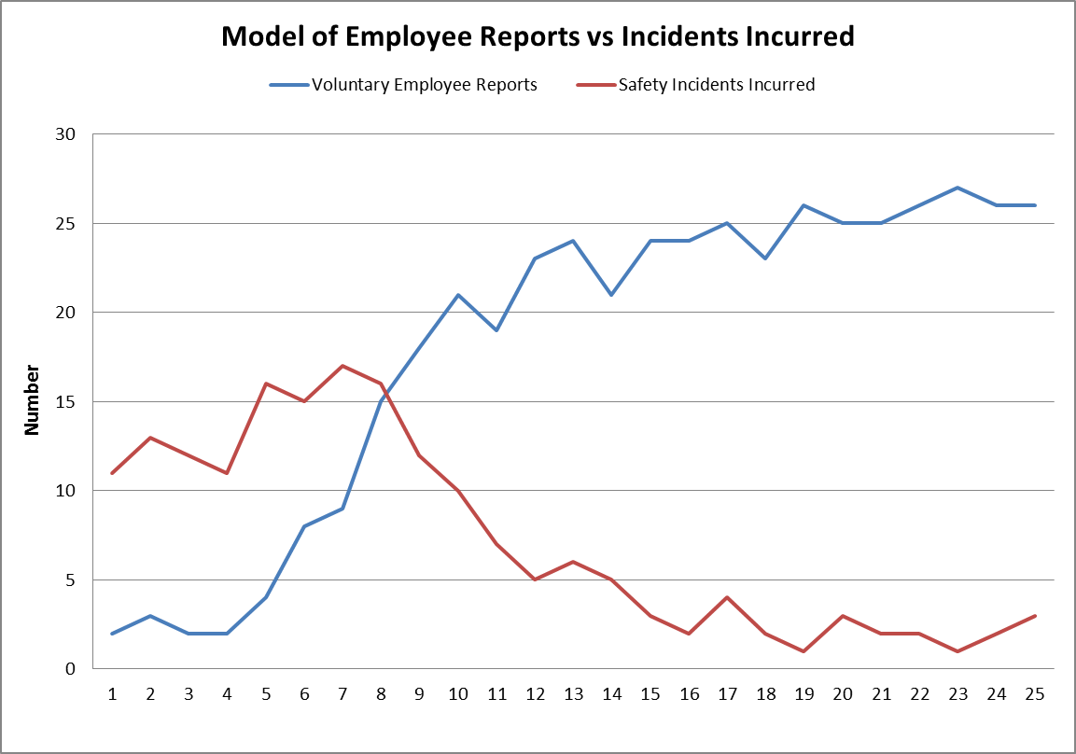
Danger Zone!
Notes:
The temptation to overreact in this phase is great … why? Many organization can never make it out of this phase! Use the East Kentucky findings as an example.

Slide 12
Incident Reaction Cycle
Incident
Operations Return to Normal
Management Reacts
Performance Improves
Safety Awareness Increases

Slide 13
Can increased participation be achieved by a safety person / department?
Notes:
It must be an organizational commitment from the senior staff to the front-line supervisor to create this environment?

Slide 14
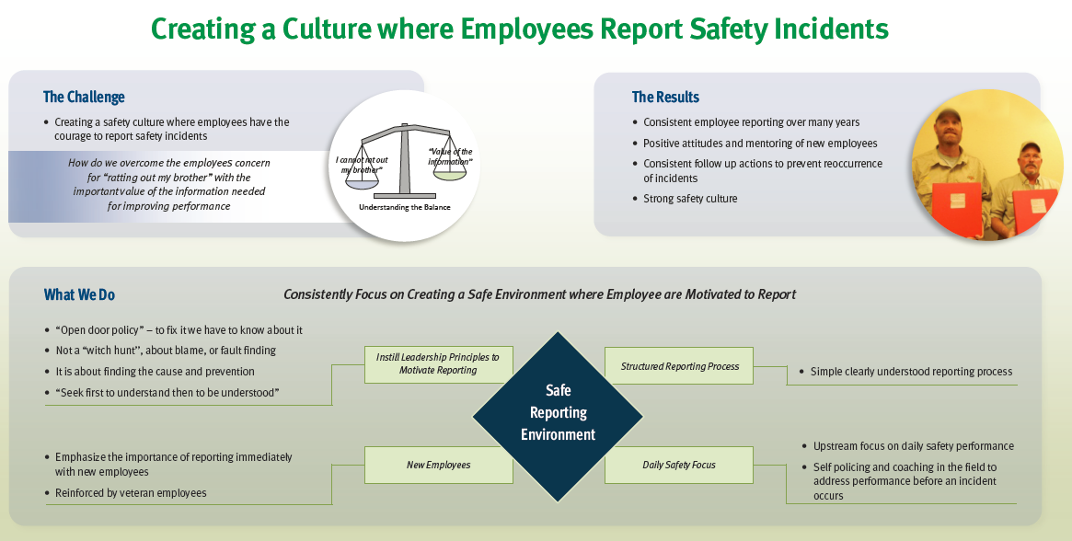

Slide 15
What actions can to be taken to create a safe reporting environment?

Slide 16
Summary
Increasing employee participation requires:
Full leadership commitment – a clear message, consistently acted upon
Established safety responsibilities applied upstream and constantly followed up on
You must stay the course, negative incidents will increase
Provide positive recognition for reporting and celebrate milestones to reinforce the behavior

Slide 17
Questions or Comments?
Bud Branham
bud.branham@nreca.coop
(561) 670-3502

