Slide 1
Wood Utility Poles Preservative Treatments, Specifications, Quality Control and In-Service Considerations
Jim Hickman
Technical Director
Langdale Forest Products Co.
Valdosta, GA
Florida Electric Cooperative Association
Operations & Safety Conference
Clearwater, FL
May 14, 2014

Slide 2
Preservative Types All Are EPA Registered Pesticides
OIL BORNE
Creosote
Pentachlorophenol
Copper Napthenate
WATERBORNE
CCA
Waterborne Penta

Slide 3
Creosote
Use began in 1800’s
Derived from coal tar
Has 200+ constituents
Primary industrial preservative for over a century
Not “people friendly”
Preservative migrates
Average life cycle 25-60 years
Defined as 50% failure rate

Slide 4
Pentachlorophenol
Began extensive use in mid-later 1900’s
Creosote users liked cleaner surface
Replaced creosote as primary pole preservative
Price fluctuates with oil market
Preservative migrates
Average life cycle 25-60 years

Slide 5
Chromated Copper Arsenate (CCA)
Patented in 1930’s
Copper is biocide
Arsenate is insecticide
Chrome enables “fiber fixing”-becomes “part of wood”
Lowest life cycle costs of three major preservatives
Cost not effected by petroleum market prices
Difficult to extinguish if burning
Surface has no lubricants, can be hard to climb
Average life cycle in excess of 100 years

Slide 6
Storms Resulted In Pole Inspections
2005 experienced most named storms and perceived service interruptions
FPL/KEMA (consultant) storm findings
1% of FPL poles failed
90% of pole failures caused by collateral damage

Slide 7
Osmose Utilities Pole Inspection
OUD commissioned to perform pole study
170,000 distribution poles at several FL utilities
Service history ranged from new to 61+ years
Pole treatments included CCA, Creosote and Penta
All poles in AWPA Severe Deterioration Zone 5
Inspections required complete excavation

Slide 8
Preservative Performance
Total pole population rejects (by treatment)
CCA – 0.2%
Creosote – 19.9%
Pentachlorphenol – 22.5%
31-60 year old pole rejects (by treatment)
CCA – 2.1%
Creosote – 20.4%
Pentachlorophenol – 26.5%

Slide 9
Most Often Asked Questions -------- Why Are My Poles So Crooked? Why Are Pole Inspectors On My Yard? How Can We Enhance Our Pole Yard?

Slide 10
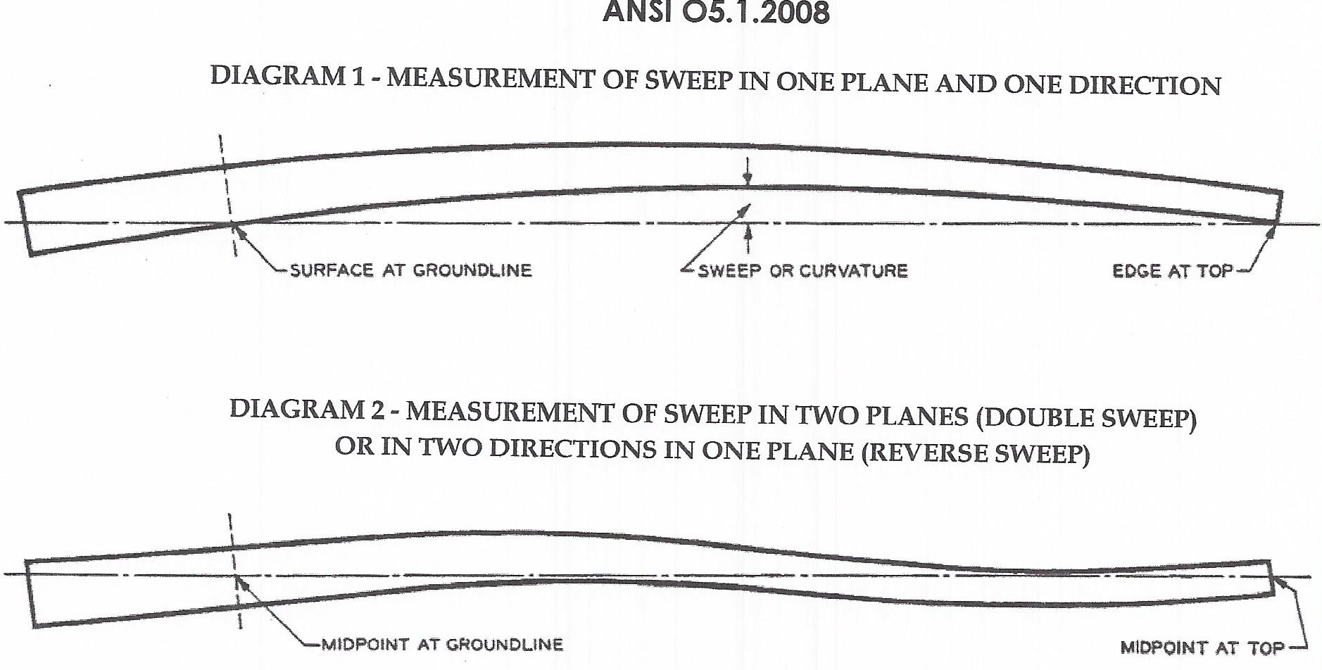
ANSI 05.1 & RUS Specifications

Slide 11
Why Are Pole Inspectors On My Yard?
NRECA’s Wood Quality Control (WQC) Program
Quality Control Monitoring Program
Producers have responsibility for all pole quality facits
WQC “agent” monitors approximately 25% of member pole producers production
Prior to Treatment (does it meet specifications)
After Treatment (preservative check, penetration and retention)
Destination Checks (shipping damage+)

Slide 12
How Can We Enhance Our Pole Yard?
Orient poles in North-South direction
Insure drivers and staff help with stock rotation

Slide 13
In-Service Considerations
Routine &/or before climbing
Recommend routine inspection program
90% of pole strength in outer one inch of circumference
Hammer test (sounding)
Perform visual inspection of entire surface
Obvious mechanical damage (fire or struck by)
Checks
Shelling
Woodpecker damage

Slide 14
How Can I Learn More About Treated Utility Poles?
Langdale Pole School addresses all aspects
of pole manufacturing
Your specifications
Selection of raw material (trees in woods)
Harvesting
Machining
Kiln Drying
Framing
Preservative Treating
Shipping
All Aspects of Quality Control During Processes

