Slide 1
Electric Co-op CEO to Member Email Program
A tool to help distribution cooperative CEOs
communicate with members about issues impacting electric bills

Slide 2
What are the goals?
Help local co-op CEOs inform members about current events that threaten to increase electric bills.
Highlight what co-ops are doing to keep electric bills as affordable as possible.
Help build member support and loyalty.

Slide 3
Statewide Coordination
Draft messages prepared.
Circulated to statewide associations with member system participants for feedback and questions.
Then posted to the email system for member system notification and review.

Slide 4
Member Systems
Co-ops get an email alerting them a new message is ready.
Co-ops review message & edit, approve or reject it.
Co-ops load email list for one-time-use.
No national database.
Messages designed to look like a personal email sent from the CEO.

Slide 5
Why an email from the CEO?
Reach members not already engaged through other communication channels.
Enhance what the co-op is already doing through magazines, newsletters, bill stuffers.
Strengthen relationship between members and co-op.

Slide 6
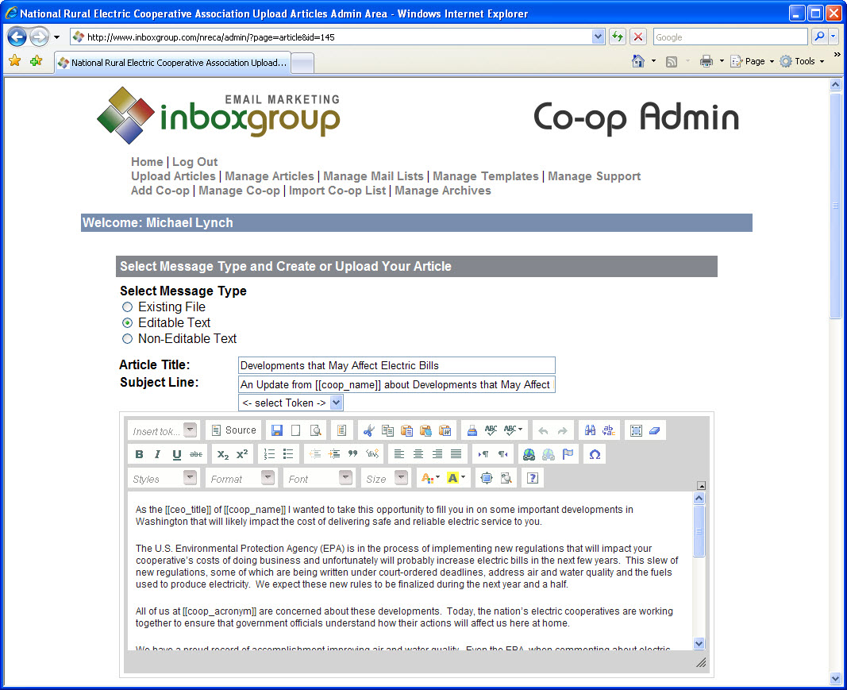

Slide 7
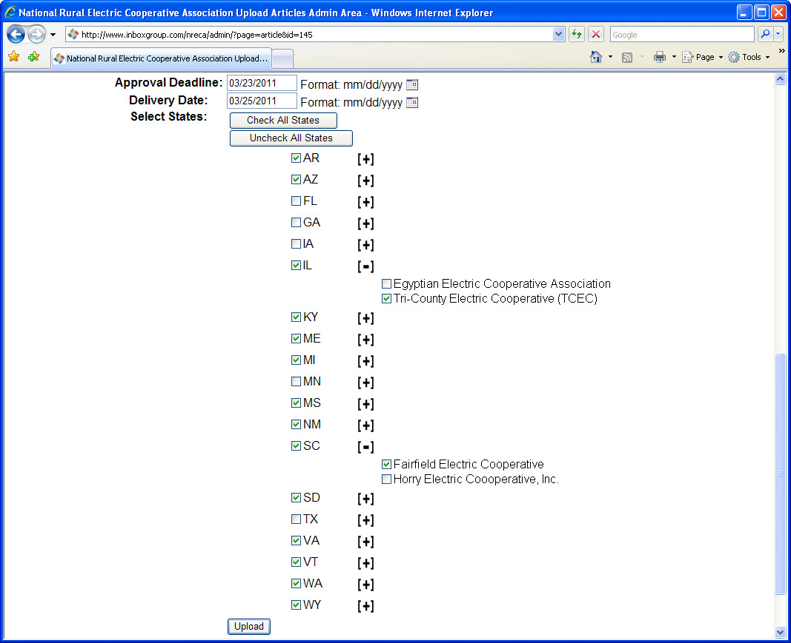

Slide 8
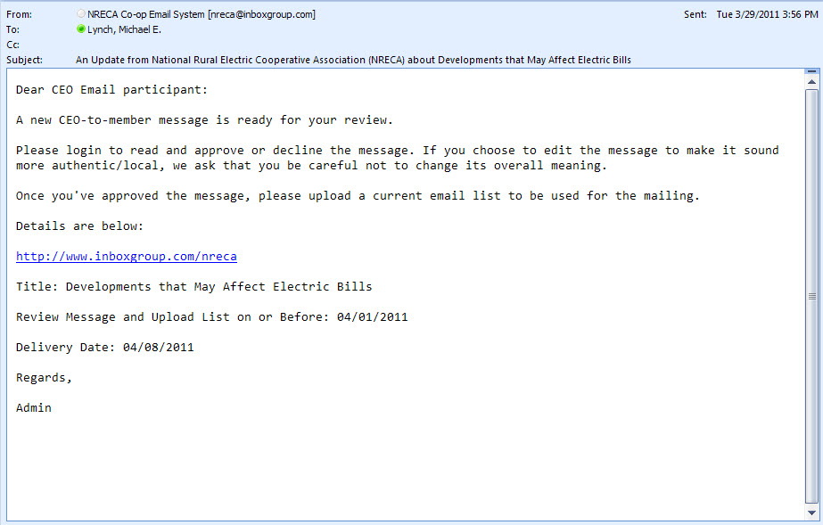

Slide 9
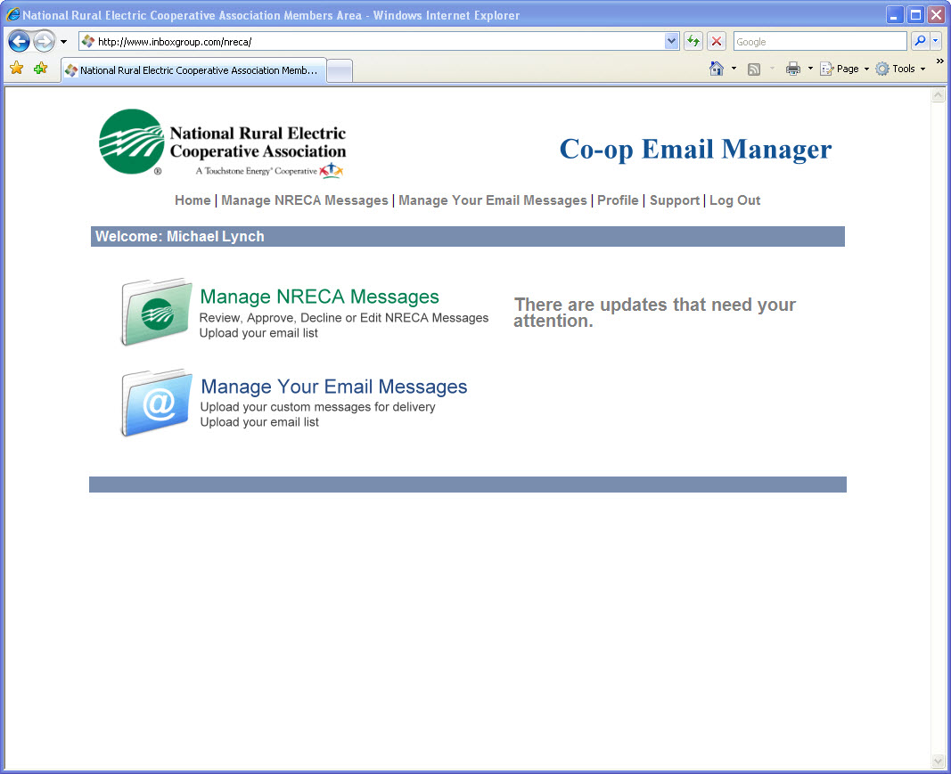

Slide 11
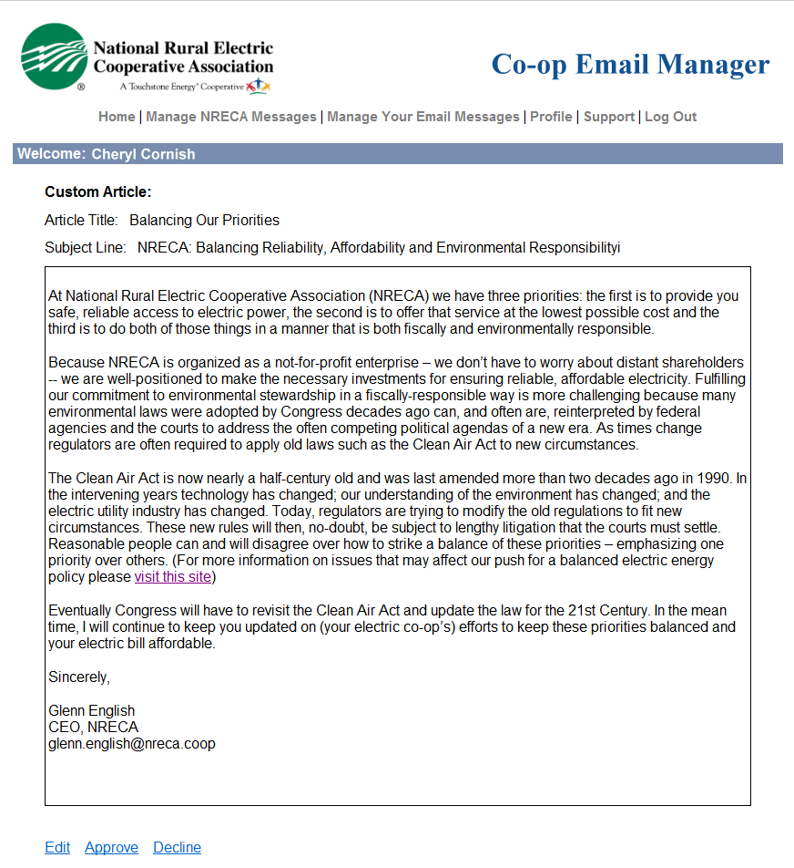

Slide 12
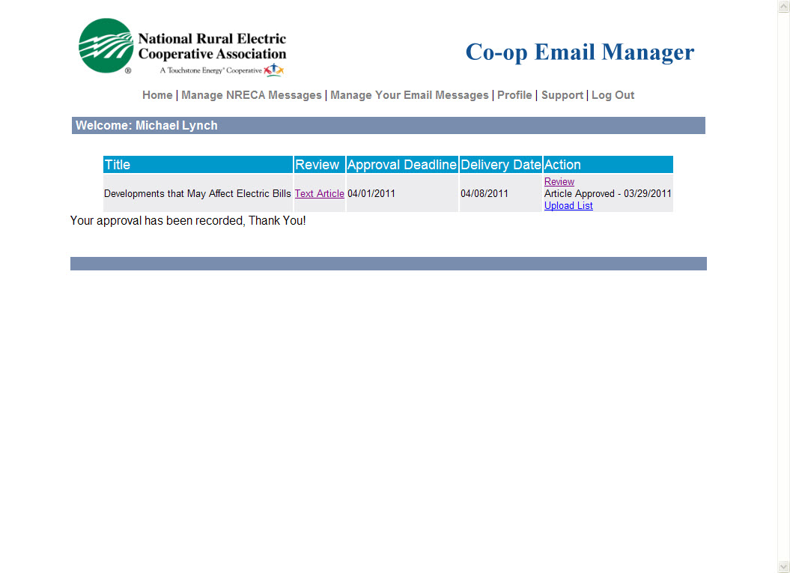

Slide 13
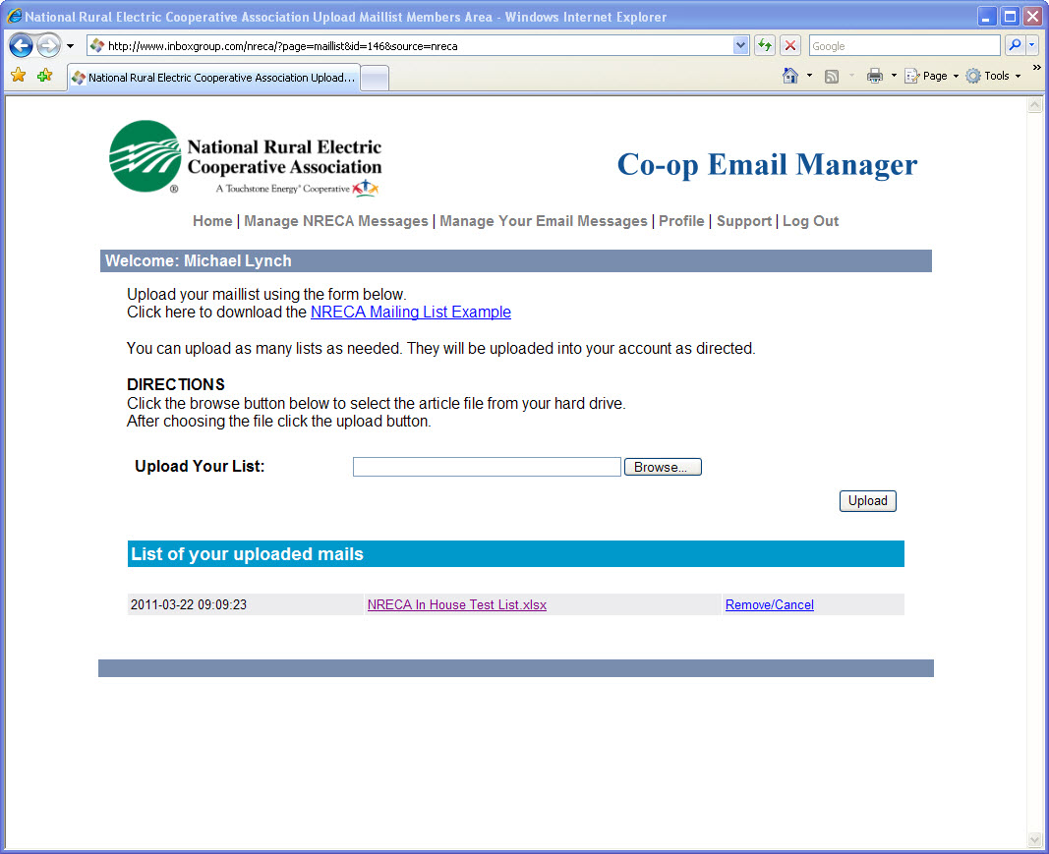

Slide 14
Thank you
Zan McKelway, VP Communications
zan.mckelway@nreca.coop
703 907 5719

