Slide 1
Energy Freedom CRC Proposal

Slide 3
15-20%

Slide 4
20.61 Million

Slide 5
76%

Slide 6
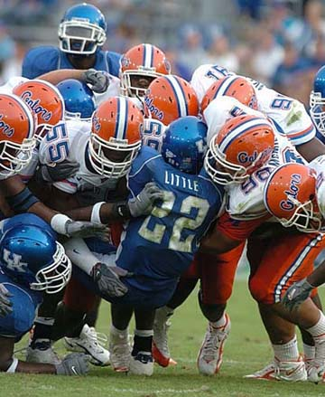

Slide 12
Chairman Brandy Marquez

Slide 13
Chairman Pat Wood

Slide 14
Chairman Donna Nelson

Slide 15
National Energy Marketers Association Fall Policy Leadership Roundtable
Chairman Donna L. Nelson
October 27, 2016

Slide 16
12 Mo. Fixed Rate Retail Products
TDU | Price | REP | 2001 Reg’d Rate | Change | Inflation Adjusted 2001 Reg’d Rate | Inflation Adjusted Change
AEPC | 5.6 | Infuse Energy | 9.6 | -42% | 12.77 | -57%
AEPN | 5.0 | Frontier Utilities | 10.0 | -50% | 13.20 | -63%
CenterPoint | 5.2 | Summer Energy | 10.4 | -50% | 13.7 | -63%
Oncor | 4.5 | Summer Energy | 9.7 | -54% | 12.8 | -66%
TNMP | 5.0 | Frontier Utilities | 10.6 | -53% | 14.0 | -65%
As of 10/13/16 for usage of 1000 kWh; 36.1% inflation since 2001 (Bureau of Labor Statistics)
Notes:
Competition in the Texas electricity market has been tremendously successful. Customers in the competitive area have a myriad of providers and products from which to choose. Prices are lower in the competitive area than in many of the municipal utilities and cooperatives (which are not open to competition) and prices are lower than they were in the regulated marketplace, almost 10 years ago. Generation companies have invested billions of dollars in private capital.
As I mentioned earlier, the ERCOT restructured market is a largely a natural gas on the margin market, meaning that natural gas generation sets the price in the wholesale market most hours of the day. As a result, when the price of natural gas started to rise several years ago, opponents of the restructured market, a market just a few years old, drew the conclusion that the competitive market had failed because prices had risen. At that time, those who believed that a competitive electric market was better than a regulated one stated that the cost of natural gas was driving the higher prices, not a failure of the market. Now that prices are low, lower than they have been in years, you would expect such opponents to embrace this market, but alas, many continue to complain.
But let’s look at the facts: prices are lower today in the competitive areas of Texas than they were prior to competition.
The Power to Choose website lists REPs’ current product offerings for residential consumers. As this chart shows, just this month the lowest twelve month fixed rate product available ranged from 4.5 cents per kWh to 5.6 cents per kWh in the various TDU service areas. These rates are all lower than the last regulated rate in each service area, and in some cases, they are much lower.

Slide 17
”Competition in the Texas electricity market has been tremendously successful.”

Slide 18
“Prices are lower than they were in the regulated marketplace, almost 10 years ago. “

Slide 19
“Generation companies have invested billions of dollars in private capital.”

Slide 20
“But let’s look at the facts: prices are lower today in the competitive areas of Texas than they were prior to competition.”

Slide 22
