Slide 1
Post Election Update
FECA Lobby Clinic
14 Jan 2015
Mike Bjorklund
Dir. of Legislative Affairs

Slide 2
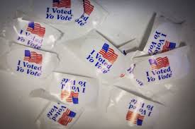
2014 Midterm Elections
5.6 million Floridians cast their votes
Republican Wave or Democratic Low Tide?
Turnout in FL this midterm election hit 50%, outperforming the 2006 and 2010 midterm turnouts of 47% and 49%, respectively
Nationally, turnout was approximately 36%

Slide 3
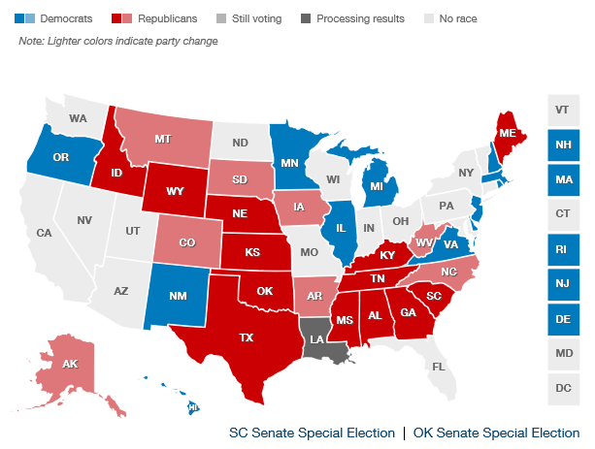
New senate make-up:
Republicans — 54
Democrats — 44
Independents — 2*
*(Caucus with the Democrats)

Slide 4
New House make-up: Republicans — 247* Democrats — 188 *(Largest Majority since 1928)
Source: CNN Elections Center

Slide 5
Florida had two Congressional seats turnover
Both have co-op territory
CD 2-Gwen Graham CD-26 Carlos Curbelo

Slide 6
Florida’s Gubernatorial Election
Rick Scott Vs. Charlie Crist
Easily the most expensive gubernatorial election, and possibly the nastiest
Scott won by 64,145 votes (1.07%)
Electric utilities/Climate change were election issues
Tom Steyer and NextGen PAC spent more than $20 million in FL alone
Kept Climate Change out front as an issue
Used Duke as the epitome of the “big bad electric company”
These issues will continue to play out during the upcoming session.

Slide 7
Florida Cabinet
All the incumbent Cabinet Members handily won their elections
Commissioner of Agriculture and Consumer Services
Commissioner Adam Putnam
Chief Financial Officer
CFO Jeff Atwater
Attorney General
AG Pam Bondi

Slide 8
Florida Legislature
Florida Senate
No open seats
All incumbents won their races
Senate did not change (26R-14D)
Florida House
Many legislators got a free pass
6 incumbent Democrats lost their seats
23 new legislators
House now has a super-majority (81R-39D)
It ain’t over yet!
Upcoming special elections in SD-6, HD-17, HD 24, & HD-64

Slide 9
Overall, ACRE supported candidates in Florida had a strong showing this cycle.
During the 2014 election cycle, ACRE contributed to the Governor and Cabinet, participated in 132 Legislative races, and contributed to 18 Congressmen.
With the exception of two Congressmen, three candidates for the Florida House, and one Senate candidate, all the candidates supported by ACRE won.
Legislative contribution limits have doubled.

Slide 10
Questions?

