Slide 1
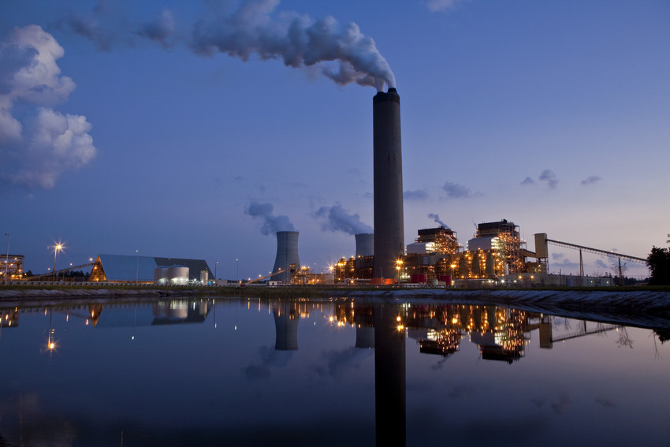
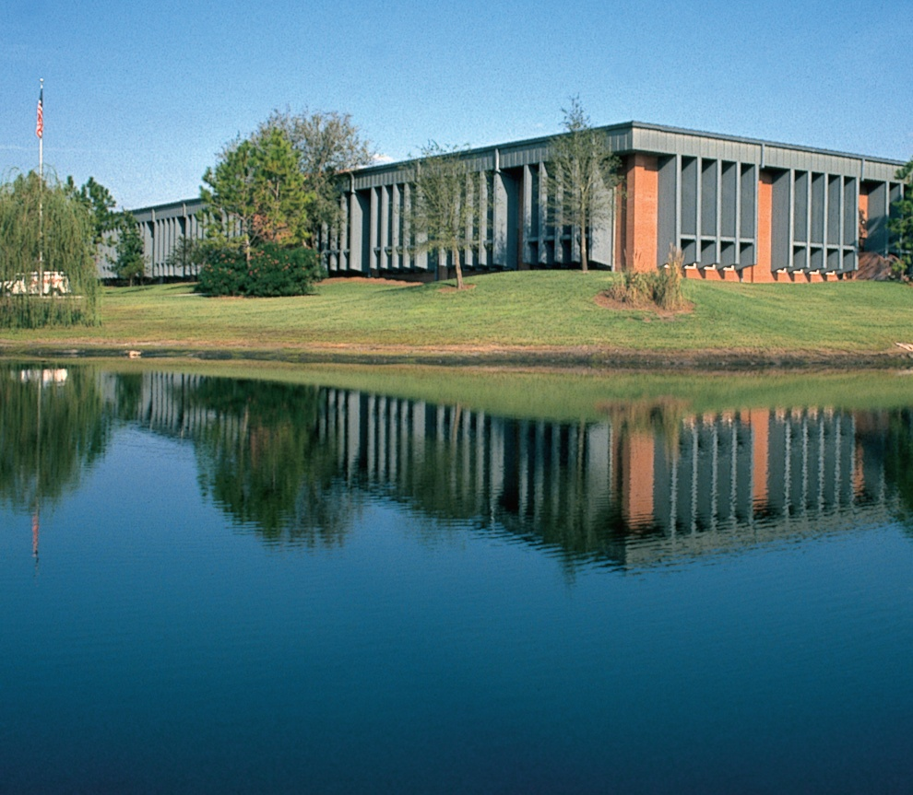
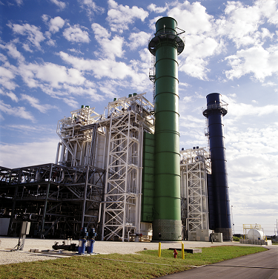
Power Generation
Environmental Regulatory Update
Seminole Electric Cooperative, Inc.
Our Mission: To be the preferred provider of wholesale
energy services for our Members.
Jim Frauen
V. P. Technical Services and Development

Slide 2
Environmental Regulatory Timeline for Coal Units
Continuation of the “Train Wreck”
SO2 Primary NAAQS
Final CCR Impoundment Provisions
Proposed Ozone NAAQS
SO2 NAAQS Infrastructure SIP
Next Ozone NAAQS Revision
SO2 Secondary NAAQS
SO2 NAAQS Monitors Operational
SO2 NAAQS 1-hr Monitoring Designations
Proposed PM NAAQS
CSAPR Vacated
CSAPR Replacement?
Final Ozone NAAQS
SO2 NAAQS 1-hr Modeling Designations
Waters of the US Rule
CCR Impoundment Compliance
PM NAAQS Attainment
‘11
‘12
'13
'14
'15
'16
'17
'18
'19
‘20
CSAPR Final
Final PM NAAQS
PM NAAQS SIPs
Compliance with 316(b) Water Intake Rules
Compliance with New Discharge Standards
GHG Compliance Begins
Final 316(b) Water Intake Rules
MATS Rule Compliance
Proposed New Discharge Standards
Proposed 316(b)Water Intake Rules
Final MATS Rule
GHG Final Existing Plants
SO2 NAAQS Infrastructure SIP Attainment
PM NAAQS Designations
Final New Discharge Standards
GHG Proposal Existing Plants
Ozone NAAQS
SO2 NAAQS
MATS
CAIR
Solid Waste
PM NAAQS
Water
GHG Regulation
Rev. 9/3/14

Slide 3
Environmental Issues
Cross State Air Pollution Rule (CSAPR)
Ozone Ambient Air Quality Standard
Mercury and Air Toxics Standards (MATS)
Startup, Shutdown, and Malfunction (SSM)
Endangered Species
Clean Power Plan (CPP)
Waters of the United States (WOTUS)
Coal Combustion Residuals (CCR)

Slide 4
Cross-State Air Pollution Rule (CSAPR)
Purpose: Emission allowance trading program intended to reduce interstate transport of particulates (PM2.5). NOx during ozone season applies in Florida. EPA is developing a new version expected to reduce ozone levels further.
Compliance: Phase I January 1, 2015, Phase II January 1, 2017
Impact to Seminole:
Florida no longer in annual SO₂ or NOx allowance programs; still in NOx ozone-season program (May 1 thru September 30).
Seminole is one of a few Florida utilities with excess ozone season allowances (@ 84 ppb standard).
Only in CSAPR due to two monitors in TX, which now comply.
Notes:
Approximately 984 extra allowances by my last calculation. Last offer I saw was $383/ton back in December. EPA is developing a new interstate transport rule, based on a lower standard for ozone, which could require further reductions from the entire state. The current CSAPR rule was modeled using an ambient standard of 84 ppb. The new standard is 75 ppb. This was from 2010. EPA is proposing a new limit to go as low as 60 ppb in the latest ozone NAAQS. The CASAC (Clean Air Science Advisory Committee) reviews the ambient standards every 5 years.

Slide 5
Ozone Ambient Air Quality Standard
Purpose: Lower ambient air quality standard of ground level ozone to protect public health by lowering NOx emissions. Current standard is 75 parts per billion (ppb). Final rule could be as low as 70 - 60 ppb.
Compliance: Proposed December 17, 2014. Comments due by March 17, 2015. EPA will finalize October 2015.
Impact to Seminole:
Existing units may need to reduce emissions
New units in Florida would be required to have best available control technology (selective catalytic reduction).
New Standard could place significant number of counties in Florida in non-attainment status.
Clean Air Science Advisory Committee (CASAC) sets ozone criteria. This committee and their processes are of concern.

Slide 6
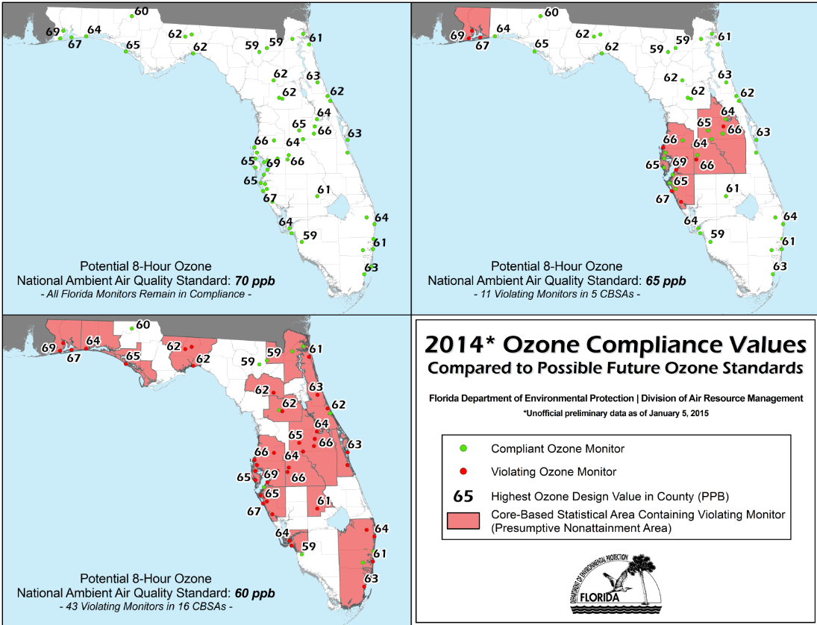

Slide 7
Mercury and Air Toxic Standards (MATS)
Purpose: Limits mercury, particulate matter, acid gases, and metals emissions from coal and oil fired power plants.
Compliance: April 16, 2015
Impact to Seminole:
SGS meets all current operational limitations in rule.
Submitted a one year compliance extension request on December 17, 2014, related to EPA’s new startup and shutdown provisions requiring compliance within 4 hours.
Notes:
Units must be in compliance with PM standard within 4 hours of sending electricity to the grid. We are evaluating whether this is possible. We will seek a waiver from this provision from the Florida DEP if we cannot.

Slide 8
Startup, Shutdown, and Malfunction (SSM)
Purpose: A “sue and settle” case between Sierra Club and EPA. EPA invalidated the State Implementations Plans (SIPs) of 36 states (including Florida) that allowed excess emissions during SSM.
Compliance: Final rule expected May 2015
Impact to Seminole:
Exemptions for SSM will no longer be allowed. Limits must be established.
All Florida utilities could be subject to citizen lawsuits and/or civil penalties unless applicable standards or limits are set and complied with for SSM.
Notes:
Florida has had an approved SIP for 40 years. SECI submitted comments in November 2014.

Slide 9
Endangered Species
Purpose: In May 2014, the US Fish and Wildlife and National Marine Fisheries Service proposed new rules to protect endangered plant and animal species and critical habitat for those species.
Compliance: Final rules expected at the end of 2015
Impact to Seminole:
Rules give broad discretion to agencies to determine critical habitat. Critical habitat would need special management and protection plans.
Currently 133 animal and 59 plant Threatened/Endangered species in Florida. National review of up to 1,200 plant and 700 animal species.
Seminole and Member cooperative land use could be impacted. Increased surveys and biological assessments would be required for current and future development.
Additional costs and time delays expected under the new rules for plant, transmission, and distribution line construction and maintenance.

Slide 10
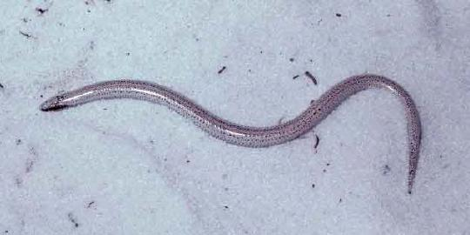
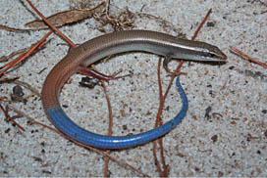
Key Species of Concern in Florida
Sand skink
Blue-tail mole skink
Caracara
Wood stork
Florida grasshopper sparrow
Red-cockaded woodpecker
Florida bonneted bat
Notes:
Currently these species are not in SECI areas.

Slide 11
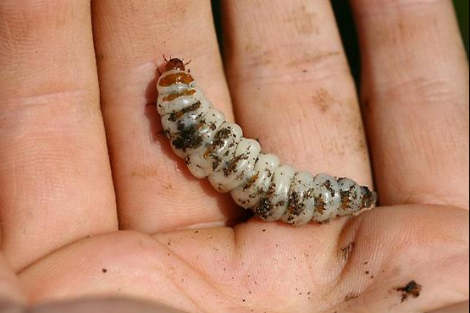
Endangered Species
Notes:
In Florida we have the Carrion Beetle

Slide 12
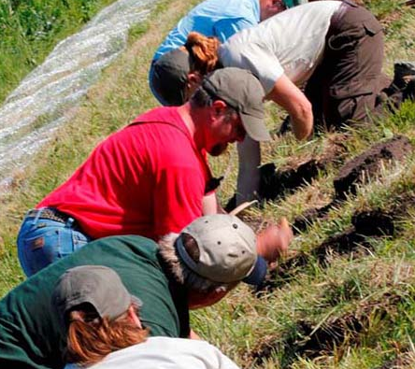
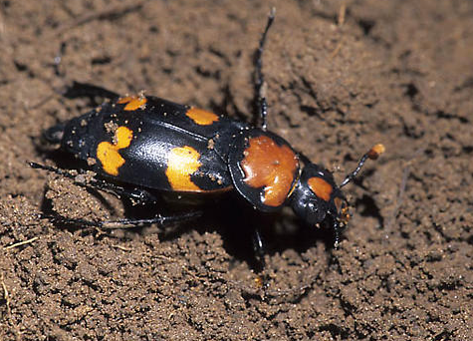
The Carrion Beetle
Notes:
US Fish and Wildlife looking for larvae. Adult Carrion beetle (Nicrophorus americanus)

Slide 13
Clean Power Plan (CPP)
Purpose: Mitigate global warming by limiting CO₂ emissions to 30% below 2005 levels from existing power plants. Florida would need to reduce CO₂ emissions by 38%.
Compliance: Final rule was expected June 2015. EPA is delaying the CO₂ NSPS (new facilities rule), which delays the existing rule. Without a new source standard you cannot have an existing standard. EPA also announced model rule or Federal Implementation Plan (FIP) for states.
Impact to Seminole:
Florida would be required to reduce emissions to an average emission rate of 794 lb CO₂/MWh in 2020 and 740 lb CO₂/MWh in 2030 . These levels would be extremely difficult to meet in a cost effective manner.
Seminole could be forced to close one or both coal-fired units at SGS.
Legal, legislative, and FERC actions may provide some relief.
Obama administration just announced actions to cut methane emissions in oil and gas industry.
Notes:
Seminole submitted extensive comments in December 2014.
Affected Sources:
Existing fossil fuel-fired boilers/IGCC
Existing natural gas-fired combustion turbines
Standards:
Does not impose limits on individual sources; Instead establishes state-specific “goals”
Goals based on four “building blocks”: 1) efficiency improvements; 2) re-dispatch to natural gas combined cycle; 3) increase renewable/nuclear; 4) demand-side management
Standards (continued):
Florida’s goal: 794 CO₂/MWh 2020-2029; 740 CO₂/MWh 2030 onward.
Goal requires 40% reduction from 2012 rates by 2030
State plans for achievement:
Proposal provides guidelines for states to follow to develop plans to meet goals
Plans due June 2016, with potential extension
State plans for achievements:
- EPA identifies variety of measures to meet goals:
Demand-side energy efficiency programs
Renewable energy standards
Improve plant efficiency
Increased use of natural gas
Energy conservation programs
Transmission efficiency improvements
Energy storage technology
Retirements
Expanding renewable or nuclear
Market-based trading programs

Slide 14
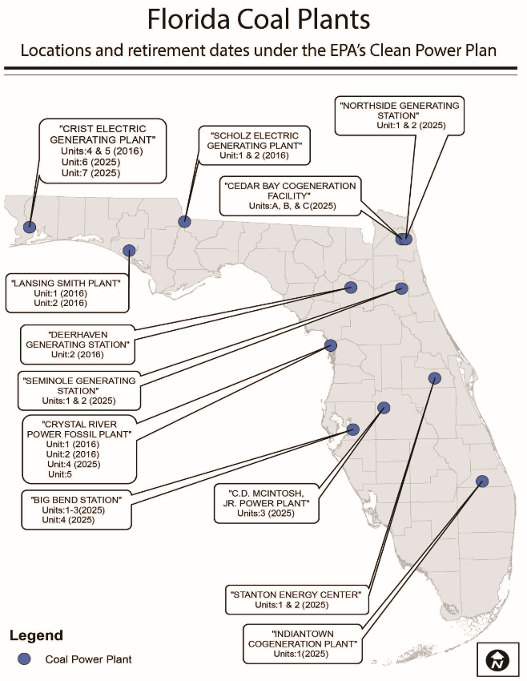

Slide 15
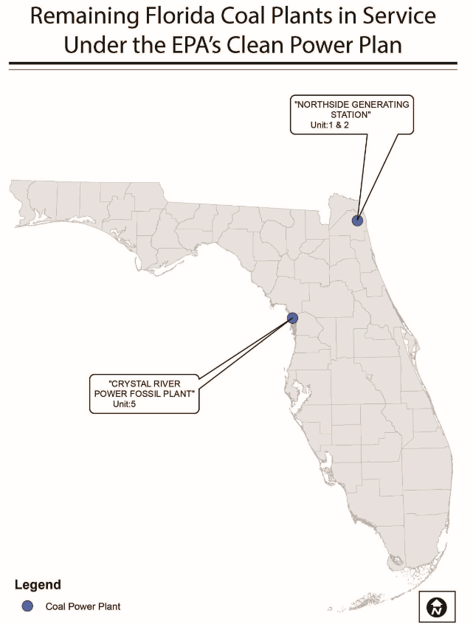
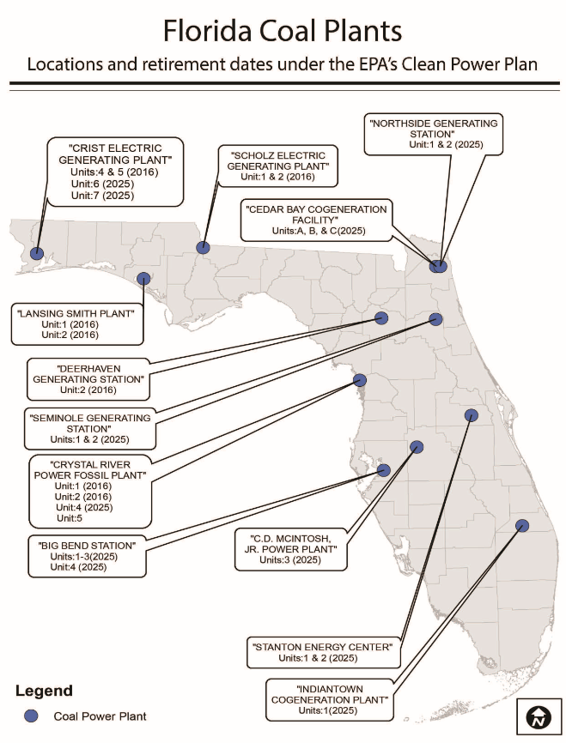

Slide 16
Waters of the United States (WOTUS)
Purpose: EPA and COE proposed rule that would expand their jurisdiction by redefining “Waters of the United States”.
Compliance: Final rule by the end of 2015
Impact to Seminole:
The rule virtually claims all water conveyances as Waters of the United States and would impose greater restrictions on lands used for transmission line corridors and plants sites.
Seminole and Member cooperatives could see increase in permitting, construction costs, and timing of projects.
Stormwater treatment facilities could be claimed and require permit revisions.
Notes:
SECI and the Florida FCG commented on this rule on November 14, 2014.

Slide 17
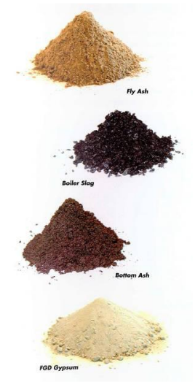
Coal Combustion Residuals (CCR)
Purpose: To develop minimum criteria for the disposal of CCRs
Compliance: Preliminary rule released December 19, 2014, compliance begins six months after final publication
Impact to Seminole:
Identifies CCR as non-hazardous waste (Subtitle D)
Establishes new definition for beneficial use/disposal
Sets minimum criteria for existing CCR landfills and Surface Impoundments and structural integrity assessments
Establishes design criteria for new landfills
Establishes Groundwater Monitoring requirements and minimum distances
Establishes Closure and Post Closure Requirements
Establishes requirement for posting landfill operating data on a public access website
Creates conflicts with Bevill amendment for certain waste streams
Rule criteria is designed to be self-implementing and enforceable through citizen suits

Slide 18
How Can You Help?
Stop the train…..or slow it down!
Derail EPA rulemaking
Switch EPA's efforts to take over the role
of legislators
Signal adverse affects on electricity rates
Notes:
Congress is not expected to act on an Energy Policy this year
- Instead, the EPA and other agencies are stepping in with increased regulation of electric companies
- The outcome could be “death by a 1000 cuts” in the absence of a comprehensive solution
With our economy still suffering, our community cannot afford steep electric bill increases due to regulation

