Slide 1
Ransomware Attack

Slide 2
Attack Timeline
October 30th
November 13th Attack
Preparation Phase
Attackers dropped the Cobalt Strike toolset on one of our servers on Oct 30th. We are not certain how they did this as we did not have logs retained back that far.
Attackers used PowerShell to execute and connect to Command-and-Control servers.
They used psexec for lateral movements across the network.
They used ipscanner to map network.
They gained access to four domain accounts; one was the domain administrator.
Disabled Exchange server so alerts would not go out.
They used copy.bat to copy their encryption executable kek.exe across the network.
They changed the password for the domain administrator.
They began running kek.exe on all of our servers and workstations on November 13th around 4 AM.
We discovered the breach around 10 AM and shut the network down.
All server files were already encrypted except for our backups which were stored on a Linux server.

Slide 6
State of the network pre-attack
Practices/Technologies in place
Multi-Factor Authentication on VPNs, Servers, workstations
Traditional Endpoint Protection
Access Control Lists on many ports
Some segmentation of subnets or networks
Active Directory Change Auditing
Password length requirements
Active Directory Policies to prevent Local and Remote Server Logins by User
Honeypots – unassigned IPs used to detect and block scanners/bots
Email Protections
Barracuda Advanced Threat scanning on attachments
Macros disabled on attachments and outlook clients
Sandboxing certain attachments before delivery
Knowbe4 Phishing campaigns and User Training
Plan in place to improve overall security

Slide 7
State of the network PRE-ATTACk
Some Technologies/Practices that were lacking
Centralized logging with retention
Threat Intelligence Feeds with Dynamic Updates
Tight egress traffic policies
Network Segmentation with Firewalling between Zones
Current hardware and Software on Routers/Switches
Overall visibility into network activity

Slide 8
Ransomware attack
Attack occurred before we could implement our Technology Improvement Plan
Game Changers
Dispatcher on duty noticed strange behavior and reported it
IT responded quickly. Discovered the encryption phase of the attack while underway
Attackers had not yet reached the actual backup data
Awesome fellow coop had spare equipment and was willing to loan.
Thanks Clay Electric!!

Slide 9
Review of incident and forensic findings
Key behaviors detected from machine images and logs
Download of malicious tools
Unusual Account Logins/Failures/Activity
Lateral Movement between workstations and servers
Suspicious usage of standard tools (LOTL)
Outbound Connections to non-business related domains and services
Encryption of Files
Newly registered domains requested or visited
Non standard ports used in requests

Slide 10
How can we detect and prevent
NTS Internal SOC (Security Operations Center) Examples
Original Challenges we wanted to solve for ourselves
Better Visibility across all Systems
Fast Search across all Logs
Correlation of Logs
Too many alerts
Better Quality Alerts (Quality = “Actionable” and “Enriched”)
Reduced Number of alerts
Automated Response to specific events

Slide 11
How can we detect and prevent
NTS Internal SOC (Security Operations Center) Approach
Researched Existing Systems
Decided to build our own and focus primarily on specific proven infrastructure
Palo Alto Next Generation Firewalls and Cortex XDR Pro Endpoint Protection
Components
Centralized logging with easy search and correlation
Actionable Alerts and Dashboards for Quick Review and Reporting
SIEM (Security Information and Event Management)
Machine Learning
Data Scientists
XSOAR – Enrichment and RESPONSE

Slide 12
Opportunities for detection
Key behaviors detected from machine images and logs
Download of malicious tools
Advanced Endpoint Protection (EDR)
Signature Based Discovery with Threat Intelligence Feeds and SSL Decryption
Unusual Account Logins/Failures/Activity
AD change detection was in place. Exchange server was down. No alerts went out.
Machine Learning
Lateral Movement between workstations and servers
Advanced Endpoint Protection (EDR)
Machine Learning
Suspicious usage of standard tools (LOTL)
Machine Learning

Slide 13
Opportunities for detection (continued)
Outbound Connections to non-business related domains and services
Machine Learning
Threat Intelligence Feeds updated multiple times daily
Encryption of Files
Advanced Endpoint Protection (EDR)
Newly registered domains requested or visited
Threat Intelligence Feeds updated multiple times a day
URL filtering
Non standard ports used in requests
Tighter Egress Filtering Policies
Machine Learning
Scan of the Network to Identify Hosts/Targets
Advanced Endpoint Protection (EDR)
Firewalls if the traffic is between zones

Slide 14
Detection is good. response is critical
Stopping the Attack
Before data is exfiltrated and all files are encrypted, damaged, or deleted
Attackers often gain access weeks before they launch the encryption phase
Attackers want Ransomware Software and Tools in place long enough to be included in backups
If Attackers are on the network long enough, there may be no usable backups that do not contain the Ransomware
After backups have been restored, the malware and covert channels activate again
Detect behaviors on the network and alert
If the behavior is serious enough, need to take immediate action until IT can properly follow up
Isolate a machine
Shut down all traffic that is not mission critical.
Disable accounts. Log accounts out

Slide 15
Recovery Plan and challenges
Forensic Analysis
Server snapshots
PC hard drives
Limited amount of server hardware for restores while performing forensic investigation
Backup restoration was time consuming
Attackers encrypted the backup server. Had to locate and install backup software before we could even confirm we had a good backup
Rebuilding workstations without typical imaging server and tools
Shout out to Suwannee and Clay Electric !!
Rebuilding firewall rules for minimal access
Difficult without written documentation
Internet access was intentionally shut down for six weeks other than accounting transactions and other critical business functions

Slide 16
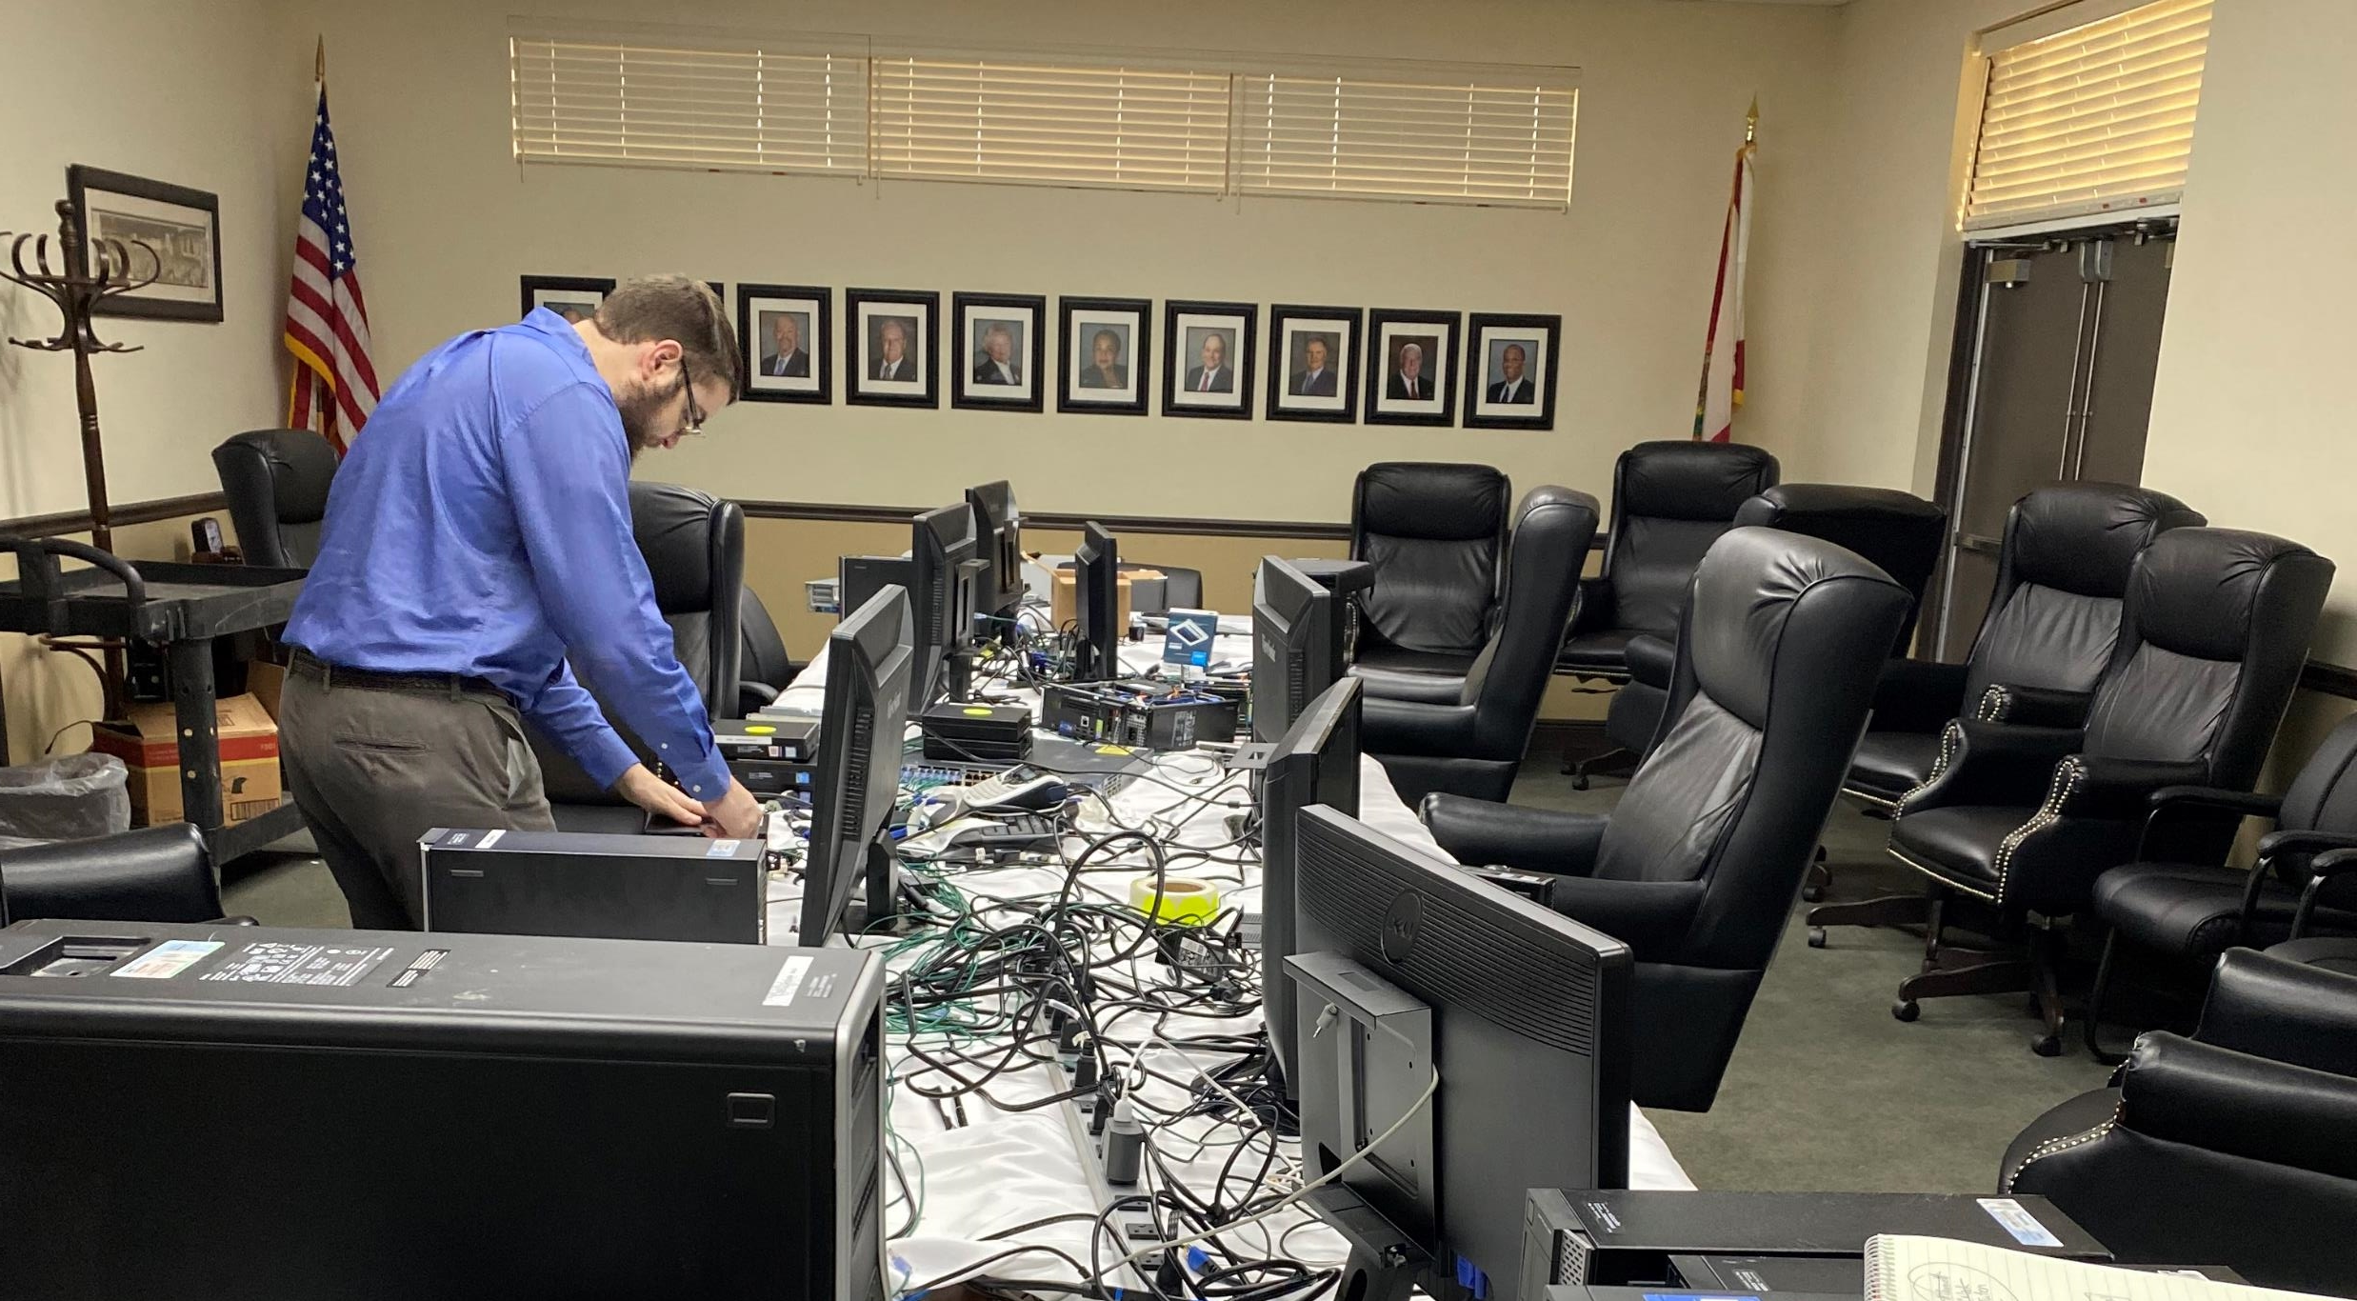

Slide 17
Moving forward: prevention
How do we PREVENT this from happening again?
What hardware and software do we need?
What changes in technology can be made?
Current Generation Endpoint Protection with Behavioral Based Prevention
True Next Generation Firewalls with Threat Intelligence Feeds updated multiple times daily
Network Segmentation
System to provide High Visibility, Actionable Alerts, and Automated Response

Slide 18
Moving forward: RECOVERY
How do we RECOVER faster?
Prevention is best, but MUST have a way to recover quickly
Backups are the Last Line of Defense
Prevent backups from being deleted or tampered with
Isolate backup server and data. Highly restricted access with multi-factor authentication
Barracuda Backups with local storage and Network Segmentation
Veeam with local storage, Immutable backups and Network Segmentation
Virtualization with Isolated Hypervisor
Fast Storage
Replication with multiple replica snapshots to revert to
Detailed Documentation

Slide 19
QUESTIONS

