Slide 1
N.R.E.C.A. Employee Benefits Update September 16, 2016
Dan Sharpe
NRECA

Slide 2
Agenda
Retirement and Group Benefits Trust Summary
Legislative Update
Retirement Security (RS) Plan Update
401(k) Pension Plan Update
Employee Benefits Website Enhancements

Slide 3
Why Does NRECA Offer Employee Benefits Programs and Services?
Our mission is to ensure that member co-ops, regardless of their size and location, have access to comprehensive, flexible and affordable employee benefit programs for current and former employees and their dependents to help them attract, retain and reward a highly skilled, dedicated and engaged workforce.
Notes:
Slides 3 - 7
NRECA is in the employee benefits business because our members have directed us to do so from the early days of seeking coverages when insurance carriers didn’t readily recognize the “co-op business model” through today where we continue to offer these programs at cost with no profit margin and no commissions. This is standard operating procedure across our three major trusts. NRECA is member driven with defined member resolution process directing the association on where to focus time and resources.

Slide 4
Retirement and Group Benefit Summary
Retirement Security Plan (Defined Benefit Pension Plan)
Over 850 co-ops with over 55,000 individual participants
$8.0 billion in net assets (12/31/2015)
401(k) Pension Plan – (Employee “Pretax” Savings Plan)
Over 900 co-ops with nearly 60,000 individual participants
$8.1 billion in net assets (12/31/2015)
Group Benefits Program – (Health and Welfare Benefits)
Nearly 900 co-ops with over 150,000 individual participants & dependents

Slide 5
Member Resolution: Health Care
We support policies that ensure all member co-ops, regardless of their size and location, have access to affordable comprehensive and flexible health care and insurance programs for current and former employees and their dependents.
We urge NRECA to explore opportunities to contain the rising premium cost of its’ group medical program, fully recognizing that tradeoffs in the level and quality of service may be necessary. We further encourage NRECA to continue to operate a national health insurance program for our membership. We also urge NRECA to ensure the continuation of a structure under the Internal Revenue Code that allows for it to provide a nationwide group medical plan.

Slide 6
NRECA’s Partnership with UnitedHealthcare
Overall usage of in-network providers and in-network discounts (for PPO plans)
2013 = 89% in-network & 32.1% discounts
2014 = 92% in-network & 44.5% discounts
2015 = 93% in-network & 45.5% discounts
Total discounts for NRECA Medical Plan
2013 = $205.0 million
2014 = $303.5 million
2015 = $327 million*
*This number will grow as 2015 dates of service are paid in 2016
Notes:
NRECA’s partnership with UnitedHealthcare continues to provide deeper discounts for co-ops, more in-network utilization and increased savings for the NRECA Medical Plan.

Slide 7
Member Resolution: Employee Retirement Benefits
We urge NRECA to support legislation to protect the ability of co-ops to offer the Retirement Security Plan and support policies which would provide opportunities and protect our employees’ ability to save for their retirement through 401(k) plans and other investment vehicles.
We urge NRECA to study alternatives to help reduce the cost pressures faced by electric co-ops participating in NRECA’s defined benefit RS Plan.

Slide 8
Legislative Success Recap
Cooperative and Small Employer Charity (CSEC) Pension Flexibility Act
Permanently exempts RS Plan from the funding rules of the Pension Protection Act (PPA); previous exemption to 2017
Permanently applies the pre-PPA funding rules to the RS Plan without the Deficit Reduction Contribution (DRC)
Pension Provisions included in the Consolidated and Further Continuing Appropriations Act, 2015
Preserves quasi-retirement feature before age 62 in 30 year Plans
Applies to those hired prior to 2017
For those hired after 2016, quasi-retirement only at or after age 62
Notes:
Here are some examples of NRECA’s recent significant legislative successes. NRECA has a dedicated, full-time employee benefits lobbyist who is constantly working behind the scenes to be ready to move quickly when small windows of opportunity appear to enact legislation. In today’s highly partisan environment, those opportunities have become exceedingly rare.

Slide 9
Affordable Care Act - “Cadillac Tax” Update
Omnibus Government Spending Law includes
Two-year delay until 2020
Provides two more years to pursue full repeal
Notes:
Full repeal in 2015 would have cost $91 Billion (over 10 years).
Two-year delay “only” cost $16 Billion

Slide 10
Retirement Security Plan Update

Slide 11
30 Year Plan Changes
For employees hired after January 1, 2017, the IRS will no longer permit “in-service” withdrawals from defined benefit pension plans with service-based retirement designs.
This rule does not affect plan designs with age-based full retirement dates (e.g., RS Plans with normal retirement ages of 60, 62 or 65).
Existing employees in NRECA’s RS 30-year Plan will be grandfathered and maintain the ability to quasi retire with 30 years of service.
Employees hired after January 1, 2017, will not be able to quasi retire until they reach age 62 (even if their RS Plan participation exceeds 30 years before age 62).
Notes:
PLEASE ONLY SHOW THIS NEW RULE TO CO-OPS WITH 30 YEAR PLANS.
Things you need to know about Retirement Security Plan modifications and options rolling out starting January 1, 2017 and continuing throughout 2017. There is also a webinar recording available if they have additional questions.
Most co-op retirees are covered by 2 pension plans. For those that are covered by both, explain how powerful the combination is: security of db and growth opportunities of dc even if the new hire can’t QUASI after 30 years of service.

Slide 12
RS Plan Update: Distribution Opt-Out
Lump Sum Option
QUASI Option
Notes:
In the future, NRECA will offer co-ops the choice to remove the lump-sum and/or quasi-retirement distribution options from the RS Plan.
These new plan options will be available after NRECA completes its large-scale computer system conversion.
Each co-op will have the option of removing the lump-sum or quasi-retirement features — but only for future earned benefits — or doing nothing (i.e., keeping both distributions as is).
Due to federal rules, the lump-sum and quasi-retirement options cannot be rescinded retroactively for benefits earned prior to the effective date of the change.
Current employees still would receive RS lump-sum and/or quasi-retirement benefits on amounts accrued before the effective date of any change to the RS Plan (if elected).

Slide 13
Recent Co-op RS Plan Change Statistics
Across approximately 850 participating co-ops
2%-3% make formula changes for existing participants each year (60% involve reductions in the formula)
About 2% each year elect to create a new (generally lower) benefit level for new hires going forward
Under 1% each year elect to change retirement age
Notes:
Bring the financial discussion back up to specifics relative to recent changes in types of retirement distributions selected by participants and the fairly constant high level of tire kicking (researching potential plan changes) versus actually implementing individual co-op RS Plan changes on an annual basis
Additional Stats:
Over the past 5 years:
6 froze their benefit formula (3 full group; 3 partial/subgroup)
6 withdrew from the RS Plan (3 as of 1/1/2012; 3 as of 1/1/2015)
11 added the RS Plan (6 transferred in over $25 million)

Slide 14
1/1/2015 Financial Results
Funded ratio (market value of assets divided by actuarial liabilities):
3% increase in base contribution rates for 2016
8-month accelerated billing continues
 | Without Prepayments | With Prepayments
2015 | 73% | 96%
2014 | 79% | 105%
2013 | 70% | 94%
Notes:
Slides 22 – 25
And what would an accounting conference presentation be without taking time to talk about “Funded Ratio”, “Annual Actuarial Valuation”, “Investment Returns”, “Inversion Relationship of Interest Rates and Lump Sums” and high level billing rate considerations.

Slide 15
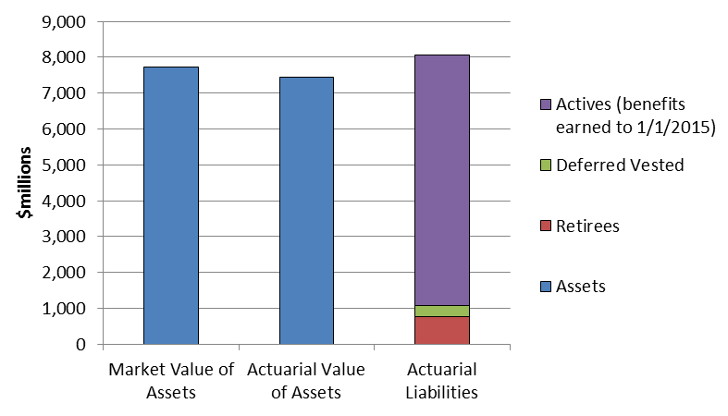
1/1/2015 Assets and Liabilities
96%
Notes:
AAV very important for dampening volatility
Low retiree ratio also very important for reducing volatility

Slide 16
Key Factors Affecting Funded Status
RS Plan investment return
Interest rates
Notes:
Two main factors are uncontrollable and recently have resulted in driving contributions to current levels:
RS Plan Investment return – lower funded levels over the last several years primarily result of:
large investment losses in 2008
September 2001 related disruptions
bursting of the tech stock bubble
Before 2001 and after 2008 average returns were more in line with assumed rate of return.
Interest rates – due to Federal Reserve actions and the slow recovery from the Great Recession, rates declined, increasing pension liabilities
much less a concern due to CSEC legislation
These factors are uncontrollable and recently have resulted in driving contributions to current levels.
During “moratorium” years, these were positive factors for the RS Plan… while we had less investment volatility PLUS higher interest rates. With improved economic conditions, RS billing rates can show a decrease.
We are not in a permanent economic condition – we might have gotten to a low point recently, but look back to see how different things could be.
Lets look at historical data to show where these factors have been and where they could be heading.

Slide 17
Notes on Interest Rates
Funding of RS Plan is based on assumed 7.75% interest rate
Lump sum payments are directly impacted by current interest rates
Increasing interest rates also impact the value of investments
Notes:
Funding of RS Plan is based on assumed 7.75% interest rate
Used to determine plan liabilities
Current interest rates do not directly impact funding
Lump sum payments are directly impacted by current interest rates
1% increase in interest rates reduces lump sum by about 10-12% (for person age 62)
Increasing interest rates result in lower annual lump sum payouts to retirees
Increasing interest rates also impact the value of investments
Decreases value of fixed income investments
Also can impact equity valuations
EXIT – lets look at how asset returns and interest rates impact billing rates

Slide 18
RS Plan Investment Return History
Year
Return
Year
Return
2015
-2.1%
1998
13.8%
2014
6.6%
1997
21.4%
2013
20.2%
1996
16.0%
2012
13.4%
1995
26.0%
2011
1.3%
1994
-0.1%
2010
12.1%
1993
15.9%
2009
26.4%
1992
9.7%
2008
-27.2%
1991
21.1%
2007
4.9%
1990
-0.9%
2006
14.9%
1989
21.1%
2005
8.6%
1988
16.3%
2004
13.3%
1987
3.0%
2003
23.7%
1986
23.9%
2002
-6.6%
1985
26.0%
2001
2.2%
1984
6.0%
2000
7.3%
1983
18.4%
1999
5.8%
1982
24.2%
Negative
Positive but less than assumed
Greater than assumed 8% (pre-2015) & current 7.75%
Notes:
Important Note on Slide:
The actuarial return of 7.75% was changed in 2014. It was previously 8%.

Slide 19
Billing Rate Considerations
Funding rules used by plan to determine contributions promote stability
Low proportion of inactive participants lessens volatility of contributions
Probability of large asset losses is very low
Assets have always recovered to prior levels
Co-ops have the ability to modify plan benefits permanently or temporarily to reduce cost pressures
Notes:
Funding rules used by plan to determine contributions promote stability
Methods used smooth any adverse experience over a long period
CSEC made the methods used by RS Plan permanent, and removed DRC rules
PPA maximum funding rules allow much higher funding levels than in the past
Low proportion of inactive participants lessens volatility of contributions
Probability of large asset losses is very low
In each of the next 10 years, the probability of a large contribution increase like the one experienced in 2010 (35% increase) is very low (under 1% chance in any particular year)
Assets have always recovered to prior levels
Co-ops have the ability to modify plan benefits permanently or temporarily to reduce cost pressures - Co-ops can amend their plan with an effective date 3 months from now
DRC= Deficit Reduction Contribution; PPA = Pension Protection Act

Slide 20
More Billing Rate Considerations
Asset returns exceeding the expected 7.75% long term assumption is a key determinant of lower future billing rates
Increased interest rates should result in cost savings from lower lump sum payouts
A change in the IRS required mortality assumption for lump sum determination would increase costs
PBGC recently increased insurance premiums for DB plans
Notes:
Asset returns exceeding the expected 7.75% long term assumption is a key determinant of lower future billing rates:
(2.08%) RS Plan Trust asset return in 2015
Increased interest rates should result in cost savings from lower lump sum payouts
A change in the IRS required mortality assumption for lump sum determination would increase costs:
Society of Actuaries released new mortality tables
Retirees expected to live longer in the future, which increases liabilities
PBGC recently increased insurance premiums for DB plans
NRECA working with congress to enact relief for multiple-employer plans like the RS Plan
Small part of overall annual contribution, but still a significant premium

Slide 21
401(k) Pension Plan

Slide 22
401(k) Pension Plan: Expense Comparison
Employee Fees:
Charged through fund expense ratios
2014 Weighted Average Expense Ratio: 0.36%
Employer Fees:
Billed annually or quarterly 0.14%
Total Plan Fees: 0.50%*
From the 401(k) Book of Averages (thru 9/30/2014):
Average fees for a plan with 50 employees and $500K in assets: 2.29%
Average fees for a plan with 2,000 employees and $20 million in assets: 1.27%
*Approximate employer expenses based on account balances of active employees only.
Notes:
Slides 32 – 33
There are still more numbers to cover within this accounting conference. Review of 401(k) fees and the significant benefits to plan participants, including retirees. (Again, this plan is made available at cost. In this case, total fees charged are less than one-half of the fees charged by other plan administrators.)
If questions arise about “employer fees”, our vetted response is:
NRECA bills participating cooperatives directly for a portion of the 401(k) Pension Plan’s administrative expenses (including but not limited to recordkeeping, legal, compliance, communications, and education, etc.) based on assets under management for active employees. The expense of the 401(k) Plan is viewed as a shared responsibility between the employer and participants. The direct employer billing helps keep expenses paid by participants through the fund expense ratios comparably low.
Employer fees have been in effect since 2011. They were split out at that time with a concurrent reduction in the fees paid by participants in net returns earned by their individual 401(k) plan selections.

Slide 23
Impact of Fees on Retirement Income
Hypothetical investment of $5,000 per year over 35 years at 8%.
Expense Ratio
Retirement income is assumed to begin at 4% of total account balance.

Slide 24
We Are Here to Help You
Provides group education and one-on-one guidance
Experienced noncommissioned planners
Specialize in the needs of electric co-op employees and retirees
_{866.673.2299}
_{(option 6)}
_{pirc@nreca.coop}
Notes:
Our financial planners in Personal Investment and Retirement Consulting (PIRC) are available for all retirement plan participants at no additional cost to the co-op or to active employees and retirees in either or both retirement plans.
PIRC provides financial education and guidance through:
group seminars
one-on-one consulting
written financial plans
Last year alone PIRC held 667 onsite co-op financial seminars and one-on-one sessions and produced a total of 562 plans written asset allocation and retirement plans.

Slide 25
Employee Benefits Website Enhancements
My Benefits

Slide 26
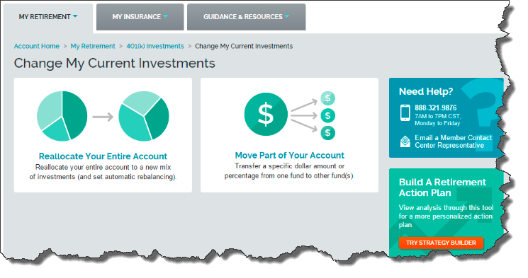
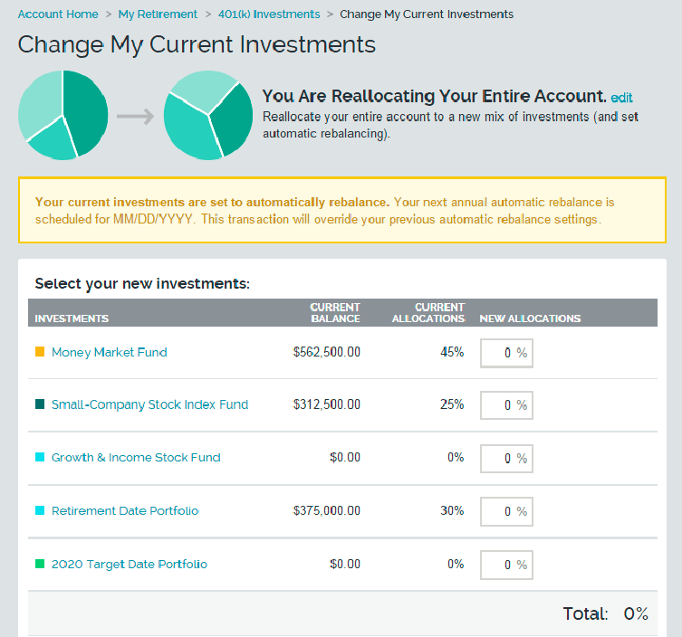
Coming this Year for Participants: Enhanced 401(k) Experience
Guided navigation
Visually enhanced design
Preview changes before sending

Slide 27
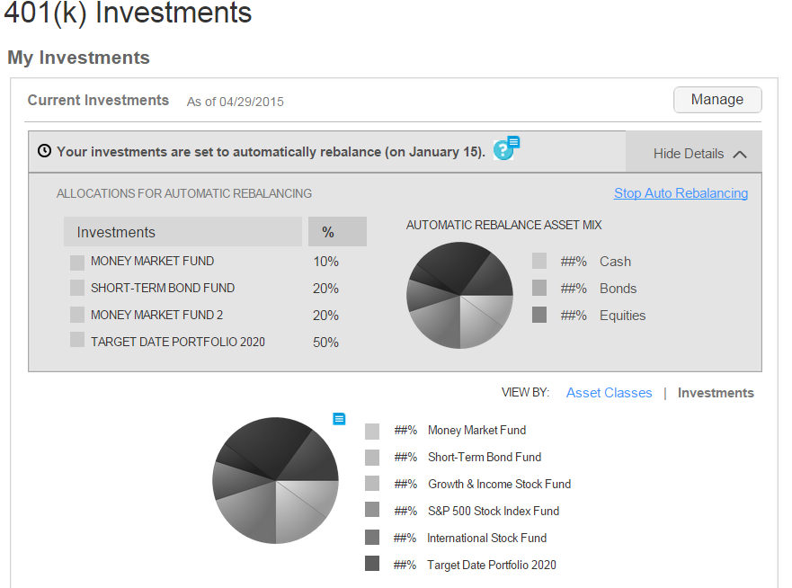
Screens Enhanced with Auto-Rebalancing Feature
Notes:
Automatic Rebalancing Feature:
Enables participants to maintain their desired asset allocations of cash, bonds, and equities over time
Ability to implement auto-rebalancing feature available from
Auto-Rebalance home page
Rebalance Entire Account screens
Change Future Contribution Allocations screens

Slide 28
2017 11/15 Salary Collection Changes
Beginning in September, 2017, new 11/15 salary collection screens will include improved job code lists and categories
New file formats will be coming
Notes:
One final heads up relating to a 2017 change – enhanced “job code” information and request to update job codes through new, enhanced 11/15 salary collection screens for distribution cooperatives…more to come in the near future.

