Slide 1


2016 SHRM Conference
Conducting an Internal Affirmative Action Plan Audit
Neil Dickinson
Managing Partner
HudsonMann
www.hrfloridaconference.org

Slide 2
Why Conduct Internal AAP Audit
2016 SHRM Conference
Audits with violations have increased from 15% to 30% in four years
Compliance reviews are more time intensive with more data requests
AAP compliance has financial risk (over 12 million in financial remedies)
New Veteran and IWD regulations & New Audit requirements

Slide 3
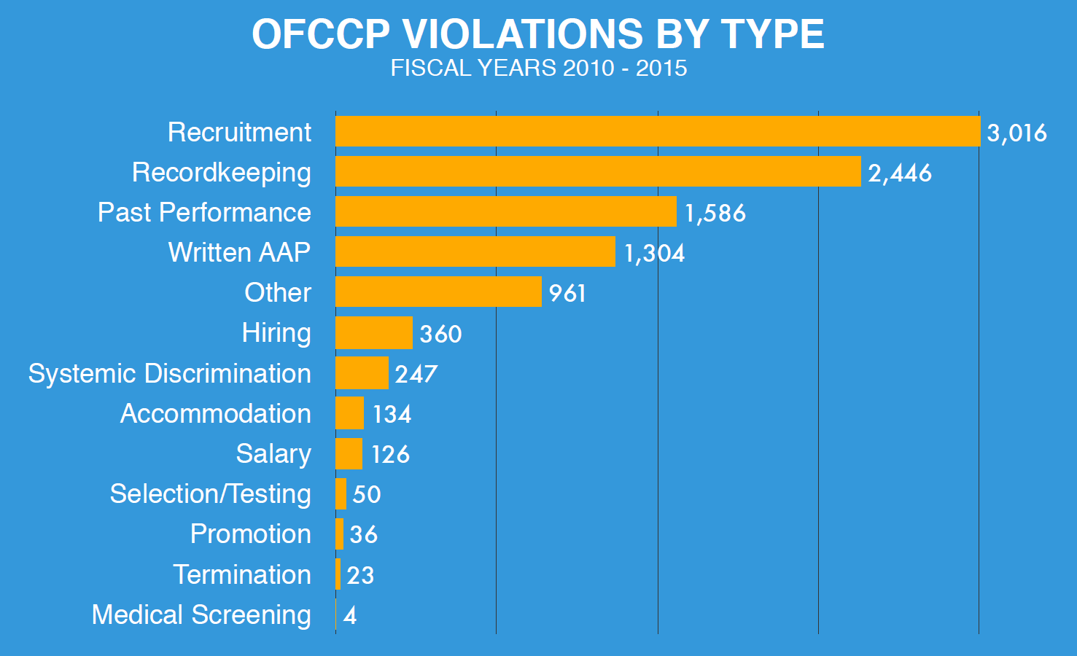
2016 SHRM Conference

Slide 4
of financial remedies are from hiring discrimination
2016 SHRM Conference
80%
FY 2014
Notes:
These analyses include a utilization analysis for individuals with disabilities with a goal of 7%

Slide 5
Will I be Selected!?!
2016 HR Conference
EEO-1 reports
Past audits
New Federal Contracts
Employee/Applicant Complaints
Compensation Surveys on the horizon

Slide 6
Know Your OFCCP Office
2016 SHRM Conference
6 regional offices
51 district offices
OFCCP Locations Link:
http://www.dol.gov/ofccp/contacts/ofnation2.htm
Federal Contracts Compliance Manual Link:
http://www.dol.gov/ofccp/regs/compliance/fccm/fccmanul.htm
OFCCP training
Industry Liaison Groups

Slide 7
Scheduling Announcement
2016 SHRM Conference
Addressed to President/CEO
Opportunity for Self-Audits and Corrective Action
Letter of compliance review notification normally comes 3 weeks – 8 weeks later

Slide 8
Initial Submission
2016 SHRM Conference
30 days from receipt of data
Current Year’s AAP
Prior Year’s Analyses
Update of analysis if you are 6 months or more into plan year
3 years of EEO-1 reports
Compensation Data

Slide 9
Required in AAP
2016 SHRM Conference
Narrative for Women and Minorities, Veterans, Disabled
Job Group Analysis
Availability Analysis using 2010 Census (Current Year Only)
Utilization Analysis/Establishment of Goals
Workforce Analysis (Current Year Only)
Report on Goals
Activity for New Hires, Terminations, Promotions (Broken out by racial categories)
Benchmark Analysis for Veterans
Utilization Analysis for IWDs

Slide 10
AAP Presentation
2016 SHRM Conference
AAP should be a professional and well organized document.
First impressions count with OFCCP

Slide 11
Beef UP Initial Submission
2016 SHRM Conference
Good Faith
Efforts
VETS-4212
Job listing
samples
Online
Accessibility language
Job ads
w/ EEO statement
Purchase
Order

Slide 12
Mock Audit Priorities
2016 SHRM Conference
Your Hiring Process
Compensation Systems
Recruiting Outreach

Slide 13
Avoid Common Violations
2016 SHRM Conference

Slide 14
Posting With State
Workforce Agencies
2016 SHRM Conference
All non-senior level jobs should be posted in state where job originates
Jobs lasting three days or less and those filled internally are excluded
Ensure ability to document
Monitor third parties

Slide 15
Applicant Self- ID
Process
2016 SHRM Conference
Must allow applicants to Self ID race,gender, disability and veteran status
This data should be maintained for three years
1 to 1 applicant to hire ratio is red flag
Ensure compliance of external recruiters and temporary agencies

Slide 16
Documenting Outreach
2016 SHRM Conference
Areas of underutilization for
minorities /females
Veteran outreach
Disabled outreach

Slide 17
Documenting Outreach
2016 SHRM Conference
Outreach in local areas you recruit
Specific to the jobs you have
Engage OFCCP as needed
http://www.dol-esa.gov/errd/index.html#search
Monitor and document results

Slide 18
Sample Audit of Outreach
2016 SHRM Conference
Does recruiting know where we have goals for women and minorities? Do we have job specific outreach for these areas of underutilization? Is this outreach documented?
Do we have 2 or 3 ongoing recruiting efforts for disabled and veteran applicants? Is it documented?

Slide 19
Monitor Discrimination Indicators
2016 SHRM Conference

Slide 20
Failure to Hire and Adverse Impact
2016 SHRM Conference
Monitor adverse impact in AAP by job group using 2 standard deviations
Ensure definition of applicant is used
Maintain disposition codes
Retain applications and supporting hiring materials
Use standardized and documented hiring process

Slide 21
Failure to Hire and Adverse Impact
2016 SHRM Conference
Know minimum qualifications for job
Focus on entry level positions
Monitor steps of hiring process that may have barriers
Beware of poorly defined filters that may be seen as discriminatory “Not a Good Cultural Fit”

Slide 22
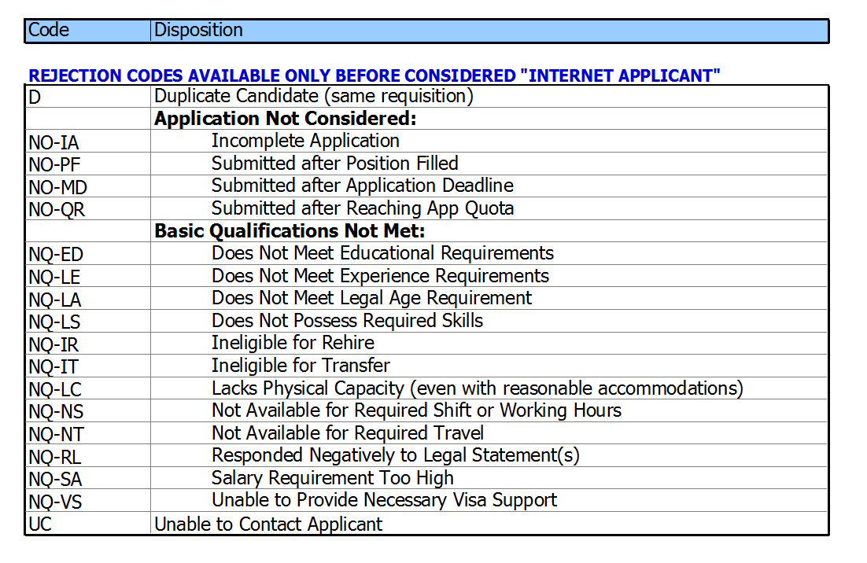
2016 SHRM Conference

Slide 23
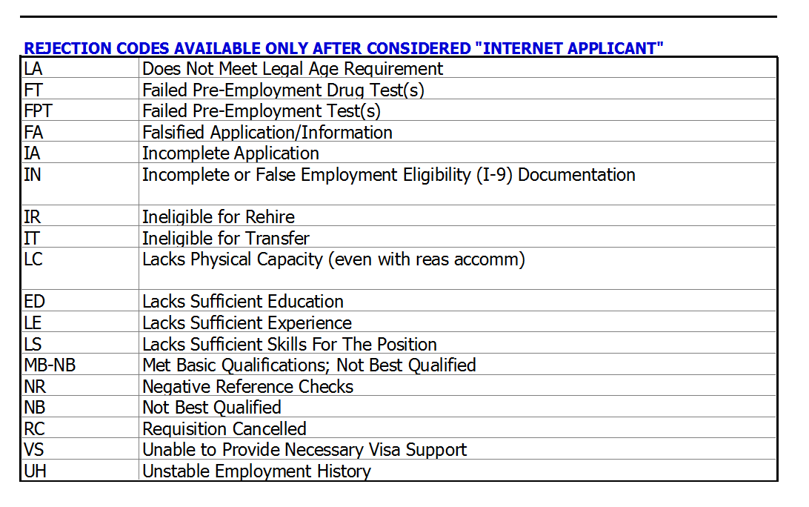
2016 SHRM Conference

Slide 24
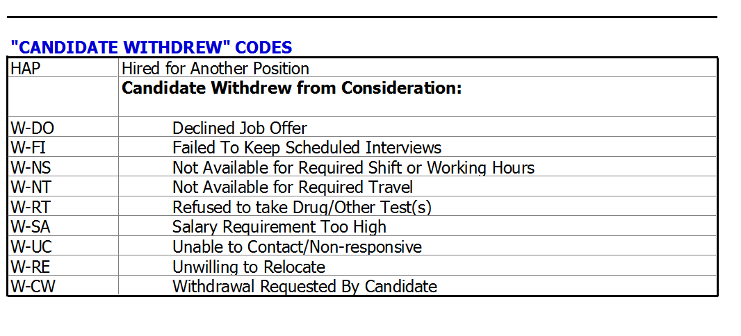
2016 SHRM Conference

Slide 25
Sample Audit of Hiring Process
2016 SHRM Conference
Do I have good pools of candidates in my applicant logs? No are few issues of 1 to 1 hire to applicant ratios.
Are my open positions being posted with State Workforce agencies? Can I document this?

Slide 26
Sample Audit of Hiring Process
2016 SHRM Conference
Do my hiring managers use the same process? Can they communicate that process uniformly? Are processes in writing and thoroughly documented?
Verify disposition codes are being used correctly? Does disposition code match application?
Do we use tests? Do they test for qualifications required for job? Have they been validated

Slide 27
2016 SHRM Conference
Internal Pay Equity
Government spotlight on compensation practices: Lilly Ledbetter Fair Pay Act
Is your compensation consistently driven by transparent business factors
Can you explain differences in pay
for employees in the same job

Slide 28
2016 SHRM Conference
Internal Pay Equity
Review Job Descriptions
Run Internal Pay Analysis
Be able to defend and document differences in pay at job title level

Slide 29
2016 SHRM Conference
Compensation Submission
Job Title
Time in current position
Time with company/date of hire
Date of birth or last degree earned
Part Time/ Full Time
Geographic Location
FLSA Status
PT/FT
Bonuses or Other Paid Allowances
Other factors that influence compensation in your system

Slide 30
2016 SHRM Conference
Compensation Submission
Employee Level Compensation for all employees on payroll including contract workers
Data should coincide with workforce analysis (1st day of new plan year)
Employee ID
Gender
Race/Ethnicity
Job Group
Job Title
Hire Date

Slide 31
2016 SHRM Conference
Required Compensation
12–month period preceding the date of the analysis:
Base Salary/Wage Rate
Hours Worked in Typical Week
Bonuses
Incentives
Commissions
Merit Increases
Overtime

Slide 32
2016 SHRM Conference
Optional Submission Factors
Education
Experience
Location
Performance Ratings
Department/Function
Merit Increases
Pay band/level/grade
Others not listed: Job Status, Shift Differential, Time in Position, Work Contract, People Managed, Certifications

Slide 33
Sample Audit of Compensation
2016 SHRM Conference
Is compensation clearly defined at my organization? Are our systems in writing and documented?
Sort your workforce by job title and then by pay? Can you explain and document why employees are at the top of the bottom of job title pay? Are certain groups consistently showing up at the top or bottom of pay in a job title?

Slide 34
Pay Transparency Act- Contractor Checklist
2016 SHRM Conference
No adverse actions against non-protected employees and applicants who discuss their compensation or their co-workers compensation
No company formal or informal pay secrecy policies that forbid or restrict disclosing compensation
Identify employees who’s essential job function includes compensation and update job descriptions as needed
Updated EO Clause (no change to reference)
Updated EEO is the Law Poster
Add Pay Transparency Policy Statement to Employee Handbook

Slide 35
2016 SHRM Conference
New Regulations for Veterans and Individuals with Disabilities
EEO Policy should incorporate top US Executive
EEO Poster accessible for online applications
EO Clause on Purchase Orders and Contracts updated
EEO Policy notification to vendors and subcontractors
Spell out Disabled and Veteran in M/F/D/V Job Postings

Slide 36
2016 SHRM Conference
New Regulations for Veterans and Individuals with Disabilities
Begin using new Vet codes and allow applicants to identify
Allow applicants to identify disability status
Set veteran benchmarks (8%)
Set disability benchmarks (7%)
Track disability and veteran hire rates using applicant logs
3 year retention period
Continued focus on veteran/disabled outreach

Slide 37
Mock Audit Walkthrough
2016 SHRM Conference
Is my AAP complete?
Do I have any adverse impact?
Is my hiring process consistent and well documented?
Do I feel comfortable defending pay differences within a job title?
Have we performed specific and local outreach for where we have goals for minorities and/or females?

Slide 38
Mock Audit Walkthrough
2016 SHRM Conference
Have we performed specific and local outreach for veterans and disabled?
Have we posted with state agencies and have the ability to document?
Is our website disabled accessible?
Is our workplace disabled accessible?
Do our managers know that we are an AA employer and understand their documentation responsibilities?
Do we have EO postings and required language in POs and contracts?
Have we implemented new regulations?

Slide 39
2016 SHRM Conference
We’re happy to be a resource.
Neil Dickinson
ndickinson@hudsonmann.com
843.884.5557

