Slide 1
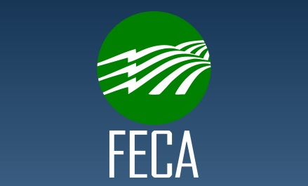
Brian Grogan
Account Executive
Notes:
Hello and thank you for allowing me to provide with you a brief update on what has been going on at your insurance cooperative.
Staff – Brian Grogan/Nathan Worsham
Board – Wayne Livingston, CEO, Diverse Power, GA / Mendel Stone, Director, Blue Ridge Electric, SC

Slide 2
Financials as of June 30, 2016
Company Financials
Combined Ratio
95.3%
Company Margins
Allocated in 2016
$32.6 M
Paid in March 2016
$7.7 M
Assets $531.4 M
Surplus $179.2 M
Notes:
Total assets are just over ½ Billion Dollars, and total $531.4 million.
Surplus at 6/30/16 was $179.2 million.
Federated’s combined ratio at June 30, 2016 was 95.3 percent, with total margins from 2015 allocated of $32.6 M, and $7.7M of margins retired in March 2016.
Federated is truly in the best position it has ever been and, rest assured, they are financially able to weather some pretty significant storms on your behalf, should the need arise. However, we can’t rest on our laurels. We do need to continue to maintain our focus on safety and do our part to further these safety efforts.

Slide 3
Company Margins
Notes:
Because you are a member of Federated, you directly benefit from the long-term financial stability of your cooperative owned and directed property and casualty insurance company.

Slide 4
Margins Returned in Florida
Notes:
Now, I would like to turn my attention to what Federated’s success means to you directly! As previously noted, we have allocated $235.0 million back to our members since becoming a reciprocal exchange back in 1999.
Margin allocations to our Florida members in March equaled $2,059,091, which brings our total allocations to Florida alone to $12,769,149.
The cash payment we made to our Florida members in March is $371,623, which brings the total amount returned to our Florida members in cash since we began writing in Florida in 2004 to $3,444,277.
This is great news. However, it’s important to note, Federated’s goal of operating at or below a 100% combined ratio is not just about margins, it’s about keeping people safe and on the job.

Slide 5
Margin Allocations as a % of ARB PREMIUMS
2013  $31.4M • 31.9%
2014  $34.1M • 27.5%
2015  $32.6M • 22.8%
of ARB Premiums
of ARB Premiums
of ARB Premiums
Notes:
Margin allocations that Federated just made in 2016 equaled 22.8% of everyone’s 2015 ARB premiums.
Add to that the fact that 78% of our members saw premiums either remain flat or go down in 2015, and you can see that it is working…members are seeing real financial benefits from these claims reductions!

Slide 6
Claim Counts
Notes:
You’ve seen this chart before. I’ve used it quite regularly over the past year to illustrate what Federated has seen as a direct result of everyone’s efforts to instill a culture of safety at their systems. When you talk about something like this, you really hold your breath that the following year doesn’t take a turn for the worse. Well….let’s see what happened…

Slide 7
Claim Counts
Notes:
More great news! 2015 proved to be another great year. We simply can’t thank you enough for all of your efforts to continue to reduce incidents and accidents at your systems. 2015 numbers represent a 28% reduction in claim counts since 2007!
Not only do these reductions result in fewer injuries and saved lives, but they also translate into some real, tangible financial benefits for all of our members.

Slide 8
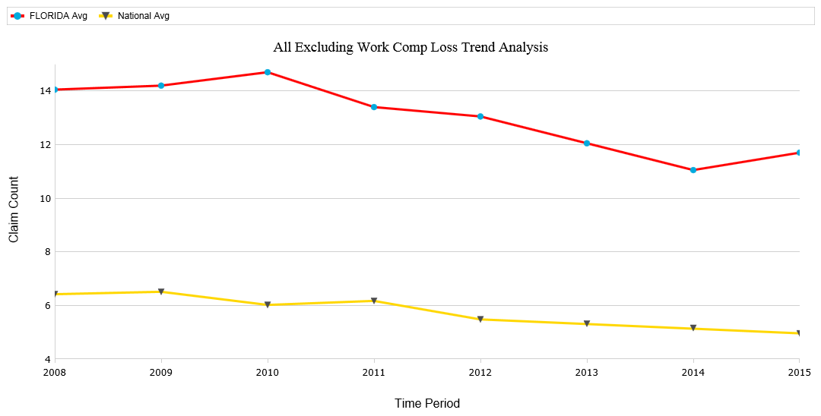
Florida Average vs. National Average* *Graph Includes All Federated Members
Notes:
Looking just at Florida’s average total losses per co-op for all lines of business except WC compared to all Federated members, things don’t appear to be very good. To see how your system compares to these trends, log in to www.federatedrural.com and view the Loss Trend Analysis report. You can compare yourself to these national numbers for all systems, and adjust the criteria to see how you compare to other systems of similar size.

Slide 9
Cyber Liability Coverage
NOW AVAILABLE
Some of the coverages that are included:
Transmission of malicious software or viruses
Privacy or security breaches
Including notification and credit monitoring expenses
Regulatory fines and penalties associated with a breach
Liability coverage related to electric utility operations
Data restoration, cyber extortion and cyber terrorism
Forms and rates have recently been approved!
Notes:
Florida was launched on June 13, 2016. Almost 1/2 of our Florida members have obtained a quote. (7 applications, 4 written)
Florida has a maximum $1M indemnity plus $1M defense limit on our endorsement – higher limits available through NetGuard application
Remember, even having just the minimum limits in place gains you access to forensic, IT and other cyber specialists should a breach occur!

Slide 10
Hazard Recognition
Notes:
This may not look bad. However, with no chain securing this gate, someone could easily push their way through…

Slide 11
Hazard Recognition
Notes:
Can you see what’s wrong here? There may be a warning label or two missing…

Slide 12
Hazard Recognition Vegetation Management?

Slide 13
Hazard Recognition Could you open this for me, please?
Notes:
Cable and telephone companies aren’t always so thoughtful when placing their pedestals and equipment…

Slide 14
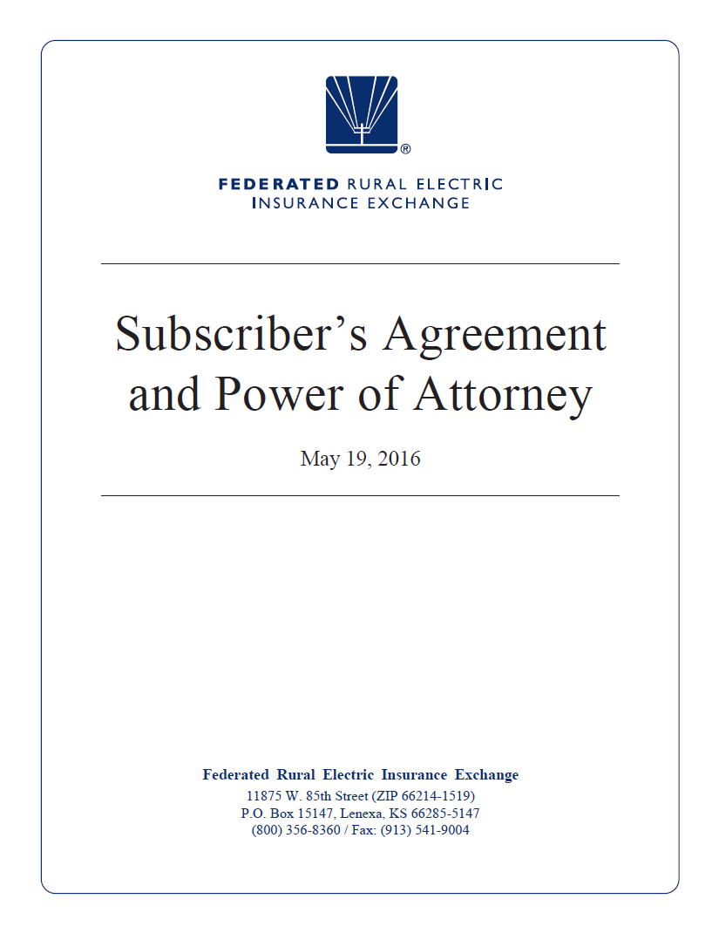
New Subscriber’s Agreement

Slide 15
Near Miss Reporting
Notes:
To close, I’d like to highlight one additional new program that Federated launched this past September. Phil talks about our claim counts declining, as I showed you earlier. However, he is constantly looking for ways to improve on these reductions even more.
We all know about the incidents and accidents that happen. They are typically reported to us as claims, which allows us to summarize and use this information to learn from. However, a bigger, more elusive piece of this puzzle are those incidents that don’t turn into an actual claim. Those near-misses that happen every day and may not get reported to anyone. How do we learn from those? We’re hoping that through this near-miss program, our employees will have the opportunity to either report anonymously or with full disclosure those near-misses that they experience. Our goal is to provide this information back in summary form to our members and statewide organizations across the country to assist them in better guiding their employee safety training efforts.
If you already have a near-miss reporting program at your system, we encourage you to keep doing what you are doing, with one additional step…whoever is responsible for tracking this information at your system, if they could also enter this information on Federated’s website, that would allow us to share this information with the rest of our members making an even greater impact. Anything we can do to make sure our employees and our members go home safely to their families every night is what these efforts are all about.

Slide 16
Thank You and Be Safe!

