Slide 1
State of the Industry’s Resources and Recruiting Best Practices
Scott A. FRY
Managing DIRECTOR – Mycoff, Fry & Prouse LLC
2015 feca Human resources CONFERENCE

Slide 2
Mycoff, Fry & Prouse LLC:
Based out of Colorado, but recruit from coast to coast with utilities.
Over 80 years of experience recruiting in the utilities and energy market.
Around 130 CEOs recruited over the past 40+ years.
Recruit in all sectors of electric utilities - Management to CEO levels.
Seminole Electric Cooperative – CEO
SECO Energy – Director of Corporate Communications

Slide 3
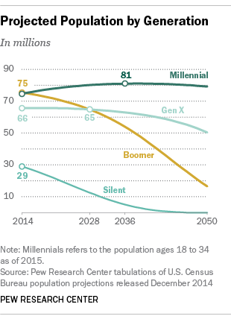
Demographics
Baby Boomers (now aged 51-69)
Around 75 million
Generation X (now aged 35-50)
Around 66 million
Millennial (“Gen Y” – aged 18-34)
75 million – become largest in 2015
*Immigration brings to 81M in 2036*
(Source: Pew Research Center)

Slide 4
Forecast: 75 million baby boomer retirements in the next 16 years and we’re already higher in baby boomer employment than the next highest industry and up to 15% higher than other industries.

Slide 5
Are there really 66 million Gen Xers to replace the Boomers in this industry? NO!
The Perfect Storm:
Deregulation (early 1990’s through early 2000’s) – the industry stops investing in the next generation.
Many would-be utility engineers, technicians, and craft personnel go to other industries (IT). Electric services industry employment drops 14% from its peak in 1990 through 1997.
Craft personnel shortage reaches peaks 2010-2015 – will it continue?

Slide 6
Supply vs. Demand
75 million Millennials entering the supervisory and management workforce, but a temporary gap will remain with Gen Xers (10-year gap?).

Slide 7
Competing Forces Arise
Cross-sector competition for intellectual capital begins:
Investor owned utilities
Contractors
Merchant generators
Private equity participants
Municipal Utilities (TARGET!!)

Slide 8
Highest Demand?
General Manager/CEO
Engineers
Finance and accounting leaders
Operations leadership

Slide 9
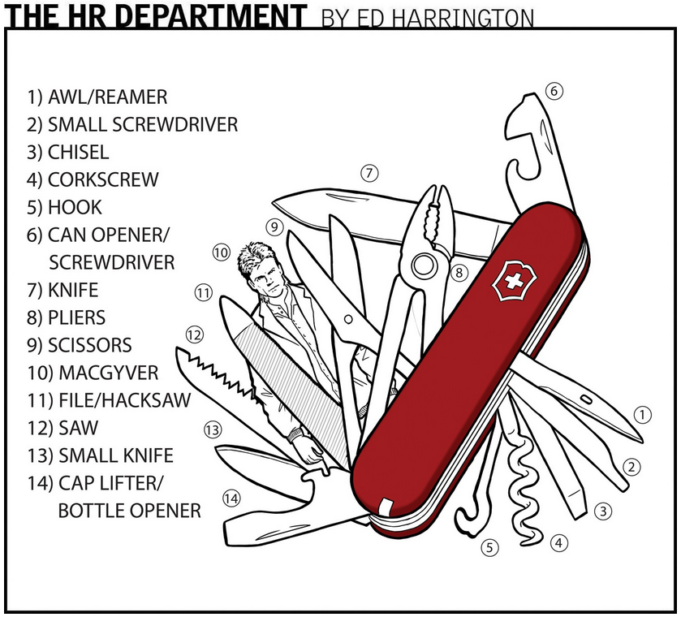
Source: styleweekly.com
Solutions?

Slide 10
Cooperative Advantages
Security/Stability
Grass Roots
Governance
Politics
Member (customer) driven decision-making
Competitive compensation
Efficiency of decision-making
Consistency of leadership
Career development opportunity
Transferability of retirement

Slide 11
Competitive Compensation
COOPS? Second place in the IOU vs Cooperative vs public power (muni) race.
Never stop educating your boards on “the market” – annual reviews with periodic external salary surveys that include a balance of data from all three segments.
Hire salary survey firms that know the electric industry and understand cross-sector surveying. What resources can be lost to an IOU or municipal utility OR ANOTHER INDUSTRY?
Are cooperatives doomed to be a farm club for IOUs?

Slide 12
Consider more than just base salary
Performance bonuses:
The standard in for-profit utilities and private equity businesses
Becoming more common in the electric cooperative sector
Attraction/Retention bonuses:
Signing bonuses for new employees
Short-term; present at the end of the year to receive
Long-term; present at the end of three years to receive (Most effective!)
457 (b or f) retention agreements with vesting period
Fringe Benefits
Flexible work and PTO schedules
Health care insurance (Chaos! Are you cutting back?)
Portable retirement plans (R&S Program?)
Adapt or death spiral – market forces dictate

Slide 13
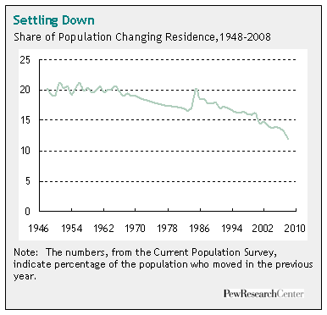
Advertising is dead or dying! Network PROACTIVELY to find employees and build a rolodex
Locally and Regionally focused!
50% of the US population lives within 50 miles of their birthplace. Find local roots and retention rates will increase!
Source: Pew Research Center

Slide 14
More problem solvers, less HR Police!!
Minimize prescriptive interviews!
Keep your organizations out of trouble legally, but develop flexibility in the hiring and interview process! Script LESS questions.
Resumes: Avoid premature decisions on resumes. Give resumes a first-tier review for factors that indicate talent (examples: early advancement, lateral movement out of core education, etc)
What percentage of applicants do you invite for interaction (telephone, Skype, on-site)?
Employment Seminars on-site at the utility headquarters
Send the right message to candidates – not hiring you now, but in the future?

Slide 16
Sourcing for Employees
Dedicated Sourcer or assigned sourcing responsibility in your coop?
Budget support for networking (NRECA, RMEL)?
Maintain a searchable database to retain applicant resumes and information for the future? Revisit on every recruitment.

Slide 17
Nepotism
Define boundaries, but don’t eliminate options.

Slide 18
Investing in Intellectual Capital: THE best retention tool
Treat like a distribution line or substation, investment increases reliability.
Avoid “under staffing”; leaders don’t have time to develop the next generation or resources to develop – the overhead cost will come one way or another.
Knowledge Transfer – if you aren’t already doing it, you are way behind.
Workforce Development - ongoing investment in intellectual capital; utilize statewide, NRECA, or regional subject matter experts’ services to train and educate with a goal in mind.
Don’t allow a great leader to retire and completely disconnect when possible – bring back on contract to mentor, they love it!

Slide 19
Your HR team should know the average cost to recruit employees at all levels.
Will help you justify budgetary support and the need and comparison cost of going outside for recruiting help.

Slide 20
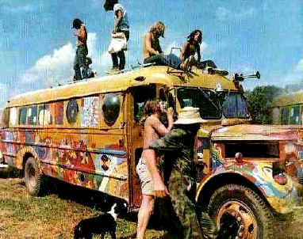
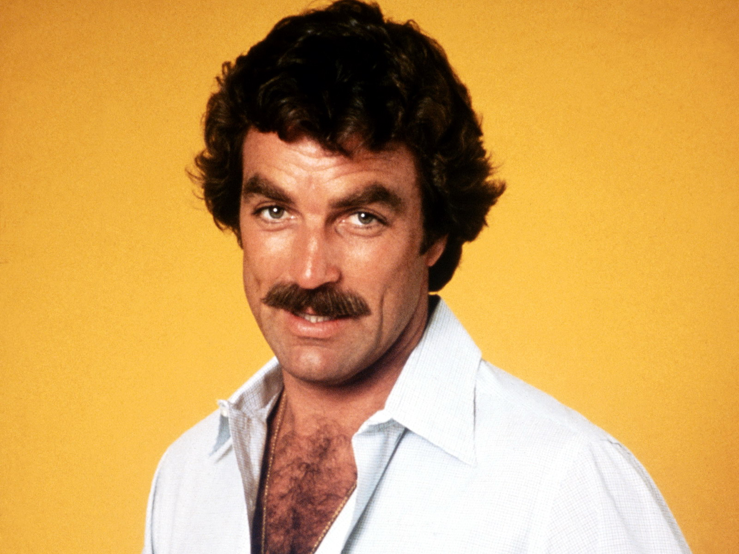
ROTATIONAL PROGRAMS FOR NEW RECRUITS
1970’s

Slide 21
Cross-training – great developmental and retention tool
Builds teamwork and interdependence in the organization.
Secures the organization’s risk against “lottery wins”
Engages employees

Slide 22
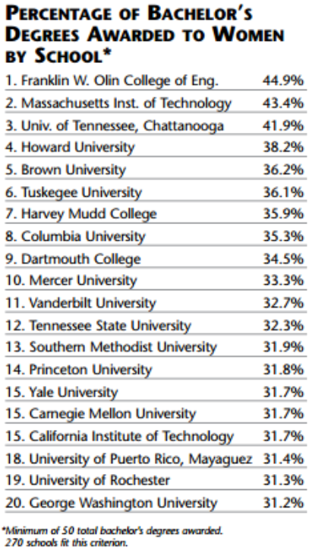
Diversification
Millennial generation static and slightly growing through 2036 before decline – immigration filling holes in the resource pool
Gender shift
Dual benefit: fill the holes in the resource pool and accomplish diversification goals.
What minority resources can you tap into?
Source: asee.org; from 2011

Slide 23
Strategic/Succession Planning
Engage in strategic planning - fight for a seat at the table!
Engage with your boards and CEO to understand their cultural expectations or vision for ideal culture, define those expectations, and target those type of candidates.
Does your organization have a formalized succession plan? That is, do you know who will succeed each leader in the event of a “lottery win” and are you investing in those successors’ skills to get them ready?
A formalized plan needs to be managed and communicated to employees properly, but can be an outstanding attraction and retention tool.
Review and renew the plan with regularity

Slide 24
Simple Fact:
Hire for talent first, qualifications second!
Talented personnel do more than twice the work of an average employee and bring more return on investment.
You can do more with less, but compensate accordingly!

Slide 25
Ride the Technology Wave
Smart Grid/Automated Metering Infrastructure (AMI)

Slide 26
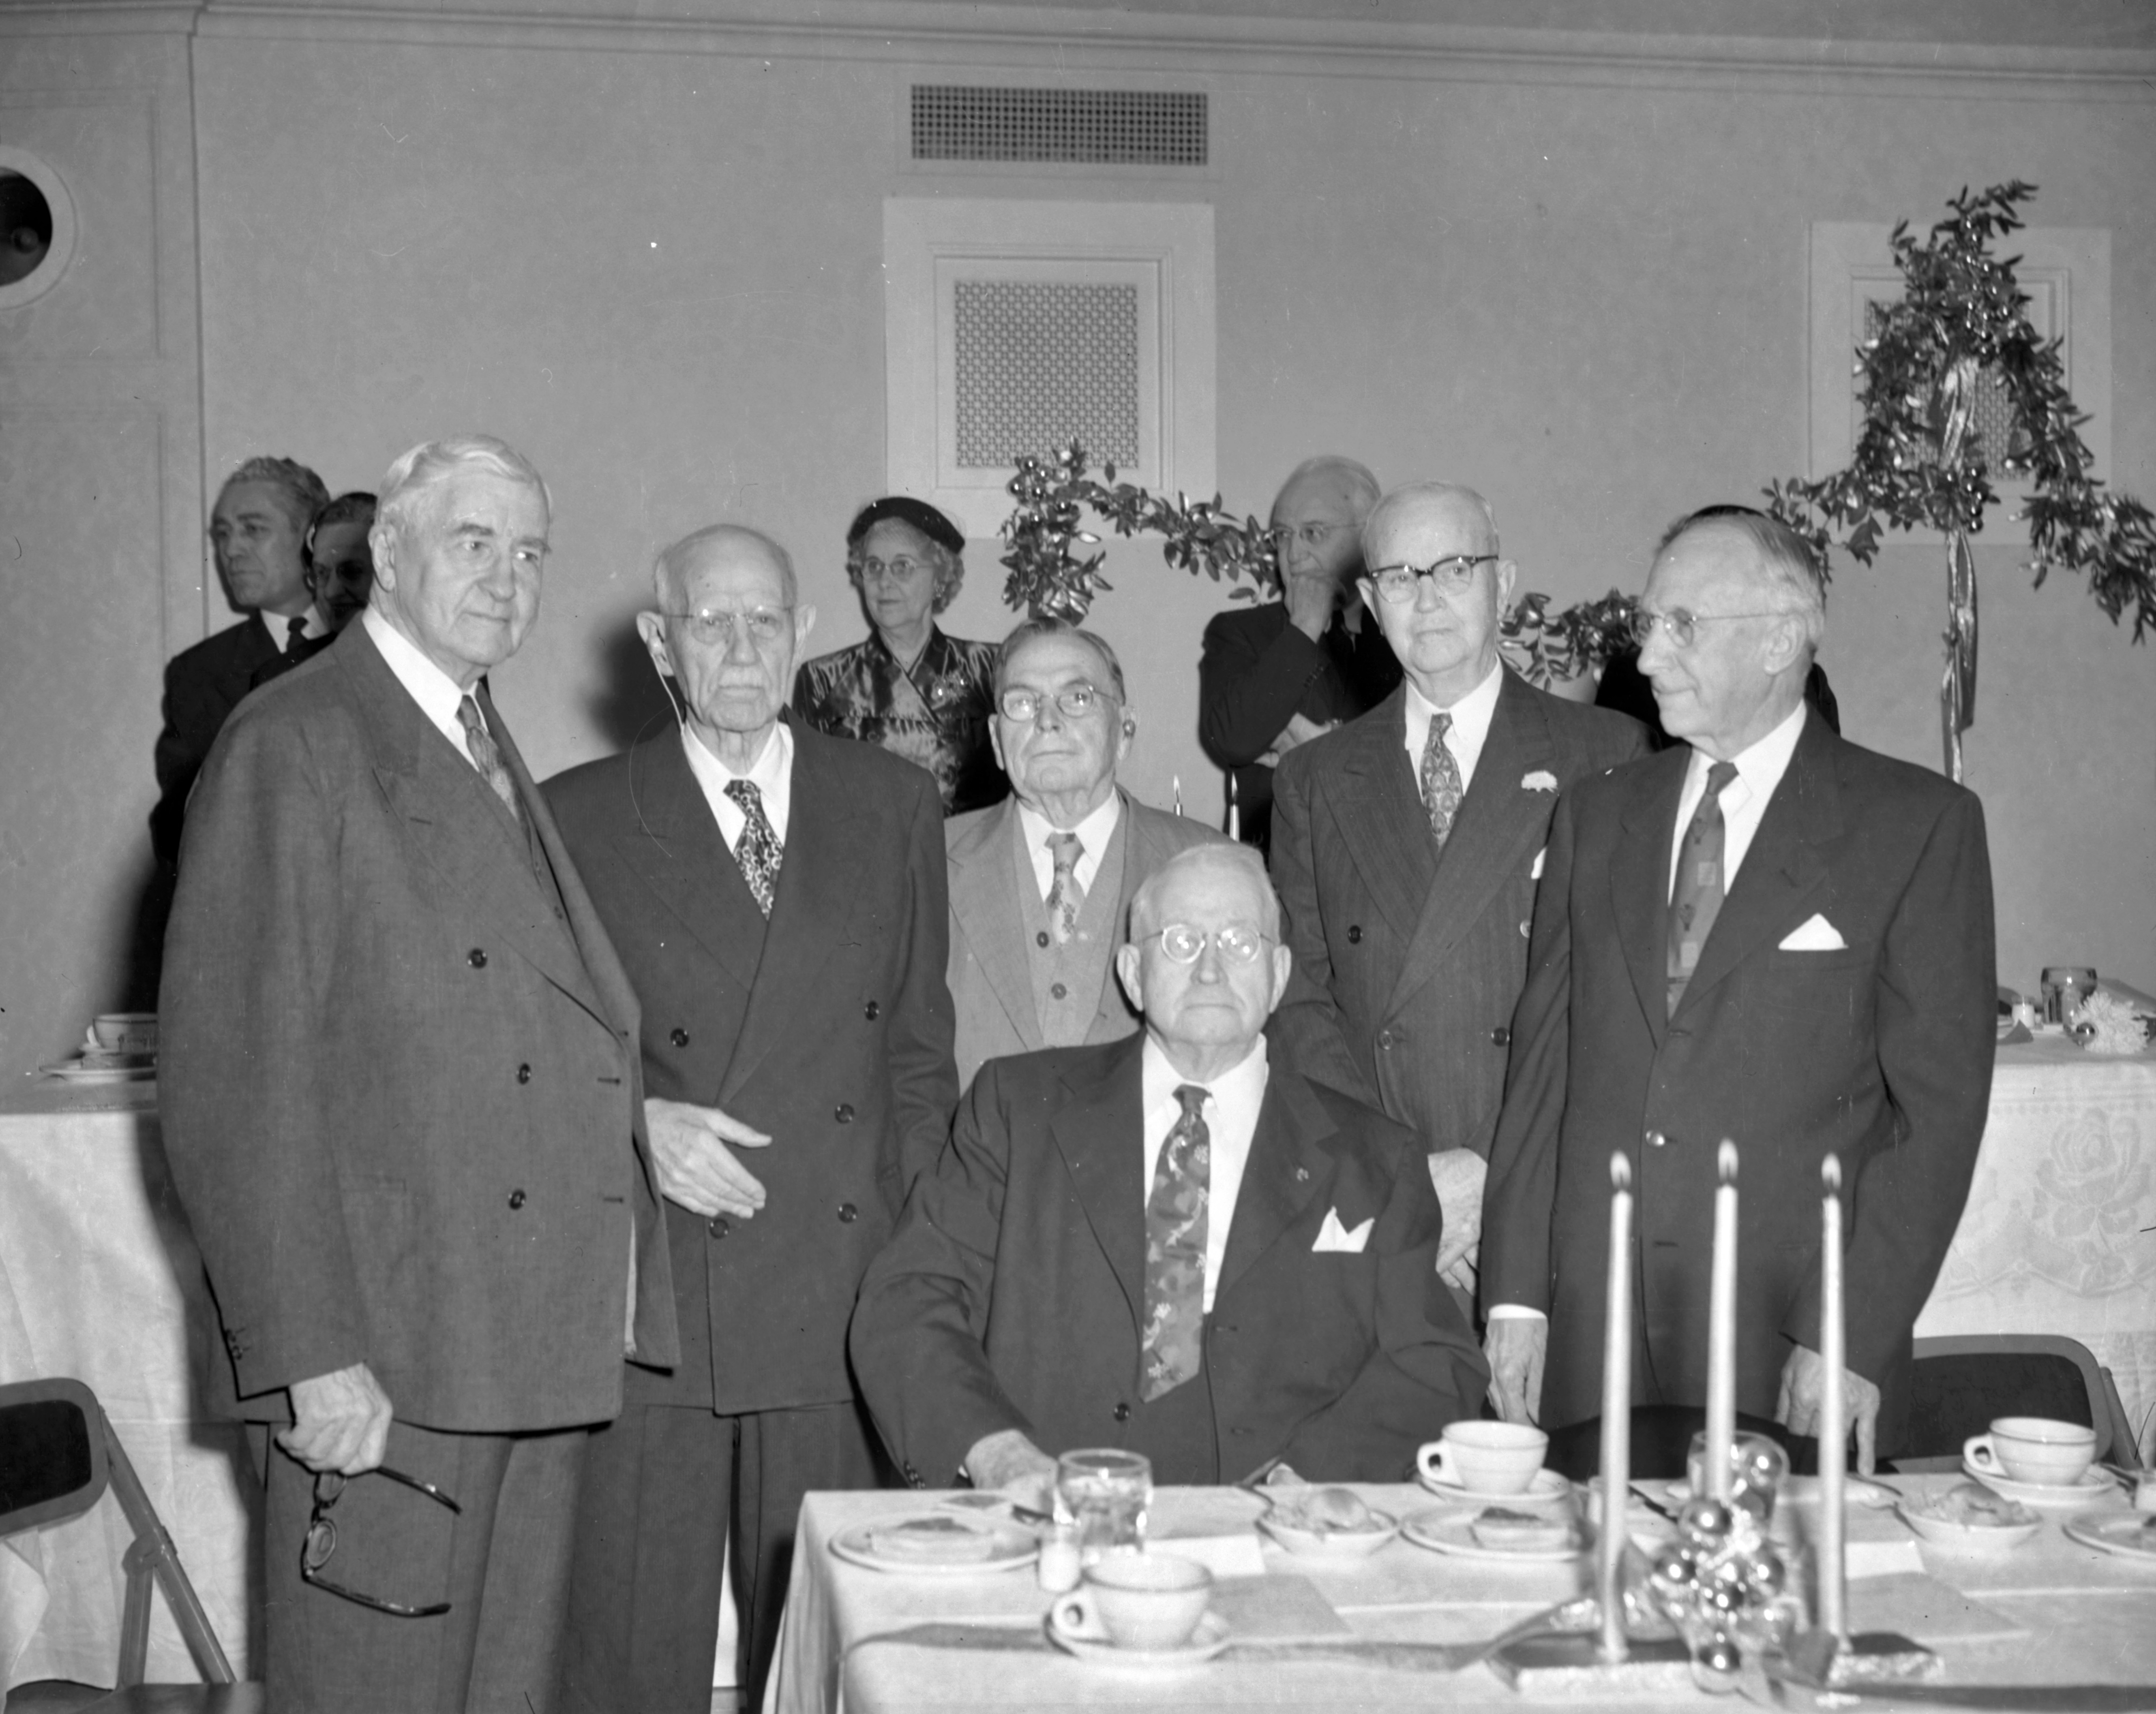
The Unanticipated Factor – Board Member Retirements
Opportunity for HR!!
Engage new board members and educate them on these challenges.
Source: Wikipedia

Slide 27
Questions? Scott A. Fry Mycoff, Fry & Prouse LLC Conifer, CO (800) 525-9082 sfry@mfpllc.us www.mfpllc.us

