Slide 1
Seminole’s “BEST” INITIATIVE

Slide 2
High utility bills?
With the downturn in the economy, many of our end use consumers are struggling to pay their power bills.
Correspondingly our budgets are tightening in an effort to control rates.

Slide 3
EPA Attacks Coal Plants
The EPA has launched an alphabet soup of regulations aimed at eliminating coal-fired generation. If successful, this will radically change the landscape of our power generation resources.
Revenue streams from recyclable materials, such as ash and gypsum, are threatened by the potential of classifying these materials as hazardous waste.

Slide 5
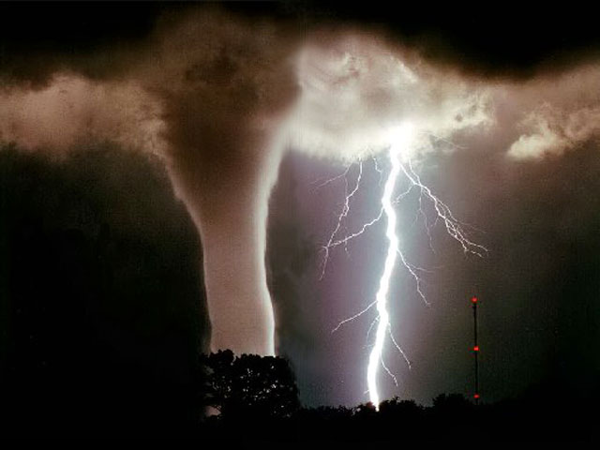
Weather
Weather patterns seem to be becoming more extreme and are increasingly affecting historical load patterns. It is either too hot, too cold, or too mild.
Droughts, floods, tornados, blizzards and hurricanes are affecting power systems nationwide. International events, such as tsunami’s, are even affecting our power
generation options here in the US.

Slide 6
Financial Issues
The US lost its AAA credit rating, financial markets are increasingly unstable, housing and construction markets are down and the financial health of the suppliers we depend on is becoming more concerning.

Slide 7
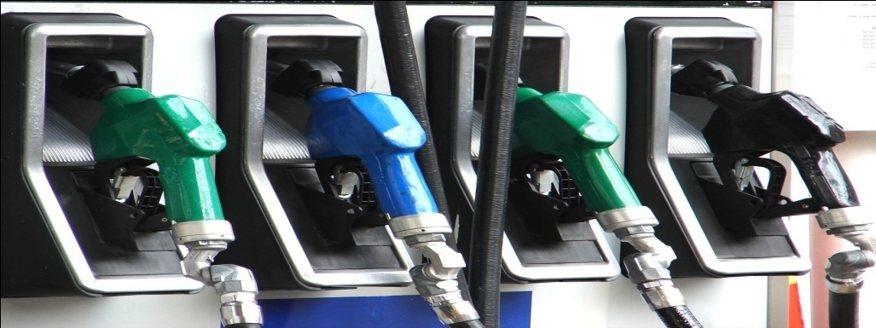
Fuel Prices And Markets
Natural gas prices dropped from $13/mmbtu in 2008 to $2.00/mmbtu in 2012. Gas hedging programs were put in a tail spin. Hydraulic fracking promises low gas prices in the future but is subject to governmental intervention. Coal prices are remaining high and CO2 regulations are still in flux.

Slide 8
Closer To Home
We are experiencing:
Too little load growth (used to be too much)
Unending audits and new reliability standards from NERC and FERC
Aging infrastructure in our power plants and transmission systems
A short supply of power sector workers
An aging workforce and the need for better succession planning
Increased workplace security requirements
The need to remain the preferred provider for our Member Systems

Slide 9
The Birth Of A Program
The number of major issues affecting
our country and industry is unprecedented
Seminole has historically maintained a very competitive market position
What we are doing to maintain competitiveness?
Are we adequately handling the current onslaught?
Are we prepared for the next “major” issue?
How can we minimize risk and work smarter?
How are we providing our Members “Peace of Mind” that all is well?

Slide 10
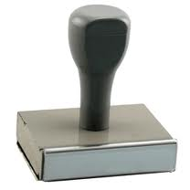
Seminole’s “BEST” Initiative
B – Business Process Improvement
E – Enterprise Risk Management
S – Strategic Planning
T – Talent Development
BEST

Slide 11
The “B” Business Process Improvement
Perform critical self-assessment
Business environment in constant flux
-We must adapt accordingly
Continual process to seek out ways to do things better
Guard against complacency of entrenched success - Past success no guarantee of future

Slide 12
The “B” Business Process Improvement
Implement a bottom up process
Solicit ideas and suggestions from all employees
Best positioned to identify workable ideas
Will be the individuals who implement program
Buy-in is essential – Employees must have ownership
Not about cutting jobs – About doing things smarter, improving productivity, and keeping our rate competitive

Slide 13
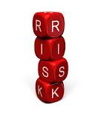
The “E” Enterprise Risk Management
Instill a culture to ensure risk management becomes second nature in making decisions
“What if” questions must be asked and answered
Analysis must be on “Enterprise Wide” basis
Use of cross functional teams
Identify informational blind spots and bias
Build internal knowledge
Bring different perspectives to the table

Slide 14
The “S” Strategic Planning
Plans must provide flexibility
Company must remain nimble
and positioned to take advantage
of changing circumstances
Hedge our bets
Don’t keep all of our eggs in one basket
Don’t make “bet the farm” decisions
Plans must build on our strengths and work to improve our weaknesses

Slide 15
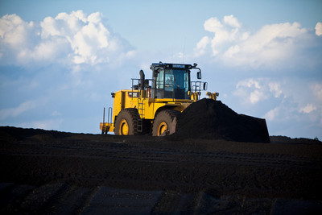
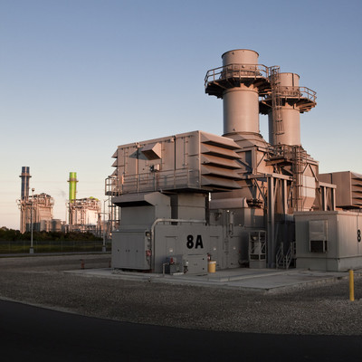
The “S” Strategic Planning
Diversified power supply portfolio
Mix of coal and gas
Mix of owned and purchased resources
Within purchases category evaluate
Staggered contract terms
System and unit power purchases
Mix of base, intermediate and peaking
Mix of purchases from IOUs and
Independents
Build financial strength for future
ownership
Equity Development Program

Slide 16
The “S” Strategic Planning
Aggressive Marketing Plans
Municipal Power Contracts
High priority on effective communications
Competitive rates and reliable service are necessary conditions for success, but not the only requirements – maintaining Member trust and confidence is the third leg in the stool
Transparency, openness and honesty in dealing with Members, the public and all business partners

Slide 17
The “T” Talent Development
The “B”, the “E” and the “S” will be for naught if we do not have employees who are capable, accountable and prepared to take effective action
Talent Development Essentials
Get the best out of everyone
Employ individual talents in the most meaningful and productive way

Slide 18
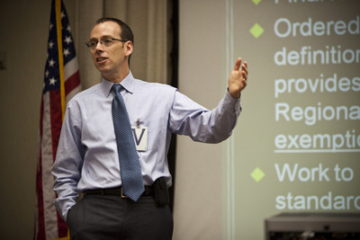
The “T” Talent Development
Leadership Development
Program
Mentorship Program
G&T Outreach Program
Renewed emphasis on written processes and procedures to ensure institutional knowledge transfer
Reorganizations
Enhanced employee training programs
Cooperative Student Program

Slide 19
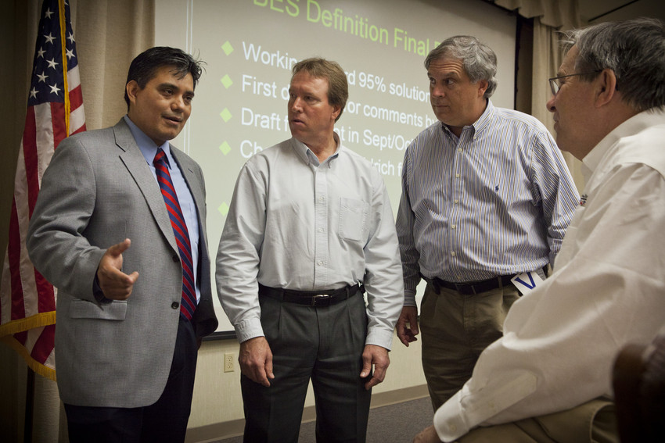
BEST Implementation
BEST initiative rolled out in January 2012
Supervisors and Managers play a critical role
A company wide effort
Major initiatives underway at plants were incorporated
Requests for suggested improvements solicited from each section at HQ and each plant
Employees from each section met to develop key BEST initiatives for implementation in their work area
Presentations made to Executive Staff

Slide 20
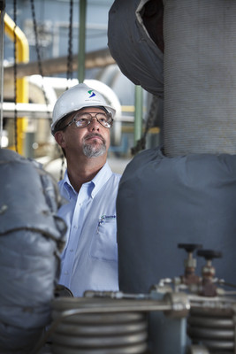
Initial Results
Hundreds of BEST initiatives identified
Numerous improvements implemented, many in process and more scheduled for future
Employees are directing their own efforts
True signs of employee engagement and empowerment taking root
Renewed focus on efficient processes, minimization of risk, strategic planning and employee development is occurring

Slide 21
Where do we go from here?
Continuing to focus efforts on our strive to be the “BEST” program
We say strive because it is intended to be a continual process, never fully realized
Stay tuned for more regarding Seminole…..
BEST

