Slide 1




D. Albert Brannen
Regional Managing Partner
Direct: (404) 240-4235
dabrannen@laborlawyers.com
Fisher & Phillips LLP
1075 Peachtree Street NE, Suite 3500
Atlanta, GA 30309
www.laborlawyers.com
Atlanta · Baltimore · Boston · Charlotte · Chicago · Cleveland · Columbia · Columbus · Dallas · Denver · Fort Lauderdale · Gulfport
Houston · Irvine · Kansas City · Las Vegas · Los Angeles · Louisville · Memphis · New England · New Jersey · New Orleans
Orlando · Philadelphia · Phoenix · Portland · San Antonio · San Diego · San Francisco · Tampa · Washington, DC

Slide 2
Introductions
Speakers
Attendees

Slide 3
Today’s Session
Miscellaneous Hot Topics In Employment Law
Effective Workplace Investigations
Accommodating Disabled Employees Under the ADAAA
Effective Performance Management
Workshop: What Would You Do If…?

Slide 4
Ground Rules
Participation requested
Sessions will be informal
Ask questions any time
Give examples if relevant
Frequent breaks

Slide 5

Miscellaneous Hot Topics
In Employment Law
www.laborlawyers.com
Atlanta · Baltimore · Boston · Charlotte · Chicago · Cleveland · Columbia · Columbus · Dallas · Denver · Fort Lauderdale · Gulfport
Houston · Irvine · Kansas City · Las Vegas · Los Angeles · Louisville · Memphis · New England · New Jersey · New Orleans
Orlando · Philadelphia · Phoenix · Portland · San Antonio · San Diego · San Francisco · Tampa · Washington, DC

Slide 6
Overview of Hot Topics For 2014
  Discrimination, harassment & retaliation
  Labor law
  Government contracts
  Immigration
  Wage/hour
  Others

Slide 7
HOT TOPICS:
Discrimination, Harassment & Retaliation
Background checks
Religious garb and grooming
Pregnancy discrimination

Slide 8

“Ban The Box” Movement
Is Sweeping The Country
Legislation limiting criminal background check information
Passed in 11 states & 51+ cities/counties
  CA
  CO
  CT
  HI
  IL
  MD
  MA
  MN
  NE
  NM
  RI

Slide 9
EEOC Focus On Background Checks
Arrest and conviction records were the subject of EEOC’s “Enforcement Guidance on the Consideration of Arrest and Conviction Records in Employment Decisions Under Title VII of the Civil Rights Act of 1964.”
Issued on April 25, 2012

Slide 10
Arrest And Conviction Records:
Illustrative Case
Pepsi reached a $3 million settlement with EEOC for using criminal background checks to screen applicants

Slide 11

Complying with the EEOC Guidance
Comply with FCRA
  Provide proper disclosures
  Get required authorizations
  Send adverse action notice
Comply with local laws

Slide 12

Complying with EEOC Guidance
Limit application questions
Include disclaimer on application:
“Answering “yes” to these questions does not constitute an automatic bar to employment. Cooperative will consider various factors, including but not limited to the nature and gravity of the offense and the position for which you are applying.”
Remember to consider applicable local laws

Slide 13
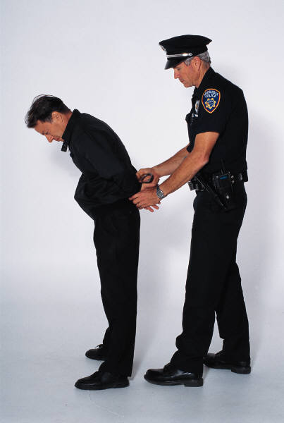
Complying with EEOC Guidance
Do not ask about arrest records
If arrests discovered:
  Conduct independent investigation
  Consider underlying conduct
Do not consider convictions that were sealed, eradicated, erased, annulled by a court, or expunged, or convictions that resulted in referral to a diversion program

Slide 14
Complying with EEOC Guidance
Conduct an individualized assessment of each conviction:
  Nature/seriousness of the crime
  Relation to the position’s functions and qualifications
  Number of occurrences
  Applicant’s age at the time of the conviction
  Time elapsed since the crime
  Applicant’s entire work and educational history
  Employment references and recommendations
  Business necessity

Slide 15
Complying with EEOC Guidance
Maintain a policy
Tailor policy to EEOC’s guidelines
Do not maintain a blanket “no conviction” policy
Train managers to comply

Slide 16

Document Your Decisions
Use FCRA paperwork
Document all “no hire” decisions based on criminal records
Describe the individualized assessment

Slide 17
Religious Garb and Grooming
EEOC issued new Guidelines in March 2014 which confirm that Title VII:
  Prohibits disparate treatment
  Prohibits segregation
  Prohibits harassment
  Prohibits retaliation
  Requires accommodation
FAQs give specific examples

Slide 18

Scenario
A Muslim woman has been employed as an MSR for 90 days. The Coop’s dress code prohibits MSRs from wearing head coverings. She has not worn a religious headscarf (hajab) to work before but her practice has been to do so during Ramadan.
Can the Coop prohibit her from wearing the hajab?

Slide 19

Scenario
A Muslim applicant wears a hajab because of her religious beliefs. Although she is qualified, the GM fears that the members may think since she is identifiably Muslim she is sympathetic to terrorists. The GM, therefore, offers her a position in the Coop’s back office where she will only interact with members by phone.
Can the GM assign her to work in the back office?

Slide 20

Pregnancy Discrimination Guidelines
  EEOC issued new Guidelines in July 2014
  Expanded definition of “pregnancy” to include:
    Current or past pregnancy
    Potential or intended pregnancy
    Related medical conditions
    Childbirth
    “persons similar in their disability or
    inability to work”

Slide 21
Pregnancy Discrimination Guidelines
  Also address equal access to benefits
    Light duty
    Leave
    Healthcare
    Various other benefits
  “Employers can violate Title VII by providing health insurance that excludes coverage of prescription contraceptives, whether the contraceptives are prescribed for birth control or medical purposes.”
    But see Hobby Lobby

Slide 22

Pregnancy Discrimination Guidelines
  Rights provided under:
    ADA
    FMLA
    Affordable Care Act
    Lactation breaks under FLSA
  EEOC’s recommended best
  practices for employers

Slide 23
HOT TOPICS:
Labor Law
NLRB is making changes
Using its rule-making powers
Adjudicating cases to expand employee rights
  “policy oscillations”
Using its enforcement powers

Slide 24
Two SCOTUS Cases Rocked The NLRB
New Process Steel (June 17, 2010)
  2 members did not have authority to act
  More than 600 decisions affected
Noel Canning (June 24, 2014)
  recess appointments of 3 members invalid
  More than 1000 decisions affected

Slide 25
Noel Canning Affects NLRB
After Noel Canning, key recent decisions now up for review
  Piedmont Gardens -- did away with categorical exemption to providing unions with witness statements
  Banner Estrella Health – outlawed blanket confidentiality policy prohibiting employees from discussing investigations
  Costco – declared social media overbroad
  Hispanics United – declared firing of employees critical of other employees on social media to be unlawful
But for now, these cases still stand

Slide 26

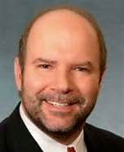



“New” National Labor Relations Board
Confirmed August 12, 2013
Mark Pearce Chairman
Democrat
Philip Miscimarra
Republican
Morgan Lewis
Harry Johnson
Republican
Arent Fox
Nancy Schiffer
Democrat
Assoc. General Counsel
AFL-CIO
Kent Hirozawa
Democrat
Chief Counsel to NLRB Chairman Mark Pearce

Slide 27
Changes To Rules
Election procedures
Posters

Slide 28
Quickie Elections Rule
Republished February 2, 2014
Would shorten time to election
  Current average 38 days
  To “earliest date practicable”
  Would end up being 15-21 days
Requires disclosure of detailed employee information
Limits pre-election litigation of issues
Could become effective this fall

Slide 29
Union Rights Posting Rule
Enjoined
DC Circuit: No authority
4th Circuit: No authority
NLRB chose not to appeal to SCOTUS
Government contractors: Still required to post

Slide 30
Changes Through Adjudicating Cases
First, a little background about employee rights
Then, some real examples

Slide 31
Employees’ Statutory Rights
Have Not Changed Since 1935
“Employees shall have the right to self-organization, to form, join, or assist labor organizations, to bargain collectively through representatives of their own choosing, and to engage in other concerted activities for the purpose of collective bargaining or other mutual aid or protection, and shall also have the right to refrain from any or all such activities…”
NLRA Section 7

Slide 32
“Concerted” Activity
Can involve one person acting to:
Initiate
Induce
Prepare for group action
Bring group complaints to the employer’s attention
  Meyers Industries Inc., 281 NLRB 883 (1986) (Meyers II)

Slide 33
“Protected” Activities
Solicitation/distribution
Wearing insignia
Complaints about pay, benefits & working conditions
Work stoppages
Discussion of pay & benefits with peers
Disclosure of information to third parties
Enlisting support of third parties
Promoting legislation contrary to employer’s interest
Filing charges/lawsuits

Slide 34
Standard Of Review For Employer Policies
Does the rule “reasonably tend to chill employees
in the exercise of their Section 7 rights?”
NLRB found unlawful a rule forbidding employees from “making false, vicious, profane or malicious statements toward or concerning the Hotel or any of its employees”
Obviously, this standard is highly subjective
The current NLRB has struck down numerous work rules by liberally applying this standard
    Lafayette Park Hotel, 326 NLRB 824 (1998)

Slide 35
NLRB Is Challenging Employer Policies
  Confidentiality
  Non-disparagement
  Gossiping
  Fraternization
  Inappropriate postings
  No bullying
  Respectful conduct
  Appropriate conduct

Slide 36

NLRB Is Challenging
Employers’ Social Media Policies
  Guidelines on social media issued:
    October 2011
    January 2012
    May 2012
  NLRB’s Division of Advice has issued
  numerous memos on the subject of social media

Slide 37
Opinions That Affect Policies
  “statements posted electronically…that damage the Company, defame any individual or damage any person’s reputation, or violate the policies outlined in the Employee Handbook, may be subject to discipline, up to and including termination of employment.”
Unlawful

Slide 38
Opinions That Affect Work Rules
“be courteous, polite and friendly”
Unlawful

Slide 39
Opinions That Affect Work Rules
“no one should be disrespectful or use profanity or any other language which injures the image or reputation of the Dealership.”
Unlawful

Slide 40
Opinions That Affect Work Rules
“not make negative comments about our fellow team members and ... take every opportunity to speak well of each other”
Unlawful

Slide 41
Opinions That Affect Work Rules
“represent the company in the community in a positive and professional manner in every opportunity”
Unlawful

Slide 42
Opinions That Affect Work Rules
“not engage in or listen to negativity or gossip and recognize that listening without acting to stop it is the same as participating”
Unlawful

Slide 43
Opinions That Affect Work Rules
“off-duty employees are prohibited from entering the workplace except to conduct employer-related business”
Unlawful

Slide 44
Opinions That Affect Work Rules
“off-duty employees are prohibited from entering the workplace, except to attend employer-sponsored events”
Unlawful

Slide 45
Opinions That Affect Work Rules
“employees are prohibited from walking off the job or willfully restricting production”
Unlawful

Slide 46
Opinions That Affect At-Will Policies
“the at-will relationship cannot be amended, modified or altered in any way.”
Unlawful

Slide 47
Opinions That Affect At-Will Policies
“No representative of the company has any authority to enter into an agreement that is contrary to the ‘employment at will’ relationship.”
Lawful

Slide 48
Opinions That Affect Confidentiality
In Workplace Investigations
“employees who disclose their participation in this internal investigation will be subject to immediate termination”
Unlawful

Slide 49
Mandatory Arbitration Provision
Class action waivers violate NLRA right to act in concert through class litigation
  “Opt out” procedure will not cure the problem
  Arbitration agreement that allows employees to file a complaint with a government agency does not cure the problem

Slide 50
Micro Units – Union “Cherry Picking”
Specialty Healthcare: New standard for deciding scope of unit
Examples:
  Maintenance unit
  Production Line 1
  Ladies shoe department

Slide 51
Witness Statements
Board overturned a 1978 decision
Employers must turn over witness statements to union prior to arbitration
Board ignored problems of witness tampering

Slide 52
Dues Check-Off After
Board overturned a 1962 decision
Employers must continue dues check-off after contract expires

Slide 53
Joint Employer Status
Board solicited input from interested parties
Considering a broader standard
Change supported by unions

Slide 54
NLRB Is Changing Enforcement Strategies
Increased use of 10(j) injunctions
Changes in interest calculations
Default language in settlement agreements
Extraordinary remedies
  Notices posted on company intranets
  Requiring CEOs to read notices
  Bargaining expenses for unions
Threats to sue states for “secret ballot election” laws

Slide 55
HOT TOPICS:
Immigration

Slide 56
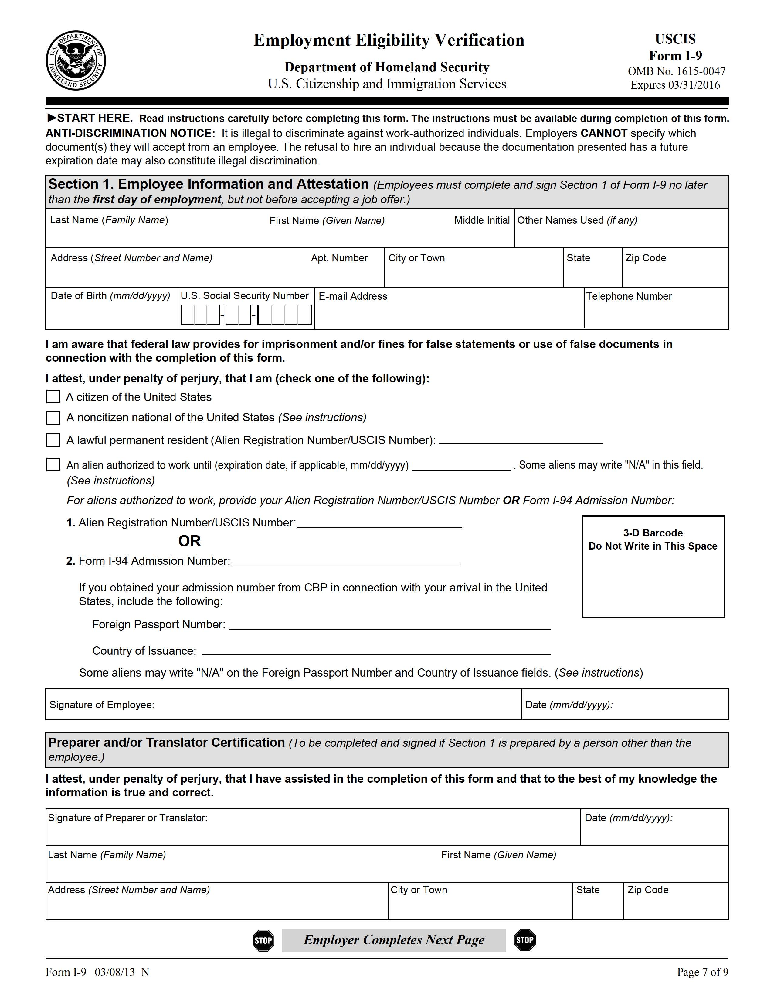

Immigration Law Changes
State laws
Use the new I-9 Form issued March 8, 2013
  www.uscis.gov/files/form/i-9.pdf
Post the new posters

Slide 57


Things To Remember
I-9 Violations $110 - $1,100/form
Document abuse $110 - $1,100/worker
Document fraud $375 - $6,500/worker
Hiring or knowingly
continuing to employ $375 - $16,000/worker
Discrimination $375 - $16,000/violation
Pattern or practice $3,000/alien +
6 months’ prison

Slide 58
HOT TOPICS:
Wage & Hour

Slide 59

Pay Employees Correctly
Wage and hour complaints continue to increase
Attorneys’ fees are expensive in these cases

Slide 60
Most Common Violations
Misclassifying workers as independent contractors
Improperly classifying employees as exempt
Failing to maintain the required time records
Failing to compensate employees for “off the clock” work
Failing to compensate for mandatory training time
Making illegal deductions from employees’ wages

Slide 61
HOT TOPICS:
Government Contracts

Slide 62
New OFCCP Regulations
Effective March 24, 2014 (or next plan year)
Pre- and post-offer self-identification forms
Establish benchmarks
  7% goal for individuals with disabilities
  7.2% hiring goal for veterans
New purchase order language
Expand some recordkeeping to 3 years
Require communication with state job service
Expand self-assessment obligation

Slide 63
New Executive Order
Bars federal contractors from firing or discriminating against employees or applicants for discussing compensation
Department of Labor has until September 15, 2015 to issue regulations

Slide 64
New Executive Order
Increases minimum wage
Effective January 1, 2015
Minimum wage will go to $10.10/hour for some workers of federal contractors
Department of Labor has until October 1, 2014 to issue regulations

Slide 65
OTHER HOT TOPICS
Substances in the workplace
Guns at work
Workplace bullying
Social media

Slide 66




Substances In The Workplace
Drugs
Alcohol
Tobacco
eCigs
www.laborlawyers.com

Slide 67
What Governs Substances
In The Workplace?
Your policies
Laws
– Federal
– State
Regulations
– DOT
– Special jobs

Slide 68
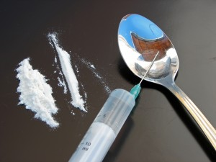
Scenario
You believe Al violated your drug policy. You ask him to take a drug test. Before you can get Al to the lab, he leaves work. Hours later his wife calls and says Al checked into rehab.
Can you fire Al?
For what?

Slide 69
Scenario
Bob, a 10-year employee with an excellent work history, was drug tested after an accident. When you shared the positive test results with him, he said “So what, I have a prescription.”
What do you do?

Slide 70
Guns At Work
More than 15 states have laws permitting guns at work
Laws vary, but they may
  Allow employees to store them in vehicles at work
  Limit employer searches
  Prohibit discrimination against gun owners
  Require some notice posting
  Provide for damaged if violated

Slide 71
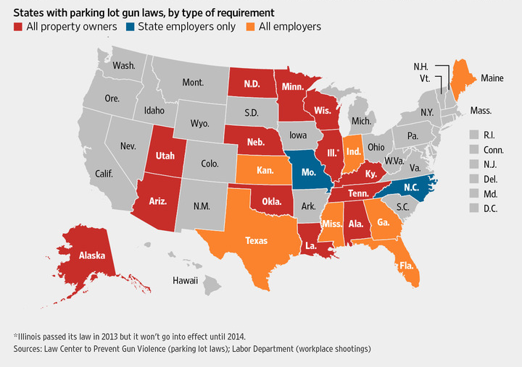
Guns At Work

Slide 72
Guns At Work
Employer liability arises from:
  State statutes
  State tort laws
  Workers’ compensation laws
  OSHA’s general duty clause

Slide 73
Florida Gun Law
Possession on employer’s property is allowed if:
  Lawful right to possess
  Locked inside a private vehicle
  In parking lot
  Person is lawfully entitled to be in such areas

Slide 74
Florida Gun Law
Cannot condition employment on
  vehicle search
  whether person has license
Only an on-duty law enforcement officer can search in compliance with Constitution

Slide 75
What Is Workplace Bullying?
  No universal definition
  Bullying is psychological or physical violence
  Actions, by an individual or group, that are:
    Repeated
    Unreasonable, out of context for situation
  And cause:
    An intentional impact on the target such as humiliation, degradation, offense, intimidation
    Harm to the target

Slide 76
Is Workplace Bullying A Problem?
  Common experience
    35% of workers report being the target of a bully
    94% report working with a bully at some point
    Bullying is 4 times more common than harassment
  Cost is incredibly high
    Lost time and productivity
    Leave
    Replacing departing employees

Slide 77
Must Employers Address This?
  Legal claims: negligent hiring, negligent retention, intentional infliction of emotional distress, assault, battery, defamation
  Discrimination claims: especially disability if dealing with mental illness
  Private/public benefits claims: disability, FMLA, unemployment
  OSHA claims: general duty clause implications

Slide 78
States Respond To Bullying
  25 states have introduced workplace anti-bullying bills that would allow workers to sue but no laws yet enacted.
  11 States have bills pending: Florida, New Mexico, Wisconsin, West Virginia, Pennsylvania, New Jersey, New York, Vermont, New Hampshire, Massachusetts, Hawaii

Slide 79
Where Do You Begin?
Policies
  Develop a Workplace Bullying & Violence Policy
    Define workplace violence and bullying behavior
    Provide a reporting procedure that identifies 2 to 3 specific management positions to report incidents to
    Include a no-retaliation clause
    Inform employees that violation of the policy may result in discipline, up to and including immediate termination
    Don’t forget about NLRB

Slide 80

Where Do You Begin?
Training
  Provide Supervisor/Employee Training
    Basic leadership skills addressing employee problems/complaints, adequate follow up, evaluating employees, and enforcing policies and procedures
    Anti-harassment/bullying
    training for all employees

Slide 81
Just A Few Policies That Relate To
Social Media
Social media/blogging
Electronic communications
Confidential information
Compensation
Business ethics
Conflict of interest
No harassment
Workplace violence
Workplace monitoring
Basic work rules

Slide 82
A Few Take-Aways
Action Items
  Follow FCRA procedures
  Follow FMLA procedures
  Reasonably accommodate individuals with disabilities, pregnant women and others based on religious beliefs
  Conduct a self-audit of I-9s
  Classify and pay employees correctly
  Update AAPs
  Train managers and employees
  Update policies
  Monitor new developments

Slide 83
A Few Take-Aways
Update Specific Policies
  Criminal background checks
  EEO/AAP
  Reasonable accommodation
  Social media/electronic communications
  Confidentiality
  No bullying/workplace violence
  No weapons
  Respectful conduct
  Substance abuse

Slide 84

Questions?
www.laborlawyers.com
Atlanta · Baltimore · Boston · Charlotte · Chicago · Cleveland · Columbia · Columbus · Dallas · Denver · Fort Lauderdale · Gulfport
Houston · Irvine · Kansas City · Las Vegas · Los Angeles · Louisville · Memphis · New England · New Jersey · New Orleans
Orlando · Philadelphia · Phoenix · Portland · San Antonio · San Diego · San Francisco · Tampa · Washington, DC

Slide 85
Effective Workplace Investigations
www.laborlawyers.com
Atlanta · Baltimore · Boston · Charlotte · Chicago · Cleveland · Columbia · Columbus · Dallas · Denver · Fort Lauderdale · Gulfport
Houston · Irvine · Kansas City · Las Vegas · Los Angeles · Louisville · Memphis · New England · New Jersey · New Orleans
Orlando · Philadelphia · Phoenix · Portland · San Antonio · San Diego · San Francisco · Tampa · Washington, DC

Slide 86

Goal of This Session
  To provide best practices for Human Resources professionals and others responsible for managing and conducting workplace investigations to ensure a respectful and legal workplace

Slide 87
Hypothetical
  Janet, a clerk at Charlie’s Chocolate Factory, enters the office of her supervisor, Willy Wonka, closes the door and says:
  Willy, I have to tell you something off the record. Gus, the new VP, has been following me around, complimenting me a lot and saying sexual things, in person and by texting. He asked me out for dinner. I said “No,” but don’t think he will stop. PLEASE don’t do anything or say anything to anyone!! He is a real high-flyer in the Co-op. I’ll =let you know if anything else happens. Thanks for listening. It makes me feel better just telling you.
  What should Willy do? What should he say to Janet?

Slide 88

Importance of a Robust Investigation
  Helps maintain respectful workplace
  Minimizes legal liability
  Provides a defense in lawsuits
  Attracts and retains employees
  Creates good reputation and profitability

Slide 89
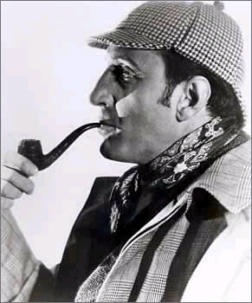
Investigation Process Steps
  Initial complaint
  Preliminary interview with complainant
  Emergency interim steps
  Decision to conduct a formal investigation
  Planning the investigation
  Conducting interviews
  Documenting the process and result
  Arriving at a conclusion
  Making a recommendation to management
  Implementing investigation results
  Follow-up

Slide 90

Initial Complaint
What is a complaint?
Take all complaints seriously
Methods of complaints
Supervisory knowledge of alleged violations
Anonymous complaints

Slide 91

Legal Issues
Harassment and discrimination
Negligent investigations
Defamation
Privacy/emotional distress
False imprisonment
NLRA issues
Workplace violence
Negligent retention
Litigation
Other statutes and case law

Slide 92

Required Statements For All Interviews
Limited confidentiality
Duty to investigate
Role of investigators
Investigation process, timing
No retaliation
Confirm no bias
Cooperation
Contact information

Slide 93

Preliminary Interview with Complainant
Ask questions to gather facts
  Open-ended questions
  Determine basis for allegations (first-hand? text message?)
  Location?
  Witnesses?
  Documentation?
  Others affected?
  Any other issues?

Slide 94

What Next?
Possible interim emergency steps:
  Imminent danger to health, safety, property, environment, personal dignity
  Allegations of violence, threats, certain harassment, retaliation, whistleblowing, criminal acts
  Options for immediate actions
Is a formal investigation necessary?

Slide 95

Planning the Investigation
        Document Checklist
          – Employer’s policies
          – Performance documents
          – E-mail, text messages, social media
          – Photographs, pictures
          – Manager’s files
          – Results of other investigations

Slide 96

Planning the Investigation
        Logistics Checklist
  – Who “owns” the investigation?
  – Who should investigate?
  – Who should be interviewed?
  – Time, date, location, order of interviews
  – Union issues
  – Notification to witnesses
  – Preparing, and anticipating, questions

Slide 97

Conducting Interviews
Opening and closing statements
Role of each investigator
Treat interviewee with dignity
Questions
  Open-ended and broad
  Chronological
  Tough or embarrassing questions
No leading questions
Allow silence
Special situations (“He said, she said,” uncooperative witness)
Review notes
Documentation issues

Slide 98

Arriving at a Conclusion
Evidence
Credibility
Previous behavior
Logic and consistency
Applicable policies
Compare notes
Testimony of multiple interviewees
Interview additional witnesses

Slide 99

Implementing Results of Investigation
If cannot conclude policy violation occurred
If conclude policy violation occurred:
  Comparable situations
  Performance history
  Discipline, discharge, monetary actions
  – Training and communications
Informing complainant and others of conclusion
  – Close-out meetings and memoranda
  – Location and order of meetings
  – Security issues
  – Communications to others
  – Retaliation and confidentiality issues

Slide 100
Questions?
www.laborlawyers.com
Atlanta · Baltimore · Boston · Charlotte · Chicago · Cleveland · Columbia · Columbus · Dallas · Denver · Fort Lauderdale · Gulfport
Houston · Irvine · Kansas City · Las Vegas · Los Angeles · Louisville · Memphis · New England · New Jersey · New Orleans
Orlando · Philadelphia · Phoenix · Portland · San Antonio · San Diego · San Francisco · Tampa · Washington, DC

Slide 101
Accommodating Disabled Employees Under The Americans With Disabilities Act Amendments Act
www.laborlawyers.com
Atlanta · Baltimore · Boston · Charlotte · Chicago · Cleveland · Columbia · Columbus · Dallas · Denver · Fort Lauderdale · Gulfport
Houston · Irvine · Kansas City · Las Vegas · Los Angeles · Louisville · Memphis · New England · New Jersey · New Orleans
Orlando · Philadelphia · Phoenix · Portland · San Antonio · San Diego · San Francisco · Tampa · Washington, DC

Slide 102
Basic ADAAA Paradigm
Minimum qualifications?
Disabled?
Essential duties of the job?
Possible accommodations?
Undue hardship?
Direct threat?

Slide 103
The Basic Rule
You must reasonably accommodate a disabled employee or applicant unless doing so is an undue hardship or creates a direct threat to health or safety.

Slide 104
What Does Reasonable Mean?
  The accommodation is reasonable on its face and does not amount to an undue hardship.

Slide 105
So Who Is Disabled?
Virtually Everybody

Slide 106
So Who Is Disabled?
ADAAA significantly expanded definition of disability
  Now, virtually all non-minor physical or mental disorders are likely to qualify as disabilities.
Result: Focus on accommodation and avoiding discrimination; do not count on convincing a court that the employee/applicant was not really disabled
Remember: Do not consider mitigating measures

Slide 107
Actual Disability
Autism
Bipolar
Blindness
Cerebral palsy
Deafness
Depression
Diabetes
Epilepsy
HIV Infection
Intellectual disability
Missing limbs
Mobility impairments
Multiple sclerosis
Muscular dystrophy
O-C disorder
PTSD
Schizophrenia
ADAAA Reg. §1630.2(j)(3)

Slide 108
Reasonable Accommodations
Provide equal opportunity for individual to be considered for the job he or she holds or desires
Enable employee to perform essential functions of job employee holds or desires
Provide equal opportunity for individual to enjoy equivalent benefits and privileges

Slide 109

So What Is The Interactive Process?
  A timely good-faith exchange of information between employer and a disabled employee or applicant to explore both:
Necessity for accommodation
Accommodation options

Slide 110

So What Is The Interactive Process?
  Neither party can take “my way only” position
  Employer must solicit and consider the employee’s input
  Employer may select among reasonable accommodations
  If first accommodation doesn’t work, keep trying until all reasonable options exhausted

Slide 111
When to Start the Interactive Process
When the employee’s disability is known or apparent. For example, when
Employee requests an accommodation
Employee presents doctor’s note with work restrictions
Employee exhausts FMLA leave
Employer otherwise becomes aware of need for accommodation through third party or observation

Slide 112
Requesting Medical Information
May request medical documentation and information
  If unclear, may seek clarification and give reasonable time to obtain
Entitled to know the nature and duration of restrictions
Not necessarily entitled to know diagnosis

Slide 113
Requesting Medical Information
If medical information provided still unclear, may require Independent Medical Examination (IME)
Inquiries must be limited to employee’s limitations that require accommodation
Employer pays cost of the examination
Usually a last resort

Slide 114
Interactive Process:
Determine The “Essential” Duties
Position exists to perform function
Time spent performing
Job description
Collective bargaining agreement
Consequences if not done

Slide 115
Interactive Process:
Get Agreement About Essential Duties
Obtain employee’s agreement regarding essential job duties:
Review list of essential duties
Have the employee sign job description or a statement of essential job functions
At least prepare a memo

Slide 116
Interactive Process:
Analyze Job-Related Limitations
Consult with employee
Review medical correspondence
Seek suggestions from employee’s medical care provider
Seek input of other experts

Slide 117
Interactive Process:
Identify Potential Accommodations
Ask employee and/or healthcare provider for proposed accommodations
Determine if other reasonable accommodations exist
Assess the effectiveness of proposed accommodations
Assess obstacles to accommodations

Slide 118
Interactive Process:
Identify Potential Accommodations
If no accommodation possible in position held, are any vacant positions available?
Is employee qualified for the vacant position?

Slide 119
Interactive Process:
Select Reasonable Accommodation
The accommodation should enable employee to perform essential job functions
Employee’s preference does not control
Provide explanation as to why employer selected a different accommodation

Slide 120
Interactive Process:
What If An Accommodation Doesn’t Work
Interactive process extends beyond the first attempt
Determine whether other reasonable accommodations
are available
Document reason first accommodation failed; i.e., employee unable to do job

Slide 121

Reasonable Accommodations
A maintenance employee with acrophobia requested not to work at heights but her employer refused, saying that was an essential duty. Her employer allowed other new employees to beg off of other tasks, such as welding, riding in a bucket, spraying, mowing and raking.
Any problems for the employer?
Miller v. Illinois DOT

Slide 122

Documentation is Essential!
Thoroughly document:
Meetings and communications with the employee
All accommodations considered
Search for alternate positions
Employee’s failure to cooperate
Communications with experts
Offers to continue interactive process
Non-participation of employee and experts

Slide 123
When Are You Done?
Accommodation no longer needed
Accommodation successful
No reasonable accommodation exists
Employee fails to cooperate
Accommodation is an undue hardship
Direct threat with or without accommodation

Slide 124

Employee Fails to Cooperate
Unresponsive to communications
No show for meetings
Does not provide requested medical documentation
Rejects a reasonable accommodation
Abandons or fails to show up for alternative work without valid explanation

Slide 125

Undue Hardship
Nature and cost of accommodation
Employer’s overall financial resources
Type of operation
Impact on employer’s operations or coworkers
- See EEOC Enforcement Guidance

Slide 126
Consider This...
If you assert the undue hardship defense, will you be required to disclose your financial records?

Slide 127

Direct Threat
Employee must pose a “significant” risk of substantial harm to self or others
  Fear of a future harm is not sufficient
  Risk must be ‘high”
Evaluation of risk should be based on recent medical judgment and available objective evidence
Required “individualized assessment”

Slide 128
Potential Accommodations
Might Include…

Slide 129
Job Restructuring
Reallocation of nonessential job functions or when/how they are performed

Slide 130
Leave of Absence
Unpaid leave for employee to seek treatment or to recover may be required if employee is expected to return following the leave
Additional leave after expiration of FMLA
Indefinite leave is not required
Tolerating erratic attendance is not required

Slide 131
Modified Or Part-Time Schedule
May be reasonable
Absent an undue hardship

Slide 132

Work At Home
Reasonable when the essential functions can be performed at home
Not reasonable when the job requires close supervision, or the essential functions of the job involve teamwork and coordination with others at workplace

Slide 133
Modification of Work Policies
Consider policy modification or waiver if employer policy normally includes:
No work at home
No transfer allowed if employee has a recent write-up
100% healed policy
Automatic termination upon finding of workers’ comp permanent disability
Inflexible leave policies
Inflexible attendance policies

Slide 134
Transfer to a Vacant Position
Only if cannot you accommodate in current position
Must give qualified disabled employee preference over more qualified applicants
Need not create a new position
Need not violate seniority unless exceptions are commonly made
May pay the rate for the position even if it is lower than rate paid for current position

Slide 135
Accommodations That Are Not Reasonable
Lowering a quality or quantity standard
Eliminate essential job function
Excusing misconduct
Creating new job
Giving a new supervisor
Indefinite leave

Slide 136
Misconduct
Employer need not rescind or forego discipline for prior rule violations but must consider whether a reasonable accommodation would enable employee to comply with rule in the future
Need not permit employee to violate rules that protect health or safety, or where violation creates disruption to the operation of the business

Slide 137

Reasonable Accommodation
A hearing-impaired employee’s request for assistance to understand and participate in employees meetings and training sessions was denied. He also missed safety updates.
Any problems for the employer?
EEOC v. Federal Express Corp.

Slide 138
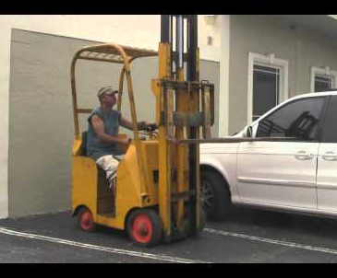
Direct Threat
A tow motor operator with angina was disqualified from driving after an examination by the Company doctor. He was transferred to another position but later disqualified from that position. Then he was placed on moderate sick leave.
Any problems for the employer?
Warzel v. Whirlpool Corp.

Slide 139

Direct Threat
An oil refinery worker with chronic active Hepatitis C applied for and was rejected for work in an oil refinery. The Company rejected him on the advice of its physician because his liver enzymes were outside the normal range.
Any problems for the employer?
Echazabel v. Chevron USA, Inc.

Slide 140
Questions?
www.laborlawyers.com
Atlanta · Baltimore · Boston · Charlotte · Chicago · Cleveland · Columbia · Columbus · Dallas · Denver · Fort Lauderdale · Gulfport
Houston · Irvine · Kansas City · Las Vegas · Los Angeles · Louisville · Memphis · New England · New Jersey · New Orleans
Orlando · Philadelphia · Phoenix · Portland · San Antonio · San Diego · San Francisco · Tampa · Washington, DC

Slide 141
Effective Performance Management
www.laborlawyers.com
Atlanta · Baltimore · Boston · Charlotte · Chicago · Cleveland · Columbia · Columbus · Dallas · Denver · Fort Lauderdale · Gulfport
Houston · Irvine · Kansas City · Las Vegas · Los Angeles · Louisville · Memphis · New England · New Jersey · New Orleans
Orlando · Philadelphia · Phoenix · Portland · San Antonio · San Diego · San Francisco · Tampa · Washington, DC

Slide 142

Performance Management Goals
Establish processes that help you get best performance from every employee
Create an accurate record of employee performance

Slide 143
Overview
Getting The Right People
Setting Expectations
Performance Coaching
Getting Rid Of
Poor Performers

Slide 144
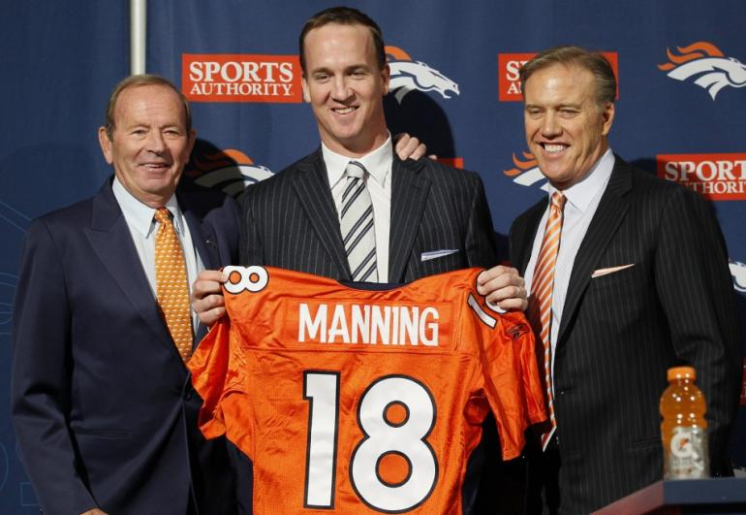
Step 1: Getting The Right People
Recruiting
Screening
Interviewing
Hiring
Using the introductory period

Slide 145

Step 2: Setting Expectations
Thorough orientation
Employee handbook
Policy memos/reminders
Training
“Work withs”

Slide 146
Step 3: Performance Coaching
Performance evaluations
Discipline
360s
Individual coaches
Intervention

Slide 147
Benefits Of Evaluations For Employer
Assess relative skills and abilities
Improve performance
Set goals and motivates
Reinforce good performance (or reverse)
Advise employee of strengths and weaknesses
Create basis for raises, promotion, etc.
Help with succession planning
Determine if additional training or guidance is needed
Make record for legal defense

Slide 148

Benefits Of Evaluations For Employee
Satisfy need for feedback
Constructively raise awareness of weaknesses
Correct unrealistic self-perceptions
Adjust future expectations
Provide upward feedback

Slide 149
Planning The Evaluation Interview
Have the employee complete a self-evaluation
Outline the major points
Anticipate the employee’s reaction
Be prepared to support your evaluation
Be clear about what you want the employee to do
Have a plan in mind for helping the employee improve

Slide 150

Common Problems With Evaluations
Managers don’t buy into process
Inter-rater inconsistency
Failure to complete on time
Forms too cumbersome
Lack of consistency
Lack of objectivity

Slide 151
Common Problems With Evaluations
Letting one incident affect the whole evaluation
Being influenced by prior evaluations
Evaluation without a proper standard
Failure to cite critical incidents
Not allowing enough time

Slide 152

Delivering The Evaluation
  Meet in a private place
  Meet at an appropriate time
  Don’t rush
  Good news first
  Don’t “sugarcoat” bad news
  Anticipate employee’s reaction
  Be ready with examples
  Let employee talk
  End on positive note
  Have employee sign form
  Signed form goes in personnel file

Slide 153

After The Evaluation
Do not discuss evaluation results
with others
Show continued interest and provide
ongoing informal feedback to employee
Don’t wait until next year to deal with
problems – use corrective action
if appropriate
Make notes throughout year for
next evaluation
Follow-up on unsatisfactory reviews –
eliminate employees who fail to improve

Slide 154
A Few Words About Discipline
Timely
Consistent
Objective
Impartial
Progressive
Appropriate

Slide 155
Documenting Discipline
Every warning should end with:
“Repetition of this conduct, failure to follow any of our normal work rules or rules of conduct or to meet our standards of performance will result in further disciplinary action, up to and including immediate termination of your employment.”

Slide 156
Other Means Of Performance
Coaching Management
360s
Coaches
Intervention

Slide 157
Step 4: Getting Rid Of Poor Performers
Your last resort is termination of employment
Must be set up properly
Consider outplacement as a performance “management” tool
Documentation is critical

Slide 158
Questions?
www.laborlawyers.com
Atlanta · Baltimore · Boston · Charlotte · Chicago · Cleveland · Columbia · Columbus · Dallas · Denver · Fort Lauderdale · Gulfport
Houston · Irvine · Kansas City · Las Vegas · Los Angeles · Louisville · Memphis · New England · New Jersey · New Orleans
Orlando · Philadelphia · Phoenix · Portland · San Antonio · San Diego · San Francisco · Tampa · Washington, DC

Slide 159
What Would You Do If…
Planning For HR Contingencies
www.laborlawyers.com
Atlanta · Baltimore · Boston · Charlotte · Chicago · Cleveland · Columbia · Columbus · Dallas · Denver · Fort Lauderdale · Gulfport
Houston · Irvine · Kansas City · Las Vegas · Los Angeles · Louisville · Memphis · New England · New Jersey · New Orleans
Orlando · Philadelphia · Phoenix · Portland · San Antonio · San Diego · San Francisco · Tampa · Washington, DC

Slide 160
Do You Have Contingency Plans?
Storm outages?
Weather-related office closings?
Employee absences?
Fire drill?
Bomb threat?
Cutting services for non-paying members?
Other similar predictable “challenges?”

Slide 161
You Need Contingency Plans
For HR Issues
Anticipate predictable HR issues
Plan your initial response
Educate the possible first responders
Successfully resolve the issues
Minimize or avoid legal liability

Slide 162
Overview Of This Session
Fast-paced, interactive scenarios
Focusing on practical day-to-day actions
With commentary on legal backdrop
Your questions and comments welcome

Slide 163
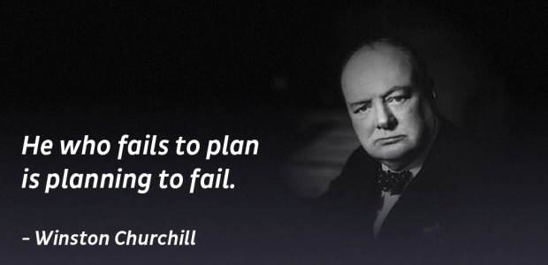
Sage Advice

Slide 164

What Would You Do If….
A new employee refuses to sign the Acknowledgment of
Receipt for your employee handbook?

Slide 165

What Would You Do If….
The background check on a job candidate job shows multiple arrests?

Slide 166
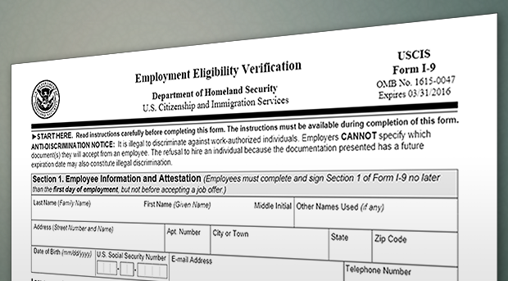
What Would You Do If….
A new employee presents evidence that his authority to work in the U.S expires only a few months after you hired him?

Slide 167

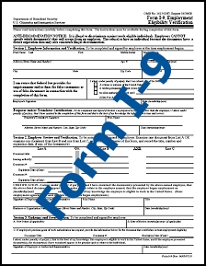
What Would You Do If….
An official from Homeland Security shows up at your Coop and asks to review your I-9 Forms?

Slide 168

What Would You Do If….
An employee in her introductory period
tells you she is pregnant?

Slide 169

What Would You Do If….
An employee claims he is legally entitled
to a “smoke break?”

Slide 170

What Would You Do If….
An employee who tested positive for cannabis metabolites claims it was OK because he spent the weekend in Colorado where recreational pot use is legal?

Slide 171

What Would You Do If….
An employee who tested positive for cannabis metabolites says he has a prescription from his home state of California for medical marijuana?

Slide 172
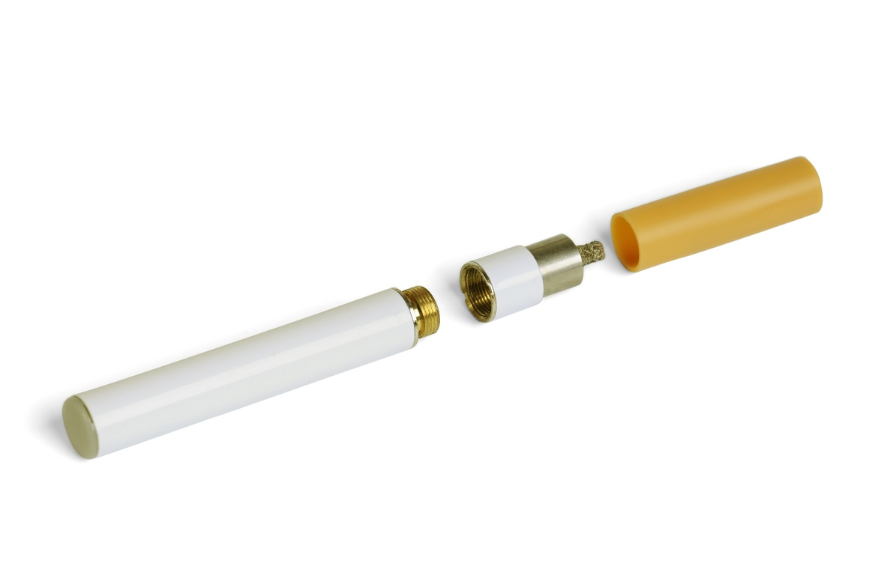
What Would You Do If….
An employee asks if he could smoke his e-cigarettes
while at work?

Slide 173

What Would You Do If….
A delivery driver is making sexual advances
toward one of your member services reps?

Slide 174

What Would You Do If….
An employee claims that a Board Member
asked her out on a date?

Slide 175
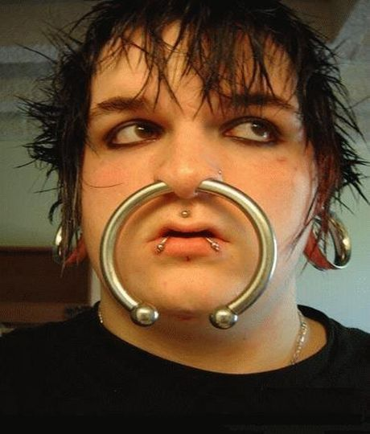
What Would You Do If….
A new employee shows up with a ring in his nose?

Slide 176

What Would You Do If….
An employee objects to being warned
not to gossip about members?

Slide 177

What Would You Do If….
Two employees post comments on their Facebook pages that are critical of your Coop’s lack of medical benefits for employees?

Slide 178

What Would You Do If….
An employee says he was approached by an IBEW organizer and told if he signed the card he would get a $4.00/hour raise?

Slide 179

What Would You Do If….
You catch an employee using your Coop’s computer
to access an on-line auction site?

Slide 180
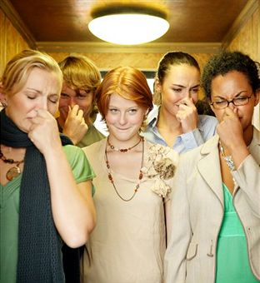
What Would You Do If….
Members complain that one of your employees
has horrible body odor?

Slide 181

What Would You Do If….
Your custodian says he doesn’t have to shave his beard?

Slide 182

What Would You Do If….
An employee reports to work one morning looking like he
hasn’t had a bath or combed his hair in a week?

Slide 183

What Would You Do If….
You get a call from the owner of another Coop asking questions about one of your former employees?

Slide 184

What Would You Do If….
An applicant shows up with a few tattoos?

Slide 185

What Would You Do If….
An employee threatens to go to OSHA
to “blow the whistle” on you?

Slide 186

What Would You Do If….
The mother of an employee called and left a message
that her daughter was sick but you have not heard
anything else from either of them in two weeks?

Slide 187

What Would You Do If….
An employee presents you with a doctor’s note
that said he could only lift 10 pounds?

Slide 188

What Would You Do If….
A depressed employee asks to work a schedule
with reduced hours?

Slide 189

What Would You Do If….
You suspect an employee of theft from your Coop?

Slide 190

What Would You Do If….
Your new General Manager wants to terminate the employment of a long-time employee who has never been disciplined?

Slide 191

What Would You Do If….
Your warehouse clerk, a self-proclaimed gun nut, says he’s mad and wants to “take out” a bunch of people?

Slide 192

What Would You Do If….
Your receptionist says she needs to be paid a flat salary to qualify for a new home loan?

Slide 193
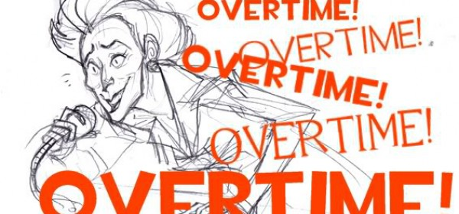
What Would You Do If….
Your assistant claims you owe her overtime for the work she took home every weekend
for the past two years?

Slide 194

What Would You Do If….
You receive a call from an investigator from the DOL’s Wage & Hour Division requesting you to send two year’s of payroll information?

Slide 195

What Would You Do If….
You receive notice of a charge of discrimination
from the EEOC?

Slide 196
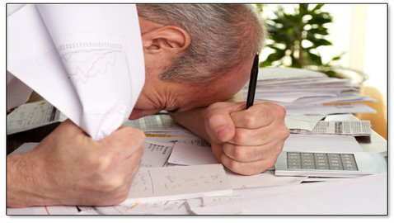
What Would You Do If….
You receive notice from a local court that you did not respond to a garnishment and are now in default?

Slide 197

What Would You Do If….
You receive a letter from an ex-employee’s attorney demanding money for damages and a copy of the employee’s personnel file?

Slide 198
A Few Action Items
1. Make sure you have the right paperwork in place
  Application
  I-9 forms
  Background check forms
  Employee handbook
  Parents’ handbook
  Agreement with your Director

Slide 199
A Few Action Items
2. Make sure you have the right procedures in place
  Background checks & screening
  Hiring
  Orientation & training
  Pay practices
  Grievance procedure
  Safety & security
  Accommodations & leaves of absence
  Protecting confidential information
  Discipline & discharge
  Documentation of all personnel related activities
  Unemployment claims
  Garnishments

Slide 200
A Few Action Items
Have Contingency Plans In Place
  Expect the “unpredictable but predictable”
  Lay the preventive “groundwork”
  Plan your initial response
  Have trusted advisors available
  Educate first responders
  Follow through

Slide 201
A Few Action Items
4. Manage the “High Risk” Decisions
  Deviations from “past practice” or inconsistent treatment
  Protected categories
  Protected concerted activities
  Whistleblower claims & retaliation
  “Problem employees”
  Every termination

Slide 202
A Few Action Items
5. Get Legal Advice Before A Problem Arises
  About transactional matters
  About contingency planning
  Individual high risk decisions
  Prior or contemporary development of “evidence”

Slide 203
Final Questions
www.laborlawyers.com
Atlanta · Baltimore · Boston · Charlotte · Chicago · Cleveland · Columbia · Columbus · Dallas · Denver · Fort Lauderdale · Gulfport
Houston · Irvine · Kansas City · Las Vegas · Los Angeles · Louisville · Memphis · New England · New Jersey · New Orleans
Orlando · Philadelphia · Phoenix · Portland · San Antonio · San Diego · San Francisco · Tampa · Washington, DC

Slide 204

Thank You
Presented by:
D. Albert Brannen
Direct: (404) 240-4235
dabrannen@laborlawyers.com
www.laborlawyers.com
Atlanta · Baltimore · Boston · Charlotte · Chicago · Cleveland · Columbia · Columbus · Dallas · Denver · Fort Lauderdale · Gulfport
Houston · Irvine · Kansas City · Las Vegas · Los Angeles · Louisville · Memphis · New England · New Jersey · New Orleans
Orlando · Philadelphia · Phoenix · Portland · San Antonio · San Diego · San Francisco · Tampa · Washington, DC

