Slide 1
Hot Topics in Labor and Employment Law
September 23-24, 2020
Bob Riegel & Katie Rudderman
Presented to:

Slide 2
Wishing we were at the Sandpearl!

Slide 3
Hot Topics
U.S. Supreme Court
Recent Happenings
Sexual Orientation and Gender Identity
Families First Coronavirus Response Act and COVID-19
Drug-Free Workplace Program and Medical Marijuana
Independent Contractor vs. Employee Misclassification
Leaves of Absence
Social Media Postings

Slide 4
And then… give us your questions!
You may email Michell Hershel (mhershel@feca.com) with questions during our presentation.
You may send “chat” messages to Alisia during our presentation.
For tomorrow, you can submit questions by emailing CCassidy@RTLAW.com by 4:00 p.m. today.
Please indicate in the subject line: FECA Conference

Slide 5
Justice Ruth Bader Ginsburg March 15, 1933 – September 18, 2020
Appointed by President Jimmy Carter to the U.S. Court of Appeals for the District of Columbia in 1980.
Appointed by President Bill Clinton to the U.S. Supreme Court in 1993.
“In 1996, Ginsburg wrote the majority opinion in United States v. Virginia, holding that qualified women could not be denied admission to Virginia Military Institute.”
“She dissented in Ledbetter v. Goodyear Tire & Rubber Co. where the plaintiff, a female worker being paid significantly less than males with her same qualifications, sued under Title VII but was denied relief under a statute of limitations issue.”
“She also called for Congress to undo this improper interpretation of the law in her dissent, and then worked with President Obama to pass the very first piece of legislation he signed, the Lilly Ledbetter Fair Pay Act of 2009, a copy of which hangs proudly in her office.”
See: https://www.oyez.org/justices/ruth_bader_ginsburg

Slide 6
U.S. Supreme Court Justices
October 2018 to September 2020
Photo: https://www.supremecourt.gov/about/justices.aspx

Slide 7
Are sexual orientation and gender identity protected under Title VII?

Slide 8
Looking Back…
2018 Spilt Among the Circuits
2nd Circuit: Sexual orientation is protected under Title VII.
6th Circuit: Transgender status is protected under Title VII.
11th Circuit: Sexual orientation is not protected under Title VII.
2019 Supreme Court
April: The U.S. Supreme Court accepted review of the above three cases.
October: The U.S. Supreme Court held oral argument on the three cases.
How did the Supreme Court rule?

Slide 9
Bostock v. Clayton County, Georgia (2020)
June 15, 2020
The United States Supreme Court ruled that discrimination because of “sex” includes discrimination because of homosexuality and transgender status.
“When an employer fires an employee for being homosexual or transgender, it necessarily and intentionally discriminates against that individual in part because of sex. And that is all Title VII has ever demanded to establish liability.”
Related Issues Not Before the Court:
Effect on other federal and state laws;
Freedom of religion;
Employee bathroom, locker room, and dress code issues.
Opinion located here: https://www.supremecourt.gov/opinions/19pdf/17-1618_hfci.pdf

Slide 10
Justice Alito’s Dissent: Transgender Status vs. Gender Identity
Footnote 6: “The Court does not define what it means by ‘transgender status,’ but the American Psychological Association describes ‘transgender’ as ‘[a]n umbrella term encompassing those whose gender identities or gender roles differ from those typically associated with the sex they were assigned at birth.’ A Glossary: Defining Transgender Terms, 49 Monitor on Psychology 32 (Sept. 2018), https://www.apa.org/monitor/2018/09/cecorner-glossary. It defines ‘gender identity’ as ‘[a]n internal sense of being male, female or something else, which may or may not correspond to an individual’s sex assigned at birth or sex characteristics.’ Ibid. Under these definitions, there is no apparent difference between discrimination because of transgender status and discrimination because of gender identity.”
Opinion located here: https://www.supremecourt.gov/opinions/19pdf/17-1618_hfci.pdf

Slide 11
OSHA: Best Practices for Restroom Access for Transgender Workers
“Core principle: All employees, including transgender employees, should have access to restrooms that correspond to their gender identity.”
“For example, a person who identifies as a man should be permitted to use men’s restrooms, and a person who identifies as a woman should be permitted to use women’s restrooms. The employee should determine the most appropriate and safest option for him- or herself.”
OSHA Guidance: https://www.osha.gov/Publications/OSHA3795.pdf

Slide 12
OSHA: Restroom Best Practices (continued)
“The best policies also provide additional options, which employees may choose, but are not required, to use. These include:
Single-occupancy gender-neutral (unisex) facilities; and
Use of multiple-occupant, gender-neutral restroom facilities with lockable single occupant stalls.”
“Under these best practices, employees are not asked to provide any medical or legal documentation of their gender identity in order to have access to gender-appropriate facilities. In addition, no employee should be required to use a segregated facility apart from other employees because of their gender identity or transgender status. Under OSHA standards, employees generally may not be limited to using facilities that are an unreasonable distance or travel time from the employee’s worksite.”

Slide 13
What else has happened in 2020?

Slide 14
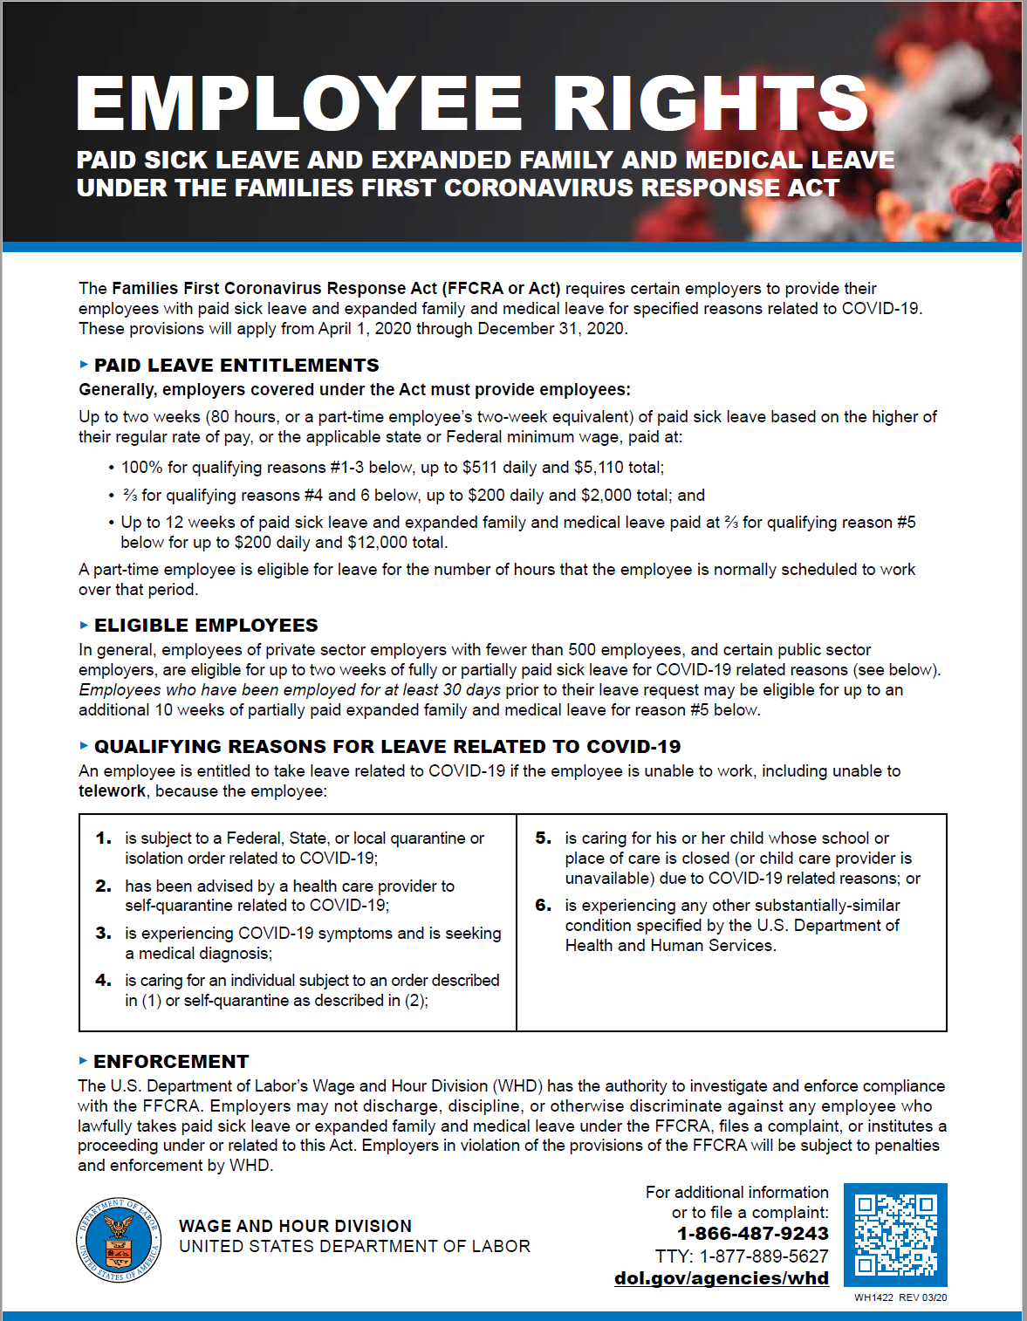
Families First Coronavirus Response Act
Currently in effect until December 31, 2020
DOL Poster: https://www.dol.gov/sites/dolgov/files/WHD/posters/FFCRA_Poster_WH1422_Non-Federal.pdf

Slide 15
Some History…
March 18, 2020: President signed into law the Families First Coronavirus Response Act with three key portions impacting employers:
Division C: Emergency Family and Medical Leave Expansion Act
Division E: Emergency Paid Sick Leave Act
Division G: Tax Credits for Paid Leaves under Divisions C and E
March 24, 2020: DOL began issuing its Questions and Answers regarding the FFCRA and has continued to expand and update its Q&A’s as recently as September 11, 2020.
March 25, 2020: DOL published a poster with a model of the notice that covered employers must post pursuant to the FFCRA.
April 1, 2020: IRS issued guidance on what records employers should obtain from their employees who request FFCRA paid leave to later provide support for obtaining tax credits.
Please note that the FFCRA does not apply to employers with 500 or more employees.

Slide 16
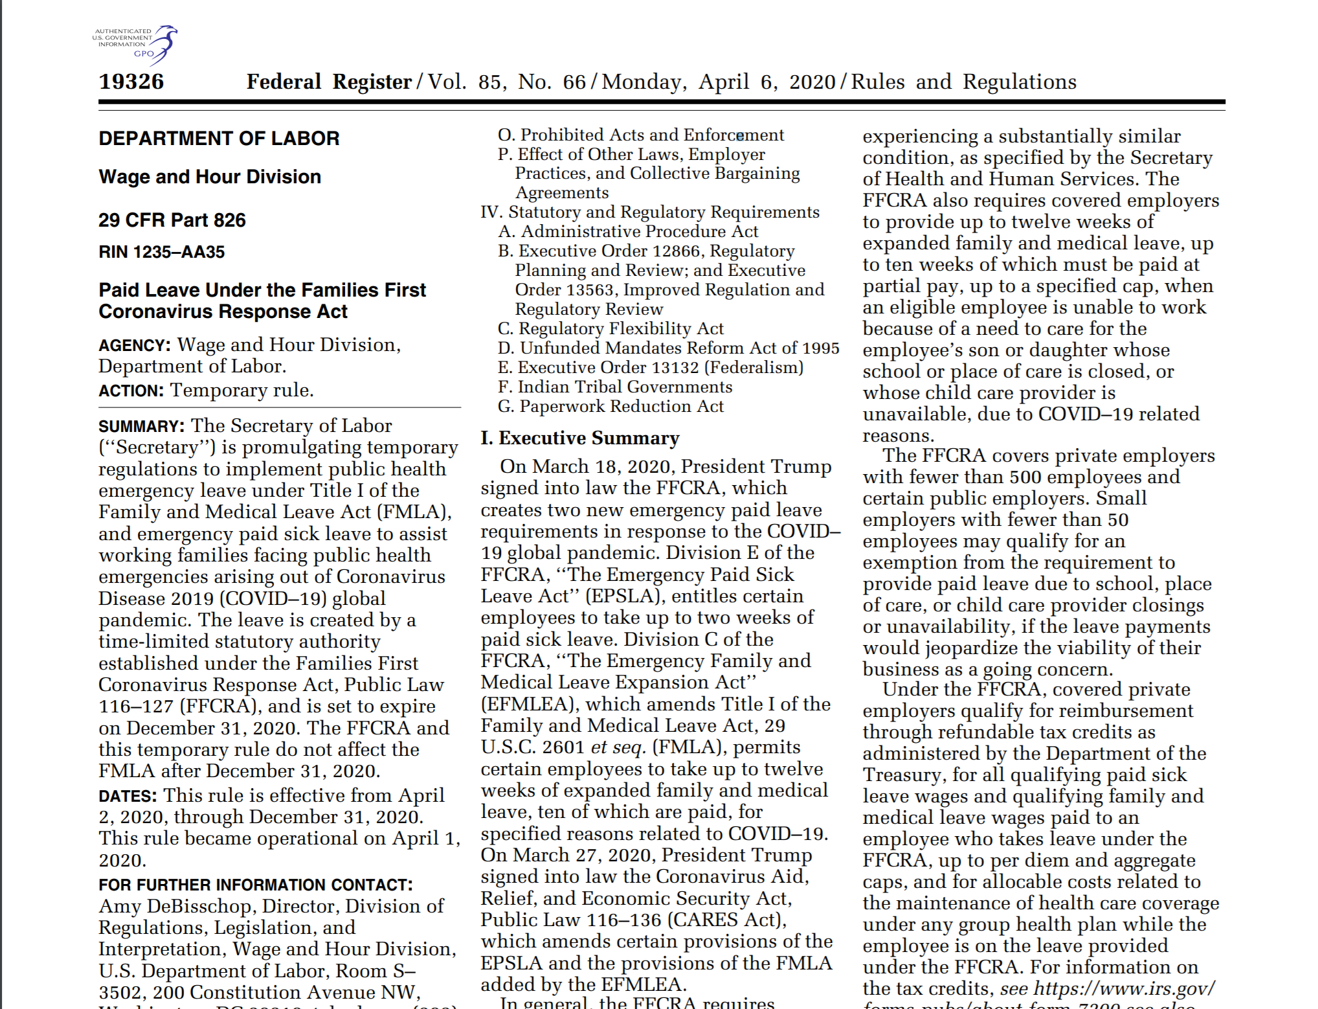
April 6, 2020: DOL Regulations

Slide 17
August 3, 2020: New York v. Scalia Some DOL Regulations Invalid
“The ongoing COVID-19 pandemic has visited unforeseen and drastic hardship upon American workers. In response to this extraordinary challenge, Congress passed the Families First Coronavirus Response Act, which, broadly speaking, entitles employees who are unable to work due to COVID-19’s myriad effects to federally subsidized paid leave. Congress charged the Department of Labor (‘DOL’) with administering the statute, and the agency promulgated a Final Rule implementing the law’s provisions. See 85 Fed. Reg. 19,326 (Apr. 6, 2020) (‘Final Rule’).
The State of New York brings this suit under the Administrative Procedure Act, claiming that several features of DOL’s Final Rule exceed the agency’s authority under the statute … the Court concludes that New York has standing to sue and that several features of the Final Rule are invalid.”

Slide 18
SDNY: Some DOL Regulations Invalid
The FFCRA’s very broad definition of health care provider “cannot stand.”
The requirement that work be available for an employee to receive FFCRA paid leave for some reasons but not others “is entirely unreasoned.”
The DOL did not sufficiently justify the requirement of employer consent for intermittent FFCRA leave.
The requirement that an employee provide documentation before being granted FFCRA leave “is inconsistent with the statute’s unambiguous notice provisions.”
But: We continue to recommend obtaining such documentation as it helps to document the tax credit the employer is entitled to receive.

Slide 19
DOL: Changes to Regulations
The definition of “health care provider” has been revised.
The DOL continues to assert that “an employee is not eligible for paid leave unless the employer would otherwise have work for the employee to perform.”
An employee must still obtain employer consent for intermittent leave (if the employee is not teleworking).
Employers cannot require documentation as a precondition to taking FFCRA leave.
Employers are not required to provide FFCRA paid leave if an employee determines on his/her own that it is unsafe for them to work, or if the employer requires the employee to self-isolate, unless the employee:
(1) has symptoms of COVID-19 that will be reviewed by a health care provider; or
(2) is subject to a health care provider’s or governmental order to self-quarantine.
No change was made to the cap on the amount of paid leave available to employees in 2020, and the law is still set to expire this December 31.

Slide 20
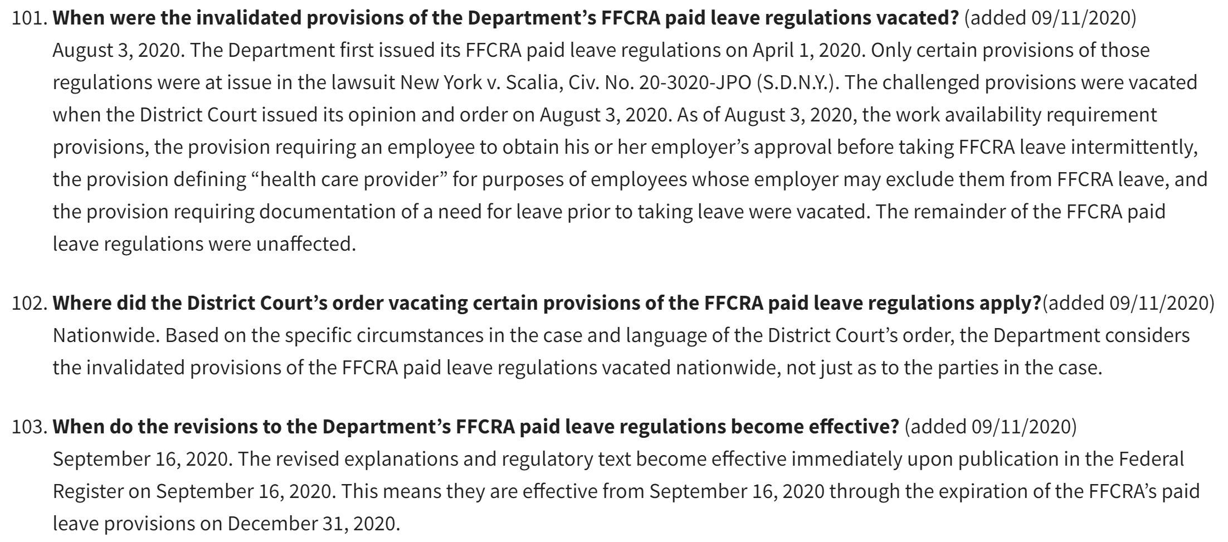
September 16, 2020: Revised Regulations Check out DOL Q&As #101-103
See: hhttps://www.dol.gov/agencies/whd/pandemic/ffcra-questions

Slide 21
FFCRA: Emergency Paid Sick Leave
Under the FFCRA, an employee may receive up to two weeks of paid sick leave if the employee is unable to work or telework because the employee:
is subject to a Federal, State, or local quarantine or isolation order related to COVID-19;
has been advised by a health care provider to self-quarantine related to COVID-19;
is experiencing COVID-19 symptoms and is seeking a medical diagnosis;
is caring for an individual who is either subject to an order described in (1) above or subject to self-quarantine as described in (2) above;
is caring for the employee’s own child whose school, place of care, or childcare provider is closed or unavailable for reasons related to COVID-19; or
is experiencing any other substantially-similar condition specified by the Secretary of U.S. Department of Health and Human Services.
No. 6 has no applicability yet because the Secretary of Health and Human Services has not specified any “substantially-similar condition.”

Slide 22
FFCRA: Emergency Paid Sick Leave (continued)
For reasons (1), (2), and (3), the employee receives of his/her normal pay for up to two weeks, with a maximum of $511 daily and $5,110 total.
For reasons (4), (5), and (6), the employee receives two-thirds of his/her normal pay for up to two weeks, with a maximum of $200 daily and $2,000 total.
For Reason #5, the employee may be eligible for another 10 weeks of paid leave – to be discussed shortly.
Employees cannot be required to use other types of paid leave before using their FFCRA paid sick leave.

Slide 23
Telework and the FFCRA
When is an employee able to telework under the FFCRA?
When the employer allows the employee to perform work at home or at another location away form the normal workplace.
If an employee is able to telework, then he/she is not eligible for paid leave under the FFCRA.
When is an employee unable to telework under the FFCRA?
When an employee is not able to perform his/her normal job duties at home or at another location away from the employee’s normal worksite.
For example: A lineman is unable to telework because he/she cannot perform his/her job duties from home.
For example: A payroll manager is likely able to telework if he/she can perform his/her job duties from a computer at home.
When an employee falls under one of the FFCRA’s six qualifying reasons and that reason prevents the employee from being able to telework.
If an employee is unable to telework and falls under one of the FFCRA’s six reasons, then he/she will be eligible for paid leave.

Slide 24
FFCRA: Emergency Paid Family and Medical Leave
Under the FFCRA, beyond the two weeks of paid sick leave, the employee may receive up to 10 weeks of emergency paid family and medical leave if the employee is unable to work or telework because the employee:
is caring for the employee’s own child whose school, place of care, or childcare provider is closed or unavailable for reasons related to COVID-19.
The employee must have been employed for at least 30 days before the leave request.
The employee receives two-thirds of his/her normal pay for up to 10 weeks, with a maximum of $200 daily and $10,000 total.
All other provisions of the FMLA still apply to the employee’s leave of absence.

Slide 25
FFCRA: When is a school, place of care, or childcare provider closed or unavailable?
When a school or place of care is closed due to Covid-19.
For example, students tested positive for Covid-19 and the school is closed for two weeks for sanitation and quarantine.
On normal school days when a child cannot (and does not have the option to) attend school in person.
For example, because a child’s school is rotating when students may attend school in person.
For example, because a child’s school is opening for distance learning only at this point.
For the reasons listed above, an employee may be eligible for FFCRA paid leave.
See DOL Questions and Answers 98-100: https://www.dol.gov/agencies/whd/pandemic/ffcra-questions#98

Slide 26
FFCRA: A school, place of care, or childcare provider is not closed or unavailable when:
In-person attendance is available to the employee’s child, but the employee instead decides to keep his/her child home and enrolls the child in online or distance learning classes.
The employee is not eligible for FFCRA paid leave in these circumstances.

Slide 27
Additional Telework Issues
Discrimination
Treat similarly-situated employees the same when deciding whether you will permit the employees to telework.
For example: Make the determination on a position basis or other legitimate business reason, not on an individual basis.
For example: Do not consider age when determining whether an employee should be permitted to telework. (Caveat: Unless the employee has provided a doctor’s note expressing a need for an accommodation.)
Disability
If an employee has been provided a reasonable accommodation for a disability at his/her normal work location, consider whether that accommodation needs to be provided to the employee if he/she is approved to telework.
If an employee requests to telework due to a medical reason, consult with legal counsel on whether the accommodation would be reasonable and/or consistent with your Cooperative’s policy and practice.

Slide 28
Additional Telework Issues (continued)
Quality Control
Make sure that work schedules and expectations are clearly established.
Implement employee monitoring controls such as requiring daily or weekly check-ins and updates on pending work tasks.
Fair Labor Standards Act (“FLSA”)
Remember that all non-exempt employees must accurately record and report all hours worked.
Ensure that no non-exempt employees are working “off the clock.”
Make sure that IT can remotely monitor and access employee computers if necessary.

Slide 29
Coronavirus Disease 2019 –- CDC Guidance
Please check the CDC website frequently for changes in guidance being issued: https://www.cdc.gov/

Slide 30
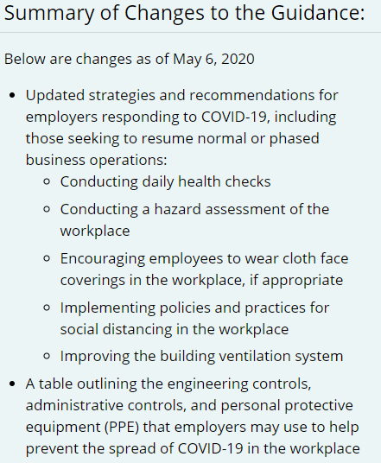
CDC Guidance: Employee Health Checks
See: https://www.cdc.gov/coronavirus/2019-ncov/community/guidance-business-response.html

Slide 31
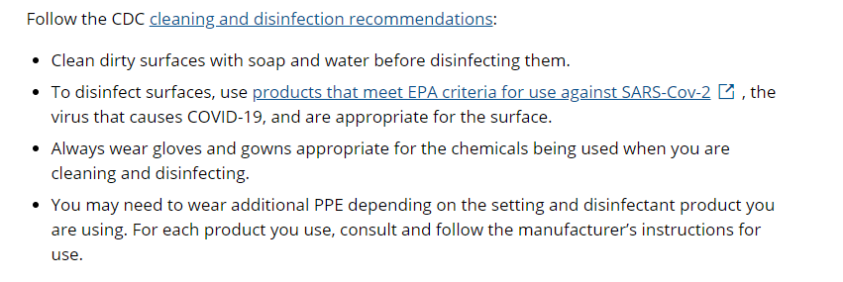
CDC Guidance: Cleaning Recommendations
See: https://www.cdc.gov/coronavirus/2019-ncov/community/guidance-business-response.html

Slide 32
CDC Guidance: When to Quarantine
See: https://www.cdc.gov/coronavirus/2019-ncov/if-you-are-sick/quarantine.html

Slide 33
What does OSHA say?
See: https://www.osha.gov/SLTC/covid-19/controlprevention.html

Slide 34
OSHA: General Guidance for All Workers and Employers
See: https://www.osha.gov/SLTC/covid-19/controlprevention.html

Slide 35
What has your Cooperative been doing to deal with COVID-19?
What are the risks of not doing anything to address COVID-19 concerns?

Slide 36
Workplace Social Distancing Considerations
Consider staggering shifts or normal arrival and departure times to limit the number of employees entering and leaving the workplace at the same time.
Increase physical space between employee workstations as much as possible.
Implement one-way paths in larger workplaces to reduce the number of employees coming into contact with each other during the day.
Use signs, tape marks, or other visual cues such as decals or colored tape on the floor, placed at least six feet apart, to indicate where employees (and customers) should stand when physical barriers are not possible.

Slide 37
Workplace Social Distancing Considerations (continued)
Close or restrict access to employee common areas where employees usually like to congregate and interact (e.g. remove tables and seats in employee breakrooms).
For meetings and other employee gatherings:
Use videoconferencing or teleconferencing whenever possible.
Cancel, adjust, or postpone large work-related meetings or gatherings that can only occur in-person in accordance with state and local regulations and guidance.
When videoconferencing or teleconferencing is not possible, hold meetings in open, well-ventilated spaces, maintaining at least six feet between each person, and require that face coverings be worn.
Prohibit handshaking.

Slide 38
If an employee tests positive for COVID-19, is the employee eligible for workers’ compensation benefits?

Slide 39
Workers’ Compensation: Fla. Stat. § 440.151
Generally, NO unless the employee is a first responder.
Greater burden of proof under occupational disease standards.
“…the term ‘occupational disease’ shall be construed to mean only a disease which is due to causes and conditions which are characteristic of and peculiar to a particular trade, occupation, process, or employment, and to exclude all ordinary diseases of life to which the general public is exposed, unless the incidence of the disease is substantially higher in the particular trade, occupation, process, or employment than for the general public. ‘Occupational disease’ means only a disease for which there are epidemiological studies showing that exposure to the specific substance involved, at the levels to which the employee was exposed, may cause the precise disease sustained by the employee.”
See: leg.state.fl.us/statutes/index.cfm?App_mode=Display_Statute&Search_String=&URL=0400-0499/0440/Sections/0440.151.html

Slide 40
COVID-19 Employment Policy Considerations
Prohibit employees from coming to work when they:
Are exhibiting COVID-19 symptoms;
Have tested positive for COVID-19 (regardless of symptoms);
Have a household member who has tested positive for COVID-19 (regardless of symptoms);
Have been exposed* to someone who tested positive for COVID-19 (regardless of symptoms);
Are in similar situations where reporting to work would risk exposing others to the virus.
Employees should still be required to follow all normal call-out procedures.
Managers should know when to contact HR for help.
HR should periodically review and update policy language as the pandemic and agency guidance, such as from the CDC, are continuing to evolve.
*Exposure includes being within six feet for 15 minutes or more.

Slide 41
Possible COVID-19 Policy Requirements for Employees
Wash your hands often with soap and water for at least 20 seconds. If soap and water are not available, use an alcohol-based hand sanitizer comprised of at least 60-95% alcohol.
Wash your hands or use hand sanitizer each time you enter or leave a work facility, each time you clock in and out, and frequently during the workday.
Additional key times to clean your hands include after using the restroom facilities, before eating or preparing food, after blowing your nose, coughing or sneezing, and after putting on, touching or remove face coverings.
Clean and disinfect frequently touched objects and surfaces using appropriate cleaning sprays or wipes. This includes workstations, doorknobs, desks, keyboards, handrails, remote controls, phones, tables, countertops, and similar objects and surfaces.
Do not use other employees’ phones, desks, offices or other work tools and equipment.
Do not go beyond the threshold of the door when speaking to other employees in their offices.
Wear face coverings, such as masks, whenever you travel through the office or anticipate being in the same space as another employee.
Do not touch your face with unwashed hands or after touching potentially contaminated surfaces.
Use proper respiratory etiquette (including only coughing and sneezing into one’s upper sleeve, not hands), and then promptly sanitize hands after coughs or sneezes.

Slide 42
Possible COVID-19 Policy Requirements for Employees (continued)
Do not shake hands with others and do not engage in other greetings involving touching, such as hugs.
Practice social distancing at all times and avoid gatherings with other employees; Remain six feet or more away from others wherever possible.
Avoid all non-essential work travel.
Utilize telephonic and web-based conferences instead of in-person meetings whenever possible.
Only when an in-person meeting becomes essential, limit the meeting to a maximum of 10 people and practice social distancing (six feet or more away from others).
Contact HR if you anticipate engaging in any personal travel more than 100 miles away.
Engage in proper social distancing practices, remaining six feet or more from others, during and outside of work hours to help eliminate the spread of COVID-19 in our communities.
Follow all governmental orders and guidance applicable to you during the COVID-19 pandemic.

Slide 43
How to Address Employee Fears about Returning to Work
Caveat: Let’s talk about the “reasonable” person…

Slide 44
Addressing Employees Afraid to Return to Work (continued)
Reassure with Preparation and Action:
Increase Sanitary Procedures
Engage in extra sanitation procedures, including disinfecting office surfaces, equipment, doorknobs, handles, and other commonly touched items.
Consult with a medical professional, such as an epidemiologist, about the proper sanitation procedures for your workplaces.
Have additional sanitation specialists, such as a fumigation company, on standby in the event you need to quickly engage them due to an outbreak.
Ensure sure that appropriate PPE, wash stations, and hand sanitizer is available.

Slide 45
Addressing Employees Afraid to Return to Work (continued)
Communicate!
Maintain communication with your employees about the Cooperative’s requirements and expectations for a safe and healthy workplace.
Provide (general) updates on what your Cooperative is doing to protect its employees.
Implement policies and procedures for COVID-19 related issues.
Educate employees about the steps they can take to protect themselves at work and outside of work.
Provide face masks and hand sanitizer for employees and advise employees about where such items are located.

Slide 46
Addressing Employees Afraid to Return to Work (continued)
Positive Reinforcement
Thank employees for complying with your Cooperative’s policies on safety, sanitation, and social distancing.
Remind employees how (and encourage employees) to contact HR with any questions or concerns.
Manager Consistency
Reach out to managers who may be reluctant to follow the rules and remind them your Cooperative’s expectations.
Make sure your managers are consistently enforcing COVID-19 related policies.

Slide 47
Employees Refusing to Return to Work
Assuming the employee does not have a sufficient reason to be out, the Cooperative can require that the employee report to work onsite. This may be a condition of the employee’s continued employment with the Cooperative.
Consider whether you have ever permitted employees to remain home or away from the worksite in the past. Does your Cooperative have a Personal Leave of Absence policy? If so, in the past, what sort of reasons have qualified for such leave? For how long was leave granted?
Consider providing a date by which the employee must provide documentation supporting a need to remain home or report to work. Otherwise, if neither will be met, consider telling the employee that you will accept his/her voluntary resignation on that date.
Remember: Consistency is key! You should treat similarly-situated employees the same.
Caveat: Concerted activity under the NLRA.

Slide 48
Masks and Face Coverings
Can you require your employees to wear masks or other face coverings during work?

Slide 49
YES! But… Important Considerations
Safety
Consider whether wearing a mask would jeopardize the safety of an employee working in a safety sensitive position.
Are there other alternatives?
Can the employee wear the mask except for when performing certain safety-sensitive tasks?
Medical Excuse
It is uncommon but possible that an employee will say he/she cannot wear a mask or face covering due to a medical condition.
If this occurs, contact legal counsel for guidance.

Slide 50
Requiring Masks and Face Coverings: Considerations
Are there any local executive orders or other requirements requiring your employees to wear masks or other face coverings indoors or in the workplace?
Implementing a policy with restrictions regarding employees and when they are required to wear face masks, such as when:
Employees are traveling to/from and throughout the workplace;
Employees are traveling for work (personal or company vehicle) with other employees inside the vehicle;
Six-feet social distancing cannot be maintained;
Employees are working in areas that are not well ventilated;
Employees are interacting with customers, vendors, and other non-employees.
The employer can issue face masks or approved face coverings, or the employer can permit employees to utilize their own face masks, so long as they meet the employer’s preferred standards.

Slide 51
U.S. EEOC – Coronavirus Resources
EEOC’s COVID-19 Resources: https://www.eeoc.gov/coronavirus

Slide 52
Coronavirus is a hazard in the workplace. But it is not unique to the workplace or (with the exception of certain industries, like health care) caused by work tasks themselves. This by no means lessens the need for employers to address the virus. But it means that the virus cannot be viewed in the same way as other workplace hazards.
U.S. Secretary of Labor Eugene Scalia

Slide 53
COVID-19 and the Americans with Disabilities Act
Medical Inquiries – EEOC says yes you can ask!
Employers can ask employees questions about COVID-19, for example, if an employee is experiencing COVID-19 symptoms such as fever, cough, shortness of breath, sore throat, loss of taste or smell, etc.
Employers can take employees’ temperatures.
If you document employee temperatures, consider indicating “yes” or “no” of a temperature of 100.4ºF or above as opposed to writing down each employee’s temperature.
Employers can require employees to stay home from work if the employees are experiencing COVID-19 symptoms.
Employers can require employees to provide doctor’s notes before returning to work after experiencing COVID-19 symptoms. (Caveat: Discuss possible issues.)
Remember to maintain all employee medical information as confidential and to put any medical documentation in a separate, confidential medical file for the employee.
See: https://www.eeoc.gov/wysk/what-you-should-know-about-covid-19-and-ada-rehabilitation-act-and-other-eeo-laws

Slide 54
Possible Emergency Responder Exception to FFCRA Requirements
What does this mean? Does the exception still apply?

Slide 55
Employers May Exclude Emergency Responders from FFCRA Leave Provisions
“The EFMLEA and the EPSLA both provide that an employer may exclude employees who are health care providers or emergency responders from leave requirements under the Acts … An employer’s exercise of this option does not impact an employee’s earned or accrued sick, personal, vacation, or other employer-provided leave under the employer’s established policies. Further, an employer’s exercise of this option does not authorize an employer to prevent an employee who is a health care provider or emergency responder from taking earned or accrued leave in accordance with established employer policies.
Because an employer is not required to exercise this option, if an employer does not elect to exclude an otherwise-eligible health care provider or emergency responder from taking paid leave under the EPSLA or the EFMLEA, such leave is subject to all other requirements of those laws and this Part, and should be treated in the same manner for purposes of the tax credit created by the FFCRA. To minimize the spread of COVID–19, the Department encourages employers to be judicious when using this definition to exempt health care providers and emergency responders from the provisions of the FFCRA.”
See DOL Regulations: https://www.govinfo.gov/content/pkg/FR-2020-04-06/pdf/2020-07237.pdf

Slide 56
DOL “Emergency Responder” Definition
“For the purposes of Employees who may be excluded from Paid Sick Leave or Expanded Family and Medical Leave by their Employer under the FFCRA, an emergency responder is anyone necessary for the provision of transport, care, healthcare, comfort and nutrition of such patients, or others needed for the response to COVID-19. This includes but is not limited to military or national guard, law enforcement officers, correctional institution personnel, fire fighters, emergency medical services personnel, physicians, nurses, public health personnel, emergency medical technicians, paramedics, emergency management personnel, 911 operators, child welfare workers and service providers, public works personnel, and persons with skills or training in operating specialized equipment or other skills needed to provide aid in a declared emergency, as well as individuals who work for such facilities employing these individuals and whose work is necessary to maintain the operation of the facility. This also includes any individual whom the highest official of a State or territory, including the District of Columbia, determines is an emergency responder necessary for that State’s or territory’s or the District of Columbia’s response to COVID-19.”
See DOL Q&A #57: https://www.dol.gov/agencies/whd/pandemic/ffcra-questions

Slide 57
Are any of your Cooperative employees “emergency responders” for purposes of FFCRA?
If yes, who?
And what is the significance?
Could DOL’s definition of “emergency responder” be challenged ion the same way that “health care provider” has been challenged?
If so, what would be the ramifications?

Slide 58
Tread carefully!
Consult with legal counsel if you plan to exclude certain employees from the FFCRA’s paid leave provisions.

Slide 59
COVID-19 makes us appreciate the issues that existed before March 2020!

Slide 60
Florida Drug-Free Workplace

Slide 61
Are you a “Florida Drug-Free Workplace”? (for workers’ compensation insurance purposes)
If YES:
If NO:
Must comply with all requirements outlined in Florida Statutes § 440.102, including:
Providing notice and the written policy statement to all applicants and employees;
Conducting pre-hire, reasonable suspicion, fitness-for-duty, and follow-up testing;
Meeting various requirements for utilization of a Medical Review Officer (“MRO”) and other procedures.
May (but is not required to) perform pre-hire and post-hire drug testing.
Not required to comply with § 440.102 requirements but can use those as guidance in formulating drug-testing policies and procedures.
Fla. Stat. § 440.102: http://www.leg.state.fl.us/statutes/index.cfm?App_mode=Display_Statute&URL=0400-0499/0440/Sections/0440.102.html

Slide 62
Written Policy must Include:
“A list of the most common medications, by brand name or common name, as applicable, as well as by chemical name, which may alter or affect a drug test. A list of such medications as developed by the Agency for Health Care Administration shall be available to employers through the department.”
“A list of all drugs for which the employer will test, described by brand name or common name, as applicable, as well as by chemical name.”
Fla. Stat. § 440.102: http://www.leg.state.fl.us/statutes/index.cfm?App_mode=Display_Statute&URL=0400-0499/0440/Sections/0440.102.html

Slide 63
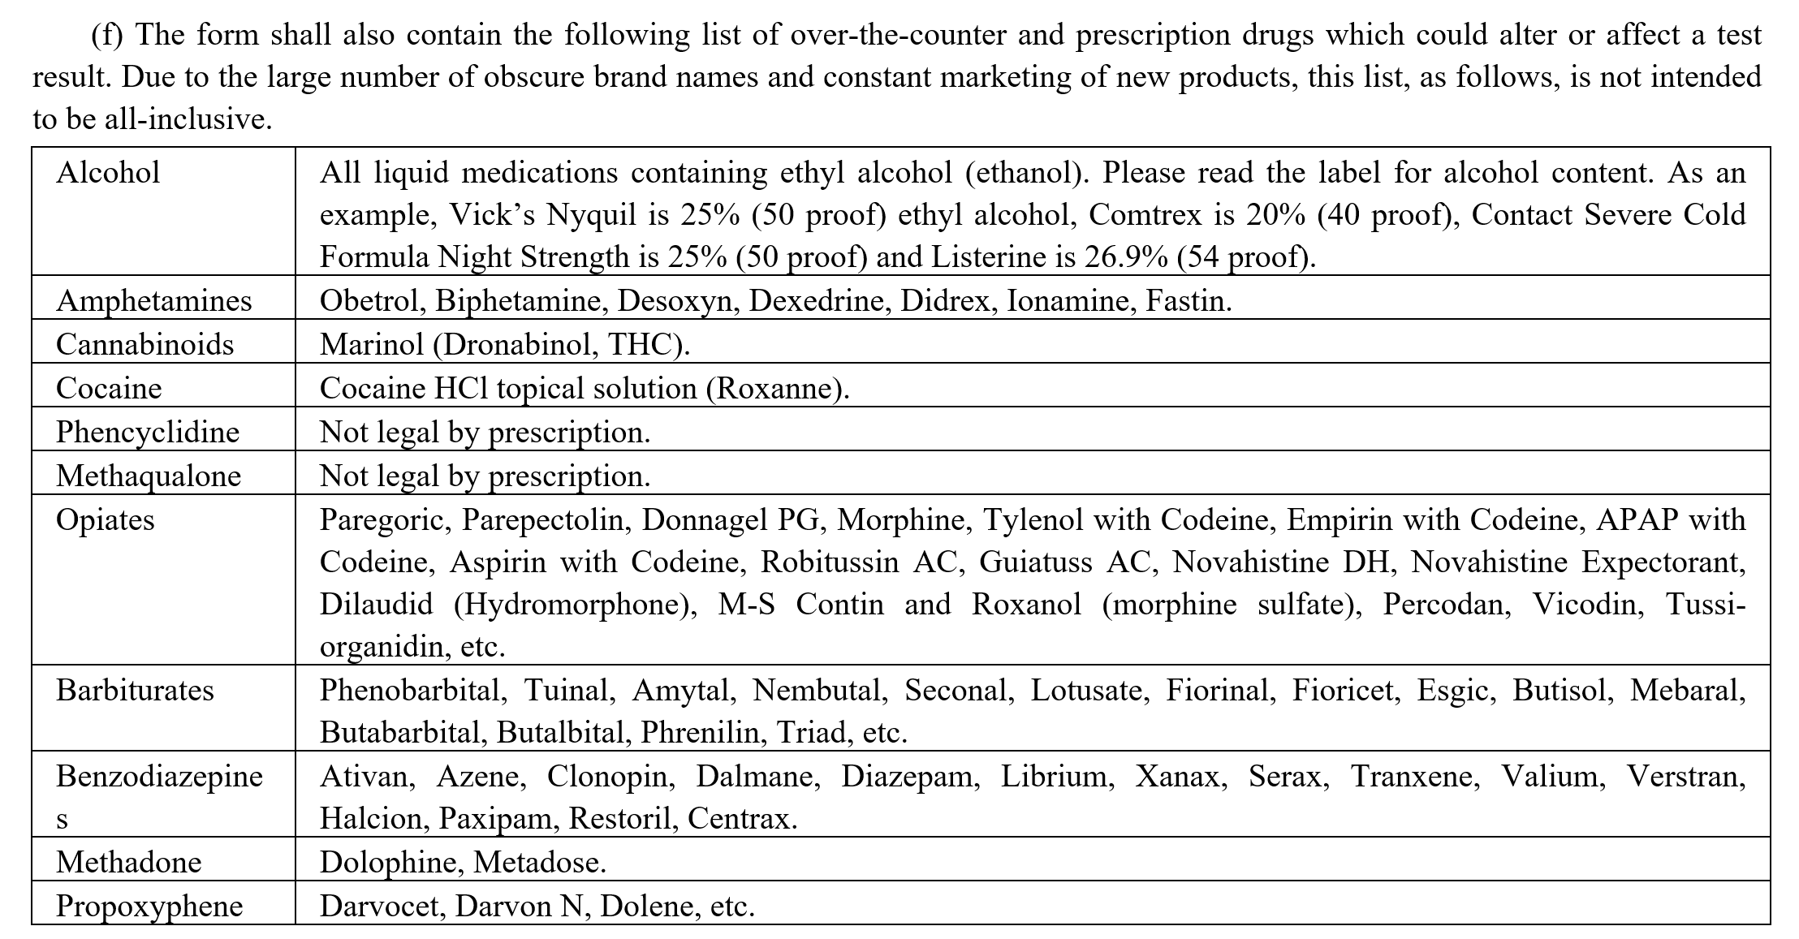
Florida Drug-Free Workplace Standards: Florida Administrative Code § 59A-24
Fla. Admin. Code § 59A-24: https://www.flrules.org/gateway/ChapterHome.asp?Chapter=59A-24

Slide 64
Florida Drug-Free Workplace Standards: Florida Administrative Code § 59A-24
Fla. Admin. Code § 59A-24: https://www.flrules.org/gateway/ChapterHome.asp?Chapter=59A-24

Slide 65
Remember! Medical Marijuana…
Is still illegal under federal law.
For U.S. Department of Transportation (“DOT”) drivers, you must follow all federal laws regarding DOT drug-testing.
“The [DOT’s] Drug and Alcohol Testing Regulation … does not authorize ‘medical marijuana’ under a state law to be a valid medical explanation for a transportation employee’s positive drug test result.”
Florida has strong protections in favor of employers who want to maintain a zero-tolerance policy.
Remember that consistency is key!
See: https://www.transportation.gov/odapc/medical-marijuana-notice

Slide 66
Florida Statutes § 381.986:
(15) APPLICABILITY.—
(a) This section does not limit the ability of an employer to establish, continue, or enforce a drug-free workplace program or policy.
(b) This section does not require an employer to accommodate the medical use of marijuana in any workplace or any employee working while under the influence of marijuana.
(c) This section does not create a cause of action against an employer for wrongful discharge or discrimination.
(d) This section does not impair the ability of any party to restrict or limit smoking or vaping marijuana on his or her private property.
(e) This section does not prohibit the medical use of marijuana or a caregiver assisting with the medical use of marijuana in a nursing home facility licensed under part II of chapter 400, a hospice facility licensed under part IV of chapter 400, or an assisted living facility licensed under part I of chapter 429, if the medical use of marijuana is not prohibited in the facility’s policies.
(f) Marijuana, as defined in this section, is not reimbursable under chapter 440.

Slide 67
Medical Marijuana in Florida: Recent Activity
January 2020: Medical Marijuana Employee Protection Act (HB 595/SB 962)
Introduced during the legislative session but did not pass!
The Act would have extended rights to private and public-sector employees and applicants, allowing persons to sue for adverse action due to status as a legal medical marijuana user.
The Act would have included an exception for positions with safety-sensitive job duties.
August 27, 2020: Florida Department of Health quietly made a change to allow edibles as a route of administration of medical marijuana to qualified patients.

Slide 68
Medical Marijuana in Florida: Restrictions on Smoking and Vaping
Medical marijuana cannot be smoked or vaped in public or in an indoor workplace.
Fla. Stat. § 381.986(1)(j).
A private party may restrict or limit smoking or vaping medical marijuana on its property.
Fla. Stat. § 381.986(15)(d).
The term “drug” means “alcohol, including a distilled spirit, wine, a malt beverage, or an intoxicating liquor; an amphetamine; a cannabinoid; cocaine; phencyclidine (PCP); a hallucinogen; methaqualone; an opiate; a barbiturate; a benzodiazepine; a synthetic narcotic; a designer drug; or a metabolite of any of the substances listed in this paragraph. An employer may test an individual for any or all of such drugs.”
Fla. Stat. § 440.102(1)(c).

Slide 69
Independent Contractor or Employee?

Slide 70
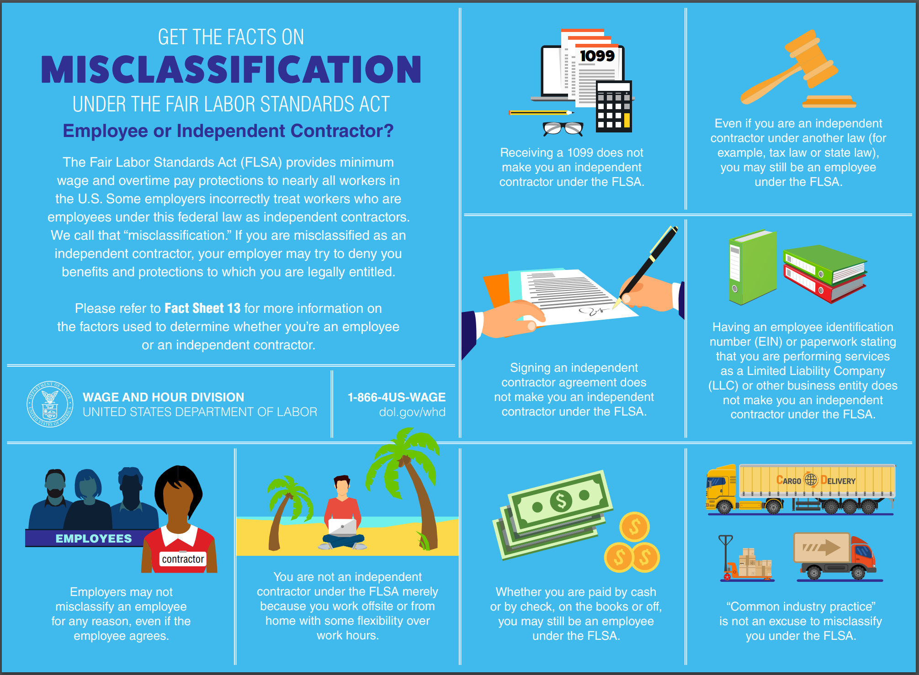
Taken from: https://www.dol.gov/sites/dolgov/files/WHD/legacy/files/misclassification-facts.pdf

Slide 71
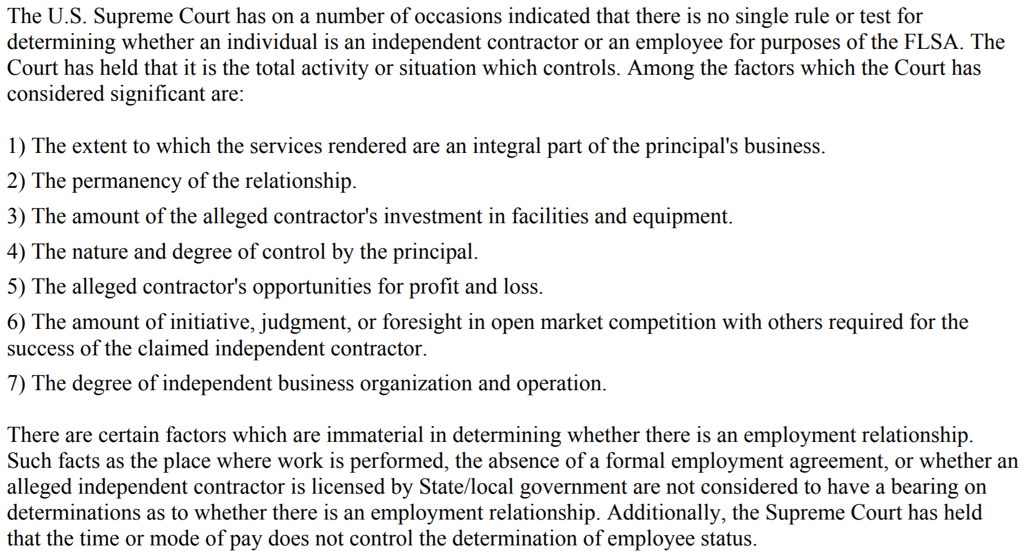
U.S. Department of Labor Fact Sheet #13
See: https://www.dol.gov/sites/dolgov/files/WHD/legacy/files/whdfs13.pdf

Slide 72
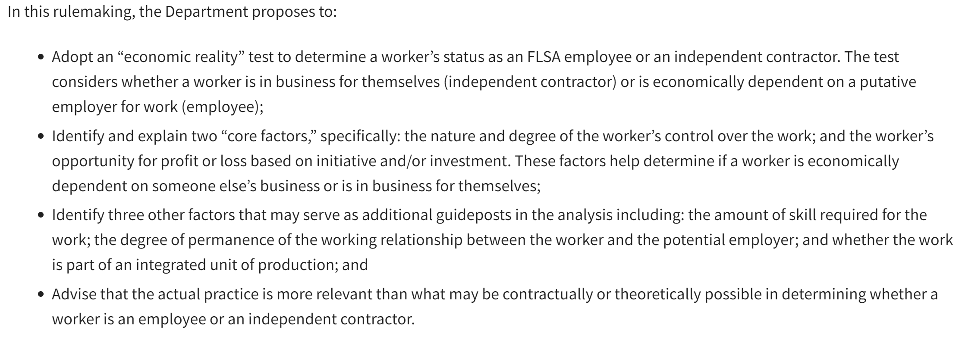
September 22, 2020: DOL Proposed Rule
Once published in the Federal Register, the public will have 30 days to submit comments.
See: https://www.dol.gov/agencies/whd/flsa/2020-independent-contractor-nprm

Slide 73
Misclassification Risks
Misclassification in this context means when an employer treats a worker as an independent contractor when really the employer should be treating the worker as an employee.
Some Risks:
Failing to pay the worker minimum wage and overtime compensation (FLSA).
Failing to pay appropriate employment-related taxes (IRS).
Failing to offer group health insurance benefits (PPACA).

Slide 74
Leave of Absence Issues
Non-FMLA Leaves of Absence

Slide 75
Considerations for: Non-FMLA Personal Leave of Absence
These are generally:
Unpaid.
Only granted for significant personal or medical reasons.
Capped at a maximum number of weeks or months. (Caveat: ADA reasonable accommodation when definite in duration)
Require use of any accrued paid time off, vacation time, and/or sick time.
Considerations for offering paid time off vs. vacation/sick time.
Considerations for implementing a leave donation program.
Apply leave consistently based on Cooperative policy and past practice.

Slide 76
Inappropriate Social Media Posts
Can an employer discipline an employee for what he/she posts on social media sites such as Facebook, Instagram, and Twitter?
What if the employee’s spouse is posting inappropriate material?

Slide 77
National Labor Relations Act
See: https://www.nlrb.gov/about-nlrb/rights-we-protect/your-rights/the-nlrb-and-social-media

Slide 78
Social Media Postings: When can an employer act?
Terms and Conditions of Employment
Vulgar, Inappropriate, and/or Derogatory Language
No!
Yes!
Be careful!

Slide 79
Now, let’s turn to your questions for discussion.

Slide 80
Your questions…

Slide 81
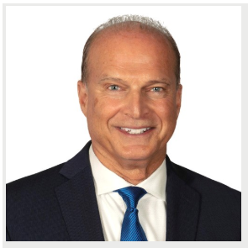
THANK YOU!
Bob Riegel
rriegel@rtlaw.com
(904) 473-1383
Ponte Vedra Beach
Katie Rudderman
krudderman@rtlaw.com
(904) 346-5791
Jacksonville

Slide 82
Please note that our presentation materials are not intended to provide legal advice concerning specific matters within your Cooperative. Please seek the assistance of legal counsel to address any particular legal issues that exist or may arise within your Cooperative.

