Slide 1
Pandemic Influenza
Appendix C-2: Employee Training

Slide 2
Overview
Introduction to pandemics
Staying healthy
Personal hygiene
Cleaning and food safety
Personal Protective Equipment (PPE)
Keeping your distance
What to do if someone is sick
If you have contact with a sick person (contact tracing)

Slide 3
Introduction to Pandemics
A flu pandemic occurs when a new flu virus that is different from seasonal flu viruses emerges and spreads quickly between people, causing illness worldwide. Most people will lack immunity to the pandemic flu virus.
It is important to be informed and not fall prey to the hype that might be associated with a pandemic virus. Keep some perspective on the issue.
At least 12,000 Americans due from the standard flu in any given year. As many as 61,000 people died in the 2017-2018 flu season, and 45 million were infected.

Slide 4
COVID-19
Coronaviruses are a large family of viruses that are common in humans and many different species of animals, including camels, cattle, cats, and bats. Rarely, animal coronaviruses can infect people and then spread between people, such as with MERS-CoV and SARS-CoV.

Slide 5
COVID-19
COVID-19 is a new disease and we are still learning how it spreads, the severity of illness it causes, and to what extent it may spread in the United States.
How COVID-19 Spreads
Person-to-person spread
The virus is thought to spread mainly from person-to-person.
Between people who are in close contact with one another (within about 6 feet).
Through respiratory droplets produced when an infected person coughs or sneezes.
These droplets can land in the mouths or noses of people who are nearby or possibly be inhaled into the lungs.

Slide 6
COVID-19
Can someone spread the virus without being sick?
People are thought to be most contagious when they are most symptomatic (the sickest).
Some spread might be possible before people show symptoms; there have been reports of this occurring with this new coronavirus, but this is not thought to be the main way the virus spreads.

Slide 7
COVID-19
Spread from contact with infected surfaces or objects
It may be possible that a person can get COVID-19 by touching a surface or object that has the virus on it and then touching their own mouth, nose, or possibly their eyes, but this is not thought to be the main way the virus spreads.

Slide 8
COVID-19
How easily the virus spreads
How easily a virus spreads from person-to-person can vary. Some viruses are highly contagious (spread easily), like measles, while other viruses do not spread as easily. Another factor is whether the spread is sustained, spreading continually without stopping.

Slide 9
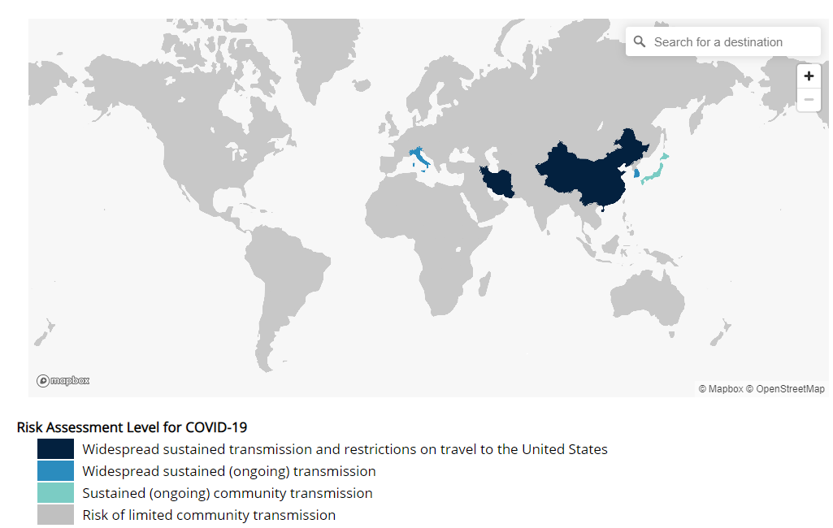
COVID-19
https://www.cdc.gov/coronavirus/2019-ncov/travelers/index.html
As of: March 4, 2020

Slide 10
Staying Healthy
There is currently no vaccine to prevent coronavirus disease 2019 (COVID-19). The best way to prevent illness is to avoid being exposed to this virus. However, as a reminder, CDC always recommends everyday preventive actions to help prevent the spread of respiratory diseases, including:
Avoid close contact with people who are sick.
Avoid touching your eyes, nose, and mouth.
Stay home when you are sick.
Cover your cough or sneeze with a tissue, then throw the tissue in the trash. If tissues not available, use elbow/shoulder, not hands
Clean and disinfect frequently touched objects and surfaces using a regular household cleaning spray or wipe.
Boosting your immune system by eating healthy foods, and getting enough rest and exercise can also help protect you against the flu.
https://www.cdc.gov/coronavirus/2019-ncov/about/prevention-treatment.html

Slide 11
Personal Hygiene
Wash your hands often with soap and water for at least 20 seconds, especially after going to the bathroom; before eating; after blowing your nose, coughing, or sneezing; and BEFORE and AFTER touching nose, eyes, or mouth.
If soap and water are not readily available, use an alcohol-based hand sanitizer with at least 60% alcohol. Always wash hands with soap and water if hands are visibly dirty.
https://www.cdc.gov/coronavirus/2019-ncov/about/prevention-treatment.html

Slide 12
Cleaning
Routinely clean all frequently touched surfaces in the workplace, such as workstations, countertops, and doorknobs. Use the cleaning agents that are usually used in these areas and follow the directions on the label.
No additional disinfection beyond routine cleaning is recommended at this time.
Provide disposable wipes so that commonly used surfaces (for example, doorknobs, keyboards, remote controls, desks) can be wiped down by employees before each use.

Slide 13
Personal Protective Equipment (PPE)
Follow CDC’s recommendations for using a facemask.
CDC does not recommend that people who are well wear a facemask to protect themselves from respiratory diseases, including COVID-19.
Facemasks should be used by people who show symptoms of COVID-19 to help prevent the spread of the disease to others. The use of facemasks is also crucial for health workers and people who are taking care of someone in close settings (at home or in a health care facility).
https://www.cdc.gov/coronavirus/2019-ncov/about/prevention-treatment.html

Slide 14
Keeping your “Social distance”
Avoid close contact with people who are sick.
If work activities include contact, you should:
Maintain distance of 6 feet or more
Keep interactions as brief as possible
Ask ill person to follow good cough etiquette, hand hygiene and to wear facemask (sick person, not you)
No handshakes and avoid crowded elevators
Use emails and phones for conversations whenever possible
Avoid attending events where large groups of people come together.
Source: SHRM Pandemic Webinar 2010

Slide 15
What to do if someone is sick
Ask yourself daily before coming to work:
Do I have a fever?
Do I have a sore throat?
Am I coughing?
Do my muscles ache?
Do I feel ill?
If you answered “yes” to any of the questions above:
Do not report to work; stay at home
Notify your supervisor as soon as possible
Seek medical guidance

Slide 16
contact with a sick person
When someone has the flu,
Keep everyone’s personal items separate. Avoid sharing computers, pens, papers, clothes, towels, sheets, blankets, food and eating utensils.
One person should be assigned to provide care to the family member who is ill. It may help for the caregiver to wear a mask when dealing with the person who is ill.
https://www.health.ny.gov/publications/7114.pdf

Slide 17
contact with a sick person
Wear disposable gloves when in contact with or cleaning up body fluids or contaminated items such as tissues. Wash your hands immediately after removing your gloves.
Use hot water for all laundry and wash your hands after handling dirty laundry.
Clean and disinfect surfaces.
https://www.health.ny.gov/publications/7114.pdf

