Slide 1
Florida Electric Cooperatives Association
2018 Finance & Accounting/Human Resources Conference
Allison Smudricks
Field Services Representative
Friday, September 21, 2018

Slide 2
Agenda
NRECA Added Value
Retirement Security (RS) Plan Update
401(k) Pension Plan Update
2018 NRECA Group Benefit Enhancements
Questions

Slide 3
The Value NRECA Adds to your Benefit Programs
NRECA’s goal is to ensure that member cooperatives, regardless of their size and location, have access to comprehensive, flexible and affordable benefit programs for employees and their dependents, so they can…
Attract, retain and reward both the current and next generation workforce they need to fulfill their mission
Improve engagement, productivity and safety of their workforce through personalized health, wellness, and savings programs promoting shared responsibility and financial security
Reduce the fiduciary, compliance and cost burden of their staff and Board
Have a voice in Washington to influence laws/regulations governing employer-sponsored benefit programs and the cost to the cooperative and its employees

Slide 4
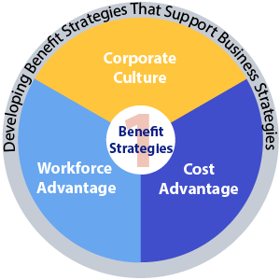
Reasons for Benefit Programs
Support the culture and business goals of the co-op
Attract and maintain quality workforce
Encourage appropriate turnover

Slide 5

Striking the Right Balance
Compensation or benefits?
Local competition
IOU benefits comparison
Collective bargaining agreement
How many employees do you have?
  Experience-rated?
  Highly-compensated employees?
  How old is your workforce?

Slide 6

Retirement Security Plan Update

Slide 7
RS Plan Investment Return History

Slide 8
RS Plan Investment Return History
7

Slide 9
RS Plan Change Statistics
Over the last 10 years, the number of co-ops with plans has remained steady at around 880
Each year 2% to 3% make formula changes for existing participants
Less than 1% each year elect to change retirement age for existing participants
From 2013 to 2017:
  4 withdrew from the RS Plan
  14 froze their benefit formula
  8 co-ops adopted the RS Plan

Slide 10
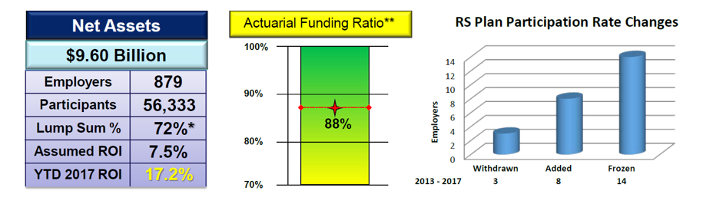
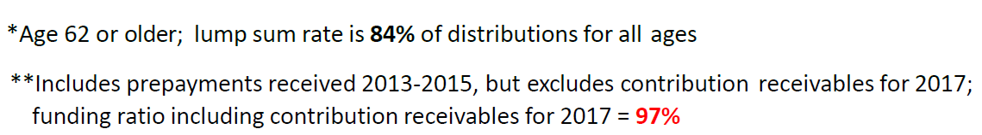
RS Plan Key Performance Indicators
18.53%

Slide 11
Prevalence of Key Co-op RS Plan Provisions: FL vs U.S.

Slide 12
Other RS Plan Provisions: FL vs U.S.

Slide 13

RS Plan Enhancements

Slide 14
Voluntary Contribution Accelerated Program (VCAP) Overview
The VCAP program permits co-ops to make flexible and accelerated RS contributions.
The VCAP contribution can be converted into a lower and/or constant billing percentage discount (Trust Contribution only, not administrative fees)
VCAP is tracked and reported over time via your notional “VCAP account balance.” The billing rate discount ends when the co-op’s notional VCAP account balance reaches zero.

Slide 15
VCAP vs. 2013 Prepayment Program
 | 2013 Prepayment Program | VCAP
1. Contribution amount | Fixed (Approx. 2.5 x expected 2013 RS trust contribution) | Variable (Set by co-op, but prudent to keep below unfunded liability)
2. Billing rate discount | Fixed (Approx. 25% of the 2013 base billing rate) | Variable (Set by co-op or based on $ contribution/discount period)
3. Billing rate discount period | Consistent (rate differential for prepayers vs non-prepayers lasts approx. 15 years from 2013) | Variable (Set by co-op, but not more than 10 years from contribution date)
4. Timing/ flexibility | Closed (2013 Prepayment Program is not available for any additional contributions) | Ongoing (Note: future availability and terms subject to approval of the RS Plan fiduciary committee)
5. Co-op participation | If co-op participated in program, generally required to prepay for all plans/sub-groups | Co-op chooses which plans /sub-groups to include, and can vary the items listed above for each plan

Slide 16
VCAP Overview (cont.)
Co-ops selects two of the three parameters below.
The third parameter is set based on this selection.
VCAP will be offered beginning 1/1/19
VCAP Contribution
Discount Period (<10Y)
Billing Rate Discount

Slide 17
Why VCAP?
Smooths annual operating costs for a co-op facing large future expenditures
Interest rate arbitrage:
  Use current cash more effectively (or borrow at low interest rate)
  VCAP account credited with RS Plan investment return (+/-)
VCAP funds the excess of actual required monthly contributions above the capped contribution level
Under VCAP co-ops can target a constant proportional reduction, or a constant billing rate, for the duration of the discount period

Slide 18
Enhanced Standard Death Benefit
Effective 7/1/18 for all plans that do not offer the optional death benefit
Cost neutral – why?
  Due to this change, participants are expected to quasi-retire a few months later than currently
  Added months of contributions, combined with a lower present value due to later retirement, is expected to offset the increased cost of the few who decease
  The 5% cost for the optional death benefit has this neutral post-NRA cost already built in:
    So there will be no reduction in the current 5% cost
    Basically the 5% cost covers the added cost of pre-NRA death benefits (those over the cost of the standard death benefit)
17

Slide 19
RS Lump Sum/Quasi-Retirement Opt-out
Each co-op may remove the lump sum and/or quasi-retirement distribution option from the RS Plan
  All benefits accrued prior to the change are protected
Cost reduction for lump sum opt-out
  Up to 5% of annual billing rate for “prepayers”*
  Up to 3.75% of annual billing rate for “non-prepayers”*
No cost reduction for quasi-retirement opt-out (initially)
Cannot opt back in for 5 years
  And vice versa
January 1, 2019 is the earliest effective date you may adopt this change.
*Trust contributions
18

Slide 20

401(k) Pension Plan

Slide 21
401(k) Plan Investment Returns (as of March 31, 2018)
Fund | 1 Year | 3 Years | 5 Years
Stable Income | 1.13 | 0.51 | 0.31
Short-Term Bond | 1.53 | 1.45 | 1.58
Value Stock Fund | 13.76 | 9.40 | 11.70
S&P 500 Stock Index | 13.71 | 10.51 | 13.05
International Stock | 20.11 | 7.49 | 7.60
Small Company | 13.23 | 6.54 | 11.60
Diversified Growth | 30.91 | 15.85 | 18.98
Retirement TDP | 5.85 | 3.70 | 5.11
2020 TDP | 6.85 | 4.25 | 5.11
2030 TDP | 9.47 | 5.66 | 6.62
2040 TDP | 11.80 | 6.82 | 7.84
2050 TDP | 12.59 | 7.26 | --
2060 TDP | -- | -- | --

Slide 22
401(k) Pension Plan: Enhancements
Enhancements to the NRECA 401(k) Pension Plan:
  Added 2060 Target Date Portfolio
  Restructured Money Market Fund into the
    Stable Income Fund
    Appointed PIMCO as fund manager
  Renamed Growth & Income Stock Fund as the Value Stock Fund to match investment strategy
  Updated investment strategy relative to the International Stock Fund

Slide 23
NRECA 401(k) Investment Options (as of 12/1/17)
LESS Level of Participant Involvement MORE
Target Date Portfolios
Retirement
2020
2030
2040
2050
2060
Core Funds
Stable Income Fund
Short-Term Bond Fund
Value Stock Fund
S&P 500® Stock Index Fund
Diversified Growth Stock Fund
Small-Company Stock Fund
International Stock Fund
MORE Risk Tolerance LESS

Slide 24
Target Date Portfolios (as of 12/31/17)

Slide 25
2018 Life & AD&D Enhancements
No more age-based benefit reductions for
  Supplemental life
  Supplemental AD&D
  Spouse life
  Director’s life and director’s AD&D
  Director’s AD&D only
Benefits reduced prior to 1/1/18 will remain at reduced levels without further reductions
Basic life and basic AD&D will continue age based reductions as they do today

Slide 26
2018 Life & AD&D Enhancements
Basic life
  Will, living will and power of attorney preparation at no additional cost through Hyatt Legal Plans
    For insured and spouse
  Estate resolution services at no additional cost through Hyatt Legal Plans
    For insured’s and spouse’s/domestic partner’s estate executor/administrator and beneficiaries
  Grief counseling at no additional cost through Harris Rothenberg
    24/7 phone access
    Up to five in-person sessions
    Also includes funeral planning assistance

Slide 27
Will Preparation
Call Hyatt@ 800-821-6400
Appointment with Local Attorney
Free or Reimbursement

Slide 28
2018 Life & AD&D Enhancements
Travel Assistance at no additional cost through AXA Assistance
  24/7 access for participants traveling 100 miles or more from home for up to 120 days
  Medical assistance services
  Concierge services
Identity theft solutions at no additional cost through AXA Assistance (do not have to be traveling to use)
  Identity theft risk and prevention tool kit and resolution guide
  Guidance with police and credit reports, contacting creditor fraud departments, and more

Slide 29
NRECA Resources
NRECA Employee Benefits Website
cooperative.com
Member Contact Center
1.866.673.2299
contactcenter@nreca.coop
Prompt #1 Health plan questions (medical, dental, vision, disability, FSA & HRA).
Prompt #5 Retirement Plans (Loans/withdrawals/option forms)
Prompt #6 PIRC - pirc@nreca.coop /8:30am – 5pm ET
Prompt #7 Benefit Compliance
Prompt # 8 Member Contact Center representatives

Slide 30

Questions?

Slide 31


















Contact
Allison Smudricks
Field Services Representative
allison.smudricks@nreca.coop
(404) 977.7716

