Slide 1
Seminole Update
FECA’s Finance & Accounting
and Human Resources Conference
Lisa Johnson
CEO & General Manager

Slide 2
Seminole Overview

Slide 3
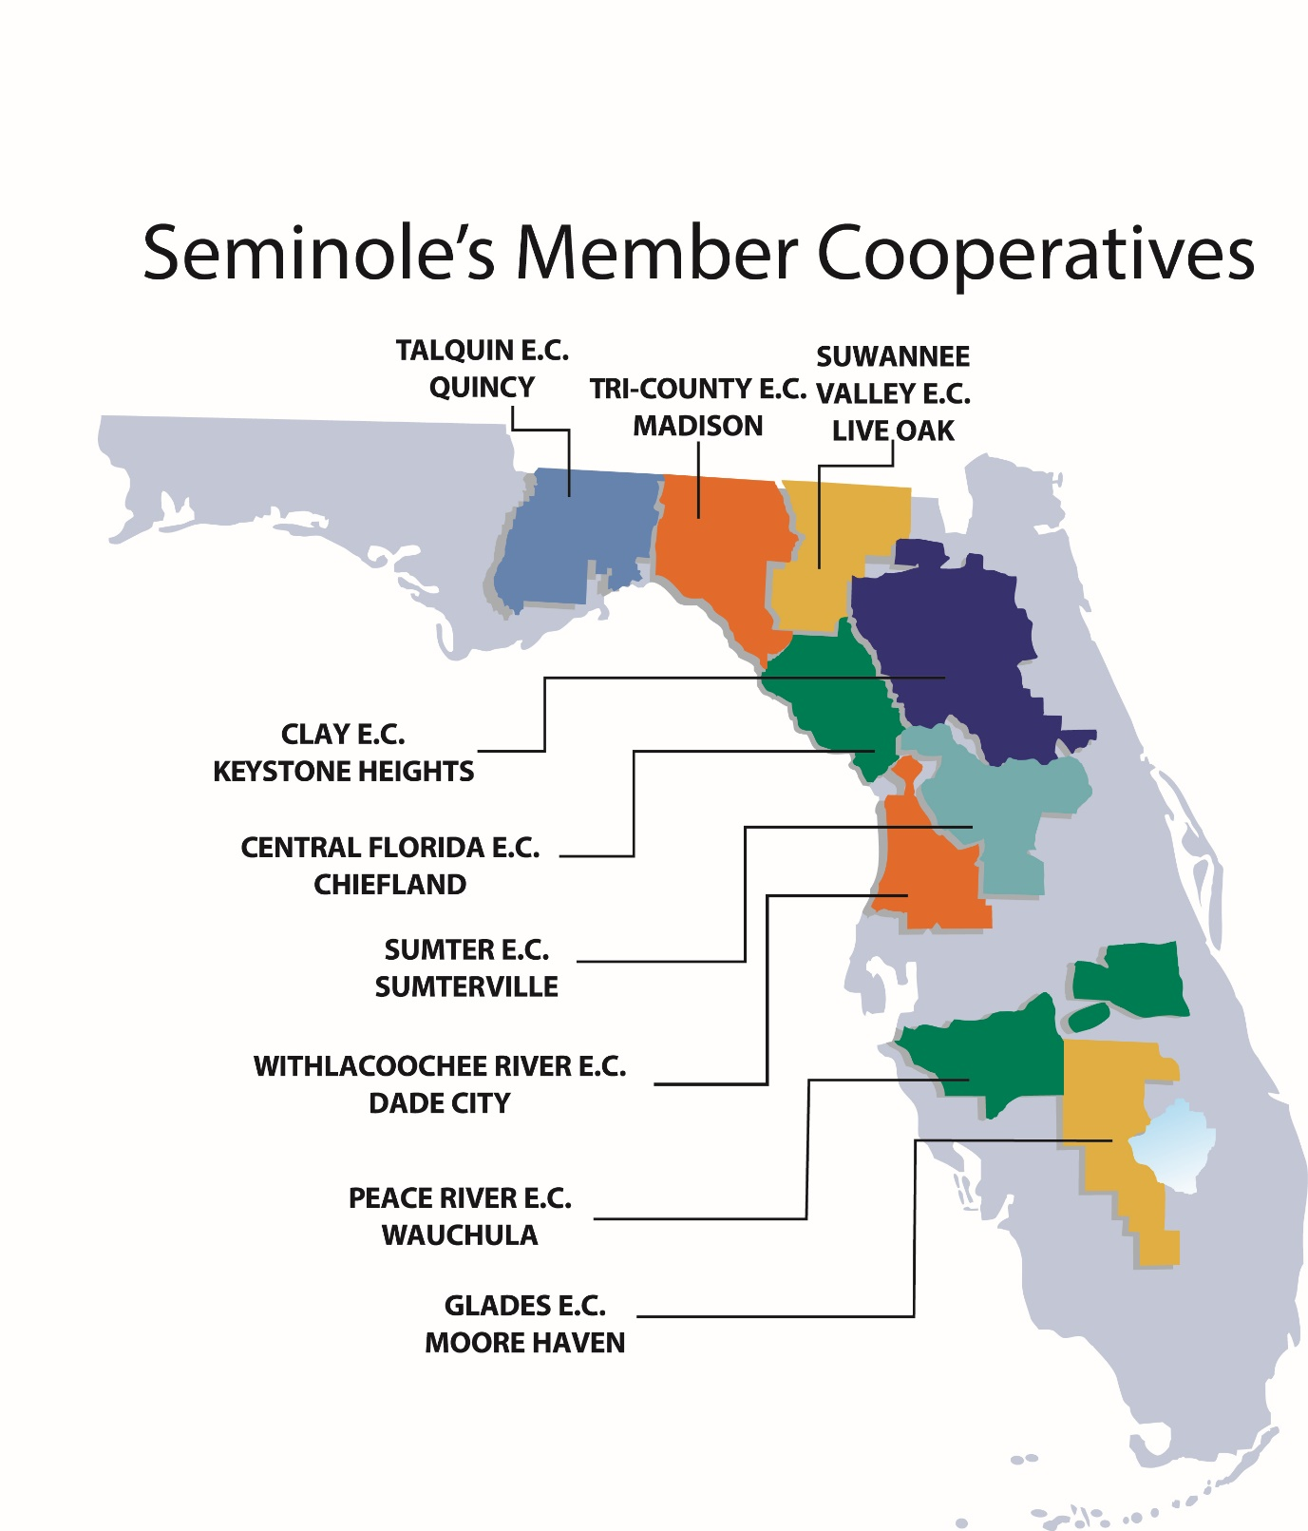
Key Statistics (from 2017 annual report)
Total Revenues | $1.07 billion
Net Margin | $23.8 million
Total Assets | $1.99 billion
Energy Sales to Member Co-ops | 14,039 GWH
Member Connections | 774,336
Population Served by Members (est.) | 1.7 million
Seminole System Coincident Peak Demand | 2,979 MW
Number of Employees | 498

Slide 4
Total Revenues – 2018 Mid-Year Look
2017 Actual
2018 Projection*
Total $1,029.5 Million
Total $1,065.5 Million
* 2018 Projection as of 6/29/18

Slide 5
Seminole’s Future

Slide 6
Strategic Plan/Priorities
Member Service | Financial Strength | Future Resource Portfolio | Transmission Investment | Risk Management
Seminole will provide competitive rates, delivery point reliability and other services requested by Members and will enhance Member relationships through active communication. | Seminole will maintain adequate liquidity, ensure access to affordable credit, and maintain appropriate credit support for contracts. | Seminole will plan a resource portfolio including attributes of diversity, flexibility and optionality. | Seminole will identify and pursue transmission options for increased direct serve and diversity to control costs/manage risk. | Seminole’s risk management practices and reporting will be continually reviewed and enhanced to ensure that all categories of enterprise risk are understood and communicated, and risk mitigation measures are in place to meet the parameters set by the Board.

Slide 7
A- / Stable Credit Rating
Credit Strengths
Financially strong & favorable member profiles
Largely residential end-use customers
Economically diverse
Wholesale power supply contracts extending through 2055
Strong liquidity
Significant changes to power supply underway
Credit Weakness
Post 2020 Wholesale Power Contract (WPC) partial requirements option
Moderately high debt levels
Marginally adequate coverage ratios

Slide 8
A3 / Stable Credit Rating
Credit Strengths
Autonomous rate setting
Strong relationship with members under long-term Wholesale Power Contract through 2055
Sound financial profile, including good liquidity
Credit Weakness
Concentration risk with SGS providing over 50% of energy needs
Coal-fired generation exposure to carbon regulation
Post 2020 Wholesale Power Contract optionality to secure a portion of their power supply needs from alternative suppliers

Slide 9
Planning to Achieve Strategic Priorities
Natural Gas 2x1Combined Cycle Plant
1122 MW
In service approx. 12/2022
Seminole’s P2021 Objectives:
Determine the most cost-effective, risk-managed resource solutions
and
Achieve our Strategic Priorities --
Value and Competitiveness for our Members
A Resource Portfolio including attributes of diversity, flexibility and optionality
Transmission options for increased direct serve and diversity to control costs and manage risk
SGS
1 Coal Unit - 650 MW
Remove from Service approx. 12/2022
Purchased Power – Traditional Resources
Purchased Power – Solar Resource
Land Purchase

Slide 10
Seminole’s Power Supply Resources
* Based on winter reserve ratings

Slide 11
Seminole’s Power Supply Resources
*2018 Projection as of 6-29-18

Slide 12
Increasing Importance of R&D
Rate of change in the power industry is unprecedented
Staying abreast of developing technologies allows informed and timely decision making
One size does not fit all
Florida can learn from others’ successes and mistakes
Environmental and cost considerations fluctuate

Slide 13
Current Areas of Interest
Utility scale solar photovoltaic systems
Energy storage systems
Microgrids
Reciprocating internal combustion engines; Aeroderivative Gas Turbines
Beneficial electrification
Residential and public electric vehicle charging infrastructure
Agricultural machinery electrification
Design of facilities for flexible (heavy cycling) operation
Demand Response Management

Slide 14
Modernizing the HR Footprint
Evaluating Medical Benefits
Assessing portfolio
Developing a wellness program
Restructuring Performance Management Tools
Implementing Total Rewards
Completing compensation and benefits study
Expanding Recruitment and Outreach
Enhancing Interactive Career Explorer (ICE)
Reinventing Employee Handbook

Slide 15
Headquarters Renovation
Project Duration – February 2018-December 2019
Recently Completed
New electrical/mechanical building walls and roof completed
New A/C system chillers installed
New building transformer installed and energized
In Progress
Interior wall framing and wall rough-in (Phase I area)
Exterior walls for new mechanical building
Pour concrete for elevator column footings and shaft

Slide 16
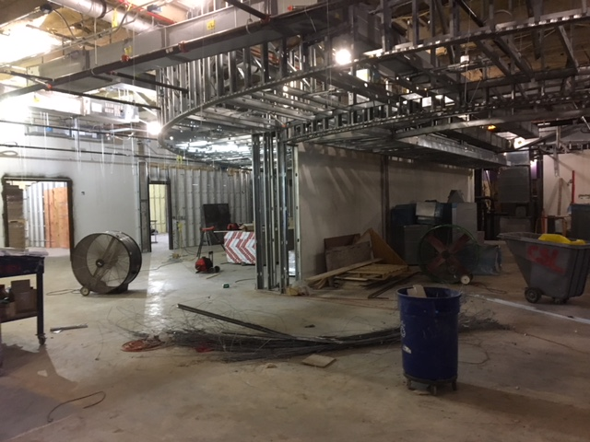
Second Floor Conference Room

Slide 17
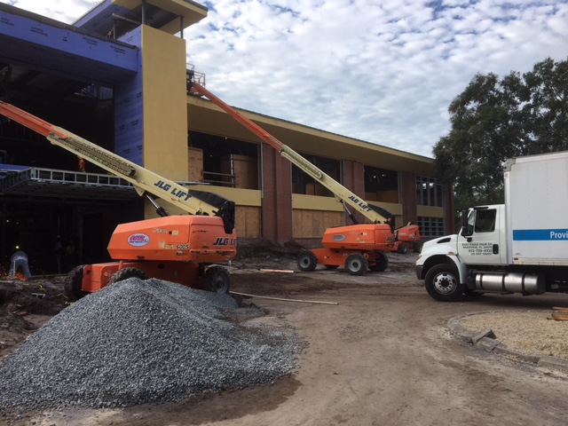
Front Entrance and New Window Frame Work

Slide 18
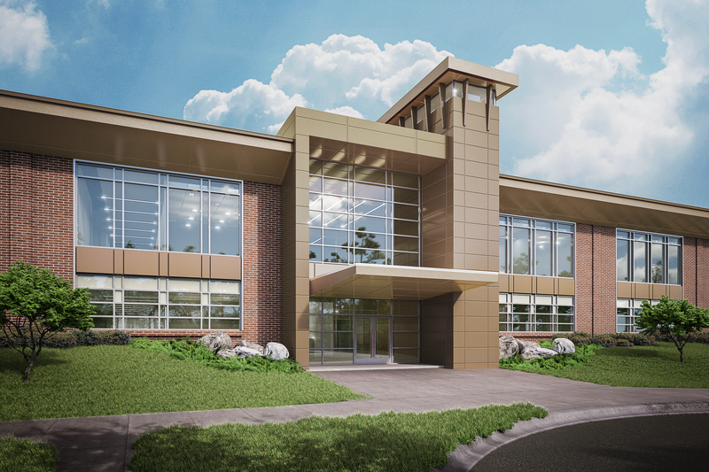
Finished Rendition - Headquarters

Slide 19
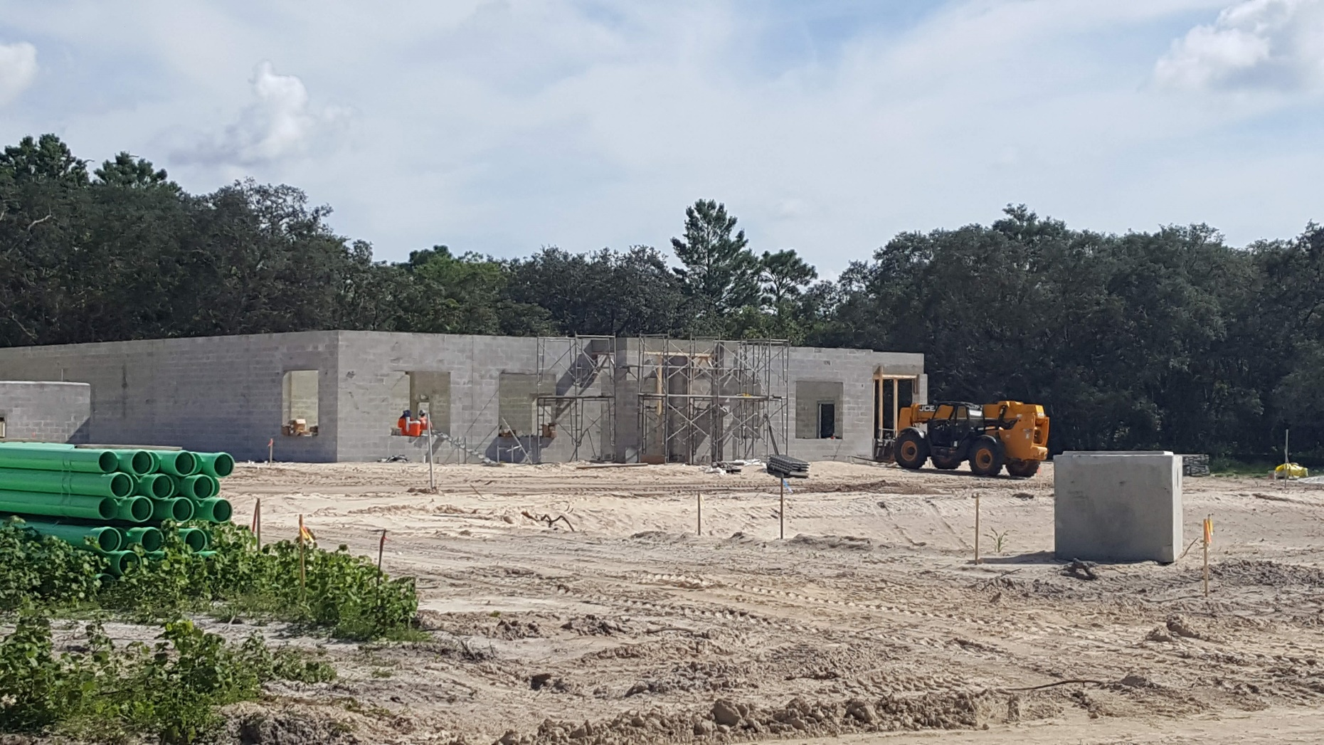
Business Continuity Center
Project Duration – January-December 2018
Current status/in progress
Contract executions, site permitting, and development complete
Building construction

Slide 20
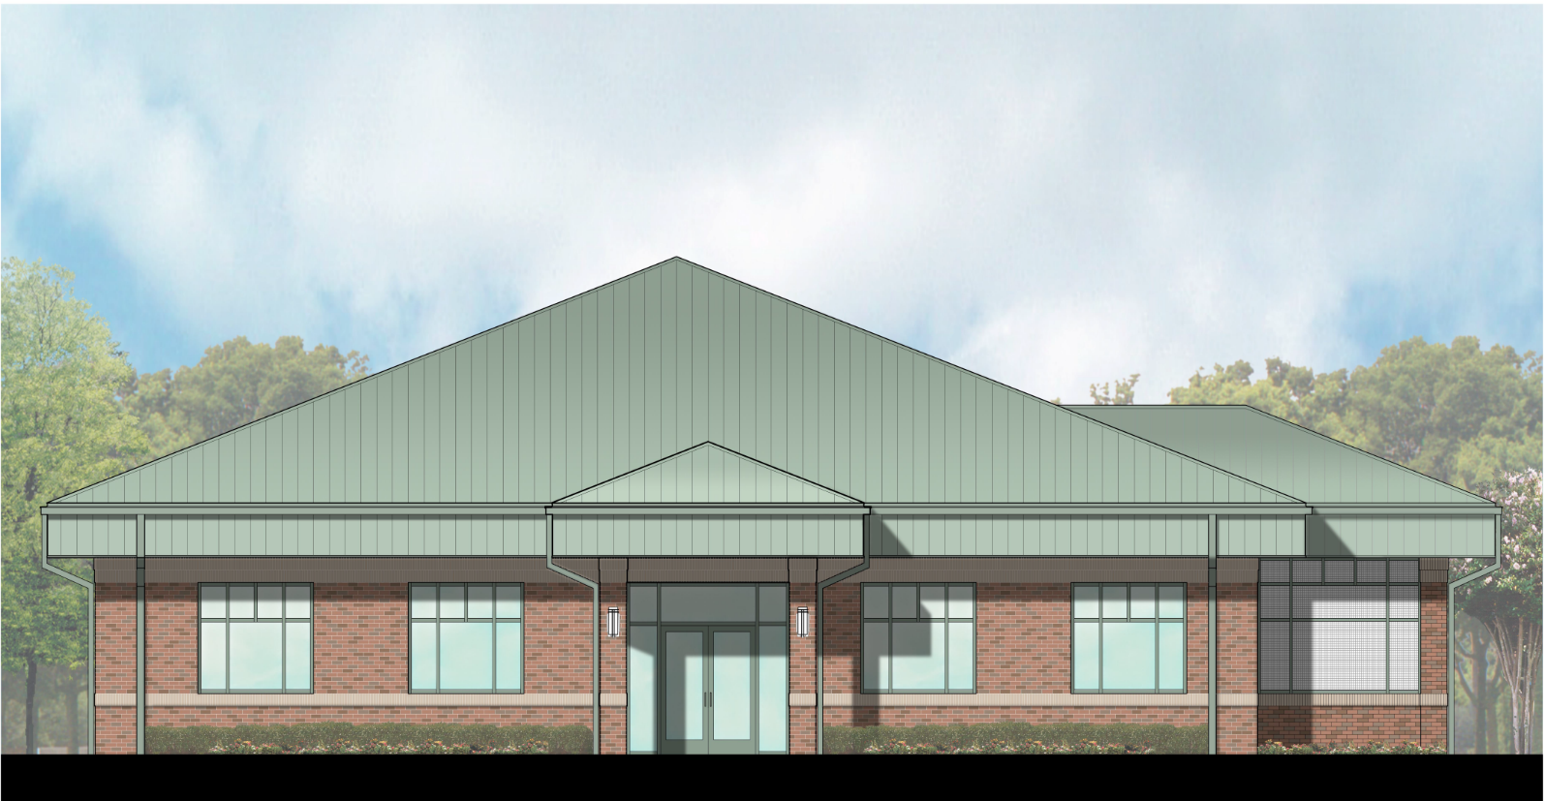
Finished Rendition Business Continuity Center

Slide 21
Questions and Discussion

