Slide 1
Fraud
Schemes & Preventions

Slide 2
Fraud
An illegal act obtaining something of value through a willful act or misrepresentation.
Must be deliberate intent to deceive.
An error is an honest mistake.
Fraud is deliberate.

Slide 3
Fraud Diamond
Personal debts
Greed
Drug abuse
Organized crime
Inadequate internal control
Weak/remote management
Inappropriate values
Job/company dissatisfaction
Knowledge of systems
Skills required to undertake

Slide 4
Fraud Red Flags
Employee
Lifestyle changes
Significant debt or credit problems
Management
Reluctance to provide information to auditors
Frequent disputes with auditors
Behavioral changes
Refusal to take vacation or sick leave
Lack of segregation of duties in vulnerable area
Weak internal control environment
Accounting personnel are lax or inexperienced
Excessive number year end transactions
High employee turnover
Service contracts result in no product
Frequent changes in external auditors
Compensation program out of proportion
Unexpected overdrafts or declines in cash balances

Slide 5
Fraud Red Flags: Keep in Mind
Do not ignore a red flag
Studies of fraud cases consistently show that red flags were present, but were either not recognized or were recognized but not acted upon by anyone.
Once a red flag has been noted, someone should take action to investigate the situation and determine if a fraud as been committed.
Sometimes an error is just an error
Red flags should lead to some kind of appropriate action, however, sometimes an error is just an error and no fraud has occurred.
You need to be able to recognize the difference and remember that responsibility for follow-up investigation of a red flag should be placed in the hands of a measured and responsible person.
Key Point: Be Aware of and Respond Appropriately to Red Flags.

Slide 6
Types of intentional acts:
Misappropriation of assets (this is what most people think of when it comes to fraud.)
Misstatement of financial information
Misstatement of non-financial information
Perpetration of illegal acts.

Slide 7
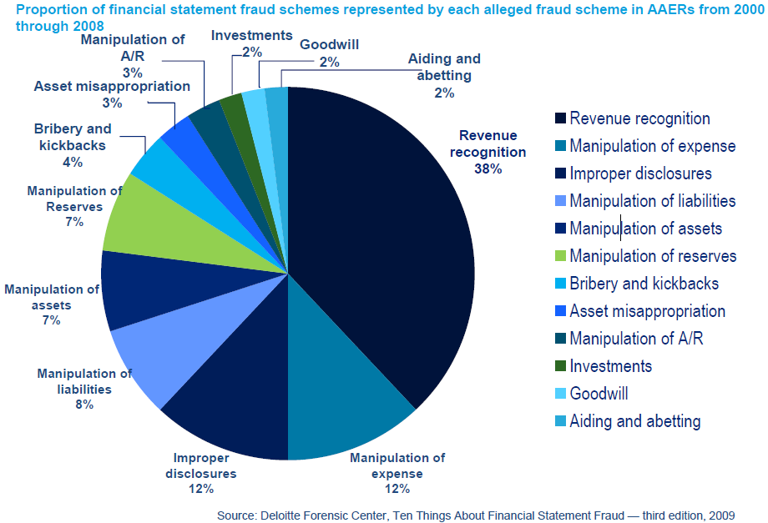
Data on Material Fraud Issues
Notes:
Note that even an effective, well-designed system of internal control can experience a failure. Limitations may result from:
The lack of suitability of established objectives
The reality that human judgment in decision making can be faulty and subject to bias
Breakdowns that can occur because of human failures such as simple errors
The ability of management to override internal controls
The ability of management, other personnel, and/or third parties to circumvent controls through collusion
External events beyond the University’s control
Again, internal control provides reasonable, not absolute, assurance of achieving objectives. The point of internal controls is to prevent what is preventable, not to prevent everything. Remember one of the key components of internal control is risk assessment.

Slide 8
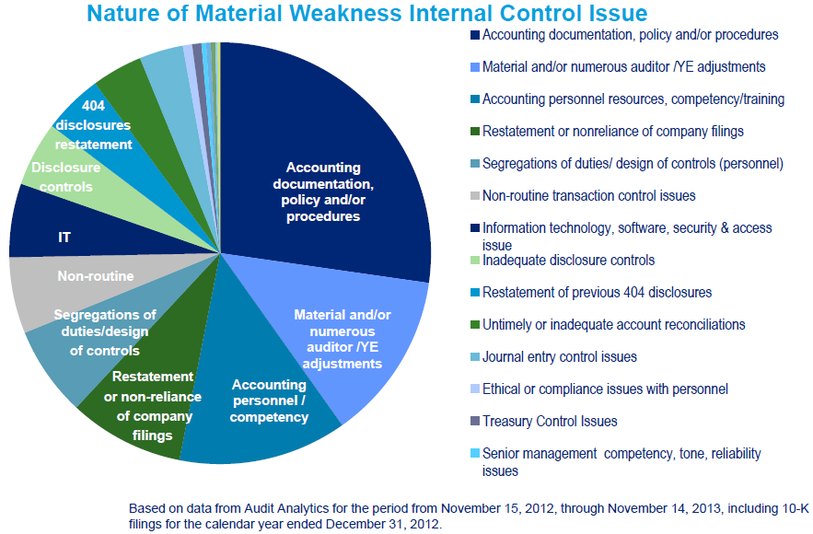
Data on Material Weaknesses
Notes:
Note that even an effective, well-designed system of internal control can experience a failure. Limitations may result from:
The lack of suitability of established objectives
The reality that human judgment in decision making can be faulty and subject to bias
Breakdowns that can occur because of human failures such as simple errors
The ability of management to override internal controls
The ability of management, other personnel, and/or third parties to circumvent controls through collusion
External events beyond the University’s control
Again, internal control provides reasonable, not absolute, assurance of achieving objectives. The point of internal controls is to prevent what is preventable, not to prevent everything. Remember one of the key components of internal control is risk assessment.

Slide 9
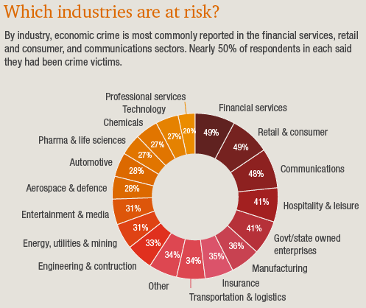
Fraud Stats & Facts

Slide 10
Board of Directors - Abuse
Board of Directors were each paid about $52,000 in one year
One Board Member claimed 102 per-diem payments in 2017 - 31 days at conferences, 45 board committee meetings, 13 full board meetings and 13 other events.
Those payments cost the Co-op $45,900 last year, part of his $79,600 in compensation from the Co-op

Slide 11
Management Override
CEO has personal charges on credit card and to vendors that are not for Co-op purposes.
Board of Directors or other responsible party does not review credit card bills of CEO monthly
Bills are paid by accounts payable – employees fearful of reprisal and do not report (or have no formal way to report)
Losses are significant – over $700,000 in one case

Slide 12
Information Technology (IT)
Co-op controls over IT systems not sufficient to prevent someone from getting into the member database
Member information accessed and used by third parties
Co-op exposed to cyber data compromise cost

Slide 13
Financial Reporting
Co-op is not meeting DSC or TIER requirements for 2nd year of a 2-year period
Co-op management defers certain expenses into the subsequent year
Co-op management changes the capitalization policies to overcapitalize expenses

Slide 14
Financial Reporting
Co-op makes excess margins in current year and anticipates much lower margins subsequent year
Co-op expenses items prior to delivery of the goods or services (right-of-way contract services)

Slide 15
Wire Fraud
Received wiring instructions for a new vendor via e-mail
Confirmed the wiring instructions by e-mail
Approved and wired the funds to the vendor
Various correspondence with the vendor by e-mail over a few days
Discovered the Fraudster had intercepted all the e-mails, changed the wiring instructions and all correspondence to keep everyone thinking the wire had gone to the proper place, until the recall period of the bank was over.
Cost to Co-op – over $25,000

Slide 16
Check Alterations
Co-op check is intercepted in the mail to delivery process
Vendor name is changed and the check is either cashed or deposited
Co-op does not discover until vendor questions the payment being late or during the bank reconciliation
Bank covers this for 30-60 days depending on the bank
Loss for bank or Co-op
Co-op liability normally occurs when the bank reconciliations are not done timely

Slide 17
ACH Drafts
Fraudster started withdrawing funds from the Co-op account in amounts of $25-40 per transaction
Did this over a period of three days in the total amount of $78,000. The Co-op discovered on the third day and notified the bank. The bank covered all withdrawals within the past 24 hours.
Co-op lost over $30,000

Slide 18
Capital Credit Check Bank Account Drafting Electric Payment
Capital credit payments bank account improperly used for drafting of member’s electric payment
Member set up monthly payment to be drafted from the Co-op’s bank account using the banking information obtained from the patronage capital retirement check
Should be quickly detected if bank account is timely and appropriately reconciled

Slide 19
Collusion
Purchasing agent or other authorized purchaser falsify invoices in collusion with third party
Invoices are overstated
Equipment trade-in value is understated
Purchasing agent or authorized party receives kick-back

Slide 20
Theft of Electric Service
Diversion of power by bypassing or tampering with meter
Colluding with employee to not report metered electric account
Theft of power from neighbor meter

Slide 21
Financial Statement Misrepresentations
In order to make financial statements better or worse certain costs or accruals are misstated
Unbilled revenue is understated/overstated
Income from associated organizations is understated/overstated
Depreciation expense understated/ overstated
Overhead allocations are modified to under or overstate capitalization

Slide 22
Prevention: Fraud Risk Management Process

Slide 23
Electric Co-op Compliance Task Force
NRECA released a COSO Compliance report in February 2018 stating that:
Electric co-ops must create and maintain a culture integrating internal control
Good governance must be promoted and nurtured intentionally and continuously
An effective board of directors is a critical part of the cooperative’s governance

Slide 24
Internal Control System
Internal control system should be designed to mitigate:
Errors
Fraud
Weaknesses in the internal control system create fraud opportunities.

Slide 25
What is Internal Control?
Internal Control is a process effected by an entity’s Board of Directors, Management, and other personnel designed to provide reasonable assurance regarding the achievements of objectives in the following categories:
• Effectiveness & efficiency of operations.
• Reliability of financial reporting.
• Compliance with applicable laws and regulations.
Enterprise Risk Management is the discipline of implementing and monitoring internal controls in order to identify and mitigate risk.
COSO has recommended 17 principles required for effective internal control.

Slide 26
COSO Framework

Slide 27
5 Integrated COSO Components for Financial Reporting
Control environment is the umbrella for the entity’s internal control framework. A good control environment is the foundation for good internal controls.
Entity
-
Level Controls
Control Environment
Fraud Controls, including Controls Over Management Override
Risk Assessment and Related Policies
Monitoring
Controls
Financial
Transactions
Information
Statement
Financial
Systems
Close
Statements
Process
Control Activities, Including Fraud Controls

Slide 28
Detailed COSO Requirements
Control Environment | Risk Assessment | Control Activities | Information& Communication | Monitoring Activities
Demonstrates commitment to integrity and ethical values Exercises oversight responsibilities Establishes structure, authority, and responsibility Demonstrates commitment to competence Enforces accountability | Specifies suitable objectives Identifies and analyzes risk Assesses fraud risk Identifies and analyzes significant change | Selects and develops control activities Selects and develops general controls over technology Deploys through policies and procedures | Uses Relevant Information Communicates Internally Communicates Externally | Conducts ongoing and/or separate evaluations Evaluates and communicates deficiencies
Per COSO, an effective system of internal control requires:
Each of the 17 principles to be present & functioning
The 5 components of internal control to be present & functioning
The 5 components to be operating together in an integrated manner

Slide 29
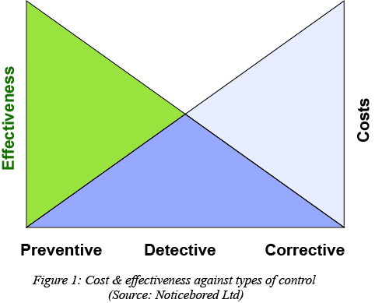
Types of Internal Controls
Preventive Control
Prevents the occurrence of a negative event in a proactive manner
“Revise the transaction before it goes on to the next process”
Corrective Control
Designed to correct errors or irregularities that have been detected.
“Help mitigate damage once a risk has materialized”
Detective Control
Detect the occurrence of a negative event after the fact in a reactive manner
“Checking the transaction of the previous process that it has been done correctly”
Notes:
The first way we can categorize control activities is between preventive and detective controls.
Preventive Controls prevent the occurrence of a negative event in a proactive manner.
[click]
Examples here at UNC Charlotte include:
Approval required for purchases greater than $5,000
Passwords required for access to Banner
Petty cash that must be held in a lockbox
Security and surveillance systems in high-risk areas, and
Pre-numbered checks
Detective Controls Detect the occurrence of a negative event after the fact in a reactive manner
[click]
Examples here at UNC Charlotte include:
Supervisor review & approval
Reports that are run showing user activity
Reconciliation of petty cash
Annual Physical inventory counts, and
Review of missing and voided checks
[click]
Preventive controls are stronger that detective controls. It is more effective and less costly to prevent something from happening rather than to attack it on the back end; sometimes it is hard to stop something that is already in motion, similar to a snowball effect.
This chart also shows corrective controls, but really I would deem these more as corrective ‘actions’, since the correction isn’t really a control itself.

Slide 30
Cyber Security
Are You REALLY Secure???
Personal Data
Identity Theft is on the Rise
Phishing
E-scams
Ransomware
Consider Penetration Testing

Slide 31
IT Controls
General:
Application:
Server Access is Secure
Data is Backed up
Backups are Tested
Software Update Approval
Segregation of Duties
Computer Operations
Data is Secure
Specific to Application
General Ledger
AP, AR, Etc. Modules
Unique Passwords
Data Validity Checks
Batch Controls
Reconciliations
Access to GL, AP, AR, etc.
Transaction Logs
IT internal controls are achieved in different ways but are just as important as the “normal” internal control system.

Slide 32
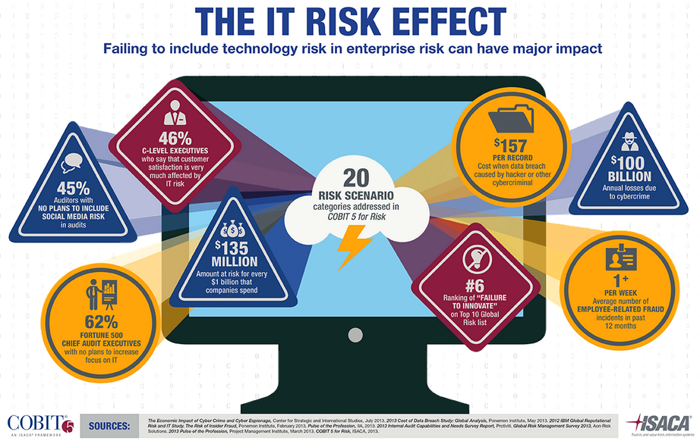

Slide 33
Business Justification for ERM
Greater visibility into business operations for the Board/Executive Management
Reduce threat of personal liability for Board Members
Executives can provide documented risk mitigation strategy to stakeholders
Risks are identified and addressed in a continuous manner through monitoring
Risk assessment can be connected to business performance/strategy

Slide 34
COSO’s ERM model
8 Risk & Control Components:
Internal Environment
Objective Setting
Event Identification
Risk Assessment
Risk Response
Control Activity
Information & Communication
Monitoring
4 Objectives management must meet to achieve company goals:
Strategic
Operations
Reporting
Compliance
4 Units of a company:
Entity Level
Division
Business unit
Subsidiary

Slide 35
COSO Compliance
In summary, organizations must develop an Enterprise Risk Management strategy to identify and mitigate risk in their financial, IT, and operations functions. Building a good internal control strategy requires a third party to provide 1) an objective view on the organization’s risks and 2) a plan to address and monitor those risks.

Slide 36
Questions and Comments

