Slide 1
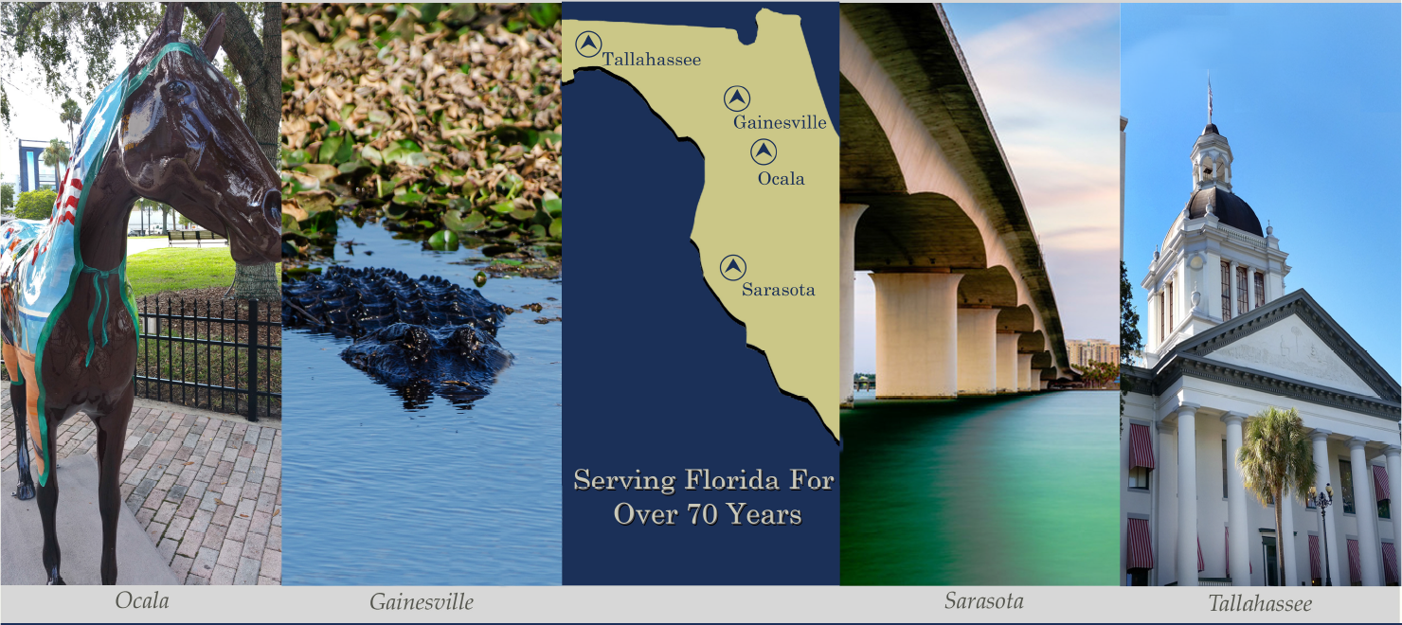
Assessing IT General Controls
Florida Electric Cooperative Association
Presented by:
Purvis, Gray & Company, LLP
Michael Sandstrum CPA, CISA, CISM, CITP
Ryan Tucker, CPA

Slide 2
Agenda
Introduction
ITGC Audit Objective
ITGC Audit Scope
Approach to Assessing ITGC
Common Audit Findings
Use of CAATS
Non-ITGC Services
Conclusion
Q&A
Celebrating 70 Years of Client Service!

Slide 3
Ransomware
Celebrating 70 Years of Client Service!

Slide 4
Employees are the Weak Link
91% of successful data breaches start with a spear phishing attack
Ransomware was a $1 billion criminal business in 2016
Less than half (45%) that paid for ransomware got their information back
Ransomware price tags shot up by 266% to $1,077 on average in 2016
CEO Fraud (aka Business email compromise) caused $5.3 billion in damages
Celebrating 70 Years of Client Service!

Slide 5
Celebrating 70 Years of Client Service!

Slide 6
ITGC Audit Objective
Determine the design effectiveness of IT general controls (ITGC) that are considered essential areas that potentially introduce risks to the financial statements or the risk of material misstatement (SAS No. 109, AU-314(.57))
Celebrating 70 Years of Client Service!

Slide 7
ITGC Audit Objective (continued)
Focus on the financial and related sub-systems.
Determine:
Suitability of Design
The control if operating as described would accomplish its objective
Implementation
Is the control in place
Effectiveness
Did the control operate effectively during the audit period
Celebrating 70 Years of Client Service!

Slide 8
ITGC Audit Scope
IT Entity-Level Controls
Management Steering Committee
IT Strategic Plan / Projects
Risk Assessment
IT Policies and Procedures
Security Awareness
Competency
Celebrating 70 Years of Client Service!

Slide 9
ITGC Audit Scope (continued)
Third party providers
Assess contracted IT vendors
Hosting provider’s Service Organization’s Reports:
SOC 1 Type 2
SOC 2 Type 2
Celebrating 70 Years of Client Service!
Notes:
Reliability of vendor (reputation, tenure, etc); Competency of vendor (experience, credentials, reputation); Adequacy of controls in vendors services (SSAE #16/SOC-1 report, or SOC-2/SOC-3 report, etc.);

Slide 10
ITGC Audit Scope (continued)
Physical Security
Data center access
Network closets
Environmental protections
Celebrating 70 Years of Client Service!

Slide 11
ITGC Audit Scope (continued)
Information Security
Logical security (e.g., user access provisioning, privileged access, user access reviews, segregation of duties, remote access)
Authentication (e.g., network, application, database)
Security strategy or strategies, policies, procedures and standards
Monitoring and audit policies, procedures and standards
Network protections
Celebrating 70 Years of Client Service!
Notes:
Protecting programs and data from unauthorized changes or malicious activities; To implement effective logical SOD

Slide 12
ITGC Audit Scope (continued)
Change Management
Program Changes
Patch Management
Configuration Changes (e.g., network, password)
Celebrating 70 Years of Client Service!
Notes:
Data processing accuracy, timeliness, integrity, and security depend on it
P&P (i.e., a formal process); Application Development (e.g., SDLC); Configuration Management; Software Management (e.g., updates);O/S Management
Network Management; Hardware/Infrastructure Management;

Slide 13
ITGC Audit Scope (continued)
Backup and Recovery
Backup security
Reasonable frequency and restart points
Restoration testing
Disaster recovery & continuity plans
Celebrating 70 Years of Client Service!
Notes:
Able to restore data after a system failure and loss of data, timely and accurately; Able to restore data after a natural disaster, timely and accurately

Slide 14
Audit Scope (continued)
Other Areas
Restoration of financial systems during the period
Financial system migrations
Celebrating 70 Years of Client Service!

Slide 15
Approach to ASSESSING ITGC
Identify
Identify significant financial applications and related information systems.
Identify key controls (e.g., application and IT-dependent manual controls), interfaces, and reports and other information generated from the Client's information systems.
Determine type of controls –
automated versus manual
detective – Identifies an incident activities
preventive – Intended to avoid an incident from occurring
corrective – Fixes components or systems after an occurrence
Recovery – Bring the environment back to regular operations
Celebrating 70 Years of Client Service!

Slide 16
Approach to ASSESSING ITGC
Gather information
Request, obtain, and review available policies and procedures, diagrams, flowcharts, and other documentation.
Solicit information using an in-house developed questionnaire or interactive interviews
Obtain service organization's third party assessments
Celebrating 70 Years of Client Service!

Slide 17
Approach to ASSESSING ITGC
Develop
Develop audit procedures
Audit procedures may include:
Reviewing policies and procedures
Inspecting diagrams
“Shoulder” auditing or observations of configurations
Inquires
Perform walkthroughs
Celebrating 70 Years of Client Service!

Slide 18
Approach to ASSESSING ITGC
Assess
Assess the Client's IT environment and IT general controls by determining
The suitability of control design
Controls are implemented
Controls were effective for the period
Celebrating 70 Years of Client Service!

Slide 19
Approach to ASSESSING ITGC
Analyze
Analyze the findings and relate to the financial reporting systems
Analyze information obtained and discuss with the Client's key IT department personnel.
Celebrating 70 Years of Client Service!

Slide 20
Approach to ASSESSING ITGC
Integrate
Integrate the IT risk assessment with the overall financial risk assessment for the audit.
Identify areas to audit through the Client's systems -vs- areas to audit around the Client's systems and develop appropriate further audit procedures to do so.
Celebrating 70 Years of Client Service!

Slide 21
Approach to ASSESSING ITGC
Report
Develop and discuss preliminary comments, observations, and recommendations regarding the IT environment and general controls with the Client's key IT department personnel.
Develop and discuss comments, observations, and recommendations with Management.
Celebrating 70 Years of Client Service!

Slide 22
Use of Computer Assisted Audit Techniques (CAATS)
Analysis of Security Access and Transactional Testing
Journal Entry Analysis
User Access Rights Analysis
Duplicate Record Checking
Gap Analysis
Accounts Receivable Aging Analysis
HR/Payroll
Cash Disbursements
Vendor Analysis
Celebrating 70 Years of Client Service!
Notes:
identify financial leakage and mistakes or errors in data processing. For example: duplicate vendor payments; fraudulent transactions, circumvention of invoice approval limits.

Slide 23
Use of Computer Assisted Audit Techniques (continued)
Data Analysis
Utility Billing Revenues
Expenses
IT Reports Reliability
Report Totals
Data Integrity
Celebrating 70 Years of Client Service!
Notes:
identify financial leakage and mistakes or errors in data processing. For example: duplicate vendor payments; fraudulent transactions, circumvention of invoice approval limits.

Slide 24
Common Audit Findings
Weak Password Configuration Standards
Network level
Application Level
Weak Logical Application Segregation of Duties
Lack of a formalized Security Awareness Program
Lack of User Access Reviews & Monitoring
No comprehensive IT Disaster Recovery Plan including Incident Response Plan and Test Plans
Limited or non-existent IT Policies and Procedures
Third Party SLA’s are not clearly written
SOC reports for third-parties have not been reviewed
Celebrating 70 Years of Client Service!

Slide 25
Non-ITGC Services
SOC for Cybersecurity
Cybersecurity Advisory Services
Cybersecurity Risk Assessment
Vulnerability Testing
IT Security Policies
Information Security Awareness Training
SOC 2 Type 2 for Service Organizations
Trust Service Criteria – Security, Availability, Confidentiality, Processing integrity and Privacy
Celebrating 70 Years of Client Service!

Slide 26
Conclusion
ITGC deficiencies
can lead directly or indirectly to operational failures
Increased substantive testing by the financial audit team
Unreliability of application controls
Celebrating 70 Years of Client Service!

Slide 27
Website References
Disaster Recovery: The National Institute of Standards and Technology (NIST) 2 publications are good resources. These are NIST-800-34 and NIST 800-84. These are guidelines for the Federal Information Systems.
FISMA: http://csrc.nist.gov/groups/SMA/fisma/index.html
https://www.cms.gov/Research-Statistics-Data-and-Systems/CMS-Information-Technology/InformationSecurity/Info-Security-Library-Items/ARS-30-Publication.html
NIST Special Publication (SP) 800-53 Revision 4
The purpose of this Publication 800-53 is to provide guidelines for selecting and specifying security controls for information systems supporting the executive agencies of the federal government. The guidelines have been developed to help achieve more secure information systems within the federal government. It provides a recommendation for minimum security controls for information systems categorized in accordance with FIPS 199 Standards for Security Categorization of Federal Information and Information Systems. http://nvlpubs.nist.gov/nistpubs/FIPS/NIST.FIPS.199.pdf
Celebrating 70 Years of Client Service!

Slide 28
Website References (cont’d)
NIST Special Publication 800-53A Revision 4
Organizations use the recommended assessment procedures from NIST Special Publication 800-53A as the starting point for developing more specific assessment procedures, which may, in certain cases, be needed because of platform dependencies or other implementation-related considerations.
The following sites offer guidance on security awareness practices. http://csrc.nist.gov/publications/nistpubs/800-50/NIST-SP800-50.pdf and http://www.cio.ca.gov/OIS/Government/documents/pdf/ISO_Roles_Respon_Guide.pdf
In addition, the Payment Card Industry (PCI) resources also provides guidance on security awareness: https://www.pcisecuritystandards.org/program_training_and_qualification/requirements awareness.
Celebrating 70 Years of Client Service!

Slide 29
Website References (cont’d)
Rural Cooperative Cybersecurity Capabilities
NRECA's Rural Cooperative Cybersecurity Capabilities (RC3) Program is designed to support cooperatives as they work to improve the cyber and physical security of their organizations. The RC3 program is funded as a collaborative partnership between NRECA and the U.S. Department of Energy's Office of Electricity Delivery and Energy Reliability, under Award Number DE-OE000080.
https://www.cooperative.com/programs-services/bts/rc3/Pages/default.aspx
https://www.cooperative.com/topics/cybersecurity/Pages/default.aspx
Celebrating 70 Years of Client Service!

Slide 30
Website References (cont’d)
Department of Energy Cybersecurity Resources
https://www.energy.gov/national-security-safety/cybersecurity
Celebrating 70 Years of Client Service!

Slide 31
Questions?
Celebrating 70 Years of Client Service!

Slide 32
Contact Information
Purvis Gray and Company, LLP
Ryan Tucker, CPA, Partner
ryan@purvisgray.com
(850) 224-7144
443 East College Avenue
Tallahassee, FL 32301
Purvis Gray and Company, LLP
Michael Sandstrum, CPA,CISA,CISM, Senior IT Audit Manager
msandstrum@purvisgray.com
(941) 907-0350
500 Lakewood Ranch Blvd. N. ,Suite 101
Sarasota, FL 3240
Celebrating 70 Years of Client Service!

