Slide 1
FECA Finance and Accounting Conference
September 20, 2018
Tax Reform and Electric Cooperatives
Presented by:
Russ Wasson,
Senior Director of Tax, Finance & Accounting

Slide 2
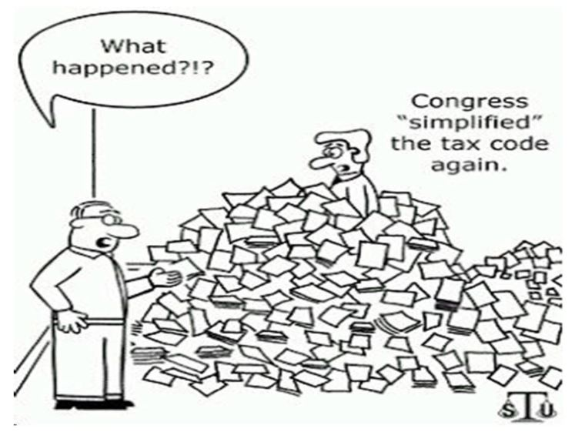

Slide 3
The Tax Cuts and Jobs Act of 2017
Maintained current tax treatment of not-for-profit cooperatives - Co-ops are able to keep their not-for-profit status
Maintained current tax treatment of entities created and owned by electric cooperatives***
Maintained current tax treatment of 401(K) Plan contributions - Allows employees to save for retirement with pre-tax dollars
Interest Expense - Interest for business purposes is generally deductible in the taxable year in which the interest is paid or accrued. Any interest that is disallowed may be carried forward indefinitely, and any excess limitation may be carried forward for three years. Senate amendment adopted in final report that the limitation(i.e. 30% of adjusted taxable income), which does not apply to certain regulated public utilities, also does not apply to electric cooperatives. (Favorable - eliminates negative impact on taxable co-ops)

Slide 4
The Tax Cuts and Jobs Act of 2017
Modification of the energy investment tax credit - The current Commercial Investment Tax Credit (Section 48) for geothermal energy, solar energy, qualified fuel cell, and qualified small wind energy property have expired. House Provisions Not Adopted Unfavorable (May Be in a later Extenders Package) – Still under current law.
Termination of private activity bonds - Private Activity Bond - Tax-exempt bonds issued by or on behalf of local or state government to provide special financing benefits for qualified projects. The PAB results in reduced financing costs because of the exclusion of federal income tax. No Provisions Favorable

Slide 5
The Tax Cuts and Jobs Act of 2017
Repeal of tax credit bonds - Current statute authorizes Clean Renewable Energy Bonds (CREBS) available to co-ops. House Provisions Adopted Unfavorable
Retirement Savings – 401(K) and 457(b) Defined Contribution Plans Section 1501 – 1506. No changes to current law 457(b) or 401(k) limits, pre or post tax (Roth) deferrals. There are some changes to hardship distributions and distributions at age 59 ½ from pension plans and 457 plans, but overall the big concern on “changing the current law tax treatment of 401(k) Contributions” has been avoided. (Favorable – No changes to current tax treatment on contributions in H.R. 1) Senate Provisions Favorable

Slide 6
The Tax Cuts and Jobs Act of 2017
Retirement Savings –Defined Benefit Plans (like RS Plan) Non-Discrimination Rules.
Section 1506. Modification of nondiscrimination rules to protect older, longer service participants - H.R. 1 fixes a growing problem for electric co-ops both in the Retirement Security Plan or sponsoring a stand-alone defined-benefit plan that have “closed” their plans to new employees, but continue to provide benefits for employees in the plan before the “closed” date. Under current IRS “Non-Discrimination” rules, co-ops that “closed” their plans to new employees will eventually be forced to close their plans completely for all employees simply because long-service employees in the plan are paid more than new employees being hired. This doesn’t make sense. The House Tax Bill solves this problem completely for all co-ops in the NRECA RS plan, and any co-op with its own defined benefit pension plan, by including identical language from the Senate Finance-passed bill from September of 2016 that we sent letters of support on last year. (Favorable – Included in H. R. 1) No Provision Unfavorable

Slide 7
The Tax Cuts and Jobs Act
Significant Corporate Changes:
Corporate Tax Rate reduced to 21%
Alternative Minimum Tax Repealed
Net Operating Losses Modified
New Interest Expense Limitation

Slide 8
The Tax Cuts and Jobs Act
Net Operating Loss Modifications:
Net operating losses generated in years after 2017 will have an indefinite carry-forward period
However, use of losses are limited to 80% of taxable income
These indefinite loss carry-forwards are still subject to a valuation allowance for financial statement purposes
Existing losses for years 2017 and prior remain subject to the 20 yr carry-forward and offset 100% of taxable income

Slide 9
The Tax Cuts and Jobs Act
Interest Expense Limitation:
Deduction for interest expense is limited to 30% of EBITDA for 2018-2021 and 30% of EBIT in 2022 forward
Interest expense not allowed can be carried forward indefinitely, subject to a valuation allowance for financial statement purposes
Electric Cooperatives are generally exempt from this limitation, however non-cooperative subsidiaries of Electric Cooperatives are not exempt

Slide 10
The Tax Cuts and Jobs Act
Additional Significant Corporate changes:
Self-created property (patents, inventions, etc.) excluded from capital asset category
Luxury automobile depreciation limits increased
Computers removed from listed property

Slide 11
The Tax Cuts and Jobs Act
Additional Significant Corporate changes:
No deduction for settlement amounts paid for sexual harassment subject to nondisclosure
Employee achievement awards changes
Tax-exempt organizations – Excise tax on compensation to covered employee over $1 M
UBIT separately computed for each trade or business activity

Slide 12
The Tax Cuts and Jobs Act
Other IRS Proposed Regulations:
Deductibility of state and local tax payments – Federal law will control characterization of payments regardless of state law
Requirement that all information returns, regardless of type, be taken into account for the 250 return threshold for electronic filing of documents. Would be effective for all returns filed after December 31, 2018

Slide 13
The Tax Cuts and Jobs Act
Suspension of exclusion for qualified moving expense reimbursements:
Under pre-enactment law, qualified moving expense reimbursements were excludable from an employee’s gross income and from the employee’s wages for employment tax purposes. Such expenses included amounts received (directly or indirectly) from an employer as payment for (or reimbursement of) expenses that would have been deductible as moving expenses if directly paid or incurred by the employee.

Slide 14
The Tax Cuts and Jobs Act
Suspension of exclusion for qualified moving expense reimbursements:
The new law suspends the exclusion from gross income and wages for qualified moving expense reimbursements for years 2018–2025.
The effective date is for tax years beginning after December 31, 2017.

Slide 15
The Tax Cuts and Jobs Act of 2017
Section 118 changes: federal, state and local grants are now taxable income to corporations.
Under the Act, section118 is amended to provide that the term “contribution to the capital of the taxpayer” does not include “any contribution by any governmental entity or civic group (other than a contribution made by a shareholder as such).”
Accordingly, contributions of money or property to a corporation by a governmental entity will be includible in gross income (unless another exclusion applies).

Slide 16
The Tax Cuts and Jobs Act of 2017
Section 118 changes: federal, state and local grants are now taxable income to corporations.
Note that this may include FEMA funds(unless FEMA funds are more in the nature of insurance), government grants for broadband, energy efficiency etc.
The IRS has never ruled on the nature of FEMA funds and has never brought this issue up in an electric coop audit insofar as we are aware.

Slide 17
The Tax Cuts and Jobs Act
Beginning in 2018, the Act instituted a 21% excise tax on the compensation and excess severance of tax exempt covered employees in excess of $1 million.
This matches the excise tax on taxable corporation compensation.

Slide 18
The Tax Cuts and Jobs Act
The Act defines a “covered employee” as any employee of a covered organization who is one of the five highest paid employees in any year after 2016. Thus, the new excise tax can apply to any individual who is currently or was previously among the five highest paid employees of the organization after 2016 (even if the individual is no longer an employee).

Slide 19
The Tax Cuts and Jobs Act
For this purpose, compensation is defined as all compensation subject to federal income tax withholding is counted for purposes of the excise tax.
It also includes any amounts that are subject to taxation under Code section 457(f) (which applies to certain deferred compensation arrangements of covered tax exempt entities).
However, compensation does not include any Roth contributions made by the employee under the employer’s 401(k) or 403(b) plan.

Slide 20
The Tax Cuts and Jobs Act of 2017
The solar ITC is a 30 percent tax credit for solar systems on residential (under Section 25D) and commercial (under Section 48) properties.
The existence of the solar ITC through 2021 provides market certainty for companies to develop long-term investments that drive competition and technological innovation, which in turn, lowers costs for consumers.
The commercial and residential ITC were maintained under the Tax Cuts and Jobs Act of 2017.

Slide 21
The Tax Cuts and Jobs Act of 2017
Tax reform did not change the prior tax law expiration dates of renewable tax incentives such as the production tax credit for wind which expires in 2019.
We will continue to work on certain renewable provisions and the nuclear production tax credit which we hope will be included in a tax extenders package to be taken up in 2018.

Slide 22
Tax Extenders

Slide 23
Bipartisan Budget Act of 2018
On February 9, 2018, Congress passed, and the President signed into law, H.R. 1892, the “Bipartisan Budget Act of 2018” (P.L. 115-123) (the Act).
Many renewable tax incentives and provisions expired on December 31, 2016 but were retroactively reinstated through December 31, 2017, unless otherwise noted below:
Section 25C, which provides a 10 percent credit for qualified nonbusiness energy property;
Section 25D credit for residential energy property for qualified fuel cell property, small wind energy property, geothermal heat pump property, qualified solar electric property, and solar water heating property. It should be duly noted that this incentive was extended through 2021;
Section 30B, which provides a credit for qualified fuel cell motor vehicles;

Slide 24
Bipartisan Budget Act of 2018
Section 30C, which provides a 30 percent credit for the cost of alternative (non-hydrogen) fuel vehicle refueling property;
Section 40(b)(6), which provides a credit for each gallon of qualified second-generation biofuel produced;
Section 40A credit for biodiesel and renewable diesel, which includes the biodiesel mixture credit, the biodiesel credit and the small agri-biodiesel producer credit;
Section 45L, which provides a credit for each qualified new energy-efficient home constructed by an eligible contractor and acquired by a person from the eligible contractor for use as a residence during the tax year;

Slide 25
Bipartisan Budget Act of 2018
Section 48 investment tax credits (ITC) for fiber-optic solar lighting system, small wind energy, qualified fuel cell (it should be noted these credits were extended through 2021, subject to the following phase-out requirements):
  If construction begins before 2020 and the asset is placed in service by the end of 2023, the ITC percentage is 30%,
  If construction begins in 2020 and the asset is placed in service by the end of 2023, the ITC percentage is 26%,
  If construction begins in 2021 and the asset is placed in service by the end of 2023, the ITC percentage is 22%, and
  If construction of these facilities begins after 2021 or the project is not placed in service by the end of 2023, no ITC would be available.

Slide 26
Bipartisan Budget Act of 2018
Qualified microturbine, combined heat and power, and geothermal heat pump facilities are entitled to a 10% ITC if construction begins before 2022;
Section 168(l), which provides a depreciation allowance equal to 50 percent of the adjusted basis of qualified second-generation biofuel plant property;
Section 179D energy tax deduction for building envelope efficiency in connection to energy efficient lighting systems, energy efficient HVAC systems; and/or an energy efficient building envelope (such as windows, doors, roofs, insulation, etc.);

Slide 27
Bipartisan Budget Act of 2018
The Production Tax Credit (PTC) under Section 45 (and ITC in lieu of PTC for facilities described in Section 45) is available, retroactive to January 1, 2017, for the following facilities if construction began by December 31, 2017:
  Closed-loop biomass,
  Open-loop biomass,
  Geothermal energy,
  Landfill gas,
  Trash,
  Qualified hydropower, and
  Marine and hydrokinetic renewable energy.
Nuclear PTC for advanced nuclear power facilities

Slide 28
Bipartisan Budget Act of 2018
Additionally, the act amends Code Section 45Q which provides a credit for sequestration of carbon dioxide captured and disposed of by the taxpayer in secure geological storage or used by the taxpayer via tertiary injection in a qualified enhanced oil or natural gas recovery project.
Qualified carbon dioxide is carbon dioxide captured from an industrial source that would otherwise be released into the atmosphere as industrial emission of greenhouse gas, and is measured at the source of capture and verified at the point of disposal or injection.
The new Code Section 45Q increases the amount of the credit, the window for carbon capture projects, and the number of years to claim the credits.

Slide 29
Bipartisan Budget Act of 2018
The 45Q tax credits could prove to be just the cure the industry needs.
Any new fossil-fuel power plant or carbon-dioxide producing industry that commences construction before 2024 is eligible for tax credits for up to 12 years (a time cap on the credits).
The tax credits offered are per metric ton of carbon dioxide captured: $30 if the carbon dioxide is put to use (pushing out oil from depleting fields is the most popular use) or $50 if it is simply buried in underground storage.

Slide 30
IRS Ruling on Batteries and Solar

Slide 31
IRS Ruling on Batteries and Solar
LTR 201809003, in which the Internal Revenue Service (“Service”) ruled that the cost of installing energy storage property to be integrated into other residential solar photovoltaic system property will qualify as a “qualified solar electric property expenditure” eligible for the tax credit under Internal Revenue Code (“Code”) section 25D.
The ruling provides that the battery is considered to be property that uses solar energy to generate electricity for use in Taxpayers’ dwelling unit located in the United States and used as a residence by them.
The software management tool portion is only considered part of the qualified solar electric property so long as it is required in monitoring the charging and discharging of solar energy.

Slide 32
IRS Ruling on Batteries and Solar
Additionally, labor costs that are properly allocable to the onsite preparation, assembly, or original installation of the Battery and for piping or wiring to interconnect the Battery to the home are eligible for the credit.
The applicable percentage in the case of Taxpayers’ request is 30 percent.

Slide 33
Tax Reform 2.0?
Current proposals would lock in the 2017 tax cuts for individuals and small businesses making them permanent – they would have expired in 2025.
Incentivize retirement savings
Introduce Universal Savings Accounts for families, expand 529 education accounts and create a new baby plan that would allow families to draw money out of retirement accounts penalty free.
Assist new businesses by allowing them to write off more of their start up costs.

Slide 34
Appendix

Slide 35
Other Tax Changes
Topic | Pre-Reform Law | 2017 Act
Dividends Received Deduction | 70% Deduction | 50% Deduction
Bonus Depreciation | 50% expensing until 2019 | 100% expensing after 9/27/17 Phased out from 2024-2028 Available for used property G&T property excluded after 12/31/17
Meals & Entertainment | 50% disallowed, no limitation on company cafeteria meal costs | Entertainment expenses no longer allowed - business meals remain 50% disallowed. Meal costs at a company cafeteria are subject to 50% disallowance until 2025 (after 2025 they are not deductible)
Like Kind Exchange Treatment | Generally Allowed | Only allowed on real estate not held for sale
R&D Expenses | Deductible | Must be capitalized and amortized over 5 years
“Local” Lobbying Expenses | Deductible | Not Deductible on or after 12/22/17
Moving Expense Reimbursements | Qualified expenses are excluded from Income of Employees | Suspended - no longer excluded until years after 2026

Slide 36
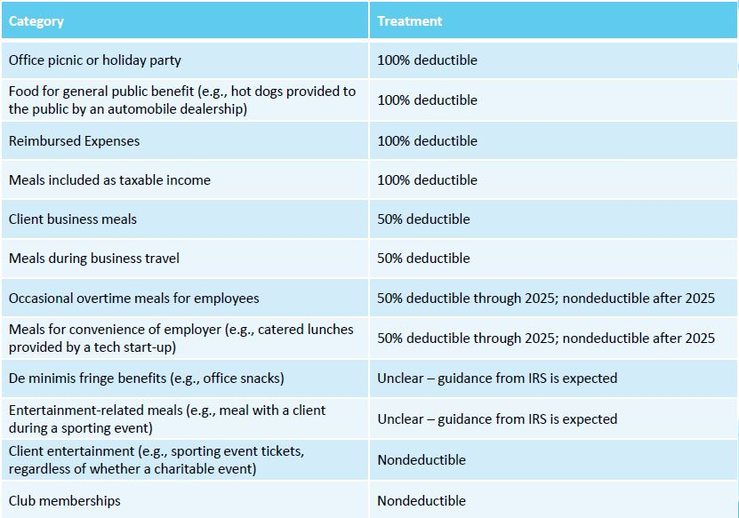
Meals & Entertainment

Slide 37
Contact Information
Russ Wasson
Senior Director of Tax, Finance and Accounting Policy
National Rural Electric Cooperative Association
4301 Wilson Blvd.
Mail Code EP11-253
Arlington, VA 22203-1860
Voice work: (703) 907-5802
Mobile: (225) 939-1298
Mobile: (703) 402-2510
Fax: (703) 907-5517
email: russell.wasson@nreca.coop

