Slide 1
Electric Rates: And the Impact of Distributed Generation on Future Design
Florida Finance & Accounting Conference
September 20, 2019
Burton Benkwith
Regional Vice President, CFC

Slide 2
Properly Designed Rates….
Are more important today than at any time in the history of electric cooperatives!

Slide 3
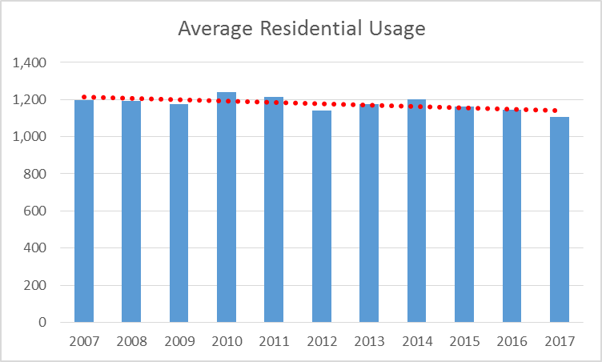
Average Residential Usage
7.7% decline since 2007

Slide 4
Impact of Slow Growth

Slide 5
Why Now?.....What Is Different?
New Technology
  AMI
  Distributed Generation
  Smart Controls
Next Generation Member
  New Services
  Flexibility/Options
  More Control

Slide 6
Our Changing World
Technology
Power Supply Resources
System Operations
Member Involvement
Portfolio model
Micro Grid
Participation

Slide 7
Our Changing World
Technology allows the member to become an active agent in our operations and erodes:
Homogeneity within a customer class
Fixed load profile based on the rate classification

Slide 8
In a Perfect World
Tomorrows single residential rate would:
  Generate required margin for the class regardless of how many kWh’s are sold
  Align with power supplier rates
  Properly charge and reward distributed generation
  Minimize subsidies within the class
  Encourage energy efficiency
  Explainable and supportable
  Be “competitive”

Slide 9
RECAP
Fundamentals of Cost of Service

Slide 10
The Big Lie
How We Incur Costs……
  Membership is cheap
  Electricity cost the same all the time
  Energy is the most important thing
So……Be Patient

Slide 11
Three Step Process to Rate Making
Revenue requirements (how much?)
Cost of service (from whom?)
Rate design (how?)
The first two are straight forward exercises
The last step requires consideration of “non-economic” factors

Slide 12

From Numbers to Rates….
Revenue Requirement
1. Customer 2. Demand 3. Energy
Notes:
The customer bucket has been slowly addressed over time but the demand bucket has not

Slide 13
Traditional Approach to Rate Design
Three part cost
  Consumer
  Demand
  Energy
Two part rate
  Consumer charge
  Energy cost
Cost of Service
  $36.00
  $10.00
  $0.0420
Common Rate
  $22.00
  $0.1256
Cost of Service
Retail Rate

Slide 14
DG Rate Issues?
Perception
Limitations of traditional rate design
  Proper cost recovery
  Subsidies

Slide 15
DG Perception
Most coops recognize the need to recover fixed costs on a DG consumer..
Charging a different rate can create distrust with your member

Slide 16
DG - All About the “WHEN” not the “HOW MUCH”

Slide 17
It’s About the “WHEN” not the “HOW MUCH”
Varies by member

Slide 18
NCP
CP

Slide 21
Demand Response
Demand rates can be designed to be the same

Slide 22
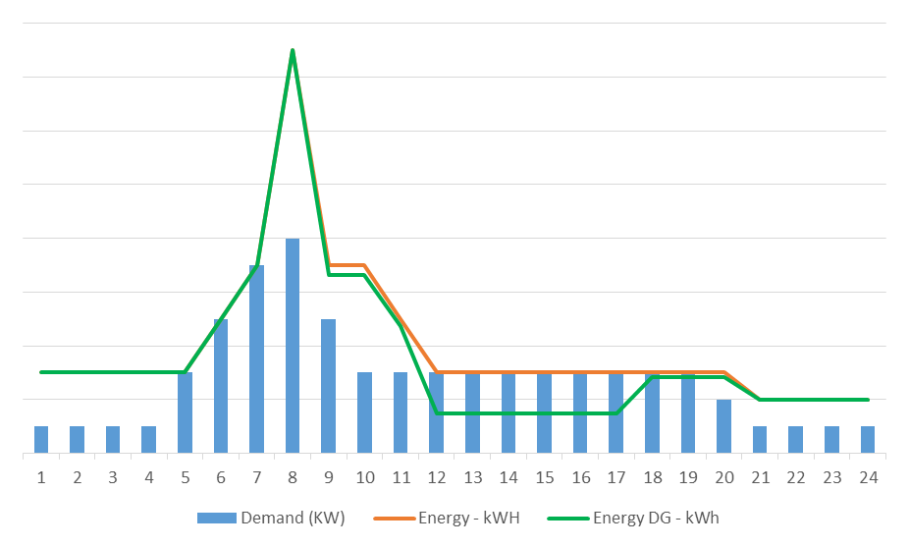
DG Usage – Winter Day
The DG and non-DG consumer will likely set a peak at the same time
DG consumer will likely purchase less kWh at some point in the day

Slide 23
Solar Usage – Winter Day
$21.06 difference includes all demand related costs being avoided by consumer
$8.00 difference includes only energy related costs being avoided by consumer

Slide 24
Solar Usage – Summer Day
$21.06 difference does not properly capture reduction in demand
$32.76 difference captures reduction in both demand and energy

Slide 25
Demand Charge
True cost-based rate
Rewards and penalizes the “right people”
Helps eliminate subsidy within the class
Can be designed where total cost is same
Can help obtain a true “net meter” energy rate (avioded costs)
Difficult to explain
May not be well accepted
Investments needed (meters – member support tools)

Slide 26

Properly Designed Rates

Slide 27
Target Specific Costs to Capture
In a perfect world, this represents the variable component of your wholesale power cost, the Coop becomes indifferent as to whether of not members are generating electricity on their own

Slide 28
Hurdles
Member acceptance – start communicating
Metering – CP vs NCP
Pre-pay Metering programs
Others?

Slide 29
Time-of-Use Rate
Greater flexibility to properly recover costs
within the class
Sends desired signal to consumer
Can be difficult to design & communicate
Low participation rates
Peak periods cannot be too large

Slide 30
Time-of-Use Rate

Slide 31
Rising Wholesale Power Cost
Increasing wholesale power cost will also put pressure on distribution rates
Highlights the importance of properly capturing fixed and variable costs
  The more fixed costs get pushed into energy the higher your energy rate must be….Creating more volatility
Might consider rate designs that “unbundle” wholesale costs from distribution costs

Slide 32
Unbundling Costs/Rates
Could go a step further and breakout wholesale between energy and demand

Slide 33
Now Add All This Together!
In reality all these forces are happening at the same time.
New members want solar and the ability to utilize technology to alter usage patterns in return for a lower bill
Coops need to have clear positions on their role in this changing landscape

Slide 34


