Slide 1
Getting social

Slide 2
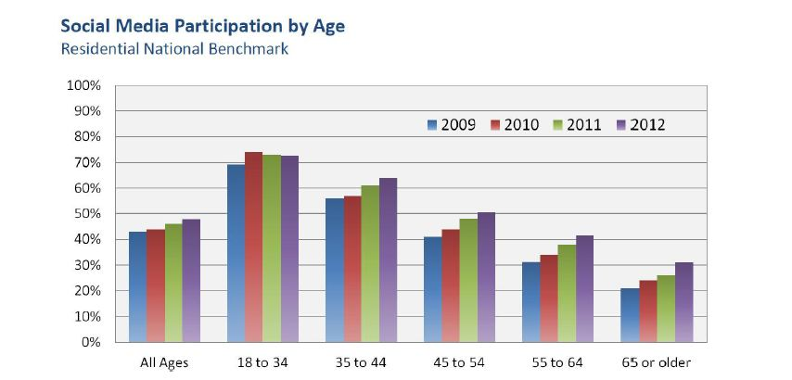
Why social media?
Notes:
In 2010, Coast Electric’s survey showed that we were not reaching members in the younger age ranges. They were aware of things like energy efficiency but weren’t getting their information from us. Older members are very satisfied with Today in MS and are loyal readers but we were missing younger members? So what is the answer? Let’s meet them where they are. And this is where they are.

Slide 3
What’s different about social media?
Notes:
So, besides demographics, what’s different about social media? It’s a two-way conversation. Until social media, our only forms of communication were one-way.

Slide 4
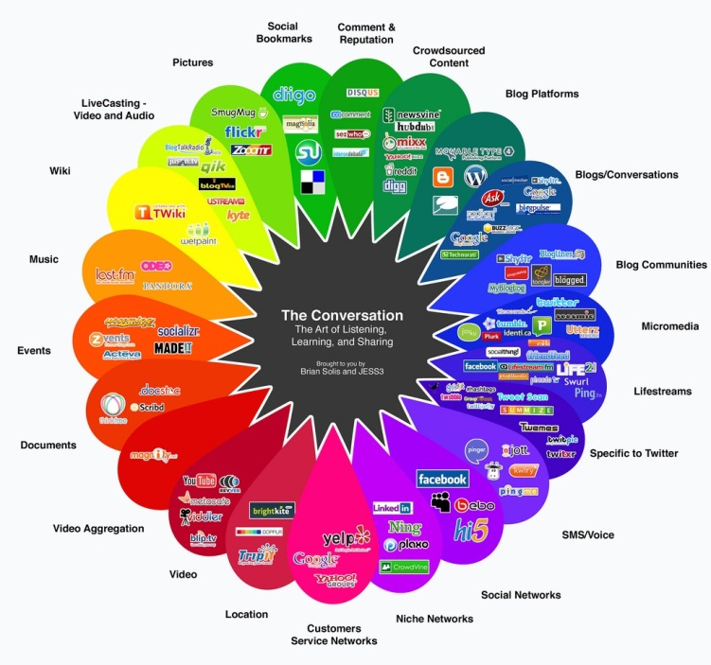
Where do you fit in?

Slide 5
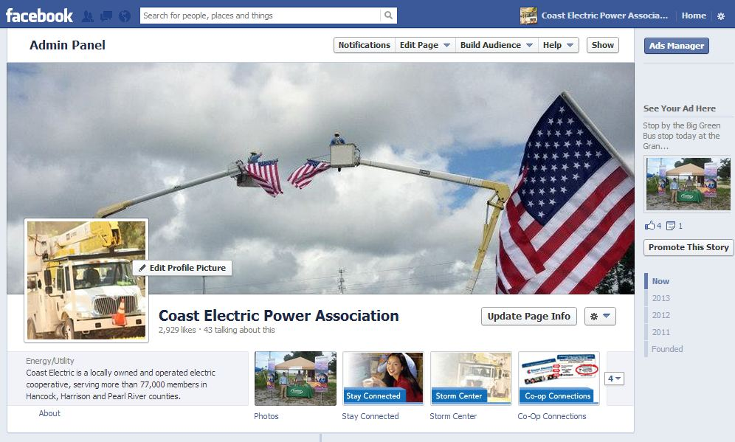
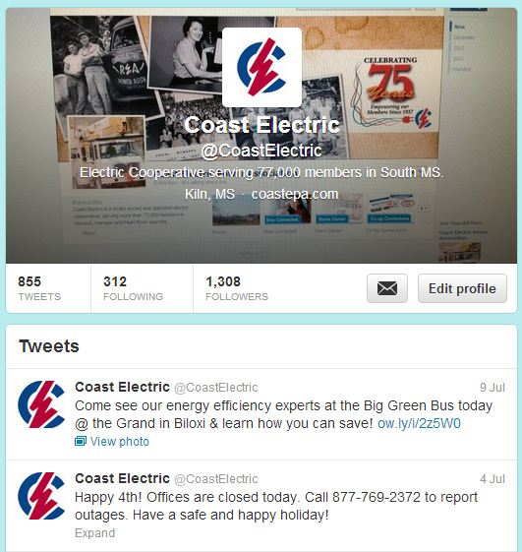

Slide 6
How do you convert the nonbelievers ?
Show them the data. THIS is where you reach a large segment of your membership.
Show them the conversation is happening with or without you.
Show them the bottom line. Social media – even if you advertise – is very inexpensive.
Show them how you will work with them.
Show them that you are not reinventing the wheel – you are simply adding another tool to reach more members.

Slide 7
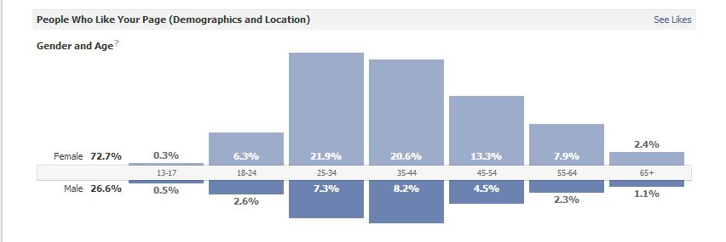
Coast Electric’s Demographics
Notes:
This is just one chart from FB. More demographics are available. FB tends to trend older, too.

Slide 8
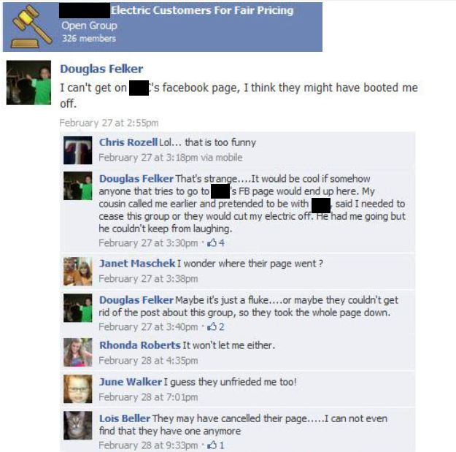
The conversation is happening
Notes:
People are talking about us. We can choose to be part of the conversation OR we can choose to ignore it. THIS is what can happen if we choose to ignore it. This is the kind of thing that can happen when you refuse to respond.

Slide 9
Cost
Advertising on social media vs. traditional media
For Coast Electric, a typical ad:
In the large, daily paper costs: $1,200
In a smaller, paper published a couple of days a week costs: $360
On a radio station costs, on average, a 30-second ad costs: $11-$25
On TV costs: From $110-$215
On Facebook costs: Around $20
*Please note: these numbers are based on several factors and are specific to Coast Electric. They may not reflect the media in your area.
Notes:
This is based on several factors – size of the publication, size of the add, is it color or not, reach, time, frequency, etc. Does this mean we stop advertising on traditional media? Absolutely not! Social media reaches a segment of the membership, but not everyone. Traditional media outlets are very important.

Slide 10
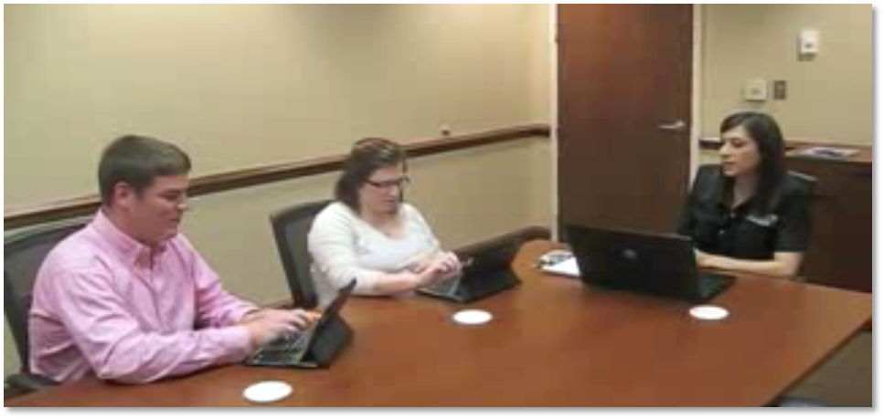
Flow of communication
Show those concerned that your process for social media is the same as it is for other outlets.
Remember, internal communications should always come first.
You may need to look outside of the department for help, especially in crisis situations.

Slide 11
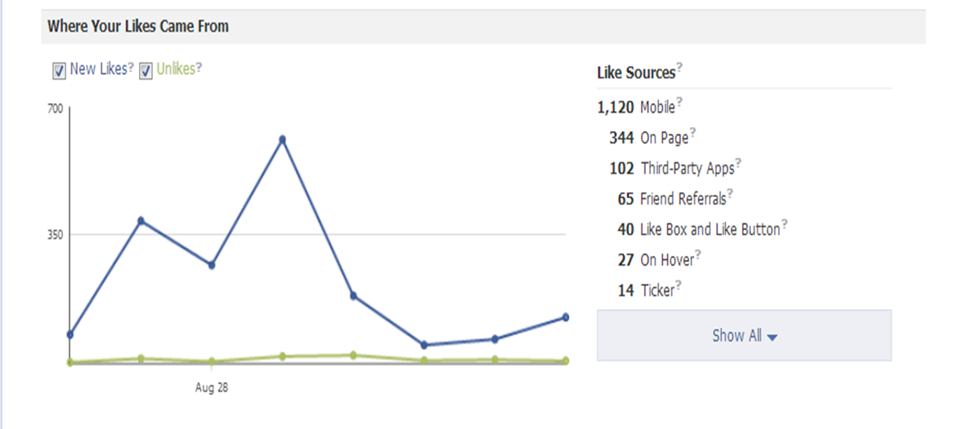
Why is social media important during a crisis?
Notes:
More than 1,800 likes in the days leading up to the storm and during restoration. 610 in just one day. (Note: the majority are from mobile devices.)
Before Isaac, a typical week would mean 103 page views. During Isaac, we had 1,252 page views in one day – the day of the storm.

Slide 12
And this …
Notes:
Our viral reach went from 2,237 the week before Isaac was a factor to 93,943 the week of Isaac

Slide 13
And also, this …
Notes:
Stories created from our posts averages 72 per week. During the week of Isaac, that went up to 5,612.

Slide 14
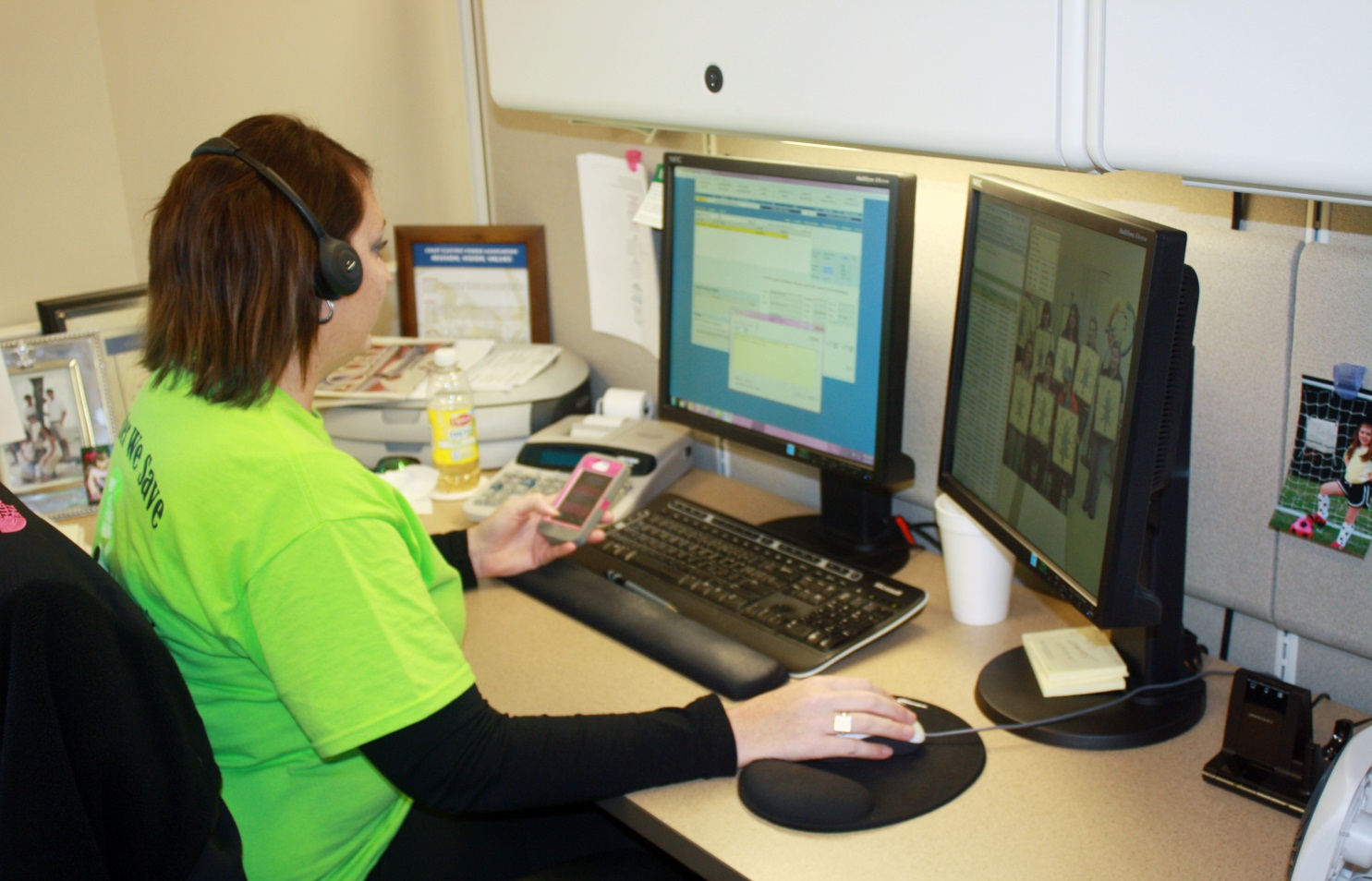
Reaching members
During Isaac, we reached 94,513 people through Facebook in one week. During that same time, the call center staff talked to 6,926 members.
Notes:
Part of the purpose of our FB interactions are to hopefully cut down on call volume for the call center.

Slide 15
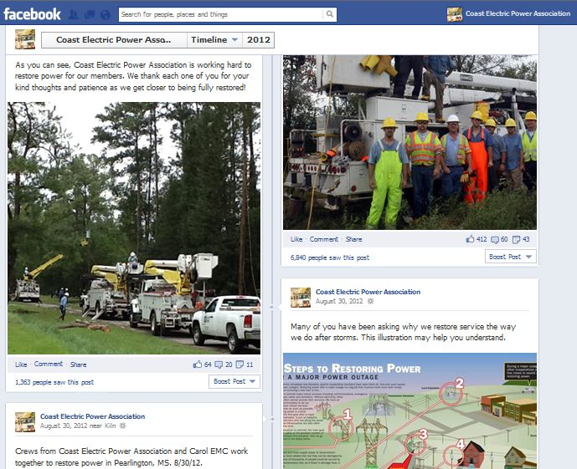
What we post

Slide 16
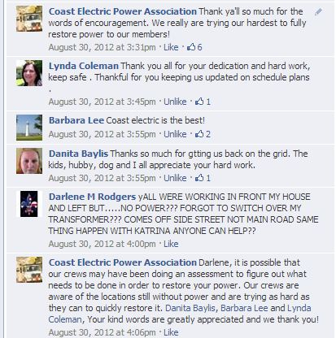
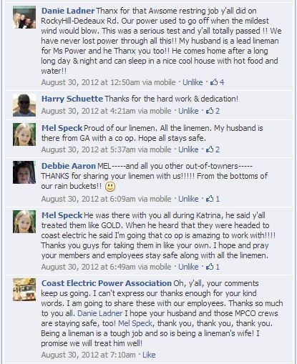
Being part of the conversation

Slide 17
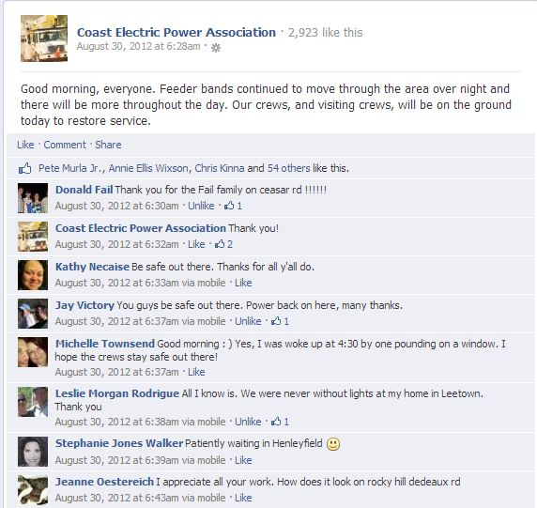
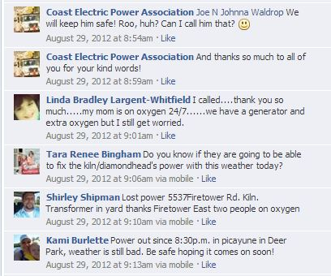

Slide 18
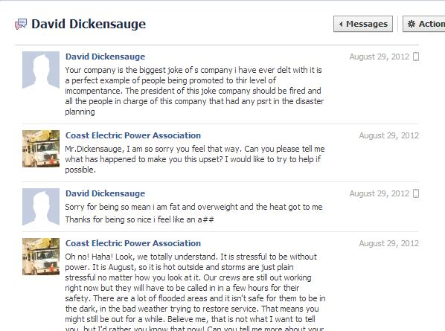
Making your detractors your supporters

Slide 19
Remember, it’s social
Tone is important.
Keep it conversational.
Show your personality.
Don’t be too corporate.
Find ways you can relate.
Respond to positive AND negative feedback.
Be transparent.
Follow up.
This is a big advantage on social media. You can’t always follow up when they call but you can on social media. Check in, ask how they are doing.
Acknowledge everyone, if at all possible.
Remember, most people just want a response, even if it isn’t exactly what they want to hear.

Slide 20
Questions?
April Lollar, APR
Coast Electric Power Association
aprillollar@coastepa.com
On FB: Coast Electric Power Association
On Twitter: @coastelectric
On Instagram: Coast Electric

