Slide 1
FECA Finance & Accounting Conference
Sandpearl Resort, Clearwater Beach, FL
Brian Grogan
Account Executive
Notes:
Good morning/afternoon! My name is (insert name here), and I am your Account Executive. Thank you for giving me a few minutes to talk with you about Federated!

Slide 2
Federated Rural Electric Insurance Exchange
Founded by Cooperatives for Cooperatives
Notes:
Beginning in 1955, rural electric leaders began holding a series of meetings to explore the feasibility of forming a self-insurance program. The goal was to secure long-term coverage at reasonable premiums. In 1956, a detailed study under the direction of the University of Wisconsin School of Commerce found savings could be achieved if co-ops were to adopt a self-insurance plan.

Slide 3
History of Federated
In 1958, Bill Thomas, Federated’s first GM, envisioned that the formation of Federated as one of the greatest assets to our cooperative members.
Notes:
In 1958, an organizational meeting of Federated was held in Madison, Wisconsin, with 15 co-ops subscribing to capital stock. On March 24, 1958, Bill Thomas, Federated’s first GM, in his report to WEC membership made the following comment: “A few years from now, we will regard the formation of Federated as one of our greatest assets to our cooperative members.”

Slide 4
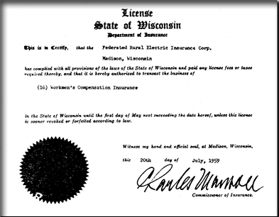
History of Federated
On July 20, 1959 Federated received a license to do business in Wisconsin.
This is the first license in the nation’s history issued to an organization of electric cooperatives.
Notes:
On July 20, 1959, the Wisconsin State Insurance Commissioner issues Federated a license to do business in Wisconsin. This is the first license in the nation’s history issued to an organization of electric cooperatives. On September 1, 1959, Federated issues first policy to the Wisconsin Electric Cooperatives for Workers’ Compensation coverage; the first policy written. Fourteen other cooperatives announced they will subscribe as their Workers’ Compensation coverage expires.

Slide 5
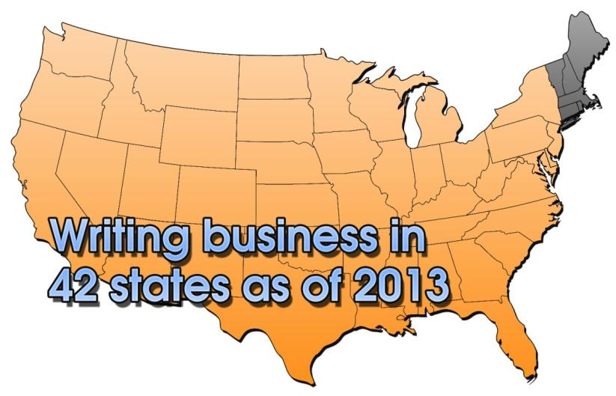
History of Federated
Today, Federated has a 84.8% market share of rural electric utilities in 42 states.
Notes:
In 1964, Federated expanded into the states of Iowa, South Dakota and Kansas and by 1983, Federated was writing business in 17 states. Today, Federated has an 84.8% market share of core electric cooperatives in 42 states.

Slide 6
History of Federated
In 1999, Federated converted from a Wisconsin stock insurer to a Kansas reciprocal insurance exchange … a cooperative owned and operated insurance company.
Notes:
In 1999, shareholders of Federated voted to amend the Articles of Incorporation to re-domesticate to Kansas and convert from a Wisconsin stock insurer to a Kansas reciprocal insurance exchange; a Cooperative owned and operated insurance company. Since becoming a Cooperative in 1999, we have allocated $136.8 million in patronage capital to our members and we have returned over $55 million in retired patronage capital and return of capital previously invested in Federated.

Slide 7
How we do Business
Notes:
Our primary ongoing financial challenge is to continue to operate your insurance company at a 100% combined ratio. This means that the premiums we collect equal the payments we make for claims and the overhead we pay to run the company. The overhead to run your insurance cooperative is currently around 15 percent. Thus, 85 percent of your premium dollars go to pay insured losses. Now if we can reduce the frequency and severity of our insured losses, we can stabilize or even lower your insurance premiums.
Claim counts are trending down, which to me, is an indicator that the Culture of Safety is becoming a reality across the country. And, as you can see, we have met our goal of operating at or below 100% combined ratio 11 out of the past 14 years!

Slide 8
Loss Control Contributions
Each year Federated sets aside a portion of our member’s premiums to be returned to statewide associations in support of the safety and training programs provided.
Since Inception $42 Million
Notes:
Each year, Federated continues to invest in the future of cooperatives through premium dollars aside to be returned to statewide associations in support of the safety and training programs provided. This year we are returning an additional $3.5 million to the Statewide Associations. This will bring our total contribution since 1959 to $42 million.

Slide 9
Member Economic Participation
Federated’s 2012 Margins
$19,355,138
FL Member’s Share
$1,214,023
Notes:
The good news doesn’t stop there, net margins for 2012 amounted to $19.4 million. Federated's Board of Directors approved management's recommendation to allocate 100 percent of those margins back to the membership. The Board also approved cash distributions totaling $7.8 million which were distributed in March of this year, and includes fully retiring our 2004 margins.
In 2012 member margins were $19,355,000
FL Member’s share for 2012 was $1,214,023, with $256,552 of that paid in cash!
FL Member’s share since becoming an Exchange is $6,679,346
OF WHICH, $968,682 was paid in cash!

Slide 10
Investing in the Future
Notes:
Member Economic Participation, we refer to it as investing in the Future of Cooperatives:
As previously reported, this year we are returning $3.5 million to the Statewide Associations to assist with Safety related expenses. This will bring our total contribution since 1959 to $42 million.
Since becoming a Cooperative in 1999 we have allocated $136.8 million in patronage capital to our members and we have paid out over $55 million in retired patronage capital and return of capital previously invested in Federated.
Members of Federated’s Workers’ Compensation Group Retention Programs that were established in the ‘90s has received over $23.4 million in dividends as a result of their efforts to lower losses.
This brings the total of cash returned to our members since our inception to more than $120 million.
This was all accomplished as a result of controlling losses and keeping people safe and on the job.

Slide 11
Current Financial Standing
7/31/13 12/31/12
Total Assets $463.2M $432.2M
Surplus $140.5M $136.6M
Combined Ratio 95.8% 94.6%
Notes:
I am pleased to report that total assets have increased $31.0 million (7.2%) from 12/31/12 and amount to $463.2 million at 7/31/13.
Surplus at 7/31/13 is $140.5 million, representing an increase of $3.9 million (2.9%) from the end of 2012.
This slight increase would be greater had it not been for the recognition and payment of $7.8 million in subscriber equity account distributions in March!
Federated’s combined ratio at July 31, 2013 was 95.8 percent as compared to 94.6 percent as of the end of 2012. This is great news. However, it’s important to note, Federated’s goal of operating at or below a 100% combined ratio is not just about margins, it’s about keeping people safe and on the job.

Slide 12
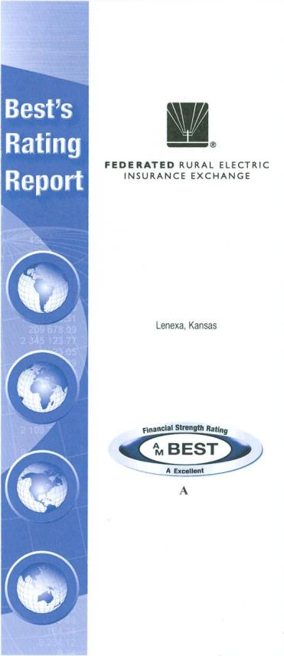
A.M. Best Rating Upgrade
A
Excellent
Notes:
Financially speaking, as you could see, Federated has continued to reach new milestones every year. This year, we are very excited that AM Best Company, the world’s oldest and most authoritative insurance rating and information source, recognized our financial success and stability by upgrading us to “A” from “A-”. As proud as we are to attain this rating upgrade, we know it would not be possible without the support of you, our members. Thank you!

Slide 13
Property Inventory Valuation
Replacement Cost Value
The amount it would take to replace property with like property of the same quality and construction.
Notes:
Next, I want to touch on a couple of areas that I have seen in my travels as being deserving of some additional attention. One of those areas has to do with making sure that your property values are adequate. It may seem fairly straightforward. However, I do want to spend just a couple of minutes going over some common valuation definitions, and then explain why it is important to make sure the values you provide to me are adequate.
First, we will look at Replacement Cost Value. This is the amount that would need to be spent in order to replace a piece of property with like property of the same quality and construction. There is no deduction taken against this value for depreciation or how much useful life is left in the property. It is literally what it would cost TODAY to replace your property should it be destroyed. This is the most common valuation methodology that Federated uses and it is the basis for all real property (buildings, towers, etc.), business personal property (contents) and hydraulic equipment (actual bucket and digger derrick units attached to your vehicles, not the cab and chassis).

Slide 14
Property Inventory Valuation
Actual Cash Value
Working rule-of-thumb definition: replacement cost new at the time of loss, less depreciation.
Notes:
Actual Cash Value, on the other hand, is the basis of loss settlement that looks at what it would cost to replace a piece of property today, and then subtracts a calculated amount for depreciation to reflect the amount of useful life that is left in that piece of property. This valuation methodology is actually the fairest basis of settlement because it gets us closest to real indemnification or restoring the insured to the same financial position they were in before the loss occurred. The types of properties that Federated uses this valuation methodology for are vehicles (cab and chassis) and mobile equipment. If anyone has ever had an accident with their own personal vehicle, you are probably all too familiar with this method of valuation.

Slide 15
Property Inventory Valuation
Book Value
The dollar amount of property shown in a company’s books.
Notes:
Next, we look at Book Value. The Book Value of property is simply that, the value of a given piece of property as listed in a company’s books. This is simply an accounting value and is not necessarily a representation of any meaningful value from an insurance perspective.

Slide 16
Property Inventory Valuation
Market Value
The amount that a piece of property could be sold for in the open market.
Notes:
Finally, we take a look at Market Value. This is the amount of money that a given piece of property could be sold for in the current open market. This may also represent what you paid for a piece of property in today’s market. As some of you may have experienced, and we have certainly seen this, in certain parts of the country real estate values have dropped significantly, and properties are being purchased for a lot less than what you could rebuild that same property for.
Unfortunately, this can create a bit of confusion when you try to place a value on this property for insurance purposes. When it comes to insuring that same piece of property, what you paid for that property is not the value we have to use when we insure that property. Think of it this way: let’s look at a $1,000,000 building that was purchased for $100,000 (yes, this has happened). If we insure it for $100,000 and a storm comes through and damages the building to the extent of $250,000 (remember, it costs $1,000,000 to rebuild this building), we have just paid $250,000 to repair a building that we have only collected premium commensurate with a $100,000 building for. You may think this is good for you. However, in the long run, you have to remember that we are an at-cost insurance provider. If this happened everywhere across the country, eventually you would see property rates increase in order to compensate for this inadequate insurance to value.

Slide 17
Property Inventory Valuation
Insurance to value
Making sure that the amount of insurance that you carry is enough to cover all of your property at its Replacement Cost Value.
Notes:
This brings us to the underlying reason for why we need to make sure that the values provided to us for all of your property are an accurate reflection of what it would actually cost to replace your property in the event of a loss. As I mentioned, Federated is an at-cost insurance provider. This means that the premiums we take in must be enough to cover the losses and the overhead expenses that we incur to stay in business. Our overhead expenses typically only run in the 15% range, as opposed to 25-30% for normal insurance carriers. This means 85% of the insurance premiums we collect are used to pay for losses that are incurred. If we don’t collect enough premium for a given line of business, like property, rates have to go up. Now, there are other legal and regulatory reasons for making sure we are collecting the correct property values. However, the bottom line is, no one likes to see premiums go up simply because values are being under reported.

Slide 18
Valuation of Property Under Federated’s ARB Policy
Blank Material
Actual Cash Value (ACV)
Replacement Cost Value(RCV)
Notes:
Having touched on the various valuation methodologies, I now want to provide you with a quick overview of how your various items are covered under the All Risk Blanket policy.
Accounting books, manuscripts, drawings, card index systems, storage media for electronic data processing systems and other records are insured only for the cost of blank material.
Some property is insured for its Actual Cash Value (ACV) or the cost to repair, whichever is less. ACV is the cost to replace the property less the depreciation on the property at the time of loss. Items covered at ACV include:
1. Property which is otherwise known as salvage material;
2. Automobiles, except hydraulic equipment attached thereto; mobile equipment, trailers, semi-trailers or any self-propelled vehicles or machines;
3. Damaged or destroyed property that is not repaired or replaced;
4. Items requested to be rated as ACV and listed in an endorsement to the policy.
All other property is insured for Replacement Cost Value (RCV) if the damaged or destroyed property is actually repaired or replaced by the policyholder. Federated’s liability for loss on an RCV basis shall not exceed the smallest of the following amounts:
1. RCV of the property or any part thereof in like kind and quality with such property and intended for the same occupancy and use or as all these conditions may be negotiated with, and agreed to beforehand, by Federated; or
2. The amount actually and necessarily expended in repairing or replacing said property or any part thereof. Expense for work performed by the policyholder’s employees can include direct labor costs plus up to 10% overhead.

Slide 19
Proactive Tips When Hiring A Contractor
Determine the adequacy and competency of your prospective contractor. (Check for appropriate licensing)
Ask for a Hold Harmless Agreement from your contractor.
Check adequacy of general liability limit on Certificate of Insurance.
Check to ensure that Workers’ Compensation coverage is in place.
Require evidence from contractor that they are complying with OSHA (Occupational Safety & Health Administration) requirements.
Notes:
Another area that many of you may end up dealing with at your system, or at least have some input to, is the hiring of independent contractors. Independent contractors are an integral part of your System’s project management. From right-of-way crews, to janitorial services, to clerical help. When considering hiring a contractor, Federated has several recommendations.
Determine the adequacy and competency of your prospective contractor. Does it have a track record of performing quality work? If you have used the contractor before, were there complaints from your members about the work they performed? If so, were these complaints handled to your satisfaction and to the satisfaction of your members. Is their licensing appropriate for work to be completed.
Ask for a Hold Harmless Agreement from your contractor. Be sure that you have a written contract in place and a specification for the contractor to carry contractual liability insurance. Ask to be named as an Additional Insured on the contractor’s liability policy. This is a common stipulation in contracts, and it is designed to place the contractor’s insurance as primary coverage over your Federated liability policy for any alleged negligent acts of the contractor.
Check their Certificate of Insurance to see if their general liability insurance limit is adequate and that they have workers’ compensation insurance in place.
Require that your contractor shows evidence that they and their employees meet the OSHA requirements set forth for the type of work they will be doing for the system.
Following the above actions will not prevent an accident or lawsuit from happening, but it should give you peace of mind in knowing that your system has acted in a proactive manner when addressing the important issue of contract labor.

Slide 20
Independent Contractor Agreements
Hold Harmless Agreement
Name System as Additional Insured
Adequate Limits
Remember to seek legal assistance when drawing up contracts with independent contractors.
Notes:
The retention of independent contractors is often a necessary and advantageous business decision made by our members. In order to protect your system, please consider the inclusion of these contract terms:
1. A Hold Harmless Agreement obligating the contractor to defend the system and compensate claimants in the event that a claim regarding bodily injury, property damage, etc. is made against the system.
2. A provision requiring the contractor’s insurance to name the system as an Additional Insured as opposed to the system being issued a Certificate of Insurance. A Certificate of Insurance certifies that the named insured, the contractor, holds a valid policy. In contrast, an Additional Insured is a party to whom the insurance carrier has agreed to extend coverage.
The contract should also require adequate limits to protect the system in the event of a catastrophic accident, and that contractor’s workers’ compensation coverage is maintained for the duration of the contract.
Always seek advice from your legal counsel on these contracts.
In addition to these terms, be cognizant of the expiration date of the contract in relation to the duration of the project. Oftentimes, work continues on a “handshake extension” which would eliminate the safeguards put in place in the project contract.
Complete, thorough independent contractor agreements fulfill a necessary component of risk management. Such safeguards complement Federated’s mission to provide affordable, quality insurance coverage to our valued membership.

Slide 21
Public Electrical Contact Accidents
January-June 2012
48 Incidents
January-June 2013
38 Incidents
Notes:
To shift gears a bit, with all of our successes, we are still seeing claims in areas that we know could be avoided with continued efforts in public electrical safety education.
As you can see, the number of public electrical contact accidents has gone down from this same period last year. However, FL has taken the top spot in 2013 for public contacts countrywide! This is not exactly the category you want to take the top spot in…
Of the nine public contacts we have had in FL in the first 6 months alone of this year, 1 was a fatality. These claims consisted of 2 orange grove workers contacting our lines with metal ladders, 2 contacts with downed lines, 2 tree trimmers coming into contact with our lines, 1 crane incident, 1 car-pole accident, and, lastly, 1 child climbing a tree and coming into contact with our lines.

Slide 22
Notes:
As you just saw, public safety is an area that everyone can continue to work at and improve upon. There simply isn’t one, single way to reach everyone in the public with information about how to be safe around electricity. It takes a lot of effort on a lot of different fronts to even scratch the surface. However, Safe Electricity is one way to at least get started, while saving your employees time by not having to create this stuff!

Slide 23
Member Benefits
Comprehensive SafeElectricity.org Web Site
Television and radio public service announcements (PSAs)
Print PSA and Billboard Designs
News Releases, articles and photo library
Video productions and streaming Web videos
Most program elements available in Spanish
Notes:
We are proud to be a national sponsor of the award-winning Safe Electricity public outreach and education program. Safe Electricity® is a unified industry effort to broadly communicate vital safety messages with the goal of increasing electric safety awareness to consumers, thus reducing accidents and mitigating risk. Safe Electricity leverages the common interest and strong commitment within the electric industry to promote electrical safety. With partners throughout the nation, the program continually expands its reach and impact.
In addition to broadcast media, Safe Electricity produces and helps to distribute news releases and articles to newspapers, magazines and other print media outlets throughout the nation.
Materials created by Safe Electricity are made available to program partners through the password-protected Members Only Site. The site has a wealth of tools including a library of news releases and articles, streamed PSAs for viewing and downloading along with scripts, program guides and materials and more. The addition of an Image Library means compelling photographs are now available to help illustrate important safety issues.

Slide 24
Programs & Features
“Teach Learn Care TLC” Campaign.
Customizable PowerPoint Presentations.
Program activity guides including: co-branding suggestions, tips on contacting media, how to place PSAs and much more.
Video productions for use at events, presentations, annual meetings, etc.
Notes:
The “Teach Learn Care TLC” campaign is a multi-year effort to put a face on electrical tragedy. Using stories of real families affected by serious electrical accidents, Safe Electricity is reaching even more people. Expanding its communications efforts with Web videos, broadcast PSAs posted to social media sites such as YouTube, and a series of compelling print PSA designs, the program actively uses new tools to educate and enhance awareness, ultimately preventing accidents, injuries and death.
The program is a natural fit with Federated’s initiative to promote a “Culture of Safety” within rural electric cooperatives nationwide, and underscores the collective commitment to protect consumers.

Slide 25
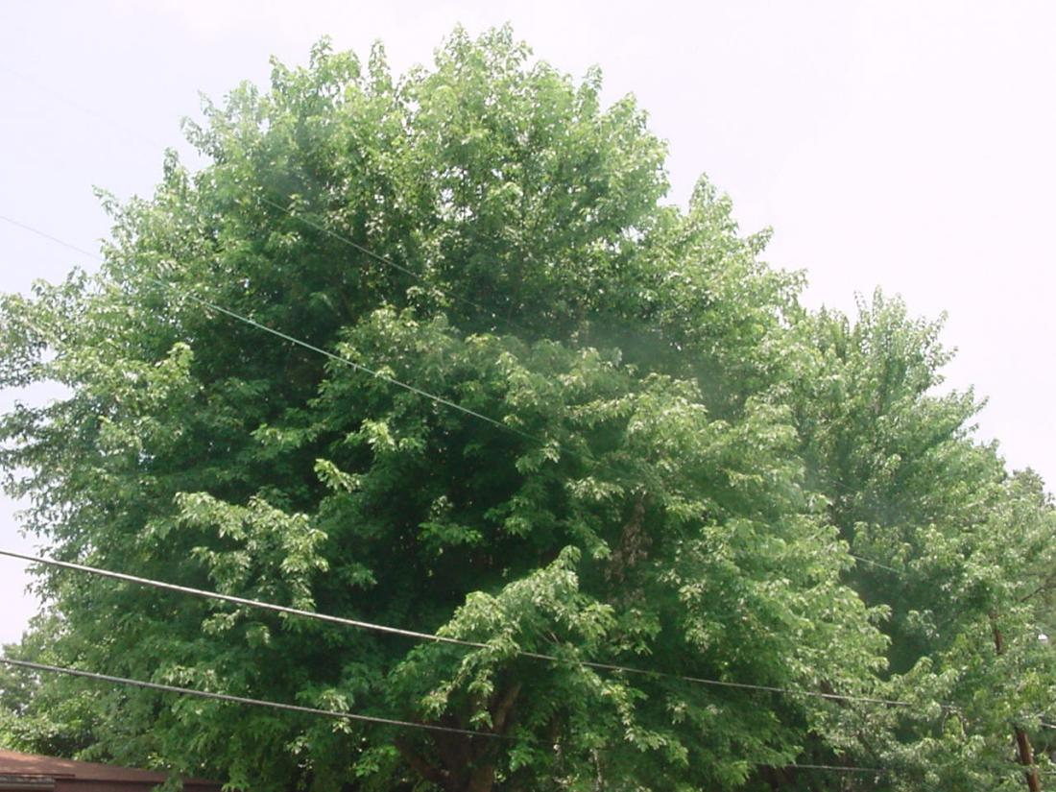
Notes:
Lastly, I would like to wrap up with some real life situations that pose some interesting questions. Let’s take a look…

Slide 26
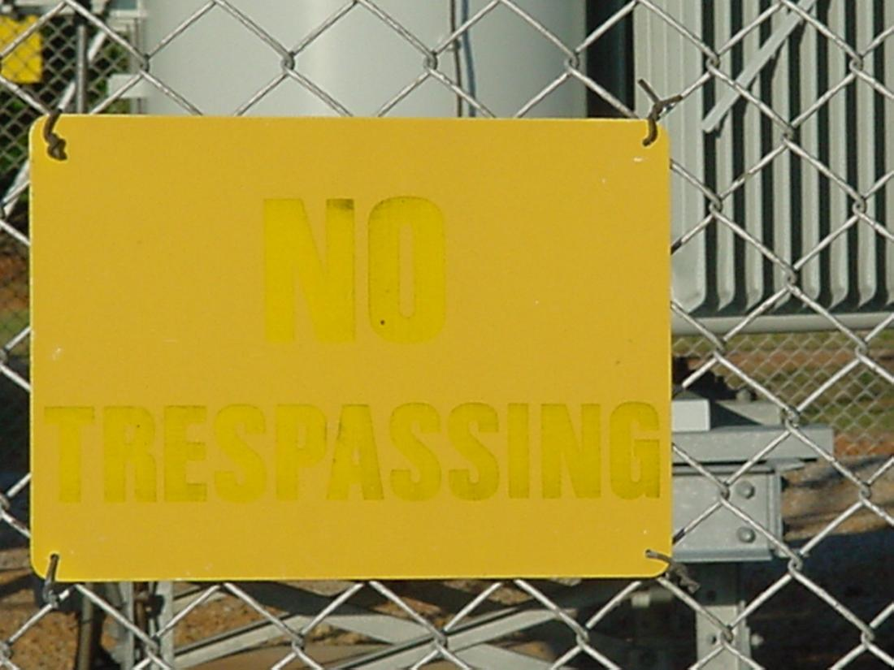

Slide 27
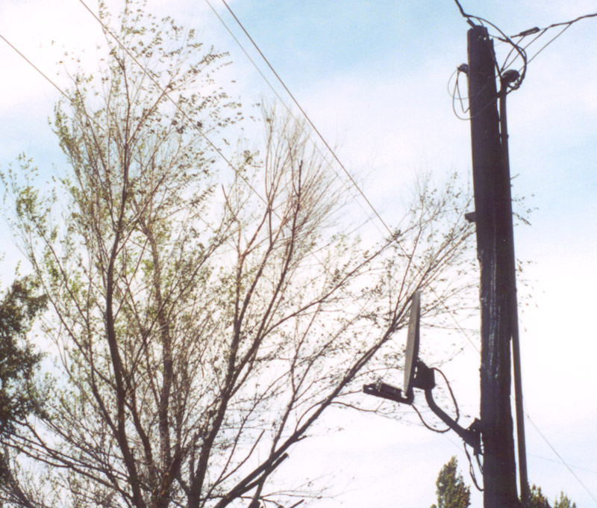

Slide 28
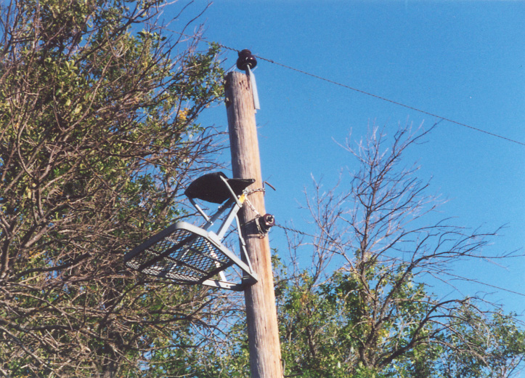

Slide 29
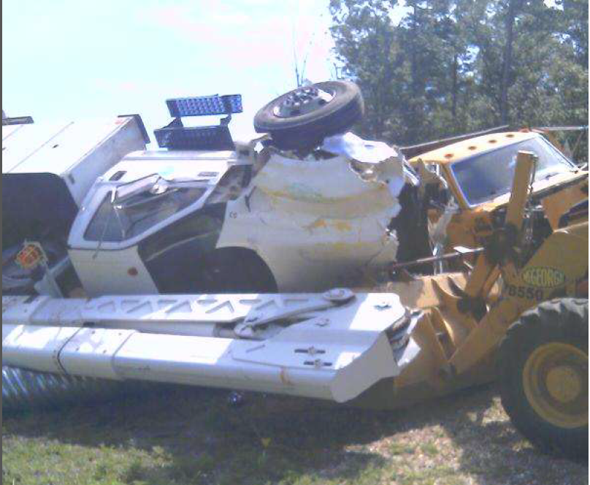

Slide 30
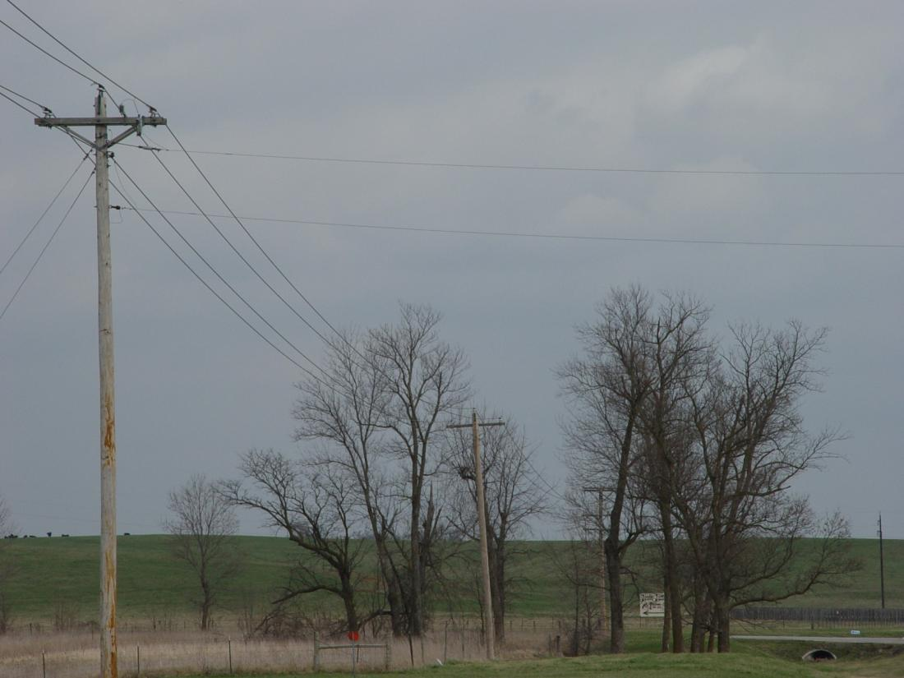

Slide 31
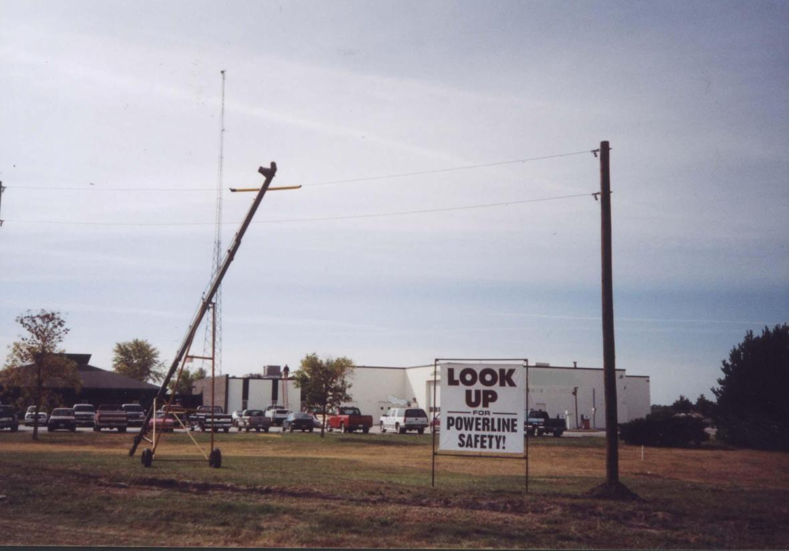

Slide 32
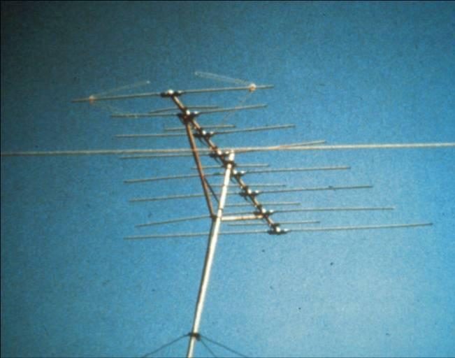

Slide 33
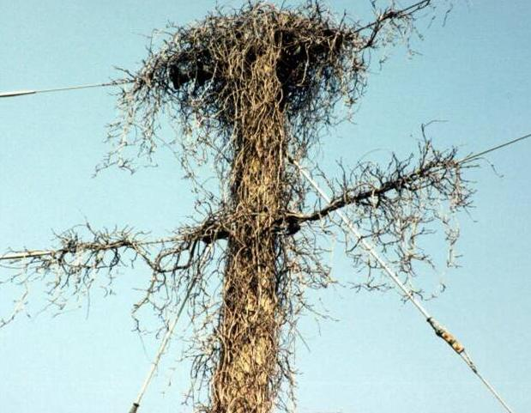

Slide 34
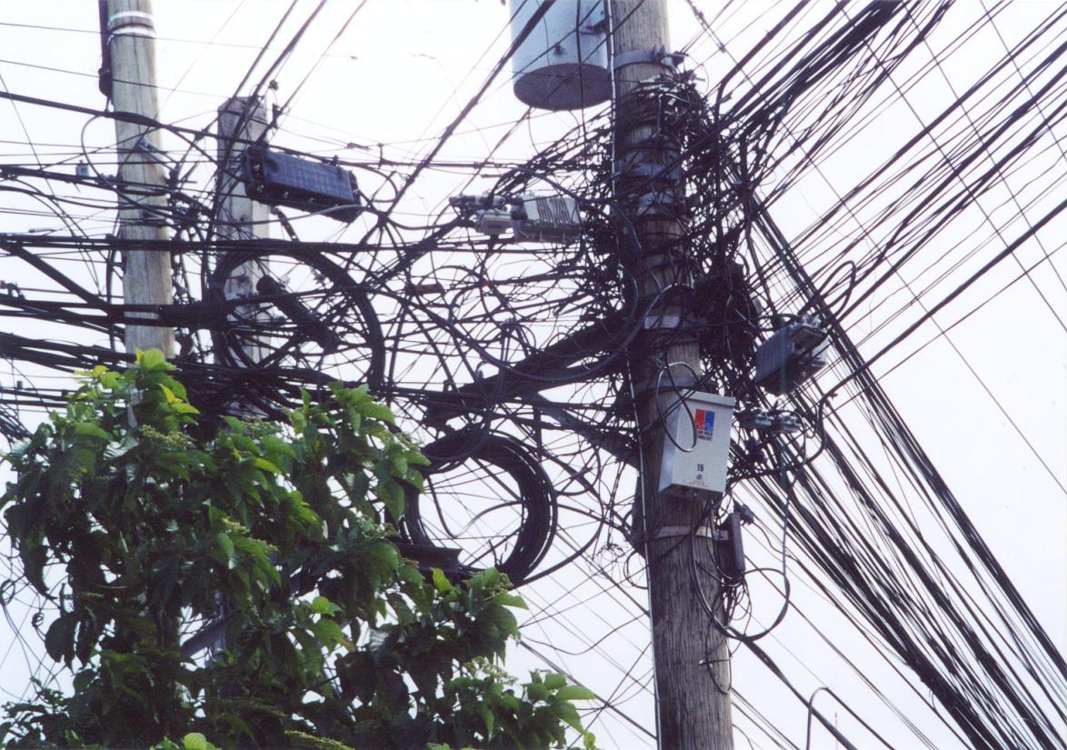

Slide 35
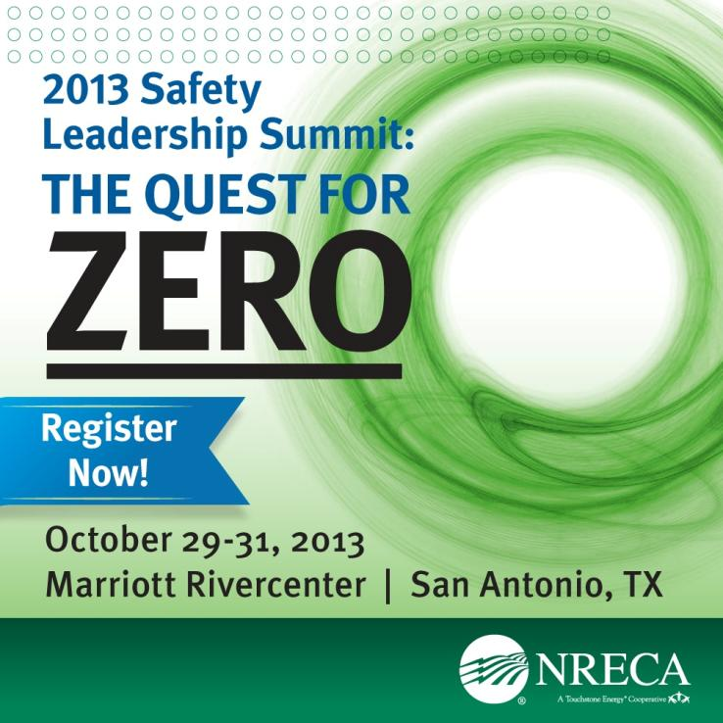
2013 NRECA Safety Leadership Summit
Notes:
In closing, we also ask you to join us as we support the 2013 NRECA Safety Leadership Summit, the leading safety event for electric cooperative CEO's, senior staff, safety and human resources professionals and crew leaders. It will be taking place October 29-31 in San Antonio and is open for registration through cooperative.com.

Slide 36
Thank You
and Be Safe!
Notes:
As you strive to make the most of your resources, Federated will continue to strive to bring value to our members through the products, information and strategies we provide to help reduce losses.
Fewer accidents can mean fewer outages and more efficient use of your resources, which is consistent with an effective risk management program.
Thank You and Be Safe!

