Slide 1

Economic and Community Development Opportunities in the 2014 Farm Bill
Florida Electric Cooperatives Association
September 15, 2016

Slide 2

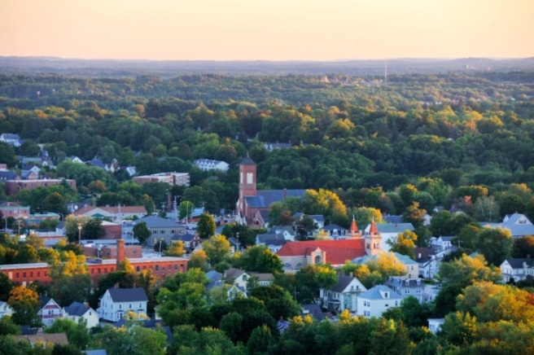
Our Mission
The National Association of Development Organizations (NADO)
To strengthen local governments, communities, and economies through the regional strategies, partnerships, and solutions of the nation’s regional development organizations.

Slide 3
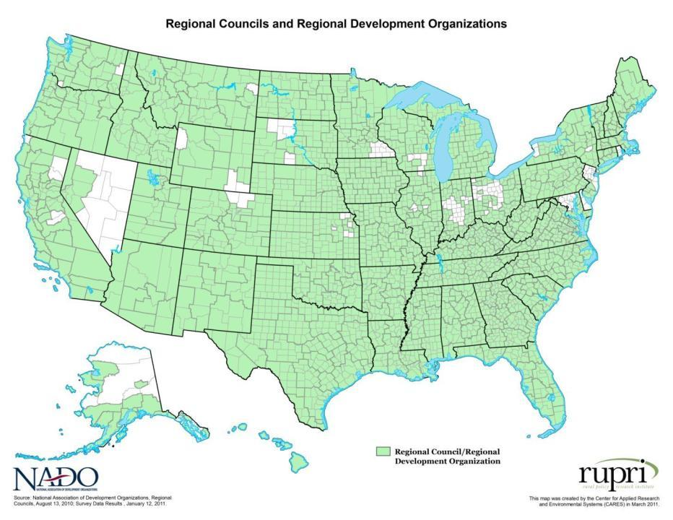
Our Membership
National membership organization for the network of over 520 regional development organizations (RDOs) throughout the U.S.
RDOs are also known as Councils of Government, Regional Planning Commissions, Economic Development Districts, and by other names.
They promote efforts that strengthen local governments, communities, and economies through regional strategies focusing on economic development, infrastructure, housing, transportation, and regional planning.

Slide 4
Presentation Outline
USDA’s Strategic Priorities
About USDA Rural Development
Regional Approaches in Rural Communities
Section 6025: Strategic Economic and Community Development (SECD)

Slide 5
USDA’s Strategic Priorities
White House regional and place-based initiatives
Commitment to poverty reduction, local food economies, and bio-economy
Bringing capital to rural America

Slide 6
USDA Rural Development
USDA Rural Development will administer $38 billion in loans, loan guarantees, and grants this fiscal year
47 state offices and 5,000 staff across the country
Key program areas: Rural Utility Service, Rural Housing Service, and Rural Business-Cooperative Service
New Community and Economic Development Team; Staff in 4 Regional Offices and Washington, DC

Slide 7
What is Strategic Economic and Community Development (SECD)?
New requirement authorized in the 2014 Farm Bill
Sets aside up to 10 percent of existing USDA-RD funds under:
  Community Facilities
  Water and Environment Programs
  Rural Business Development Grants
  Rural Business & Industry Guaranteed Loans
Prioritizes projects that support the implementation of a multi-jurisdictional plan

Slide 8
What is Strategic Economic and Community Development (SECD)?
Unobligated funds go back to applicable program after June 30 of fiscal year
To be eligible for SECD, the proposed project must be carried out solely in a rural area
Projects must meet the underlying program’s eligibility criteria

Slide 9
Examples of Multi-Jurisdictional Plans
Comprehensive Economic Development Strategies (CEDS): U.S. Economic Development Administration
Stronger Economies Together (SET): USDA
Promise Zones: Interagency initiative
Investing in Manufacturing Communities Partnership (IMCP): Interagency initiative
Sustainable Communities: HUD and EPA

Slide 10
Who Has a Multi-Jurisdictional Plan?
  Councils of Government/Regional Planning Councils
  Regional Authorities
  State Agencies
  Coalitions of Counties, Towns, etc.
  A plan can also be a product of a non-profit organization serving multiple jurisdictions

Slide 11
Why is SECD Needed?
Designed to support communities engaged in:
  Multi-jurisdictional collaboration with federal, state, and local partners
  Long-term growth strategies
  Aligning and leveraging resources
  Capitalizing on regional strengths

Slide 12
What makes SECD Unique?
Only rural projects are eligible
Specifically supports implementation of multi-jurisdictional plans
Works across USDA Rural Development agencies
Funds projects developed as part of a regional vision

Slide 13
SECD Implementation
Stakeholder engagement in lead up to 2014 Farm Bill
Farm bill passed in February 2014 with SECD language included
SECD regulation published in Federal Register in May 2015
FY2015 Pilot program June-July 2015 (25 awards granted)
FY2016 applications accepted on rolling basis through June 30, 2016

Slide 14
SECD Pilot Awards in FY2015
City of Cash, AR (Sustainable Communities Plan)
Community Facility Funds for a community center roof
West Stewartstown, NH (CEDS Plan)
Water and Waste Disposal funds to address public health and safety concerns from contamination in failing supply lines
North Adams, MA (Community Plan)
Rural Business Development Grant to construct a cheese aging business in the Old Greylock Mill

Slide 15
Community Facilities (CF)
Purpose: Loans and grants to improve, develop, or finance essential community facilities such as public safety, fire and rescue, telecommunications, schools, libraries, hospitals, and other health care facilities
Applicants: Public sector, non-profits, and federally-recognized tribes
Population: City, town, or unincorporated area of no more than 20,000; Facilities must serve rural residents

Slide 16
Water and Waste Disposal (WEP)
Purpose: Loans and grants to build, repair, and improve public water systems and waste collection and treatment systems
Applicants: Public sector, non-profits, and federally-recognized tribes
Population: Rural areas with up to 10,000 residents

Slide 17
Rural Business Development Grants (RBDG)
Purpose: Grants to assist the start-up or expansion of small and emerging private businesses and non-profits in rural communities
Applicants: Public sector, non-profits, and federally-recognized tribes
Population: All areas except cities with populations over 50,000 and their contiguous urbanized areas

Slide 18
Business and Industry Loans (B&I)
Purpose: Guaranteed loan to create jobs/stimulate rural economies by providing financial backing for rural businesses
Applicants: Lenders/businesses
Population: All areas except cities with populations over 50,000 and their contiguous urbanized areas

Slide 19
FY2016 Awards

Slide 20
Looking Ahead
In Progress/Development:
  Collecting feedback on FY2016 SECD process from Rural Development staff and Stakeholders
  FY17 Funding Decision Memo
Ongoing:
  Communities updating multijurisdictional plans for FY17 funding cycle
  Outreach to new stakeholder groups
Forthcoming:
  USDA blog on SECD success story
  USDA webinar on regional planning and SECD success stories
  Farm bill expires in 2018…What changes or expansions to this program are needed?

Slide 21
QUESTIONS?
Susan Howard
Director of Government Relations and Legislative Affairs
showard@nado.org

