Slide 1

Notes:
Hello and thank you for allowing me to provide with you a brief update on what has been going on at your insurance cooperative.
Staff – Brian Grogan/Nathan Worsham
Board – Wayne Livingston, CEO, Diverse Power, GA / Mendel Stone, Director, Blue Ridge Electric, SC

Slide 2
Financials as of June 30, 2015
Company Financials
Combined Ratio
93.4%
Company Margins
Allocated
$202.3 M
Paid
$86.9 M
Assets $500.4 M
Surplus $170.5 M
Notes:
total assets have increased to $500.4million.
Surplus at 6/30/2015 is $170.5 million.
Federated’s combined ratio at June 30, 2015 is 93.4 percent, with total margins allocated since 1999 of $202.3M, and $86.9M of that paid in cash. (This includes the March 2015 Allocation Distribution)
Federated is truly in the best position it has ever been and, rest assured, they are financially able to weather some pretty significant storms on your behalf, should the need arise. However, we can’t rest on our laurels. We do need to continue to maintain our focus on safety and do our part to further these safety efforts.

Slide 3
Company Margins
Notes:
Because you are a member of Federated, you directly benefit from the long-term financial stability of your cooperative owned and directed property and casualty insurance company.

Slide 4
Margins Returned in Florida
Notes:
Now, I would like to turn my attention to what Federated’s success means to you directly! As previously noted, we have allocated $202.3 million back to our members since becoming a reciprocal exchange back in 1999.
Margin allocations to our Florida members in March equaled $2,083,983, which brings our total allocations to Florida alone to $10,710,058.
The cash payment we made to our Florida members in March is $414,811, which brings the total amount returned to our Florida members in cash since we began writing in Florida in 2004 to $2,550,505.
This is great news. However, it’s important to note, Federated’s goal of operating at or below a 100% combined ratio is not just about margins, it’s about keeping people safe and on the job.

Slide 5
Margin Allocations as a % of ARB PREMIUMS
2012  $19.4M • 15.5%
2013  $31.4M • 26.1%
2014  $34.1M • 23.4%
of ARB Premiums
of ARB Premiums
of ARB Premiums
Notes:
Margin allocations that Federated just made in 2015 equaled 23.4% of everyone’s 2014 ARB premiums.
Add to that the fact that 72% of our members saw premiums either remain flat or go down in 2014, and you can see that it is working…members are seeing real financial benefits from these claims reductions!

Slide 6
Claim Counts
Notes:
We did not see another year with lower claim counts than last year. However, we came darn close! 2014 claim counts were within ½% of last year’s numbers and settled in at 9,864.
While it is an increase, it is still a tremendous accomplishment that can only be attributed to the continued focus on safety by all of our members across the country. As Federated has talked about for years, if claims can be reduced, members will be able to reap the financial benefits that result. This past year was no different.
The downward trend in the reduction in claim counts is finally being recognized by our actuaries and has allowed us to reduce reserves, or amounts set aside to pay claims that haven’t been settled yet, or that simply haven’t been reported yet but are still expected to be reported.

Slide 7
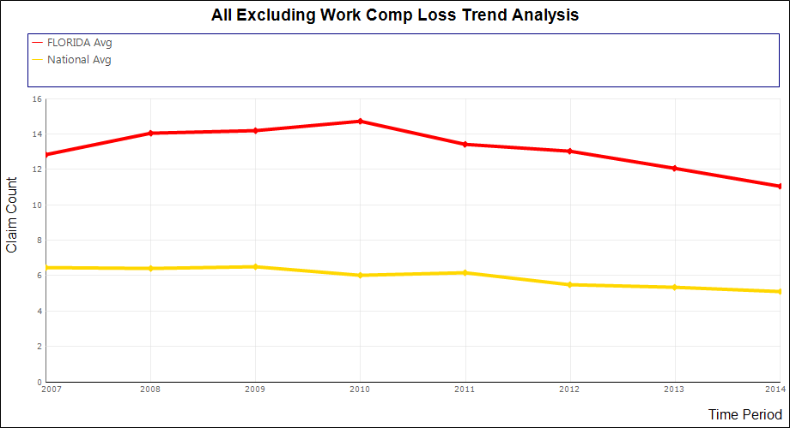
Florida Average vs. National Average*
*Graph Includes All Federated Members
Notes:
Looking just at Florida’s average total losses per co-op for all lines of business except WC compared to all Federated members, things don’t appear to be very good. To see how your system compares to these trends, log in to www.federatedrural.com and view the Loss Trend Analysis report. You can compare yourself to these national numbers for all systems, and adjust the criteria to see how you compare to other systems of similar size.

Slide 8
Cyber Liability Coverage
Coming Soon!
Some of the coverages that will be included:
    Privacy or security breaches
      Including notification and credit monitoring expenses
    Regulatory fines and penalties associated with a breach
    Claims alleging liability for transmitting a virus or malicious code to someone else
    Cyber Extortion
    Cyber Terrorism

Slide 9
Cyber Liability Coverage
Status of Implementation
  Forms and Rates are being filed
  Availability will depend on state insurance departments
  We will notify our members as approvals are received state-by-state
  Will be available mid-term, if desired

Slide 10
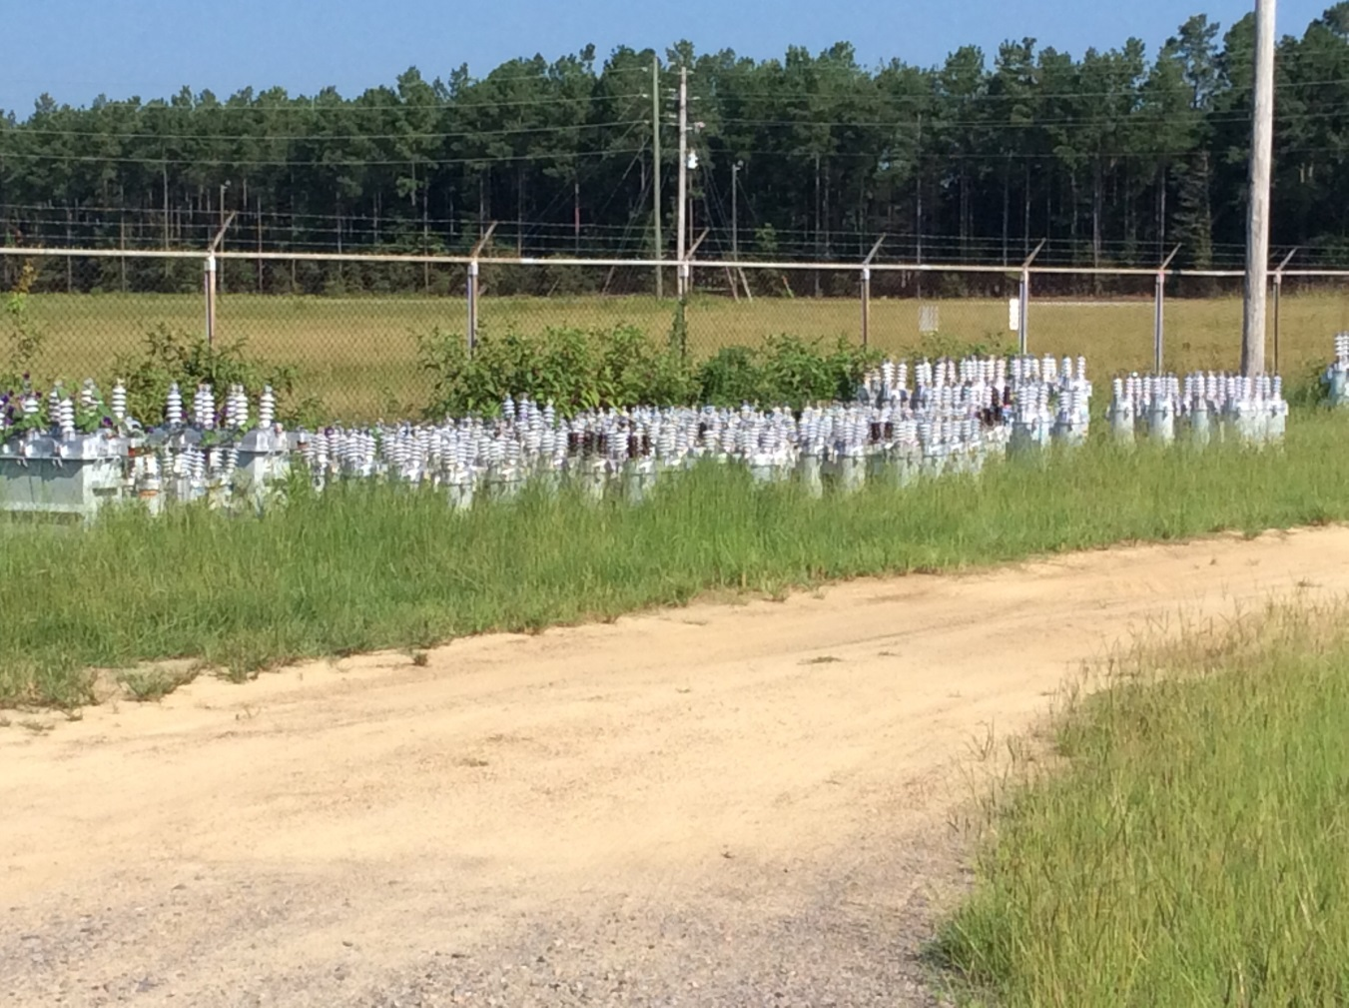
Hazard Recognition
Notes:
Weeds and overgrowth need to be controlled in storage yards for your employees safety. Not just from slips, trips and falls, but also from snakes and anything else that might make their home here.

Slide 11
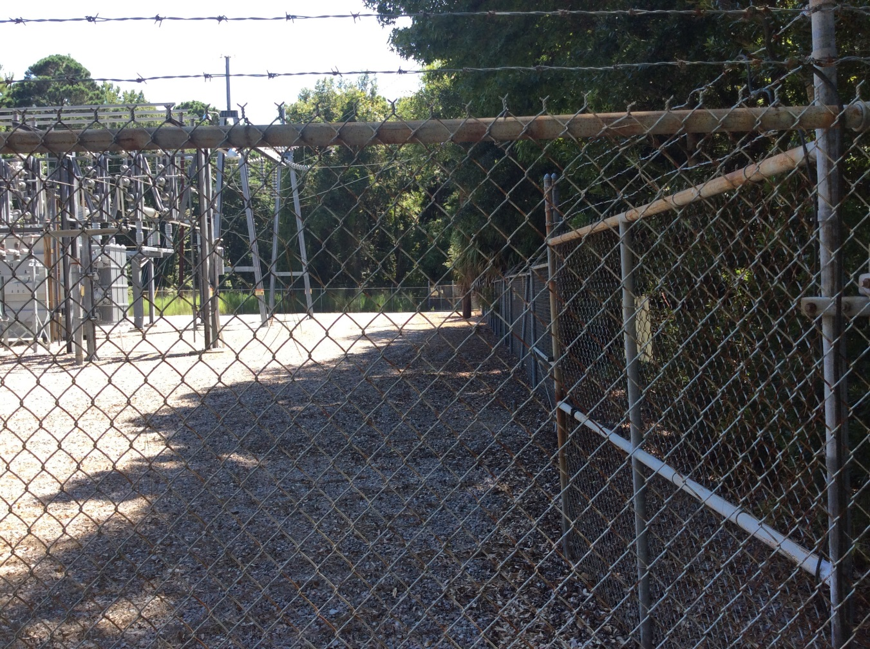
Hazard Recognition
Notes:
Can you see what’s wrong here? ROW needs to be cleared around substations so that trees and shrubs don’t encroach here as well.

Slide 12
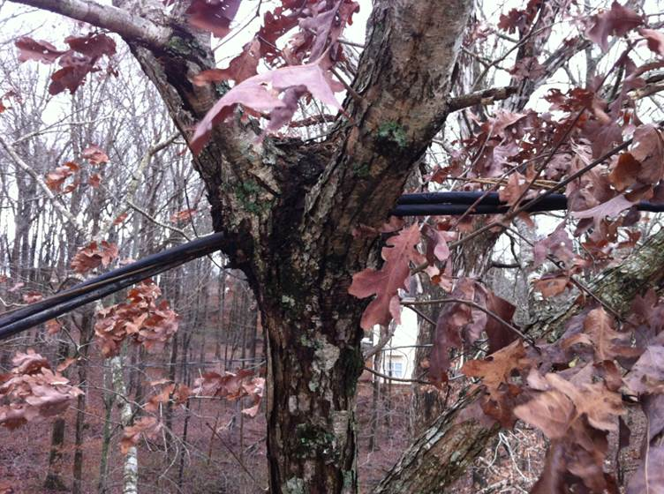
Hazard Recognition
Who needs poles?

Slide 13
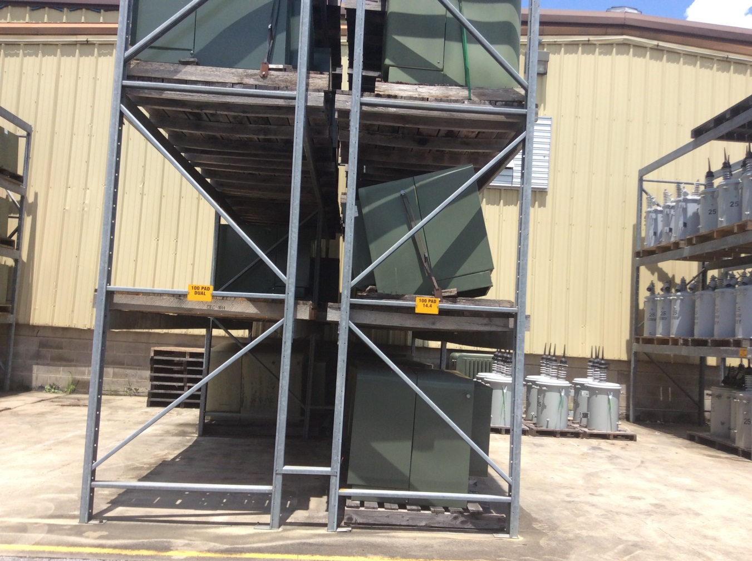
Hazard Recognition
Time to replace a pallet?
Notes:
Pallets that are deteriorating need to be replaced.

Slide 14
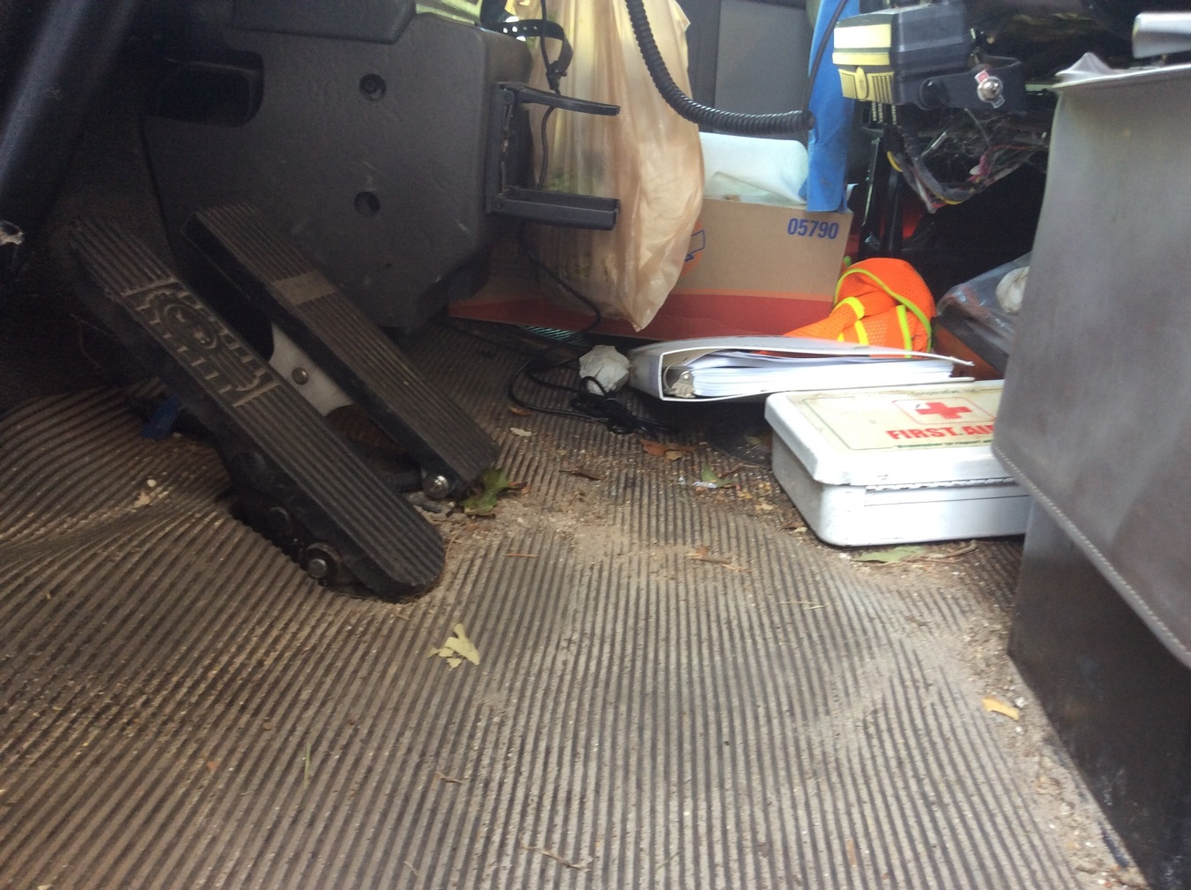
Hazard Recognition
Could this interfere with your driving?
Notes:
Imagine having one of these objects getting wedged under the gas pedal?

Slide 15
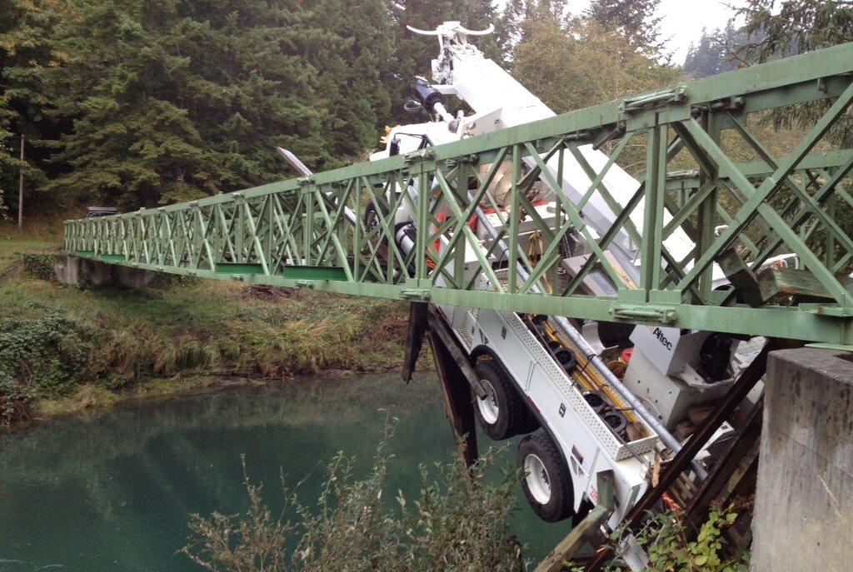
Think Safe - New Digger vs Old Route

Slide 16
Thank You
and
Be Safe!

