Slide 1
Solar Energy
Florida Electric Cooperatives Association
2014 Finance & Accounting Conference
Glenn Spurlock
September 17, 2014

Slide 2
Solar Energy
In 1 hour, the Earth receives more solar energy than it takes to power the world for 1 year.
0.22% - The portion of US electricity that is generated from solar power installations.

Slide 3
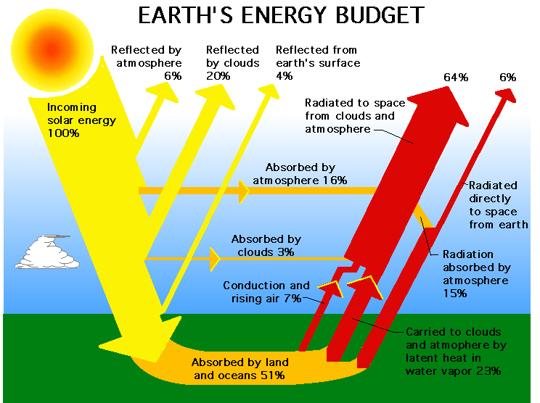

Slide 4
What do we mean by “Solar Energy”?
Solar Thermal Water Heating
Concentrated Solar Thermal Power (CST)
Concentrated Solar Power (CSP) Technologies
Solar Photovoltaic

Slide 5
Solar Thermal Water Heating
Solar thermal systems are a way to satisfy heating needs by capturing the thermal energy of the sun for heating applications such as buildings, hot water or swimming pools.
Most households use, on average, 20% of their total energy for heating water.
The US market penetration for medium temperature, domestic solar hot water is currently less than 1%.
Adoption is driven by energy prices, environmental awareness, state and local renewable energy goals

Slide 6
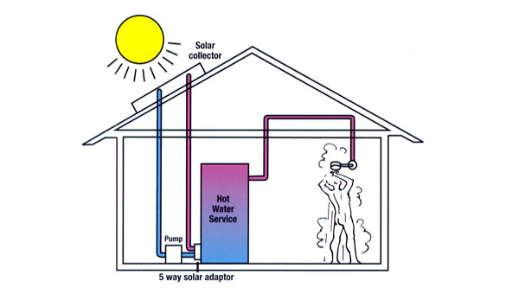
Solar Thermal Water Heating

Slide 7
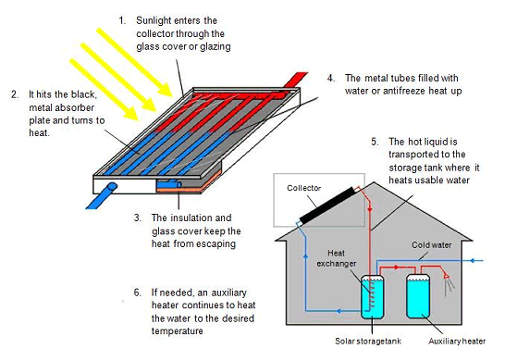
Solar Thermal Water Heating

Slide 8
Concentrated Solar Thermal Power (CST)
Concentrated solar thermal power (CST) uses mirrors to direct sunlight, or solar thermal energy, onto a receiver/absorber tube. The solar thermal energy converts the water in the receiver to steam which drives a turbine connected to a generator, thus converting the solar thermal energy into electrical energy.
CST technology is intended for areas of high irradiation and low humidity/low cloud cover, making it suitable for large power plants in desert regions.

Slide 9
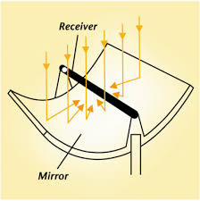
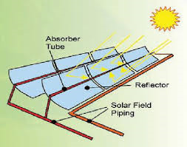
Concentrated Solar Thermal Power (CST)
Troughs

Slide 10
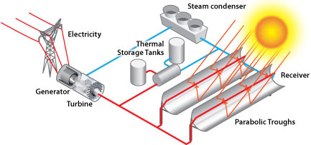
Concentrated Solar Thermal Power (CST)

Slide 11
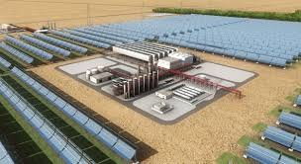
Concentrated Solar Thermal Power (CST)

Slide 12
Concentrated Solar Power
Concentrated solar power (CSP) uses mirrors or lenses to focus direct sunlight onto a receiver located at a “power tower” in the center of the array. The solar energy converts the water in the tower-mounted receiver to steam, which drives a turbine connected to a generator, thus converting the solar energy into electrical energy.
CSP technology is intended for areas of high irradiation and low humidity/low cloud cover, making it suitable for large power plants in desert regions.

Slide 13
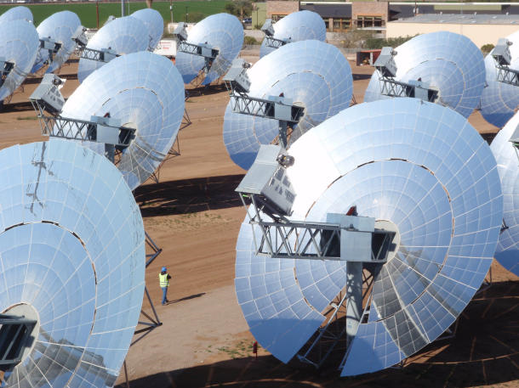
Concentrated Solar Power (CSP) Technologies
Dish

Slide 14
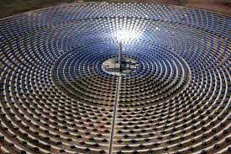
Concentrated Solar Power (CSP) Technologies
Concentrated Solar Power Facility

Slide 15
Solar Photovoltaic
Solar panels that convert sunlight to electric energy are referred to as photovoltaic panels (PV for short). The PV panels collect sunlight and turn it into direct current (DC) power. This current is created when photons hit the panel and cause electrons in the silicon to be excited.
These excited electrons are conducted out of the solar panels and are transmitted to a DC to AC inverter for interconnection to the public utility grid.

Slide 16
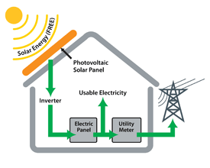
Residential Solar Photovoltaic

Slide 17
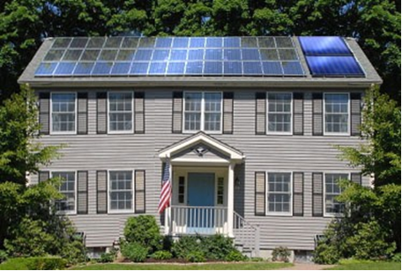
Residential Solar Photovoltaic
Solar Photovoltaic (12 kW) Solar water heating

Slide 18
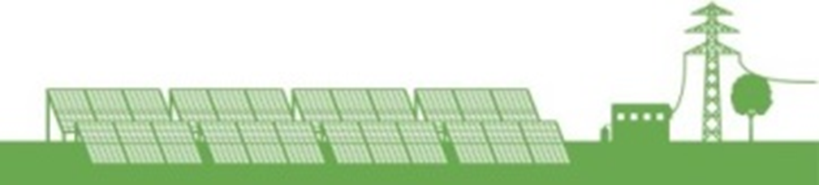
Utility-Scale Solar Photovoltaic

Slide 19
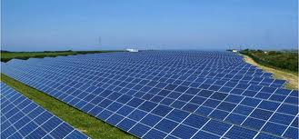
Utility-Scale Solar Photovoltaic

Slide 20
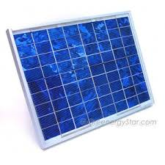
Utility-Scale Solar Photovoltaic
Key Components
Panels
  Thin-Film (generally of lower efficiency)
  Silicon (60, 72, or 80 cells)
    Mono-crystalline silicon
    Poly-crystalline silicon

Slide 21
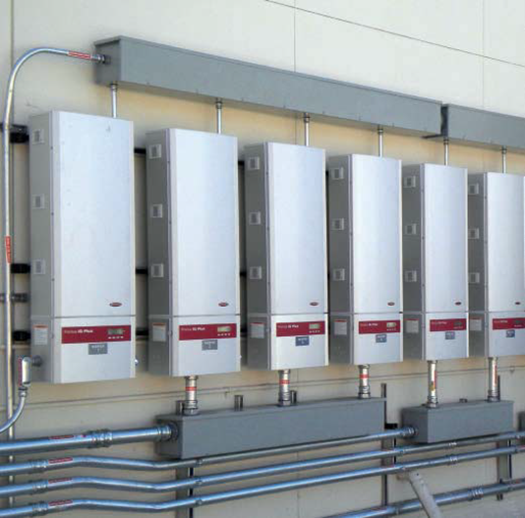
Solar Photovoltaic
Key Components
DC/AC Inverters
Micro Inverters String Inverters Central Inverters

Slide 22
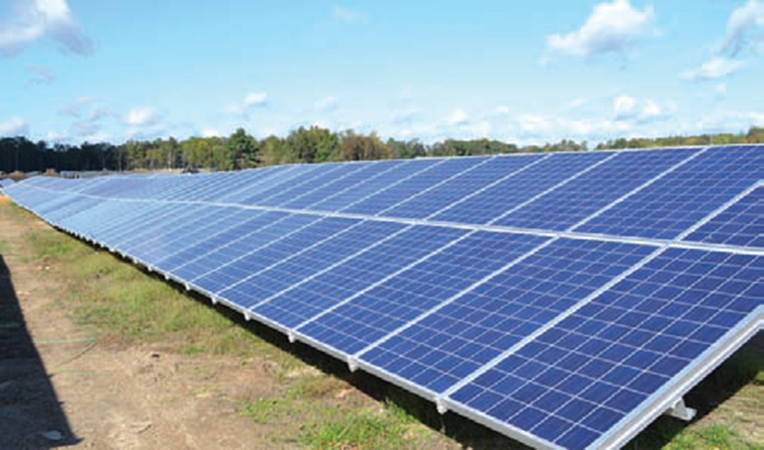
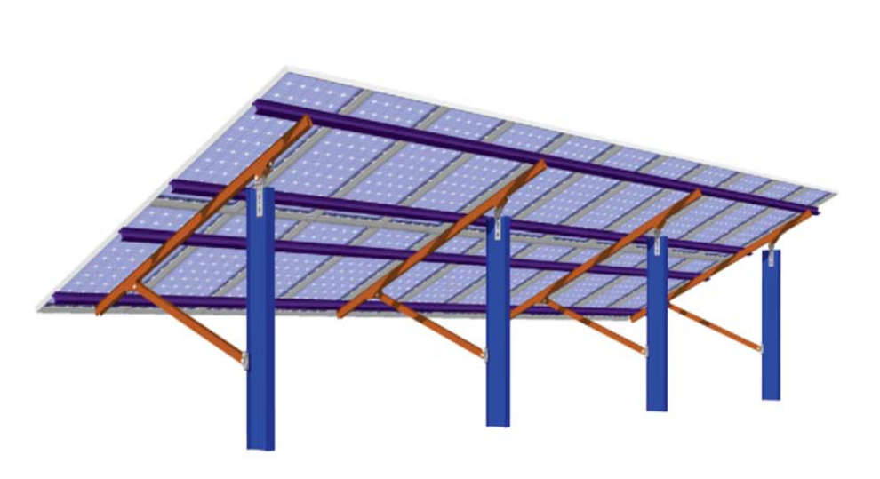
Solar Photovoltaic
Racking & Mounting
  Roof
  Pole
  Ground
    Fixed Tilt
Fixed Tilt
Fixed Tilt Mounting System

Slide 23
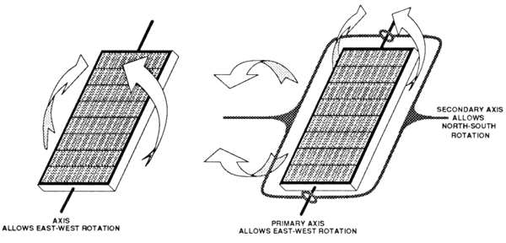
Solar Photovoltaic
Racking & Mounting (cont.)
  1-Axis Tracking
  2-Axis Tracking
Balance of Plant
Grid Connection

Slide 24
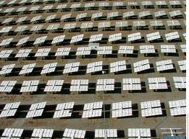
Solar Photovoltaic
2-Axis Tracking

Slide 25
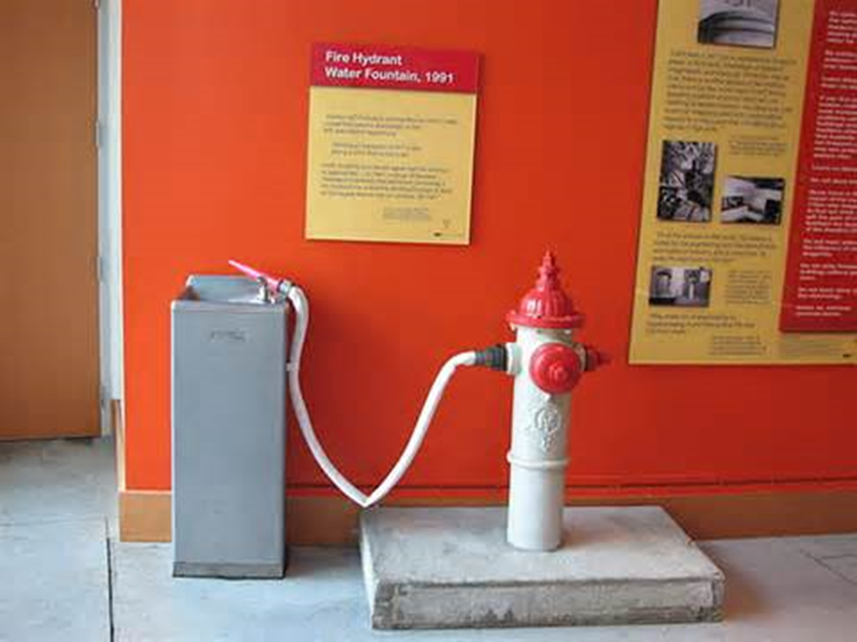
Solar Energy

Slide 26
Solar Energy
Industry Trends
&
Influences

Slide 27



Solar Energy
Politically popular on left and right
  Environmentally friendly
  Appearance of freedom from government-regulated monopolies

Slide 28

Solar Energy
Some Perceive All Utilities Like This…

Slide 29
Solar Insolation

Slide 30
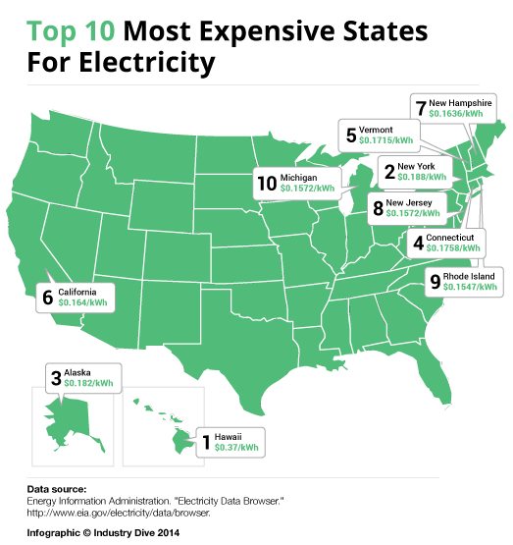
Why Consider Solar?

Slide 31
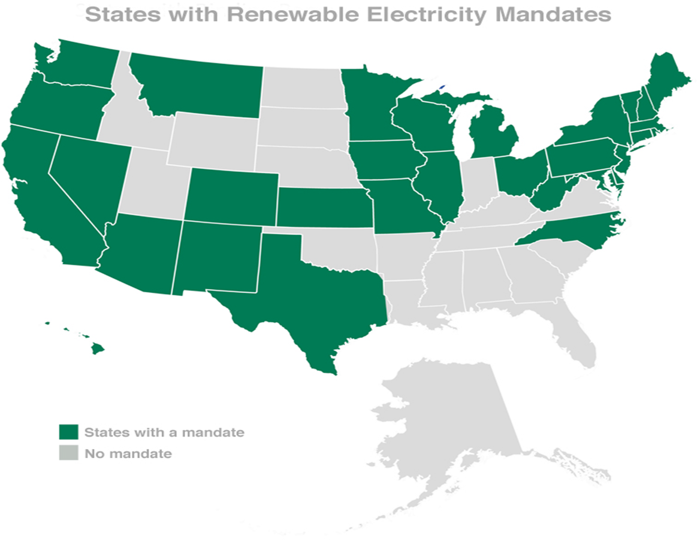
Solar Energy
Political Challenges

Slide 32
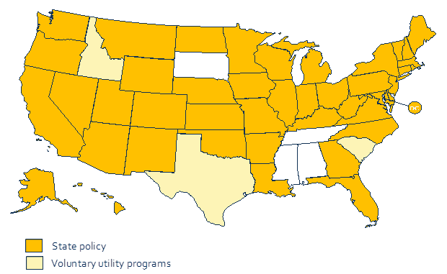
Solar Energy
Political Challenges
Net Metering Policies

Slide 33
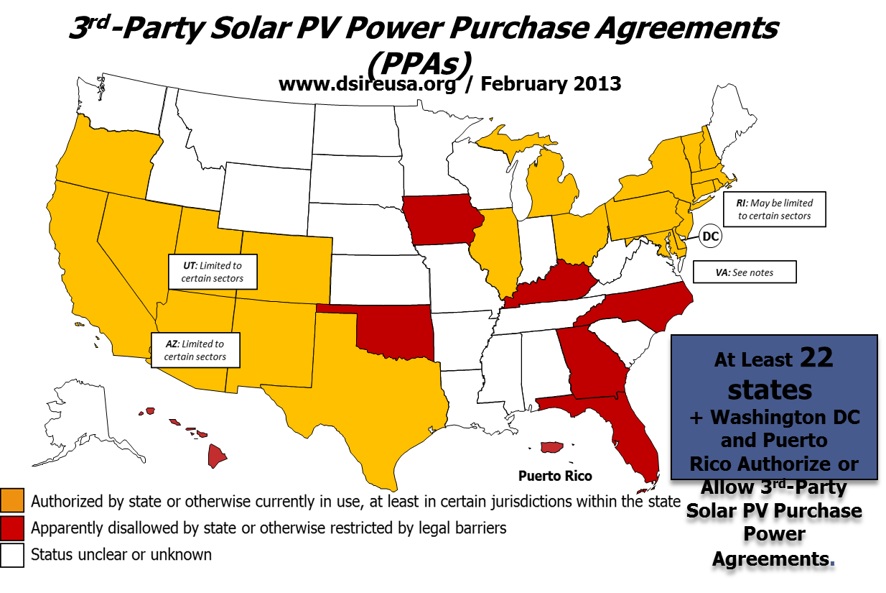
Solar Energy

Slide 34
Solar Photovoltaic

Slide 35
Solar Energy
Grid Impacts

Slide 36
Grid Impacts
At higher penetration levels, under ideal circumstances, DG can have positive impacts on the grid
  Reduced losses
  Delayed distribution and/or transmission investment
  Delayed capacity investment
These potential benefits are overplayed in the policy arena, underplayed in real life.

Slide 37
Grid Impacts
Without appropriate regulation, at higher penetration levels, DG can:
  Undermine safety, reliability, and power quality on the distribution or the transmission grid
  Require additional investments in the grid
  Require potentially costly re-dispatch of generation
  Reduce the reliability, and increase the O & M costs, of the existing generation fleet by forcing plants to “cycle”
  Require additional investments in generation
  Strand investments in generation
  Require DG to be “integrated” not just “interconnected”

Slide 38
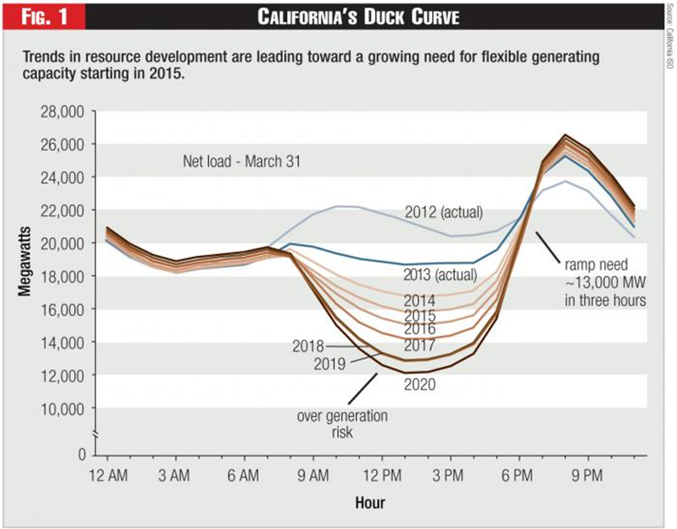
Grid Impacts

Slide 39
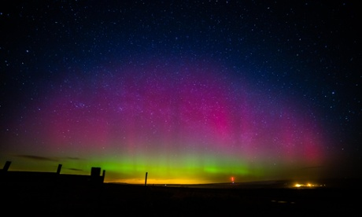
Solar Energy

