Slide 1
How I got here…
9/14/2014 | DC | Philadelphia, PA
9/14/2014 | Philadelphia, PA | Detroit, MI
9/14/2014 | Detroit, MI | Pellston, MI
9/14/2014 | Pellston, MI | Mackinac, MI
9/16/2014 | Mackinac, MI | Traverse City, MI
9/16/2014 | Traverse City, MI | Chicago, IL
9/16/2014 | Chicago, IL | Tampa, FL
9/16/2014 | Tampa, FL | Clearwater, FL
5 planes
2 rental cars
2 ferries
1 Horse-drawn cart

Slide 2
Cooperative Solar PV Projects
For Discussion at the Florida Accountants’ Conference
Clearwater, FL

Slide 3
Listening exercise: 60 seconds
Solar Financing in a minute
With your partner(s) tell me what you heard.

Slide 4
What did you catch?
Everyone else is doing it!
Power company pushing for extra fees to “make up the difference”
Solar becoming a threat to “Old Power Conglomerates”?
“Don’t fund big power’s losses…” -----(You are big power)
“While everyone else goes solar…” -----PEER PRESSURE
“Get caught in the middle, OR, go with a TRUSTED LOCAL solar company!”
Own your solar power
Reduce your energy bill
No down payment… or interest!

Slide 5
No payments for one year!
Get Tax Breaks & big energy savings
Don’t Fall behind or pay extra
Don’t be the last one in line… (PEER PRESSURE X2)
Nation’s power supplies are shifting
Don’t wait!... Or you’ll pay… (FEAR PRESSURE X3)
Completely eliminate your power bill!
Get tax incentives YOU are entitled to… While you still can!
Time is running out!
Do it locally… because WE are the good guys!
And … WE FINANCE!

Slide 6
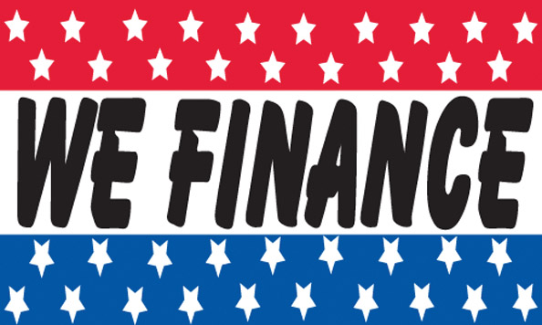

Slide 7
Coop Activity in Solar Space
*MW, NRECA Survey June 2014
 | Own | Purchased
Existing | 37 | 54
Planned | 77 | 68
Overall, Distribution coops dominate coop activity in the solar space
Distribution Coops dominate owned capacity - both existing and planned
Existing purchases are dominated by G&Ts
Planned Purchases are accounted for 2/3 by Distribution and 1/3 by G&Ts
Notes:
State of Coops in Solar…
Big point is that coops LAG the industry with Solar Activity.

Slide 8
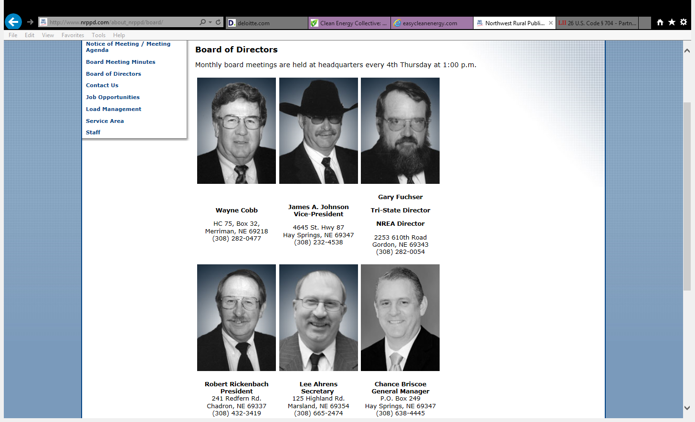
Easy to spend money?
Notes:
And Why?
Conservative boards don’t like to spend money… aren’t really “Greenies”
To get them involved… we have to introduce financial engineering!

Slide 9
Scale Economies in Solar Projects
Cost Component | 40 KW - 100 KW | 100 KW - 250 KW | 250 KW - 500 KW | 1 MW
System Cost($/Watt) | 2.90 | 2.40 | 2.15 | 1.70
Developer Cost ($/Watt) | 0.44 | 0.30 | 0.22 | 0.12
Installed Cost ($/Watt) | 3.34 | 2.70 | 2.37 | 1.82
Power Cost Cents/Kwh (No Tax Incentives) | 22 | 18.40 | 16.75 | 14 to 15
Power Cost Cents/Kwh (With Tax Incentives) | 15 | 13 | 10 | < 9.5
Notes:
Size matters

Slide 10
Community solar – why it works
Improved economies of scale
  Community size allows you to hit that ‘sweet’ spot
“NOMBNR”
Optimal project siting
  ____% of residential rooftops are suitable
Address increasing public demand → Be the LOCAL source
Improved ability to educate public on power cost/usage
Notes:
Community options expand access to solar power for renters, those with shaded roofs, and those who choose not to install a residential system on their home for financial or other reasons.
As a group, ratepayers and tax payers fund solar incentive programs.
A utility project’s ability to use tax incentives depends on the individual utility’s characteristics. Electric co-ops, municipal utilities and public utility districts are exempt from federal income taxes, and thus, cannot benefit from federal tax incentives, like the ITC and depreciation.
Securities Compliance. In designing mechanisms for customer participation in solar projects, utilities must be careful to comply with state and federal securities regulations. This requires carefully considering what benefit a customer-participant receives in exchange for a financial contribution to the project and how the project is marketed. For example, customer participants may be offered ownership stakes in the solar system itself or just the rights to certain benefits from the energy produced (such as credit on their electric bills, RECs, or access to a special electric rate). However, regardless of how the program is marketed, depending on your state, the receipt of credits on electric bills or other benefits may constitute a return on an investment and fall within the blue sky laws (state laws that regulate the offering and sale of securities).
 Allocation of Incentives. In addition to federal tax incentives, a utility-sponsored project might be eligible for various state incentive programs that provide cash benefits or savings to the project. The utility must consider whether and how these incentives will be passed on to customer participants and the tax implications of how the incentives are handled. For example, in Washington State, participants in a utility-sponsored program are eligible for production incentives. While the state Department of Revenue has ruled that the incentive is not taxable, the IRS has not ruled definitively on whether subsidies for solar PV in community shared solar installations are taxable income, although the precedent is that subsidies for energy conservation measures are not taxable.5
 RECs. Customer participants in utility-sponsored projects often desire to claim the environmental benefits of using solar energy. Participants can only make such a claim if they receive RECs or the utility retires the RECs on the participants’ behalf. If the utility keeps the RECs for any reason, including Renewable Portfolio Standard compliance, only the utility can make environmental claims related to the solar system. The utility-sponsored project should consider and make explicit how RECs are allocated.

Slide 11

What language are you speaking?
Notes:
Take a moment to define some terms with the audience.

Slide 12
Solar Tax Credits – Basic Rules
ITC increased from 10% to 30% by Energy Act of 2005
30% credit now sunsets on December 31, 2016
Emergency Economic Stabilization Act of 2008 – “Bailout” Package
Signed by President Bush on October 3,2008 –H.R.1424
8-year extension for Section 48 investment tax credit
$2,000 credit cap lifted for residential installations
AMT relief–2009
Public utilities may now use the tax benefits

Slide 13
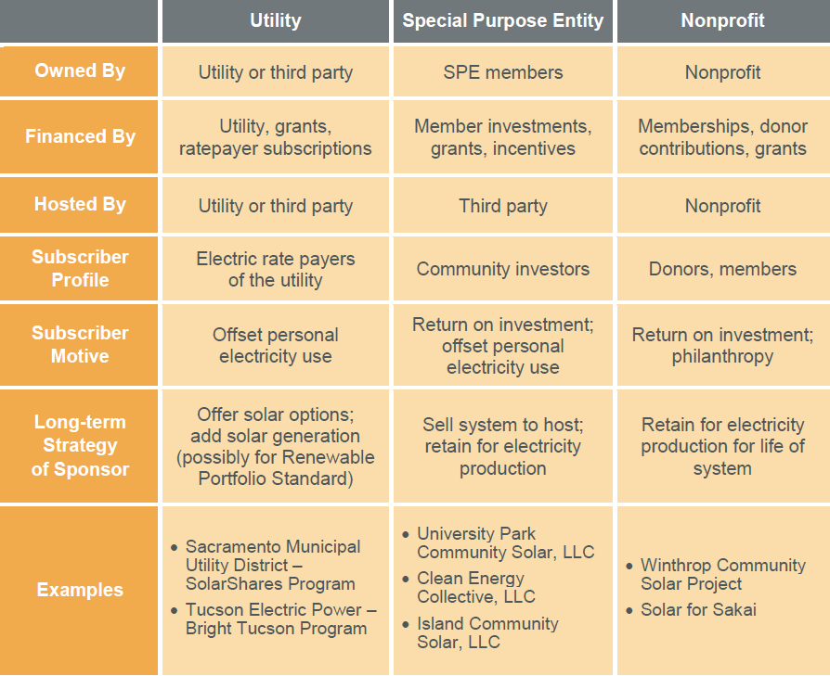
Notes:
People have many reasons for organizing or participating in a community shared solar project. Just as their motives vary, so do the possible project models, each with a unique set of costs, benefits, responsibilities, and rewards.
 Utility-Sponsored Model: A utility owns or operates a project that is open to voluntary ratepayer participation.
 Special Purpose Entity (SPE) Model: Individuals join in a business enterprise to develop a community shared solar project.
 Nonprofit Model: A charitable nonprofit corporation administers a community shared solar project on behalf of donors or members.
Before selecting a project model, every planner should consider the issues below.
 Allocation of Costs and Benefits: Who will pay to plan, construct, and operate the solar system? Who will have rights to benefits, including the electricity produced, RECs, revenue from electricity sales, tax benefits, other incentives, and ownership of the project’s assets (such as the solar system itself)?
 Financial and Tax Considerations: Will money be raised through a solar fee on electricity bills, by equity or debt financing of a business entity, through charitable donations, or other options? What kind of tax implications will there be for participants—e.g., will the project generate taxable income for participants? Will it generate tax credits or deductions for participants?
 Other Legal Issues: How will the project design address securities regulation, utilities regulation, business regulation, and the complexity of agreements between various project participants?

Slide 14
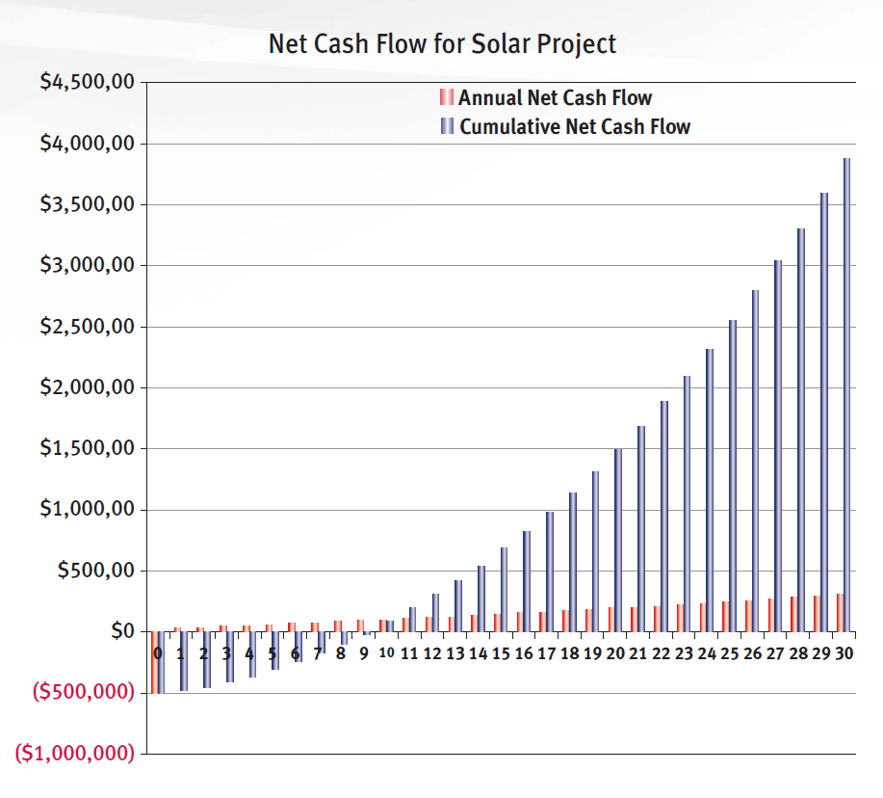
Case Study From NRECA: 5 MW Project
Takes ~9 years to
reach investor return

Slide 15
Case Study From NRECA: 5 MW Project
Used to be ~6 years to reach investor return

Slide 16
5% /95%
Cooperative utility
Long Term PPA
Distributions
Distributions
Blocker Corporation
(Taxable)
SPE
(Pass through entity)
Equity
Tax equity Investor
Equity
Retail Electricity Sales
(Wholly-Owned by Cooperative)
Utility Consumers
Renewable Power Project
Partnership Structure for Cooperatives’ Renewable Power Projects

Slide 17
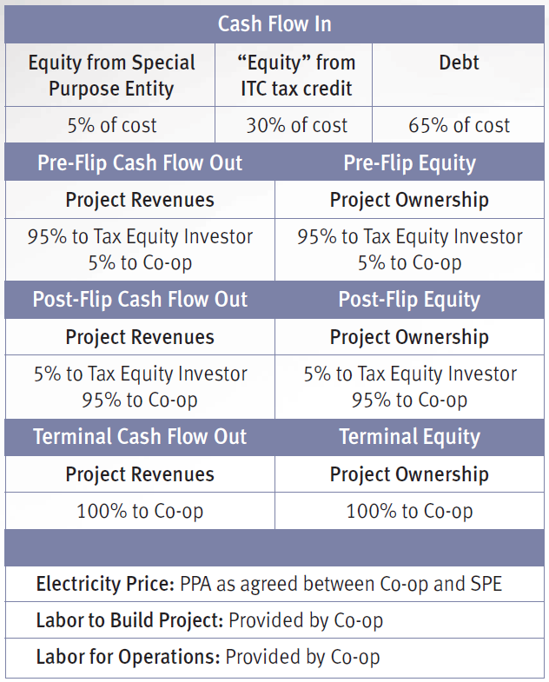
Case Study From NRECA
Step 0:
Money In
Build project

Slide 18
Case Study From NRECA
Step 1:
Operate Project
Realize Investor Hurdle Rate

Slide 19
Case Study From NRECA
Step 2: ~Year 9
Investor happy!
Flip Capital Structure

Slide 20
Case Study From NRECA
Step 2(a):
New Capital Structure

Slide 21
Case Study From NRECA
Step 3:
Coop Buys 5% residual share from Investor

Slide 22
95% /5%
Cooperative utility
Long Term PPA
Distributions
Distributions
Blocker Corporation
(Taxable)
SPE
(Pass through entity)
Equity
Tax equity Investor
Equity
Retail Electricity Sales
(Wholly-Owned by Cooperative)
Utility Consumers
Renewable Power Project
Partnership Structure for Cooperatives’ Renewable Power Projects

Slide 23
CFC/NRCO/Federated Collaboration 1/2
Designed to leverage scale & repeatability/standardization to drive down our members administrative burden/cost
16 cooperatives have signed up
  Projects began Fall 2013
  Most have come online in 2014
Initial projects were in the 40 KW to 500 KW range
Interest is now at larger scale project size via G&T’s

Slide 24
CFC/NRCO/Federated Collaboration 2/2
The Paper!
  Ground lease/easements
  Equipment Supply Contract
  Construction/EPC Contract
  O&M Agreement
  Interconnect Agreement
  Offtake agreement – PPA, Lease, Hedging
  REC Sales

Slide 25
Development Cycle –Solar
Determine which cities, states and utilities offering attractive incentives
Find the host / sell the host
Get bids from integrators
  Negotiate the PPA with the host
  Make sure your deal is financeable
Handle all permitting issues
  Negotiate the EPC Contract
  Execute the installation
Operate and maintain the facility per the O&M Agreement

Slide 26
How Do I Get Involved?
CFC MEMBER
Investor
(Tax Equity)
CFC
RVP / AVP
PPROJECT IMPLEMENTATION
NRCO
Call John Kimsey! 770-317-3348
Debt Funding

Slide 27
The Community Solar Model
There are a number of structures that make sense for solar, among them direct ownership.
To recognize full value of solar investment, community solar model recommended for Electric Cooperatives.
Community Solar Creates rare Win-Win-Win-Win-Win:
  Electric Cooperatives procures affordable power for the long term
  Investors receive attractive return – (Very American)
  Cooperative raises awareness through perfect cost visibility
  More Engaged Electric Cooperative membership
  Next Slide

Slide 28
Remember these guys?
Notes:
We learned a bit about organizational culture yesterday.
Raise your hand if you’d say that your board would qualify as an “Early Adopter” of a new paradigm?

Slide 29






Mission Accomplished : Happy Board & Greener Looking Cooperative
Notes:
We learned a bit about organizational culture yesterday.
Raise your hand if you’d say that your board would qualify as an “Early Adopter” of a new paradigm?

Slide 30
Call John Kimsey… TODAY!!
770-317-3348

Slide 31
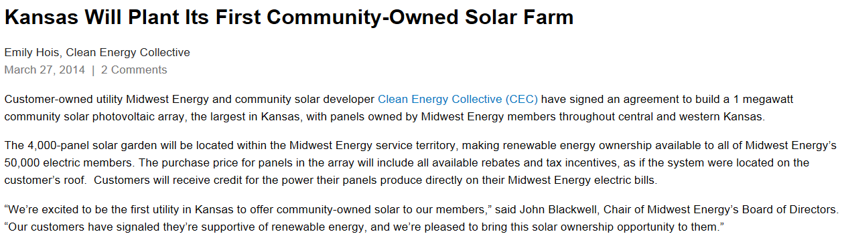

Slide 32
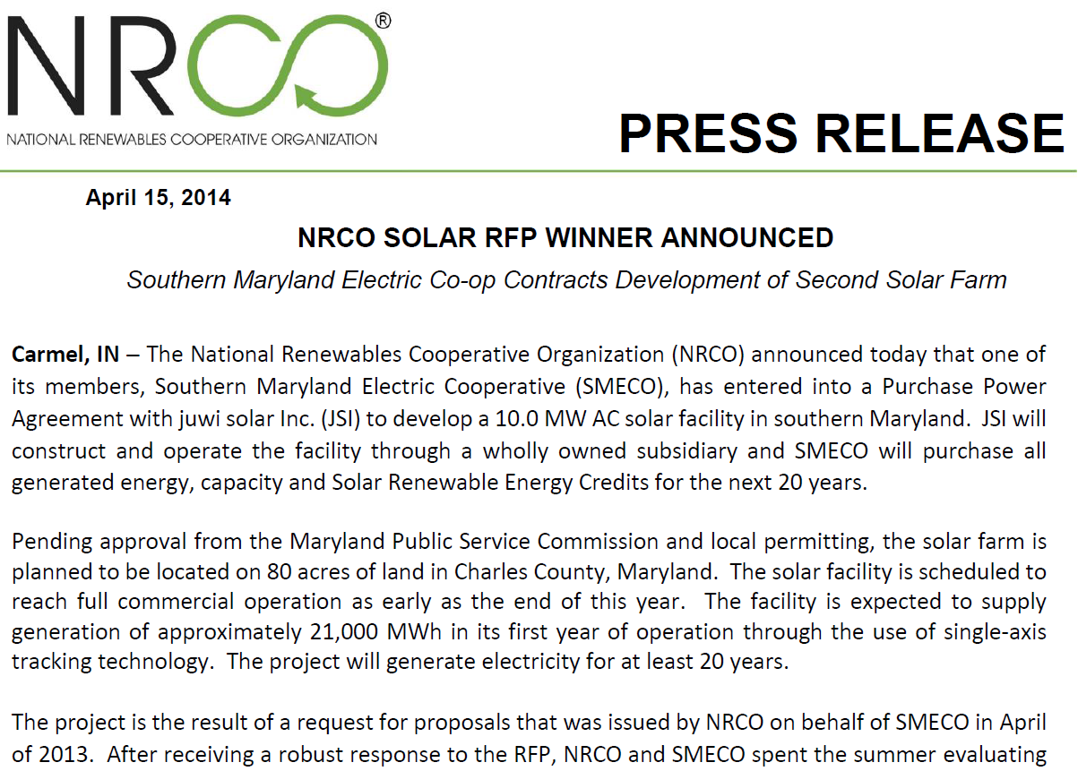

Slide 33
Fresh Survey Data
Consumer perceptions on energy
University of Michigan research
Same people who conduct national surveys on consumer sentiment
Almost one year of data
Consistent notable findings in the data

Slide 34
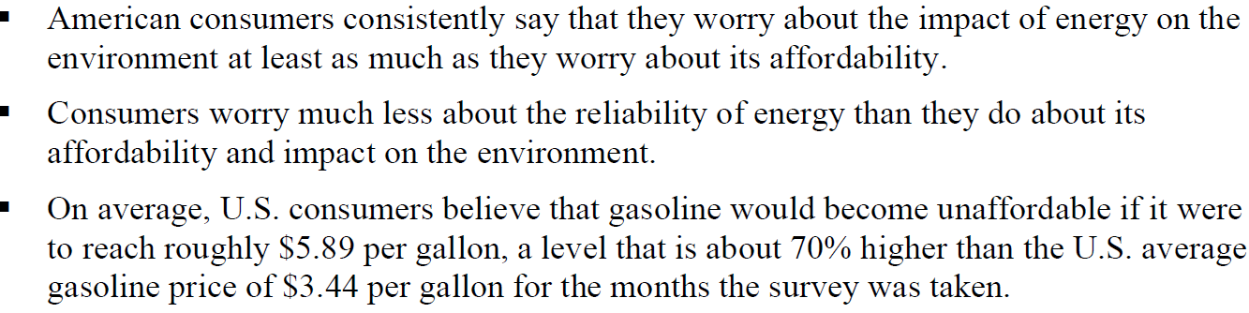
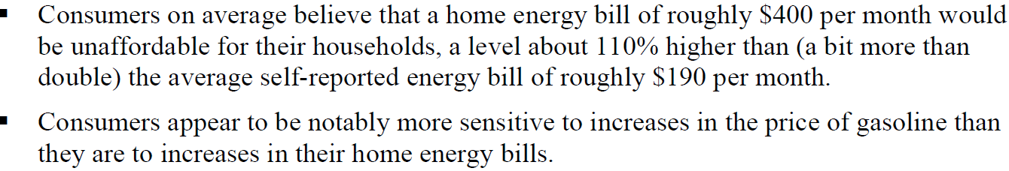
General Conclusions

Slide 35
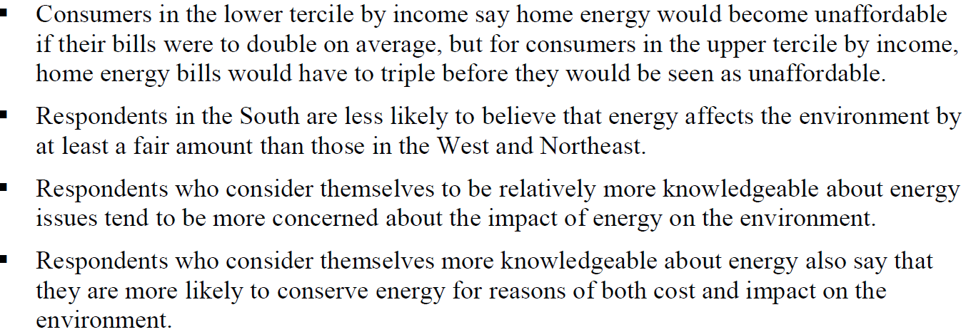
Nuanced Findings

Slide 36
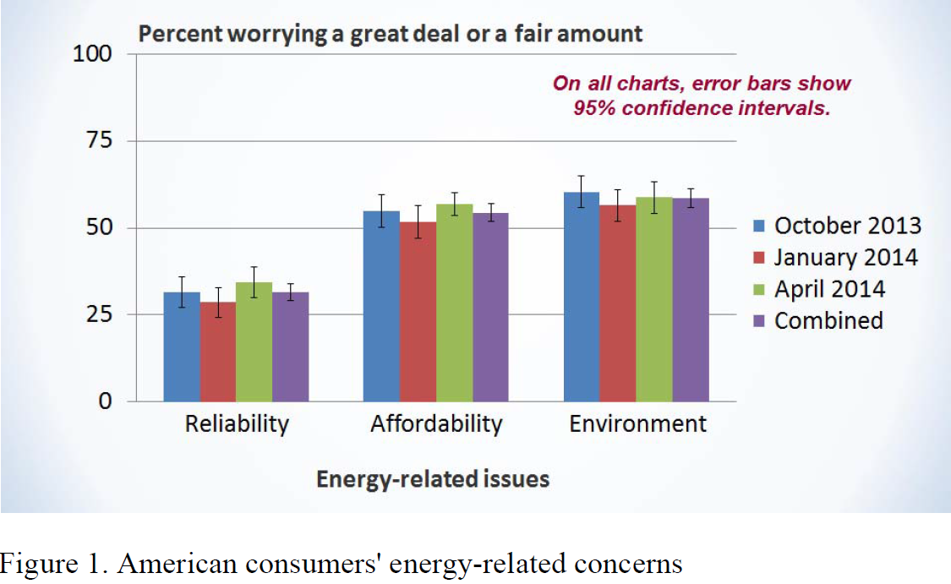

Slide 37
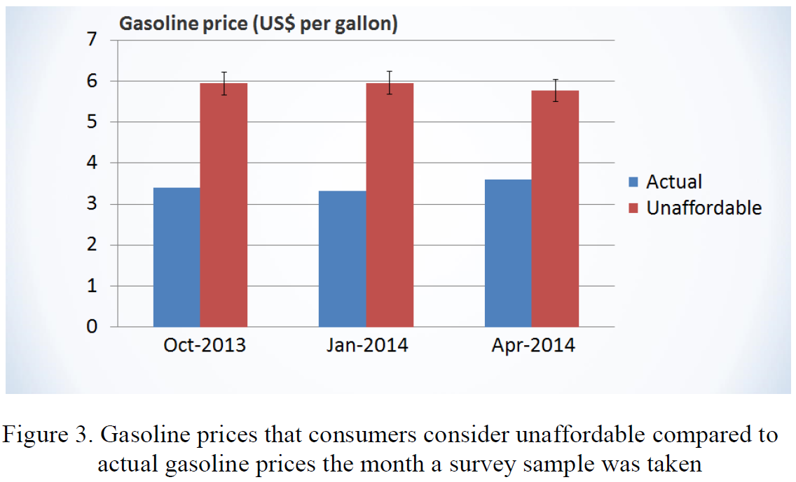

Slide 38
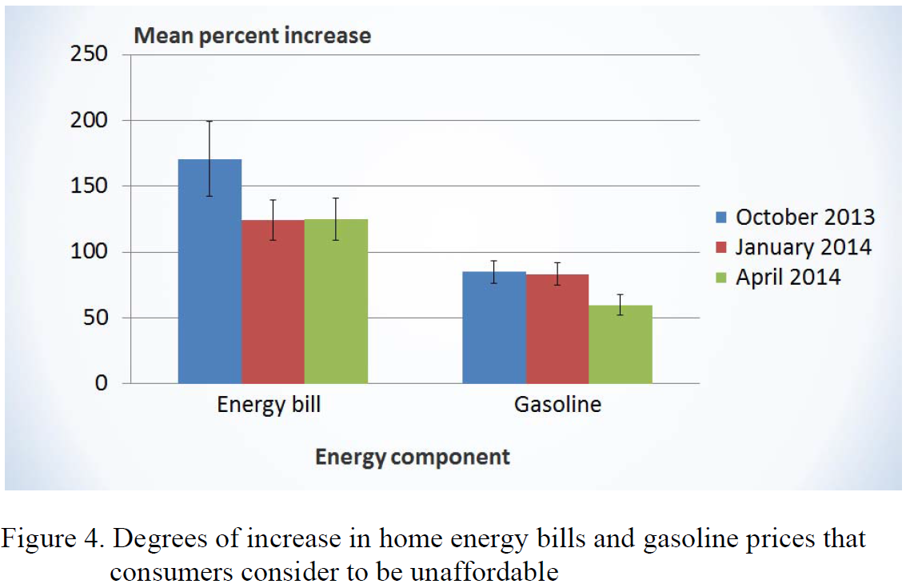

Slide 39
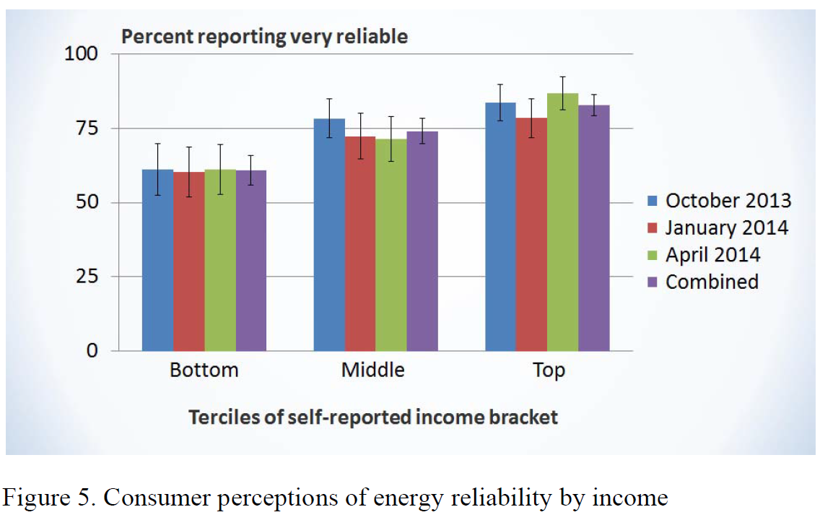

Slide 40
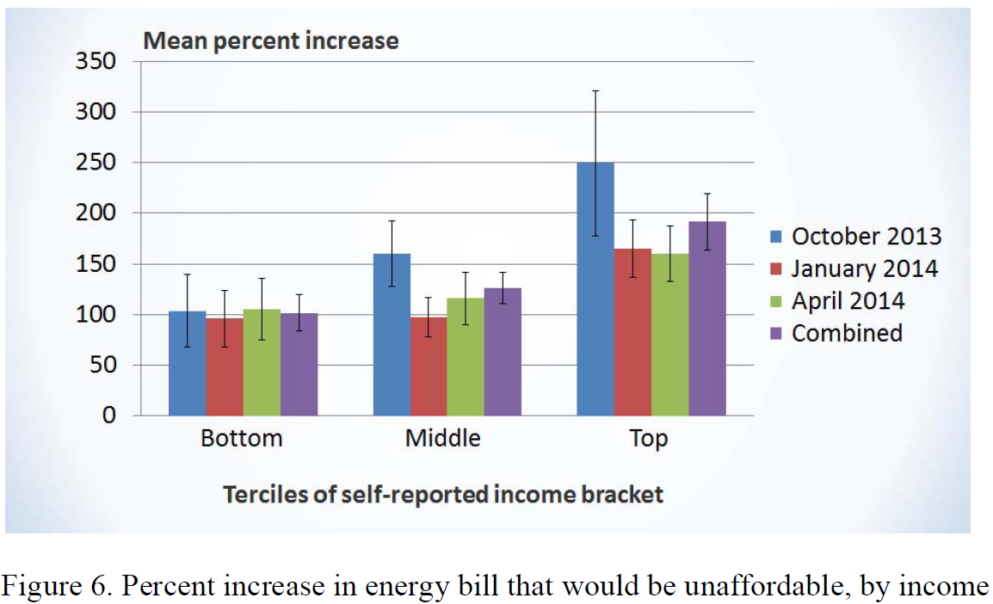

Slide 41
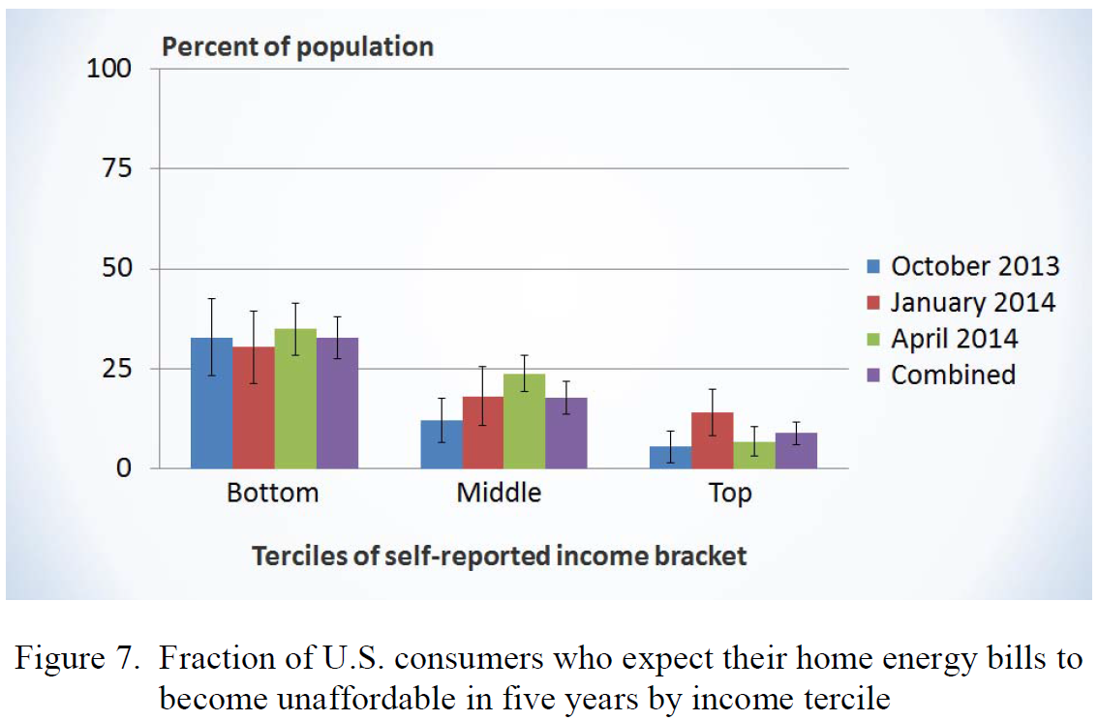

Slide 42
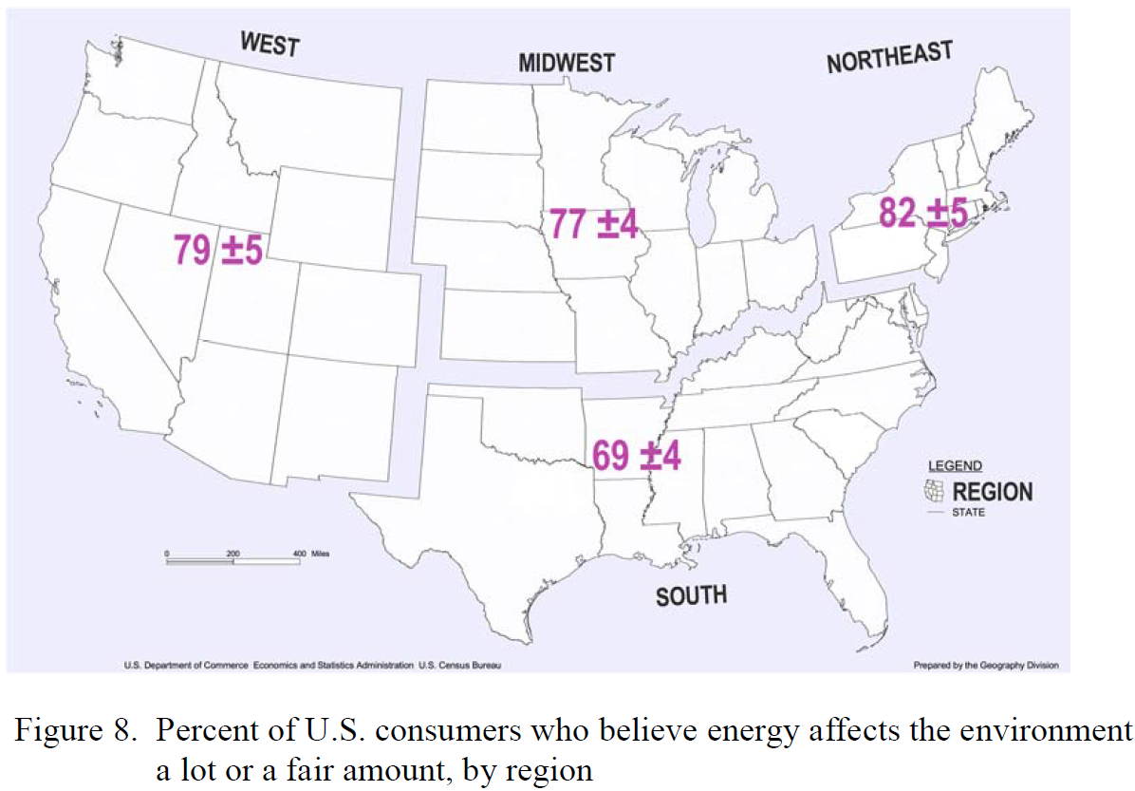

Slide 43
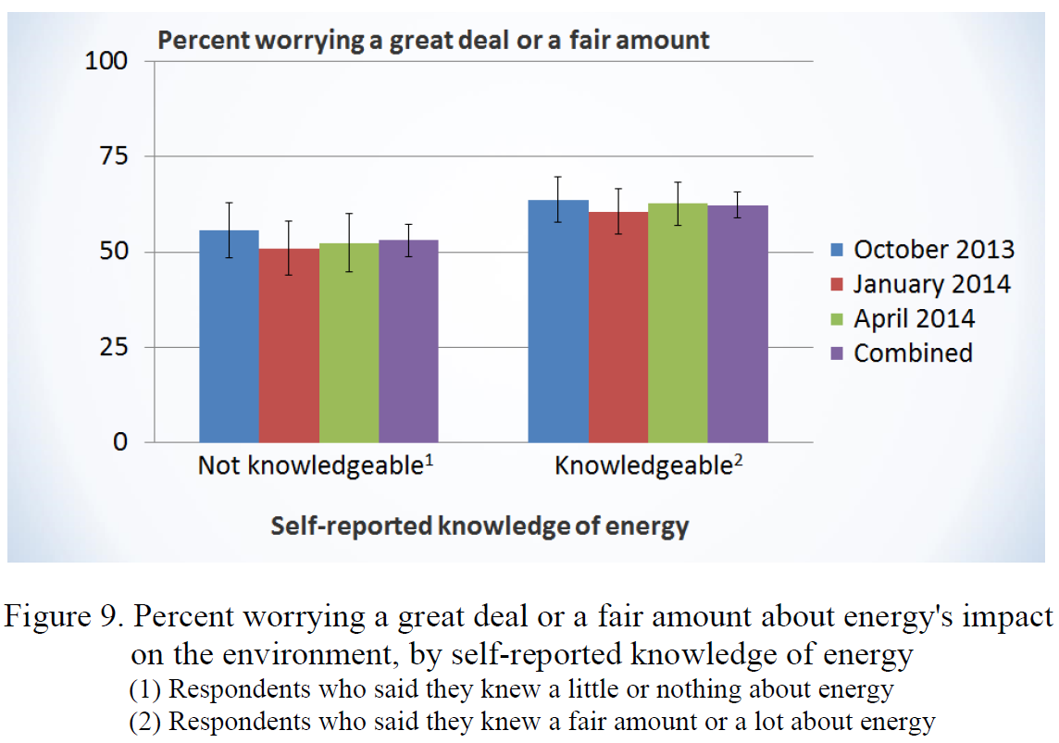

Slide 44
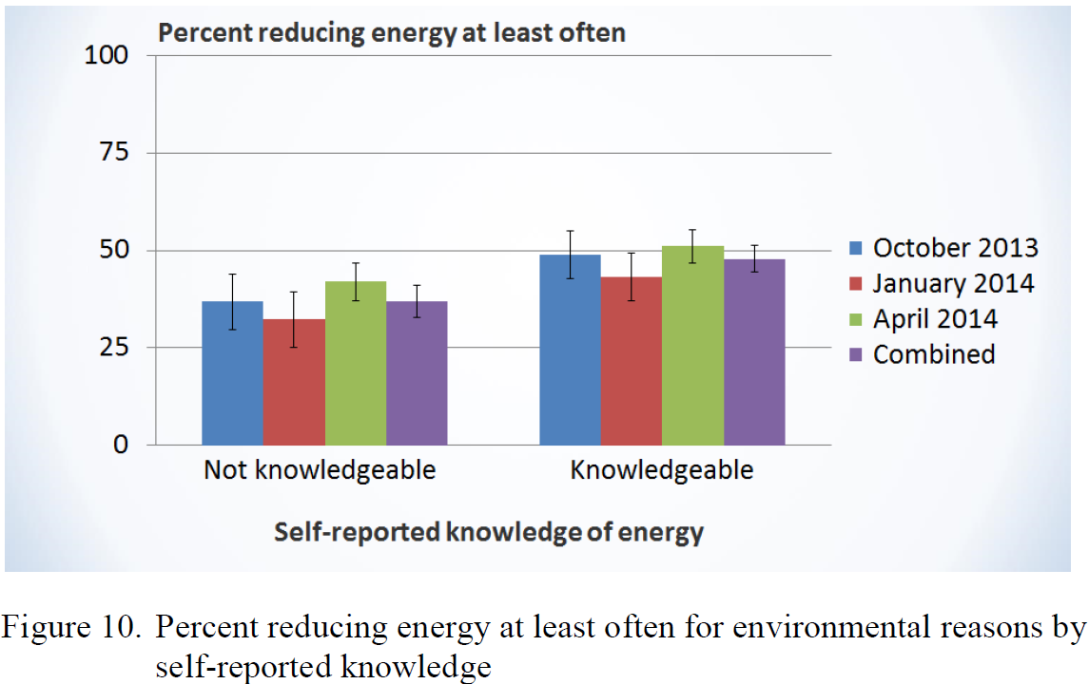

Slide 45
Crystal Ball - Interest Rates
  Long term rates built up from 10 Year UST (+)
    Rates move UP when investors are NET sellers of bonds
    QE still in effect in US - $35 Billion – Wait and see
    Ultra Low rates in Europe pushing investors to buy the UST
      German Bund 10 year = 1.01% 10 year UST = 2.54%
      ECB announced negative deposit rate
    Pension funds buying UST to rebalance gains from 2013
    China buying UST to weaken it currency
  GDP Expectations - nothing special – housing OK

