Slide 1
Florida Electric Cooperative Finance and Accounting Conference Thursday, September 18, 2014 Cyber Security What do you need to know? Presenters: Will Simmons, Seminole Electric

Slide 2
Did you know?
Every 1 minute a host accesses a Malicious Website
Every 9 minutes a High Risk application is being used
Every 27 minutes Unknown Malware is being downloaded
Every 49 minutes sensitive data is Sent Outside the organization
Every 24 hours a host is infected with a BOT

Slide 3
University of Toronto
According to a recent study, there is a growing trend toward sophisticated attacks focused on consumer and citizen data.
However the same study indicated, government entities are experiencing twice the number of breaches than the private sector, with a 73+ percent increase in one year.
The increase can be explained by a significant investment in detection and response capabilities, which enable greater visibility into breaches.

Slide 4
From Hacker to Attacker
Hacking is incredibly easy. Survey data shows 80-90 percent of successful corporate network breaches use tools acquired from the Internet, including tools that “crack” passwords in minutes.
Attackers historically have delivered malware via e-mail. They are now delivering malware via FTP and Web pages. Web pages load instantly and can be modified quickly.
94% of undetected malware comes from web browsing
95% of FTP based exploits are never detected by anti-virus
97% use non-standard ports to infect systems

Slide 5
Measures that Block Most Attacks
Application whitelisting, allowing only authorized software to run on a computer
Very rapid patching of Operating Systems and software
Very rapid patching of Application software
Minimize the number of people on a network with “Administrator” privileges.
Implementing these measures reduce risk by 85 percent

Slide 6
Traditional Enterprise Security
Firewalls
IPS
Secure Web Gateways
Anti-Spam Gateways
Desktop Anti-Virus

Slide 7
A New Model – Advance Threat Protection
Real-time threat analysis of Web, E-mail and File security to stop advanced targeted attacks
Global Threat Awareness and dynamic threat intelligence provides unique, zero-day intelligence
Centralized management reporting
Data theft and loss prevention
Automation ensures higher detection accuracy and low TCO

Slide 8
Cyber Resilience
The ability to return to the original position or recover readily from adversity
In order for a company to achieve cyber resilience, a company-wide awareness is required
Parameters:
Recognition of interdependence
Role of leadership
Integrated risk management
Extended security chain

Slide 9
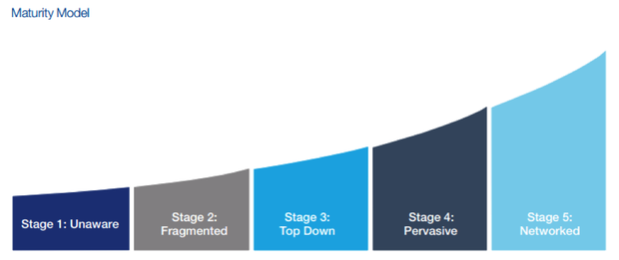
Where Cyber Resilience Starts
Company management support of a cybersecurity program is fundamental, without it there is no program
Steps of maturation with regards to cyber resilience

Slide 10
One Last Thought
Want to play a game … WAR

Slide 11
QUESTIONS

