Slide 1

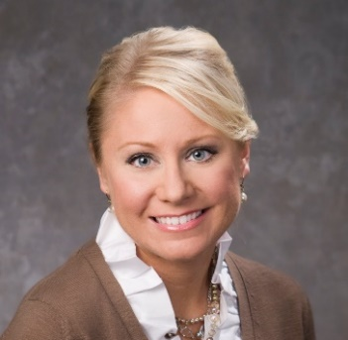
PREPARING FOR HURRICANE SEASON
FEMA Public Assistance Program: Programmatic Nuances
Wendy Huff Ellard
601.969.4681
wellard@bakerdonelson.com

Slide 2
Today’s Agenda
Session 1: Procurement and Documentation
Session 2: Mutual Aid and COVID-19
Session 3: Programmatic Nuances
  Types of Projects
    Standard
    Capped
    Categories: B vs. F
  Mitigation
    Public Assistance Program (§ 406)
    Hazard Mitigation Grant Program (§ 404)
    BRIC (§ 203)
  Reconductoring Eligibility Requirements
  Management Costs
  Emergency Work / Logistics
  Broadband Considerations

Slide 3
Standard Projects – Reimbursed at Actual Cost
Standard Reimbursed Project
  Repair / Restore / Replace to Pre-Existing Condition
  For buildings and electric power, consensus-based codes, specifications and standards must be incorporated
    Codes for Electric Power available at FEMA’s Feb. 2020 FAQ
    Exceptions: technically infeasible, extraordinary burden
  Project is obligated based on actual cost or estimated and then adjusted up/down to reflect actual cost

Slide 4
Capped Projects
Improved Projects
  Incorporates changes to the pre-disaster design and function (changes are not required by applicable codes or standards)
  E.g., relocation, increased capacity, upgraded finishes
  Requires Recipient and sometimes FEMA pre-approval
Alternate Projects
  Damaged facility is abandoned and funding is put toward a different eligible facility or facilities or another approved use
  Requires FEMA pre-approval if alternate project involves construction
Fixed Cost Project (§ 428 Alternative Procedures)
  FEMA and applicant agree to fixed cost estimate; applicant can use funds on any § 428 project and can use excess funds for certain eligible purposes; FEMA will not fund overruns

Slide 5
Category of Work – Trend to Re-Classify Projects
Considerations of Category B vs. F
Cost Share
  Frequently there are different cost shares applicable to Emergency and Permanent Work
  Hurricane Michael –
    100% FEMA share for Category A and B October 10, 2018 through November 24, 2018
    90% for Category A and B After
    75% for Permanent Work inc. Category F
Force Account Labor Eligibility
  Emergency Work – Only OT
  Permanent – Regular Time and OT
Contracting Considerations – No formal impact but presumption
Mutual Aid – Policy now confirms both eligible
Eligibility / Duplication of Work

Slide 6
Funding Opp - Mitigation – Public Assistance (§ 406)
Public Assistance Hazard Mitigation (§ 406)
  Mitigation of incident-caused damage
  Generally available only for disaster-damaged facilities
    Exception: § 428 Alternative Procedures
  FEMA evaluates proposals for:
    eligibility
    cost-effectiveness (15%, 100%, or BCA)
    technical feasibility and effectiveness
    compliance with EHP laws, regulations, and EOs
  Generally must be applied to damaged portions of the facility
    Exception: e.g., floodwalls, sprinkler system

Slide 7
Mitigation – Hazard Mitigation Grant Program (§ 404)
Hazard Mitigation Grant Program (§ 404)
  Funding is limited; not all projects selected
  To be considered for funding under HMGP, a project must:
    Conform with the approved state and local mitigation plan
    Benefit the disaster area
    Conform with environmental regulations
    Solve a problem and be technically feasible
    Meet all applicable state and local codes and standards
    Demonstrate cost-effectiveness
    Consider a range of alternatives

Slide 8
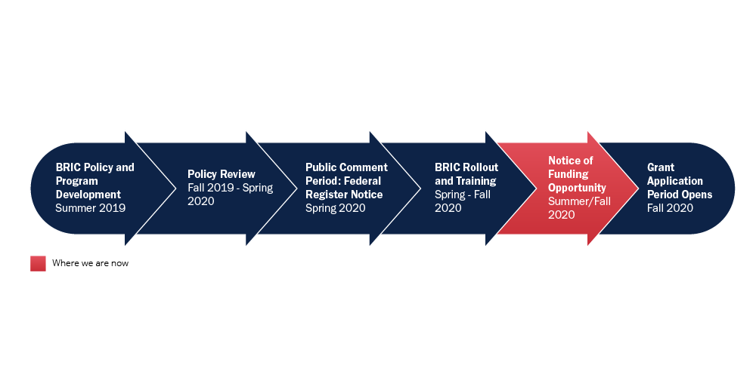
Mitigation – BRIC (§ 203)
Building Resilient Infrastructure and Communities (§ 203)
  New program replaces Pre-disaster Hazard Mitigation Program
  NOFO Issued August 4, Applications Open Sept 30
  FEMA will fund BRIC from a 6% set-aside of estimated disaster expenses for each major disaster
  Current Funding of $500 million, $446.4 million available through “National Competition”, $50 million cap per project

Slide 9
Mitigation – BRIC (§ 203)
Application Deadline: January 29, 2021 (3:00 p.m. ET)
Mitigation Projects
  Cost-effective mitigation projects designed to increase resilience and public safety; reduce injuries and loss of life; and reduce damage and destruction to property, critical services, facilities, and infrastructure
Have to be in a state with a declaration in past 7 years (All – thanks CV19)
Management Costs - Up to 15% (10% rec. / 5% subrec. split)
Subject to 75% Cost Share
https://www.fema.gov/grants/mitigation/building-resilient-infrastructure-communities

Slide 10
Funding Opp - Management Costs
Based on actual costs incurred up to 5% of total award amount
“Total award amount” includes Federal share, but not insurance or other reductions
Obligated via Category Z PW and funded at 100% federal share
Cat Z PW is obligated with project obligations
FEMA may process additional versions on a quarterly basis

Slide 11
Management Costs
Documentation Requirements:
  Payroll data
  Procurement procedures
  Contracts
  Invoices
  Explanation of activities performed (e.g., purpose of meeting or site inspection)
  Representative sample of daily logs/activity reports
  Demonstration of cost reasonableness

Slide 12
Eligibility Issue – Reconductoring
Must meet one of six criteria within a line section.
What is a line section?
  A group of contiguous spans selected for evaluation.
  A span is the distance between two poles or structures.
  A line section can be:
    A single span
    All the spans between two dead-end structures
    All the spans on a feeder
    All the spans on a tap
    Any other group of contiguous spans that are evaluated together

Slide 13
Eligibility – Reconductoring Criteria
25%+ of conductor spans have visible damage, e.g., broken strands, splices, sleeves (installed as a result of the incident), severe pitting, burns, or kinks
30%+ of line spans are visually stretched (out of sag), or do not meet clearance requirements, e.g., conductor-to-conductor or conductor-to-ground clearance
40%+ of supporting poles need to be replaced or plumbed (straightened). Test: leaning such that it is unsafe to climb

Slide 14
Eligibility – Reconductoring Criteria
40%+ of supporting structures (other than poles) have damage, e.g., broken cross-arms, braces, ties, insulators, guys, pulled anchors, or bent pins;
  If more than one element of the support structure is damaged, it still only counts as one damaged support structure.
  If a pole is counted under the previous bullet, FEMA does not count the supporting structure under this criterion
65% or more of any combination of the damage described in the bullets above; or
Evidence provided by a licensed Professional Engineer that demonstrates the conductor is damaged beyond repair.

Slide 15
Eligibility – Reconductoring
Applicant must provide sufficient document to establish:
  Pre-disaster condition
  A line section of its system meets one of the six criteria above
What is “sufficient documentation” of pre-disaster condition?
  A signed, dated, and stamped letter from a licensed PE with direct experience with the damaged electrical transmission or distribution system
    Certifying the pre-disaster capacity and condition of the conductor
    With records providing satisfactory evidence of the pre-disaster capacity and condition of the conductor

Slide 16
Eligibility – Reconductoring
Records may include, but are not limited to:
  Maintenance records, contract documents, work orders, inspection logs, or a description of past inspection and maintenance activities certified by a licensed PE.
  If available, copies of construction work plans demonstrating past practices and current and future projects.
  If required by RUS, a copy of any corrective action plans submitted to RUS in compliance with 7 C.F.R. § 1730.25, Corrective action (RUS borrowers only).
  Staking sheets.
  The Applicant is not precluded from substantiating the pre-disaster condition with other documentation if it is unable to provide the documentation described above.

Slide 17
Eligibility – Reconductoring with #2 ACSR
FEMA considers #2 ACSR a lower cost alternative to conductor with equal or lesser amperage capacity, e.g.,
  Copper weld conductor
  Hard and soft drawn copper wire
  Smaller ACSR
  Amerductor
Adjustments to other components of the electric distribution and transmission systems to accommodate #2 ACSR are eligible, e.g.,
  Adjusting span lengths between utility poles
  Increasing pole heights and standards
No need to cite a code or standard for this additional work

Slide 18
Eligibility – Reconductoring with #2 ACSR
Choosing a conductor with less amperage than #2 ACSR:
  Eligible if cost is less than conductoring with #2 ACSR
Choosing a conductor with more amperage than #2 ACSR:
  If not required by code or standard meeting eligibility requirements, then must be requested as Improved Project.

Slide 19
Eligibility – Example of Reconductoring with #2 ACSR
Conductor 1 is a #4 ACSR supported by utility poles with a long span.
  FEMA should fund replacement of the damaged conductor with #2 ACSR because FEMA has pre-determined that #2 ACSR is a lower cost equivalent to #4 ACSR.
  FEMA should also fund work to adjust the span lengths to support the new #2 ACSR.
Conductor 2 is an Amerductor with an equivalent amperage capacity to #2 ACSR.
  FEMA should also fund replacement of the damaged conductor with #2 ACSR if the applicant prefers because, despite being the same amperage capacity, FEMA has pre-determined that #2 ACSR is a lower cost equivalent to replacing the Amerductor with equivalent or lesser amperage capacity.
Neither of these replacements requires the existence of or the applicant to cite to a code or standard.

Slide 20
Second Appeals – Reconductoring
Lyon Rural Electric Cooperative, FEMA-4114 (Mar. 17, 2016)
Pre-disaster condition demonstrated by:
  PE certification that lines were “maintained in good repair and in intact operating condition” to general industry and Iowa Utilities Board (IUB) requirements prior to the disaster.
  IUB inspection reports for previous years.
  Planning study with 5-, 10-, 20-year construction plans.
  Capital expenditure budgets.
  RUS corrective action plans were not provided, because applicant was not RUS borrower.
Conductor replacement satisfied by:
  PE certification that line section met at least one criteria.
  Corresponding inspection reports.

Slide 21
Second Appeals – Reconductoring
Lyon Rural Electric Cooperative, FEMA-4114 (Mar. 17, 2016)
FEMA contractor performed an independent inspection, which differed from applicants, but:
  …FEMA Region VII’s Technical Report reflects the highly subjective nature of inspecting conductor lines and provides a reasonable explanation for the variances. As such, the Applicant’s provision of conductor replacement certifications specifying the line sections that qualify for conductor replacement, which were signed and stamped by a professional engineer and substantially verified by FEMA, are sufficient to meet the requirements of DAP 9580.6.

Slide 22
Eligibility Issue - Emergency Work Issues / Logistics
Major Current Issue: Logistics / Base Camps
Ensure that you document the nature of the restoration work / need
Document Anticipated Use
Document Support for Location, Configuration, Alternatives
Consider your procurement, is it compliant?
  Must have a NTE for Time and Materials Contract
  Must have a Termination for Convenience Clause
  NOTE: Minimums are a current high risk area
Document a Cost or Price Analysis
  Compile and Keep Documentation of Reach-outs / Rates
Document Actual Use

Slide 23
Eligibility Issue - Broadband
Critical Services – Include Utility and Communications Services
Communications includes “communications transmission and switching, and distribution of telecommunications traffic”
FCC 2017 Classification: Broadband is an Information Service
  Intended to lighten regulation but what impact on FEMA eligibility?
For YOUR use to operate/provide power – Eligible
Providing as a service to public – Likely Eligible
  Sheltering includes internet, IPAWS, First Net, critical for communications, now critical for work/school/health
Careful about Partnerships
  Sharing lines with for-profit entities
  Lease considerations
  Careful re Non-Profit Status / Subsidiary Arrangements

Slide 24

Questions?

Slide 25
PREPARING FOR HURRICANE SEASON
FEMA Public Assistance Program: Programmatic Nuances
Wendy Huff Ellard
601.969.4681
wellard@bakerdonelson.com

