Slide 1
Florida Engineers Conference 2016
6.6.2016

Slide 2
Topics:
Distribution Reliability Benchmarking
Product/Distribution Quality Lifecycle
How to get money for network reliability improvements.
System Interoperability

Slide 3
2014 Distribution Reliability Study
2015 IEEE PES General Meeting
Denver, CO

Slide 4
NRECA Benchmarking Background
Participants are anonymous
Participation list is not revealed to anyone.
No inference about “good” or “bad” reliability
Intended to provide information to allow participants to assess their performance relative to others
This information with raw data is provided to the participants so that they can make/share their own graphs.
Data is provided to Touchstone Energy for use in the Balanced Performance Scorecard.

Slide 5
System Avg. Interruption Duration Index
Minutes of Interruption
Excluding Major Event Days
Min | 28.30
1st Quartile | 82.45
2nd Quartile | 121.55
3rd Quartile | 177.36
Max | 332.90
SAIDI SCORES FOR INDIVIDUAL STUDY CONTRIBUTORS – 2014

Slide 6
System Avg. Interruption Frequency Index
FREQUENCY OF INTERRUPTIONS
Excluding Major Event Days
Min | 0.41
1st Quartile | 0.88
2nd Quartile | 1.24
3rd Quartile | 1.69
Max | 3.93
SAIFI SCORES FOR INDIVIDUAL STUDY CONTRIBUTORS - 2014

Slide 7
Customer Avg. Interruption Duration Index
AVG. INTERRUPTION IN MINUTES
Excluding Major Event Days
Min | 43.72
1st Quartile | 79.02
2nd Quartile | 92.66
3rd Quartile | 111.51
Max | 177.39
CAIDI SCORES FOR INDIVIDUAL STUDY CONTRIBUTORS - 2014

Slide 8
Year to Year Performance
 | 2012 |  | 2013 |  | 2014 | ∆
Average SAIDI | 128.60 |  | 118.80 |  | 131.29 | 12.49
Average SAIFI | 1.40 |  | 1.20 |  | 1.35 | 0.15
Average CAIDI | 97.00 |  | 97.30 |  | 95.88 | -1.42
Note: We don’t track specific members so the yearly performance shown is a generic average over the entire population of respondents

Slide 9
Product Quality
What is product quality at an electric cooperative?
How do we improve it?

Slide 10
Data Analytics Platform

Slide 11
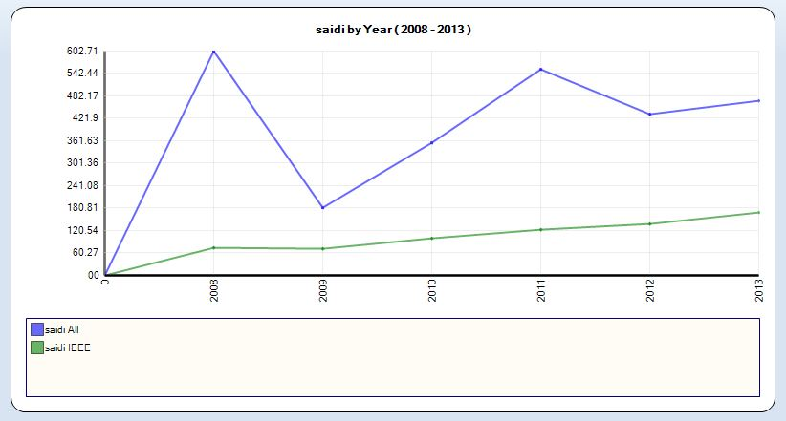
Data Analytics Platform
SAIDI trending up over time
This is an example of a SAIDI score that is trending up over time. Note the removal of Major Event Days reveals the operational efficiency trend that would be hidden in the data.

Slide 12
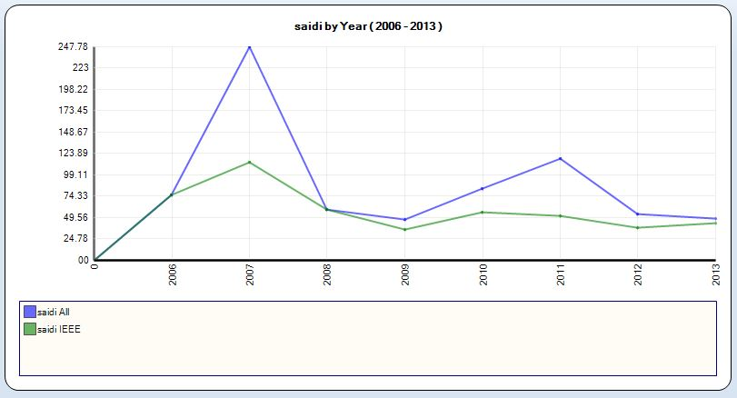
Data Analytics Platform
Typical SAIDI trending over time

Slide 13
Product Quality
Evaluate
Goal Setting
Plan
Execute
Measure
Typical product quality lifecycle

Slide 14
Evaluate:
Is this the distribution reliability trend we want?
If not, what actions are we going to take?

Slide 15
Set Goals:
What should our goal be?
How are we going to accomplish the goal?

Slide 16
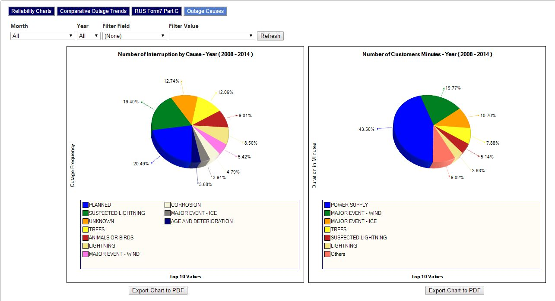
Make a plan: Data analysis

Slide 17
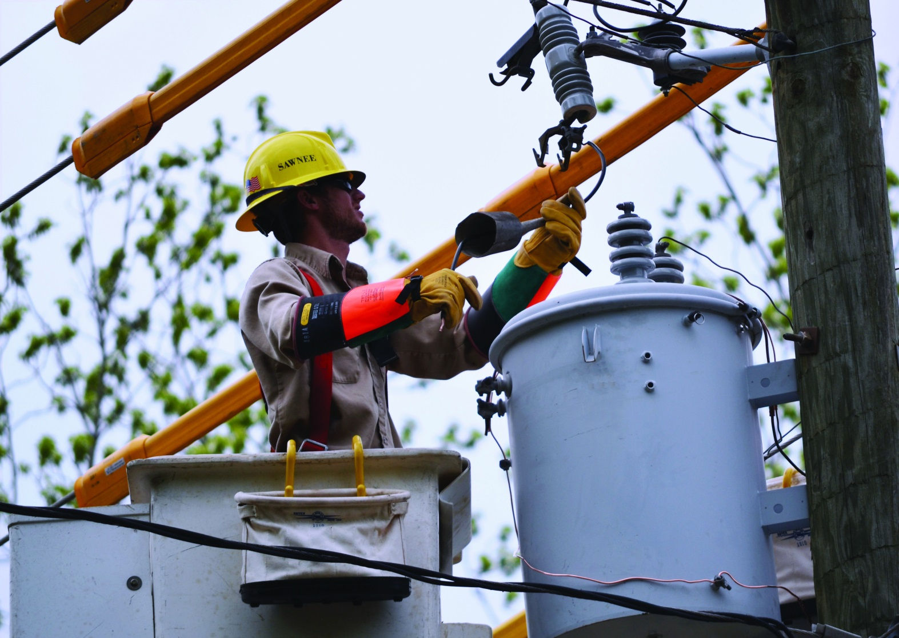
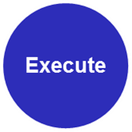
Execute the plan:
Measure the results

Slide 18
Product Quality
Evaluate
Goal Setting
Plan
Execute
Measure
Typical product quality lifecycle

Slide 19
But Tony, I can’t get money for upgrades.
Develop a plan
Sell the plan to your CEO and Board
Execute the plan
Measure the results
Report the results
Rinse and repeat.

Slide 20
Developing a plan requires tools
Your plan should include nice pictures that help explain the plan.

Slide 21
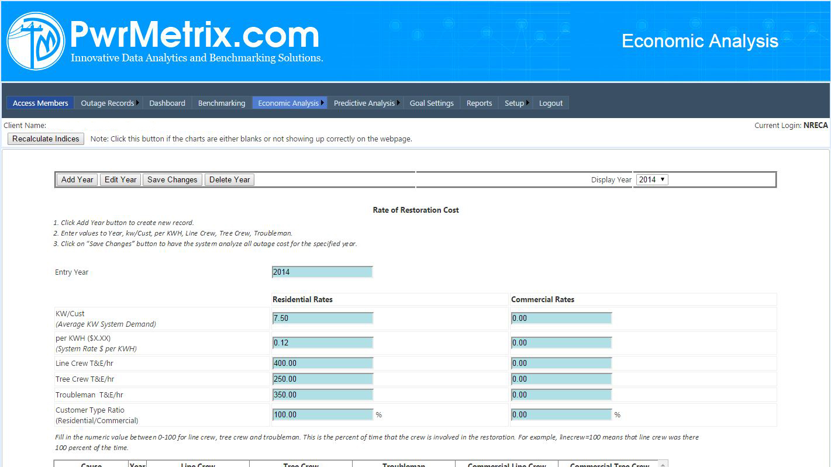
Tools: Economic Analysis: your Cooperative
What does your SAIDI score cost your Rural Electric Cooperative?

Slide 22
Tools: Economic Analysis: your Members
What does your SAIDI score cost your Members?

Slide 23
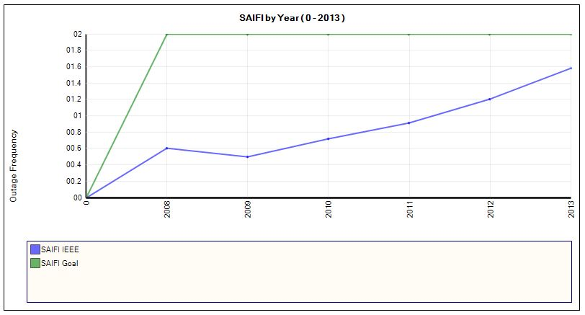
Tools: Goal Setting
Explain problem areas and set goals
Set both long term and short term goals.
Have a “road map” that explains how you intend to meet your goals.

Slide 24
The Presentation
Bundle up your nice pictures into a nice presentation.
Keep the written narrative short.
Develop a printed “package” with your analysis of the current situation, long term goals, short term goals and costs of the status quo.
Depending on your Cooperative, emphasize either the costs of your SAIDI score to your REC or to your Members.
Ask for money. Be specific, but ask for more than you need.
Remember, this is an iterative process
Next year you’ll do this all over again.
Be sure to highlight the improvements your made the previous year.

Slide 25
System Interoperability

Slide 26
Foundational Technologies:
Smart Grid
Data
Analytics
Communication
Systems
System Interoperability

Slide 27
Applications must be interoperable:

Slide 28
Applications must be interoperable:
MultiSpeak is a System Interoperability Standard
Added to the Smart Grid Interoperability Panel “Catalog of Standards” in 2014
In worldwide use today.
www.multispeak.org

Slide 29
Questions?
Tony Thomas, CEM, GICSP
NRECA Principal Engineer
tony.thomas@nreca.coop
703-850-4718

