Slide 1
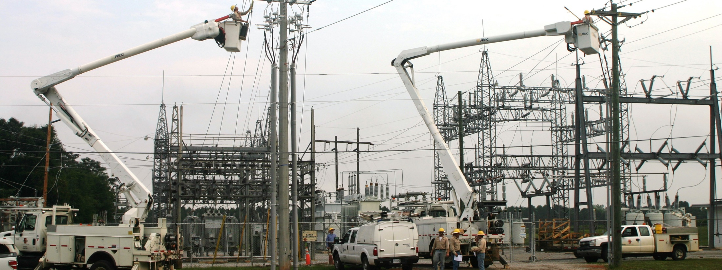
Distribution / Feeder Automation CHELCO FECA Engineers Conference June 6, 2016 Presented By: Matthew Avery and Mike Kapotsy

Slide 2
CHELCO Facts
Located in Panhandle of NW Florida
22 Substations (76 Feeders)
System Peak: 241 MW
51,002 Meters (12 meters/mile)
Featured in Touchstone Energy Best Practices

Slide 3
CHELCO Reliability
Notes:
2014 year slipped in reliability due to many big storms that were just shy of being classified as MEDs.
Refer back to TSE paper – bad year following article

Slide 4
Association of Large Distribution Cooperatives (ALDC) - 2014 Reliability

Slide 5
CHELCO Reliability
Notes:
Pie chart of Types of outages

Slide 6
Why Feeder Automation?
Current Sectionalizing Plan
2014 Slip in Reliability
Mitigate Storms/Events that do not Qualify as MEDs
Improve Balanced Scorecard in Member Satisfaction and Reliability
Next Logical Step Given Current Sectionalizing Methods
*71% of feeders have back-feed capability (54 Feeders)
*Assuming 50% restoration on feeder level outages
Notes:
Current sectionalizing plan is to fuse all taps off the main 3 phase line. OCRs for taps with more than 20 members.
Featured in Touchstone Energy’s Best Practices for Reliability, but given our current sectionalizing across our system, our aggressive ROW clearing, and our general system maintenance.
Members see an outage whether it qualifies as MED or not – automation improves overall reliability which means the member sees less outages – even in MED events
The next logical step is automating the process of an outage.

Slide 7
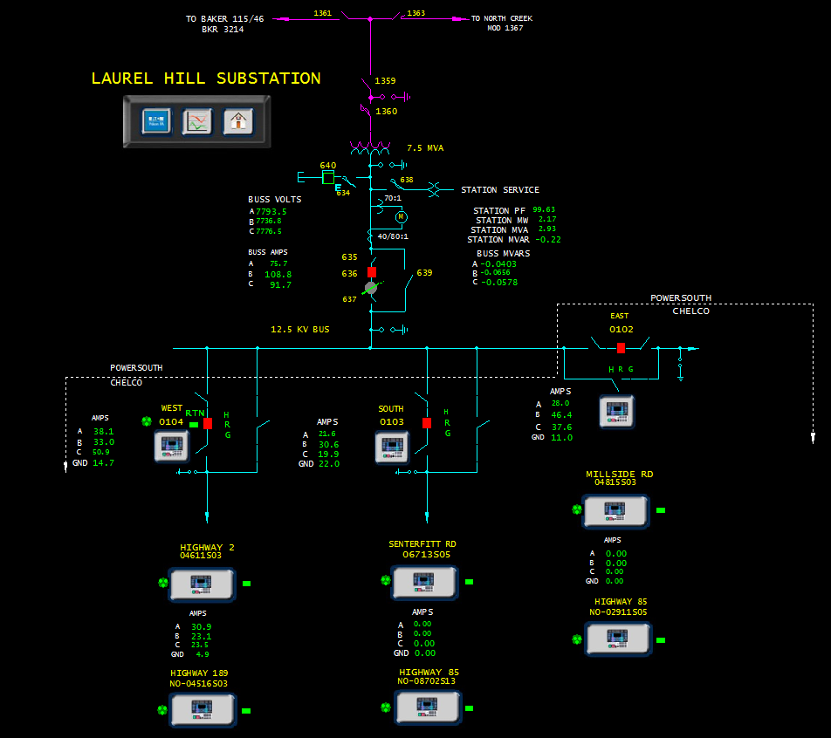
Yukon Feeder Automation?
YFA is a server based application that performs Fault Location, Isolation, Service Restoration (FLISR)
YFA restorations typically in the time frame between 30s to 2m depending upon communication system (Radio System ~2 minutes)
Using YFA as a Bolt-On to Existing SCADA
Operators can control YFA through SCADA
Existing Experience with YFA at CHELCO
Notes:
Mike Starts

Slide 8
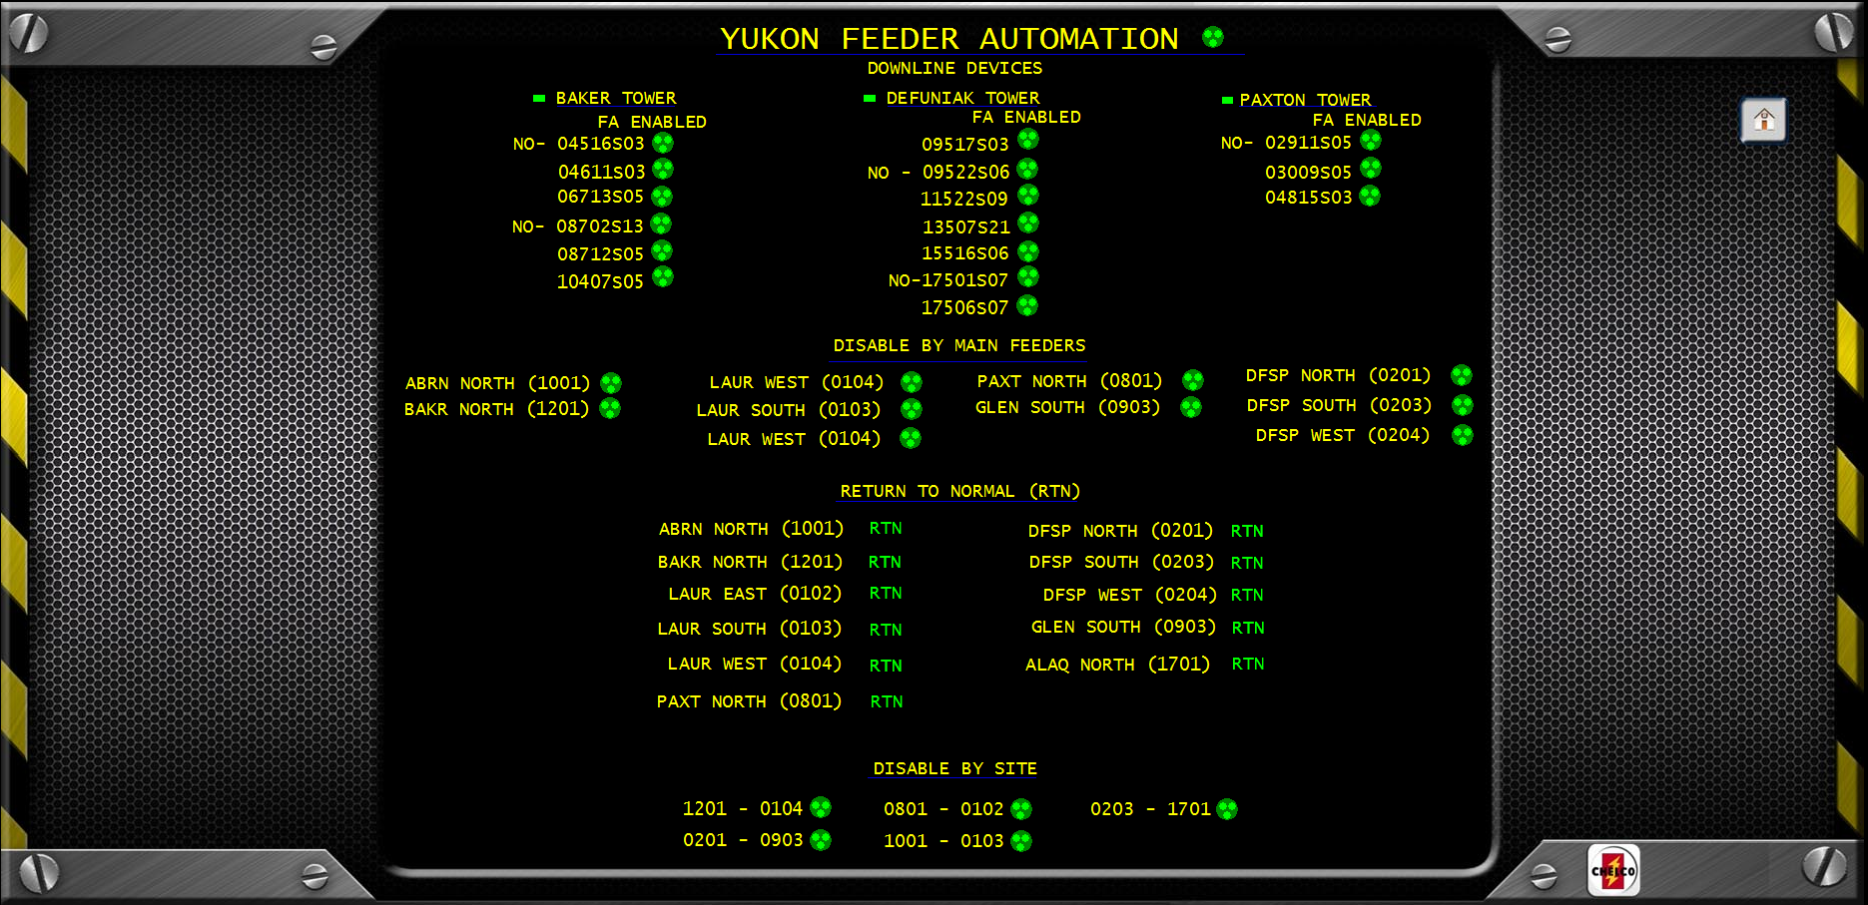
Yukon Feeder Automation?

Slide 9
CHELCO Plan
10 Year Implementation (Due to Cost)
Automate 54 Feeders (Out of 76 Feeders Total)
Automating Worst Performing Feeders First
Automate 111 Downline YFA Reclosers (71% of System)
Operations Buy-in
Benefits Expected in Reliability
Total Cost: $3,028,758 (Already Budgeted: $1,528,75)
Cost Per Site:
YFA Software (One Time Fee) $15,000
YFA Site License $2,500 (Adjusted as Devices are Added)
Annual Maintenance Contract 18% (Negotiable)
Triple Single Recloser/Control $21,500
SCADA Communications $4,500
Notes:
Operations Buy-in: multiple presentations and Q&A with Ops personnel

Slide 10
Cost Over 10 Years

Slide 11
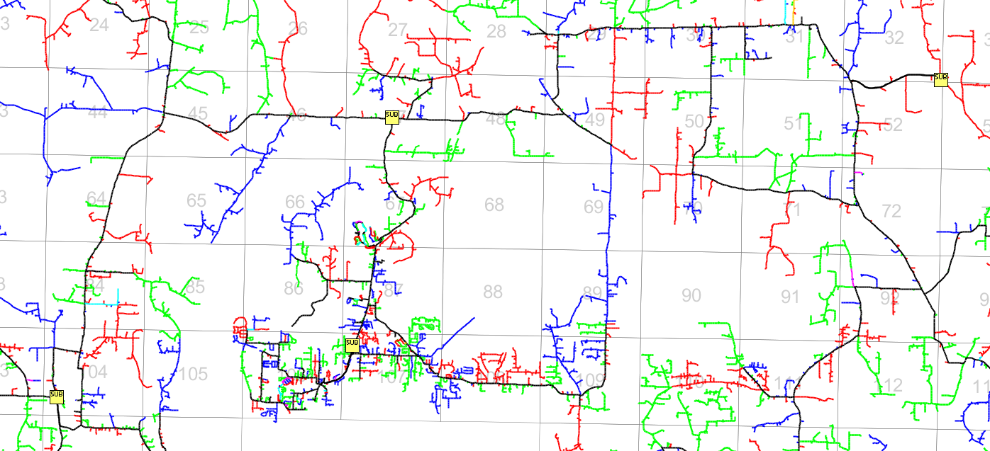
CHELCO Plan
PAXT
LAUR
ABRNn
BAKR

Slide 12
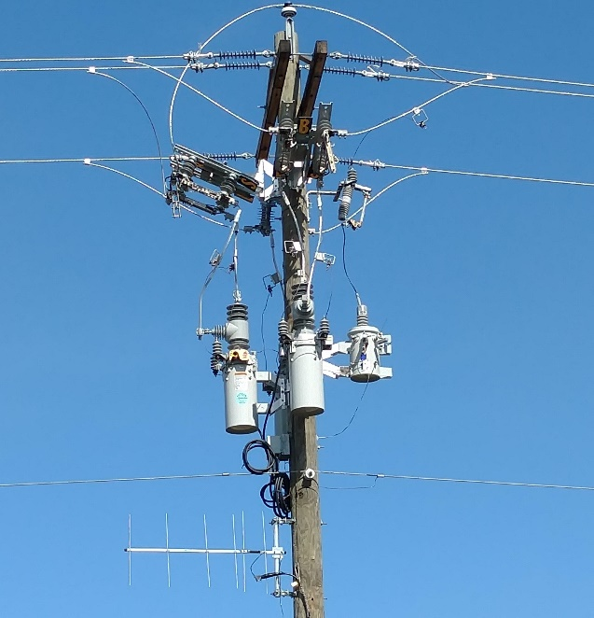
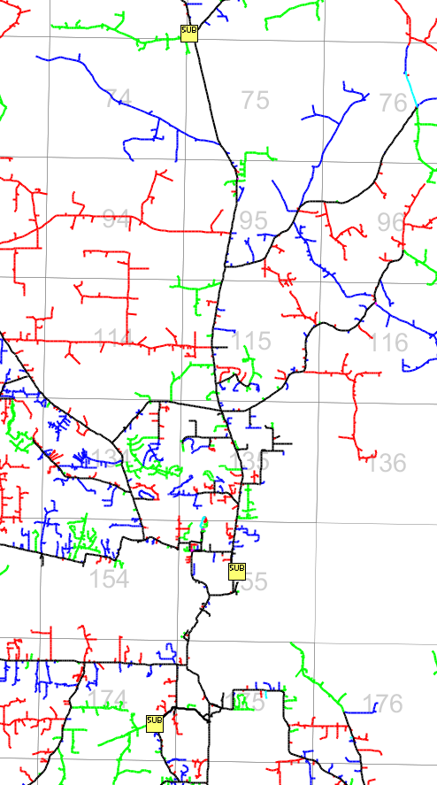
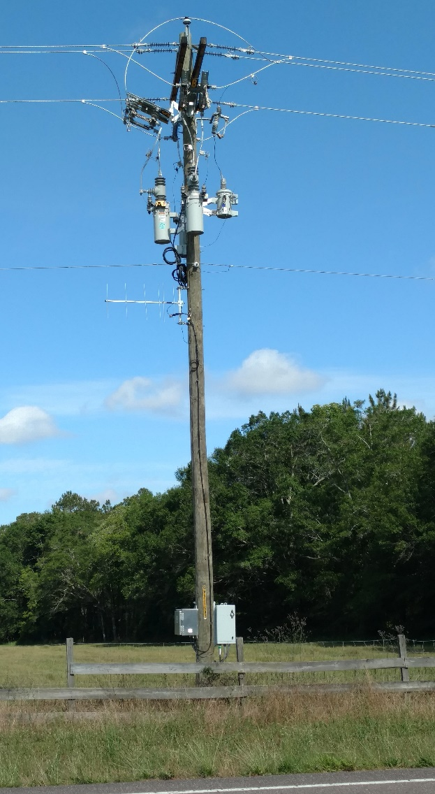
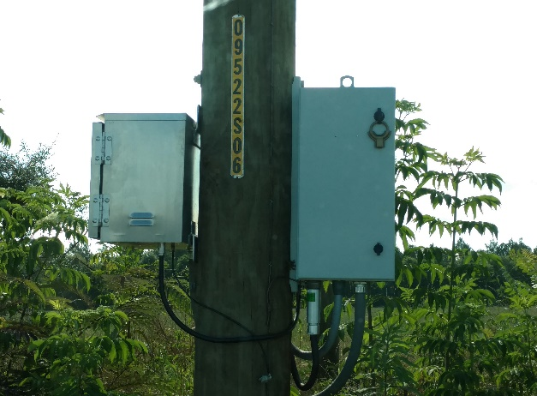
CHELCO Plan
GLEN
DFSP
ALAQ

Slide 13
Next Steps
Padmount Switch Gear
Further Sectionalize Line Segments
Analyze Cost of Tying Radial Feeders Together
Notes:
Matthew Starts
Next Steps:
Automate padmount switchgear in beach areas,
Add triple single devices in automated sections to further sectionalize.

Slide 14
Questions?
Matthew Avery, P.E. Vice President of Engineering mavery@chelco.com
850-307-1190
Mike Kapotsy, M.E., P.E. Engineering Services Supervisor mkapotsy@chelco.com
850-307-1198
Levi McNeely Electrical Engineer II lmcneely@chelco.com
850-307-1235

