Slide 1
Seminole Initiatives
FECA Engineers Conference
Glenn Spurlock
June 7, 2016

Slide 2
Seminole Initiatives
Seminole Solar – The Project
Seminole Solar – Marketing Materials
Energy Efficiency

Slide 3
Seminole Initiatives
Seminole Solar – The Project

Slide 4
Seminole Solar – The Project
(Review)
Issued Request For Proposals with two options:
  Engineer, Procure, Construct (EPC)
    MGS Site
    2 MW_{AC}
    25 year life
    Fixed Tilt or Single Axis Tracking
  Power Purchase Agreement (PPA)
    Within peninsular Florida
    2 MW (open to consider 2 MW – 20 MW)
    Term 20-30 years
    Technology Agnostic

Slide 5

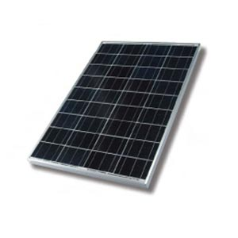

Seminole Solar – The Project
385 V
AC
DC
Inverter
Low (V)
1000V
Step-Up Transformer
Med (V)
High (V)
Substation
12.47 kV
Distribution Lines

Slide 6
Seminole Solar – The Project
(Review)
4/08 – EPC Mandatory project walk-down
4/14 – Bidder Qualification Questionnaire Deadline
4/22 – Bid Clarification Deadline
5/08 – Bid Submission Deadline
      Received 5 EPC Bids & 4 PPA Bids

Slide 7
Seminole Solar – The Project
Status Update
EPC “Self-Build” Option Selected
Radiance Solar, LLC Selected as EPC Contractor
Contract Executed
Contract Assigned to Farm Credit Leasing (Owner)
Facilities Lease Documents Executed
Site Geotechnical Study - Project Design and Layout Modified

Slide 8
Seminole Solar – The Project
Status Update
Grazing Lease Modified and Cattle Removed
FDEP Amendment Approved
Grid Interconnection Study Started
Site Clearing is Underway
Project Kick-off Meeting Occurred on June 2nd
Groundbreaking – June 14th
Site TOPO Survey - June 15th
Video Shoot - June 30th
June 7, 2016

Slide 9
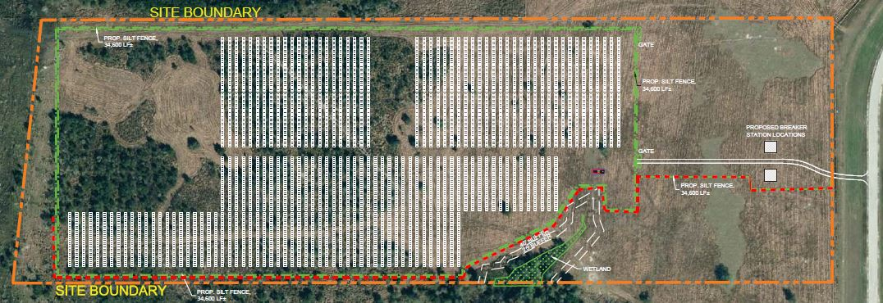
Seminole Solar – The Project
Status Update
June 7, 2016

Slide 10
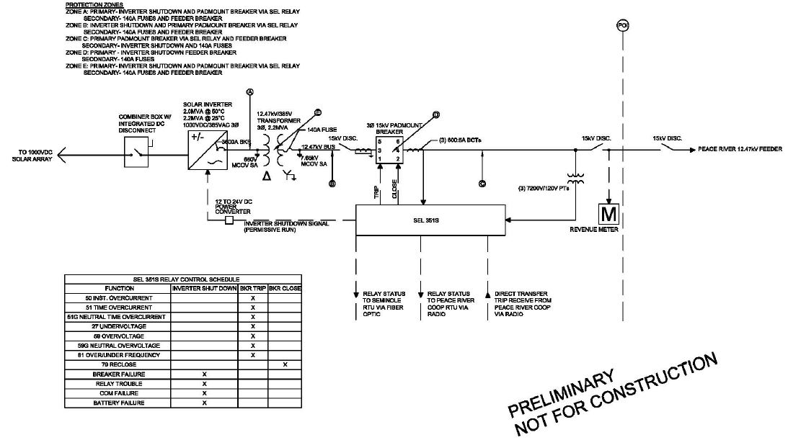
Seminole Solar – The Project
Status Update
June 7, 2016

Slide 11
Project Summary
2.2 MW_{AC} @ peak (≈320 watts/panel)
First Year Annual Energy Forecast - 5,000+ MWh
Located at MGS facility
EPC Contract
Owned by Farm Credit Leasing
Approximately 29 acres
12.47 kV Grid Interconnection with PRECO
Financing with benefit of 30% Federal Investment Tax Credit
Substantial Completion – November 2016
June 7, 2016

Slide 12
Seminole Initiatives
Seminole Solar – Marketing Materials

Slide 13

Seminole Solar – Marketing Materials

Slide 14

Community solar: a cooperative approach
Co-ops make solar affordable
Co-op energy advisors can help members make smart energy investments, including right-sizing solar arrays so you don’t pay for more than you need
Co-ops are local, not-for-profit, member-owned utilities – we strive to provide affordable power to our Members
Cooperative Solar is safe and reliable
Community-owned and operated solar is safe: the co-op handles all the installation and maintenance
The co-op manages power produced by the solar array
Trusted relationship
Cooperative solar is simple
With community solar, members don’t need to take on the risk and liability associated with rooftop solar
If you move locally, your solar energy moves with you
Consumers can immediately benefit from participation either by credits on their bill or rate savings
Members can monitor the performance of the array
Notes:
Seminole started the marketing process in July of 2015 with a communicators meeting to develop a plan for marketing/communications for the project, objectives, goals, and deliverable outcomes.
At the meeting we identified:
Message Triangle (NRECA Solar toolkit) Community solar is affordable, safe, reliable, and simple
Key and secondary audiences,
identified key messages, for materials
Our Members asked…and we listened… Seminole “Cooperative Solar”
The relationship that our Members have with end-use consumers is key to the marketing strategy:
Cooperative Solar is a safe, reliable, affordable and simple way to participate in solar

Slide 15

Solar Fit for the Cooperative
Aligns with what we do best:
  Provide safe and reliable energy to our Members
  Allows Seminole to take advantage of economies of scale
  Engage our Members directly
  Use our expertise and knowledge to optimize the system to provide maximum value
Solar Fit for Member-Consumers
Provides opportunity for our member-consumers:
  Members benefit from economies of scale
  Removes barriers: physical and financial
  No third party relationship
  Allows Members to share in the value of the co-op’s grid integration of renewables
Notes:
NRECA: Community Solar fit: changed for Seminole’s project
We looked at the goals and objectives of Cooperative Solar and came up with the deliverables

Slide 16




Cooperative Solar
Marketing Deliverables….
Share The Power Of The Sun
Press Release: Seminole Solar Project “Cooperative Solar”
Individualized Member Logos
Community Talking Points
Information Card
Community Power Point Presentation
Member Connections Column
Cooperative Solar Video
Member Cooperative Solar Toolkit:
  Quarter-page Ad
  Yard signs/window clings
  Brochure/information card
  Bill Stuffer
  Business Reply Card
Share The Power Of The Sun
Notes:
To date
Completed:
Press Release
Member logos
Community Talking points
Member Communications “Connections Column”
In-progress:
Solar video (expected completion November 2016)
Member toolkit (expected to be online late June)

Slide 17
Seminole Initiatives
Energy Efficiency

Slide 18
Energy Efficiency
Seminole is developing a plan that helps characterize the current and potential future EE and DSM activities of Seminole and its Member cooperatives. The Assessment encompasses two primary goals:
  Examine and report on the current practices and programs at Seminole and each Member cooperative including a quantification of energy savings and peak demand reductions; and
  Develop future energy efficiency and demand response (EE/DR) scenarios through 2021, reflecting a range of constraints and assumptions, e.g., specific EE/DR budgets and selected cost-effectiveness constraints.
June 7, 2016

Slide 19
Energy Efficiency
Seminole Contracted with Advanced Energy/Tierra Resource Consultants for EE & DSM Assistance
Quantify Existing Member Behind-the-Meter Energy Savings/EIA 861
Quantify Existing Power Systems Energy Savings (Seminole and Member Systems)
Enhance Existing Program Efforts and Explore New Cost Effective Programs and Measures (RIM Test)
June 7, 2016

Slide 20
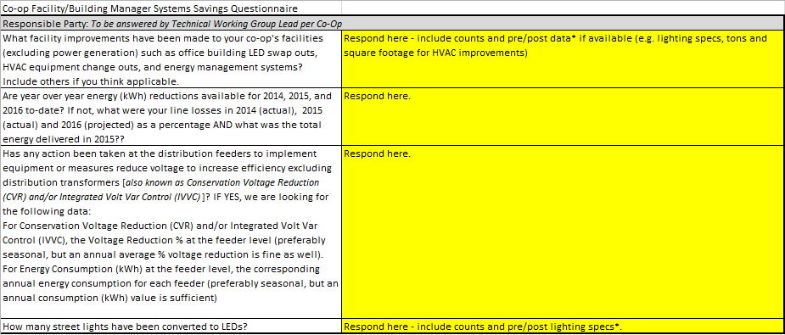
Energy Efficiency
Survey
June 7, 2016

Slide 21
Seminole Initiatives
Reference Slides

Slide 22
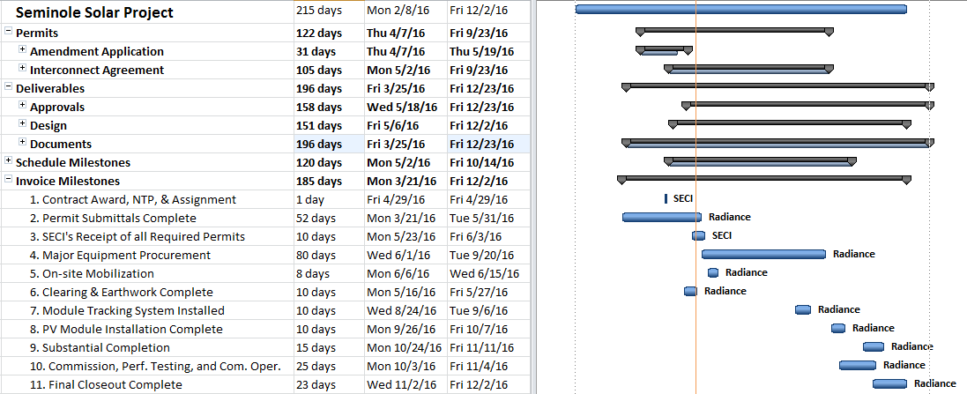
Planned Schedule
June 7, 2016

