Slide 1
Seminole Community Solar Initiatives
Florida Electric Cooperatives Association
2015 Engineers Conference
Glenn Spurlock
June 8, 2015

Slide 2
Technical Solar Challenges
Solar is Non-Dispatchable
Solar is Must-Take Energy – Regardless of the Costs
Solar Forces Two Shifting of Fossil Fuel Units
Increases Maintenance Costs of Fossil Units
Reduces Reliability of Fossil Units
High-Density of Solar Causes:
Grid Instability Issues
Grid Voltage & Power Quality Issues

Slide 3
Grid Impacts

Slide 4
Why Solar Gains in Popularity?
Early adopters embrace solar to be “Green” (regardless of cost)
Solar costs continue to drop due to:
Regulatory Support
Federal Investment Tax Credit - Renewable Portfolio Standards
Net Metering Policies - Pressure to Reduce Coal Generation
Technological advancements
Mass production
Simplicity of residential installations (Plug & Play)
Solar becomes cost effective in some high utility cost markets
Media encourages Solar

Slide 5
Seminole Solar Research
End-consumers (@ annual meetings) request solar energy
Consumer survey indicates solar Interest
Seminole researches solar energy options, as shown on the following slides:

Slide 6
Solar Thermal Water Heating

Slide 7
Solar Thermal Water Heating

Slide 8
Concentrated Solar Thermal Power (CST)

Slide 9
Concentrated Solar Thermal Power (CST)

Slide 10
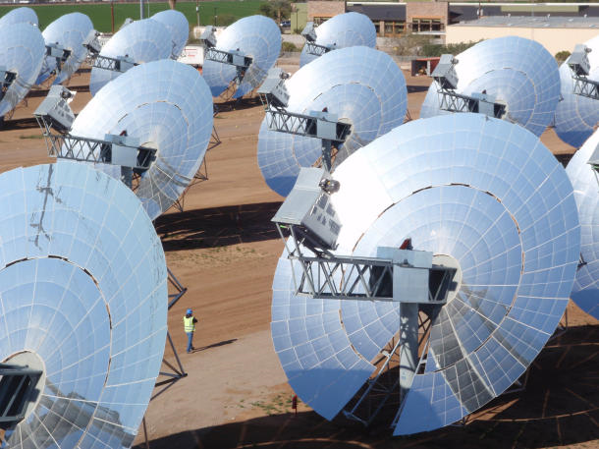
Concentrated Solar Power (CSP) Technologies
Dish

Slide 11
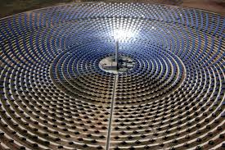
Concentrated Solar Power (CSP) Technologies
Concentrated Solar Power Facility

Slide 12
Utility-Scale Solar Photovoltaic

Slide 13
Utility-Scale Solar Photovoltaic

Slide 14
Seminole Community Solar Initiatives
3/31 - Issued Request For Proposals (RFP) with two options:
Engineer, Procure, Construct (EPC)
MGS Site
2 MW_{AC}
25 year life
Fixed Tilt or Single Axis Tracking
Power Purchase Agreement (PPA)
Within peninsular Florida
2 MW (open to consider 2 MW – 20 MW)
Term 20-30 years
Technology Agnostic

Slide 15
Seminole Community Solar Initiatives
4/08 – EPC Mandatory project walk-down
4/14 – Bidder Qualification Questionnaire Deadline
4/22 – Bid Clarification Deadline
5/08 – Bid Submission Deadline
Received 5 EPC Bids & 4 PPA Bids
7/09 – Board Approval to Award Contract
11/02/2016 – Commercial Operation Date

