Slide 1
PREPARING FOR HURRICANE SEASON
RESPONSE AND RECOVERY
FLORIDA ELECTRIC COOPERATIVE ASSOCIATION
JULY 2021
WENDY HUFF ELLARD
SHAREHOLDER
601.969.4681
wellard@bakerdonelson.com
CHRIS BOMHOFF
DISASTER POLICY SPECIALIST
954.768.1630
cbomhoff@bakerdonelson.com

Slide 2
TODAY’S AGENDA
Immediate Actions/Considerations
Deadlines to be Aware Of
Project Formulation Basics
Grants Portal Basics/Best Practices
Dispute Resolution Process

Slide 3

PA PROCESS – INITIAL DEADLINES
Preliminary Damage Assessment (PDA) – Critical to Participate
Declaration Issued – Note Date, Categories, Cost Share
Applicant Briefing – Attend if Possible (Virtual for Now)
Request for Public Assistance (RPA)
  Due 30 days from Date of Declaration

Slide 4
PA PROCESS – INITIAL DEADLINES
CONTINUED
Assigned a FEMA Program Delivery Manager (PDMG)
  May also meet a Task Force Leader (TFL)
Exploratory Call – within 7 working days of assignment
Recovery Scoping Meeting (RSM) – within 21 days of assignment
Identify and Report all Damage to FEMA – within 60 days of RSM
  Can ensure you meet this deadline by submitting your damage identification documentation (photos, damage assessment reports, damage location maps, etc.) in your Grants Portal projects.

Slide 5

PA PROCESS – INITIAL DEADLINES
CONTINUED
Documentation Deadline
  Within 90 days of RSM or completion of work (whichever is later)
Request for Information (RFI) Process - Ongoing
Determination Memo (DM)
  FEMA’s formal decision document
  Triggers Right of Appeal
  Document date of receipt of DM
  Must file with recipient within 60 days of receipt
Notes:
Right of Appeal may be triggered by other FEMA decisions, not always a “DM”

Slide 6

STANDARD PROJECTS – REIMBURSED AT ACTUAL COST
Standard Reimbursed Project
  Repair/restore/replace to pre-existing condition
  For buildings and electric power, consensus-based codes, specifications and standards must be incorporated
    Codes for electric power available at FEMA’s Feb. 2020 FAQ
    Exceptions: technically infeasible, extraordinary burden
  Project is obligated based on actual cost or estimated and then adjusted up/down to reflect actual cost

Slide 7
CAPPED PROJECTS
Improved Projects
  Incorporates changes to the pre-disaster design and function (changes are not required by applicable codes or standards)
  E.g., relocation, increased capacity, upgraded finishes
  Requires recipient and sometimes FEMA pre-approval
Alternate Projects
  Damaged facility is abandoned and funding is put toward a different eligible facility or facilities or another approved use
  Requires FEMA pre-approval if alternate project involves construction
Fixed Cost Project (§ 428 Alternative Procedures)
  FEMA and applicant agree to fixed cost estimate; applicant can use funds on any § 428 project and can use excess funds for certain eligible purposes
  FEMA will not fund overruns

Slide 8
Category of Work – impact to Projects
Considerations of Category B vs. F
Cost Share
  Frequently there are different cost shares applicable to Emergency and Permanent Work
  Hurricane Michael –
    100% FEMA share for Category A and B October 10, 2018 through November 24, 2018
    90% for Category A and B After
    75% for Permanent Work inc. Category F
Force Account Labor Eligibility
  Emergency Work – Only OT
  Permanent – Regular Time and OT
Contracting Considerations – No formal impact but presumption
Mutual Aid – Policy now confirms both eligible
Eligibility / Duplication of Work

Slide 9

FEMA Projects are Primarily Managed
Through Grants Portal
Project formulation responsibility shifting to applicants
Applicants deal directly with FEMA instead of through the State
Less guidance from FEMA in the grant application and management process
Applicants must be familiar with the ins and outs of Grants Portal to properly request and manage projects in a timely fashion.

Slide 10
What is FEMA’s Grants Portal?
Online platform where Public Assistance applicants can:
  Submit a Request for Public Assistance (RPA)
  Submit and request approval of a project
  Upload all documentation to support project eligibility
  Communicate with FEMA and document meetings
  Respond to FEMA Requests for Information
  Monitor FEMA project review progress
Provides applicants more control over their project formulation
  Ensure all damages are captured
  Provide FEMA with an eligibility road map prior to review

Slide 11
How to Use Grants Portal
Account Creation
4. Project Tracking
Request for Public
Assistance (RPA)
5. Requests for Information
3. Project Formulation

Slide 12
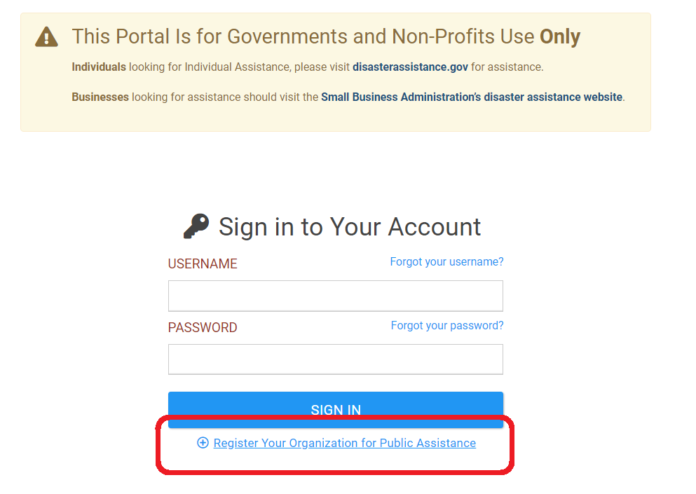
Creating a Grants Portal Account
https://grantee.fema.gov
Point of Contact Information
DUNS Number
IRS Employer Identification Number (EIN)
Primary Location
Notes:
Full name: Uniform Administrative Requirements, Cost Principles, And Audit Requirements For Federal Awards
In 2016, OIG questioned $155.6 million (23%)

Slide 13
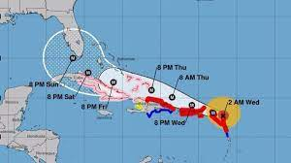
Request for Public Assistance (RPA)
Following a Presidential Disaster Declaration in your area, FEMA will open the RPA period for 30 days.
https://www.fema.gov/locations/florida contains up-to-date information on disaster declarations throughout the State of Florida.
You must submit a new RPA for each declared disaster to be eligible for PA funding.

Slide 14
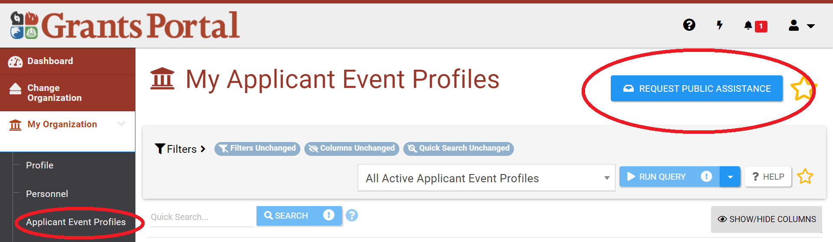
Request for Public Assistance (RPA)
Select “Applicant Event Profiles” from the left-hand menu
Click “Request Public Assistance”

Slide 15
Request for Public Assistance (RPA)
Documentation and information required with the RPA:
  Documentation to support nonprofit status (e.g. Internal Revenue Service that was in effect on the declaration date and granted tax exemption under sections 501(c), (d), or (e) of the Internal Revenue Code)
  Estimated cost of all incident-related impacts
  If applicable, authorized contractor contact information
  List of damaged facilities
This information is likely already recorded in Grants Portal if you currently have an account.
Important to answer all questions thoroughly even if you have been approved for Public Assistance in previous disasters.

Slide 16
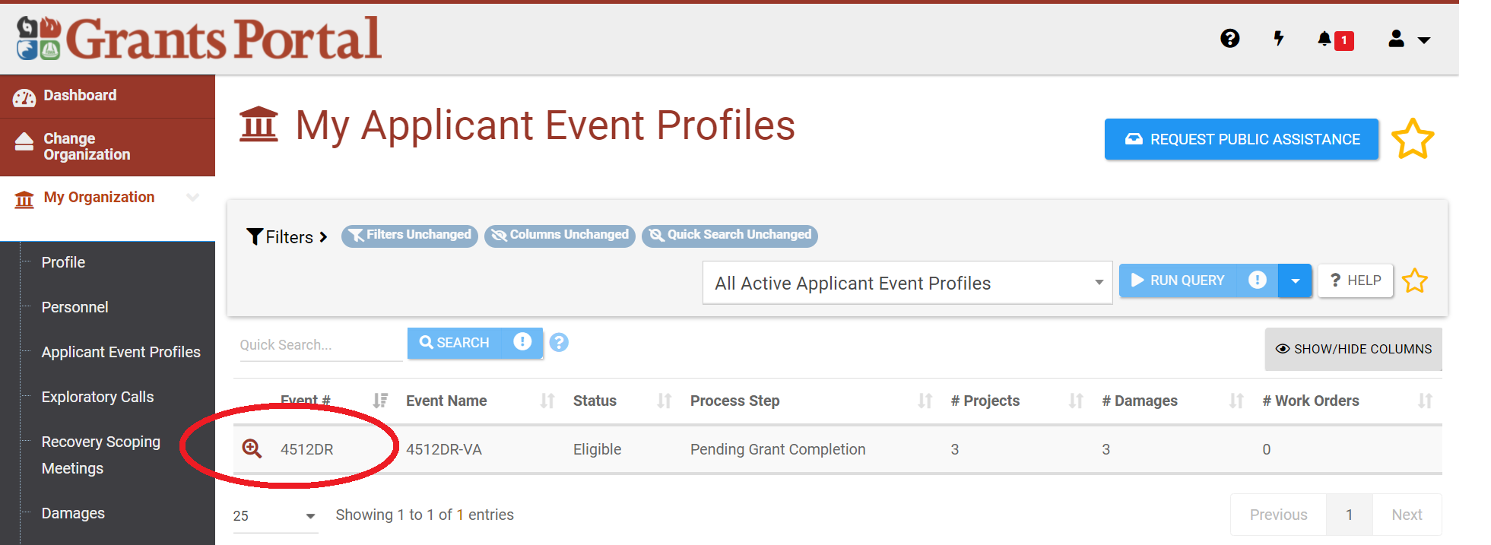
Requesting Project Applications
Requesting a Public Assistance Project
Notes:
Focus is top 5 general standards

Slide 17
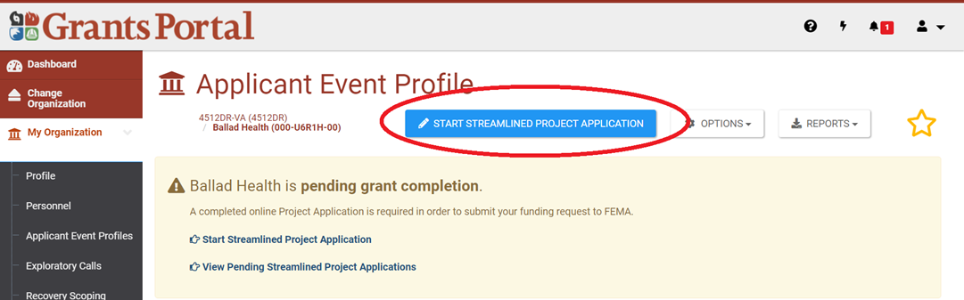
Requesting Project Applications
Requesting a Public Assistance Project
Notes:
Focus is top 5 general standards

Slide 18
Requesting Project Applications
CONTINUED
Required information
  Facility information
  Documentation of damages
  Projected scope of work to repair the damages
  Estimated cost to repair the damages
  Contractor/contract information, if applicable
  Procurement policy
This process allows you to control the messaging of your application and provide eligibility rationale upfront.

Slide 19
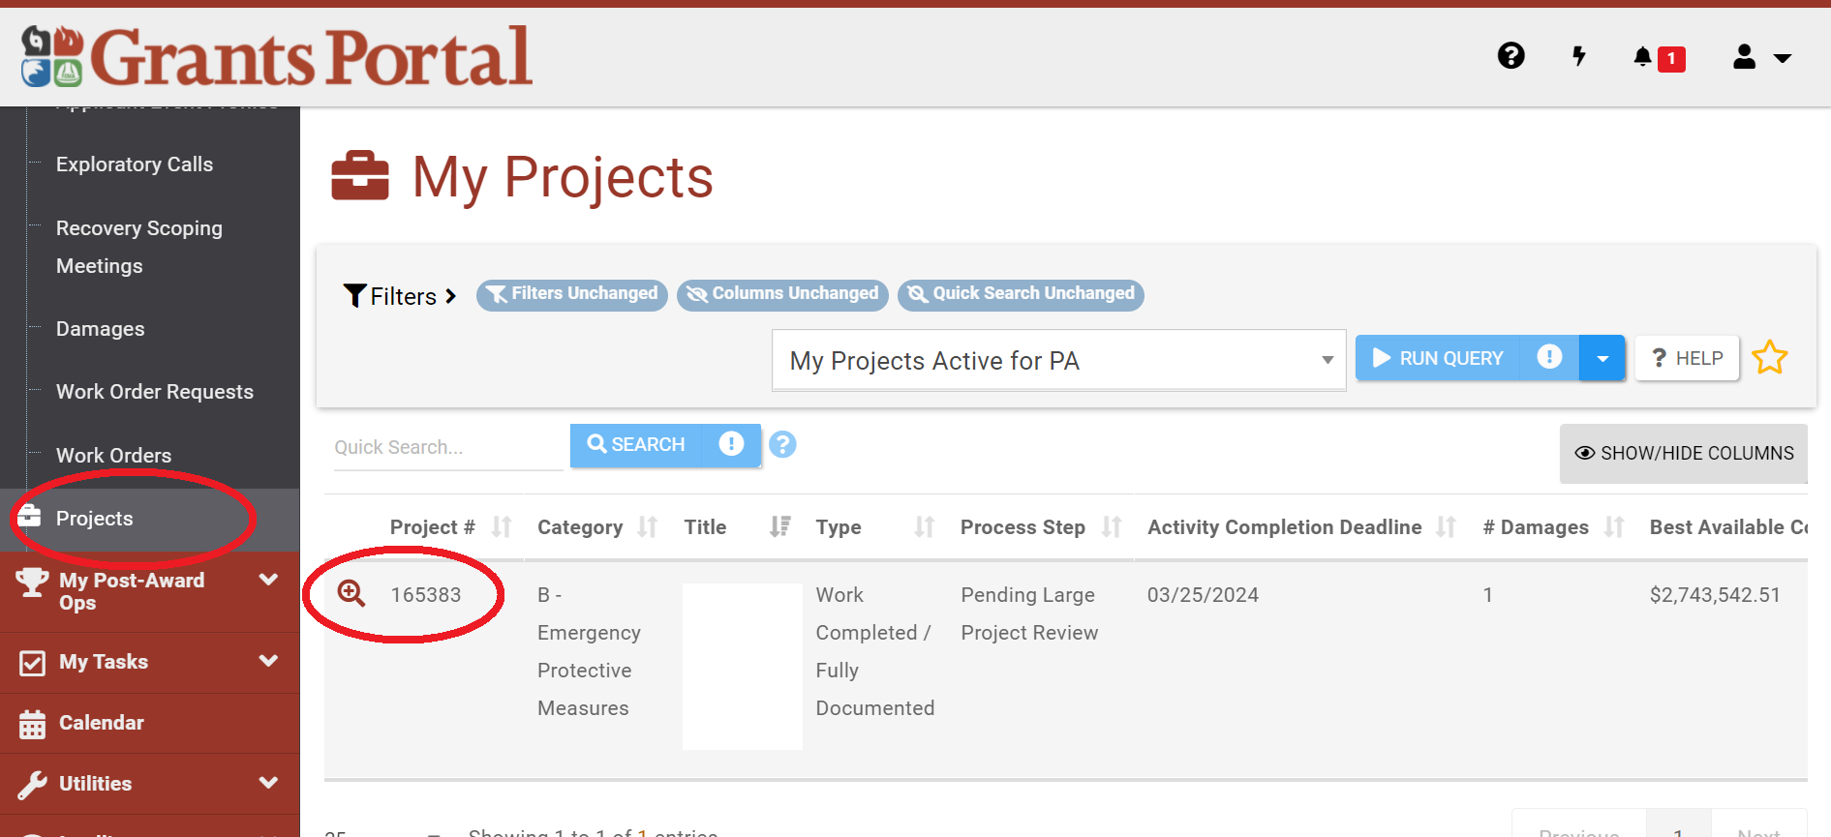
Project Monitoring
CONTINUED
Notes:
Tip: create a checklist to document reasons for determination of suitability, cost analysis, development of ceiling price
Tip: document monitoring of performance of work

Slide 20
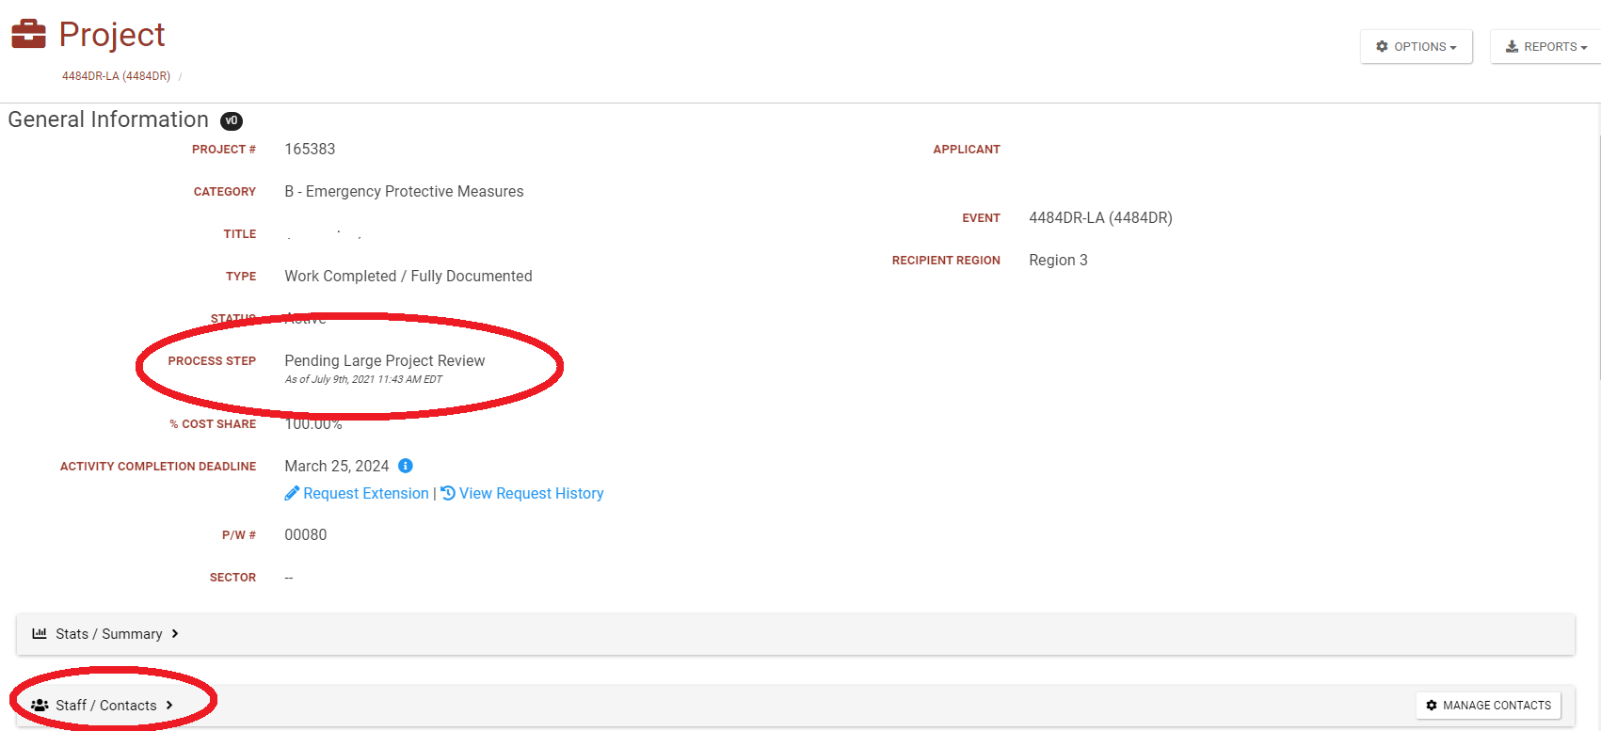
Project Monitoring
CONTINUED
Notes:
Tip: create a checklist to document reasons for determination of suitability, cost analysis, development of ceiling price
Tip: document monitoring of performance of work

Slide 21
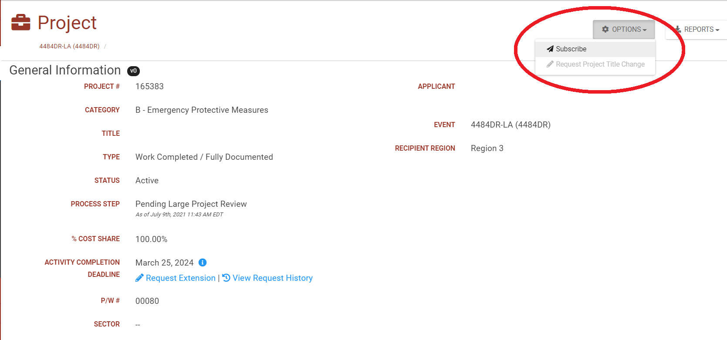
Project Monitoring
CONTINUED
Notes:
Tip: create a checklist to document reasons for determination of suitability, cost analysis, development of ceiling price
Tip: document monitoring of performance of work

Slide 22
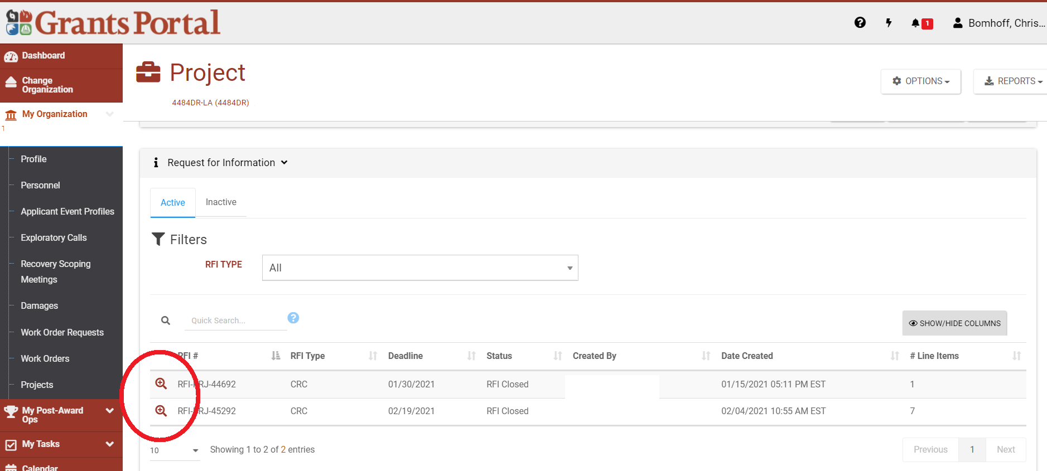
Requests for Information (RFI)
CONTINUED
Notes:
Tip: create a checklist to document reasons for determination of suitability, cost analysis, development of ceiling price
Tip: document monitoring of performance of work

Slide 23
Grants Portal Tips and Best Practices
You can always upload additional documentation to your project after it is submitted to FEMA. As soon as you receive an invoice for work or document new damage, upload the document to your Grants Portal project.
Document your interactions with FEMA in either meeting minutes or directly in the comments of your Grants Portal projects.
Track the progress of your projects on a weekly basis and check in with your FEMA representative if you are not seeing movement.
Activate subscriptions to your project applications so you can get in front of any potential issues with your projects.
Utilize the project application process to proactively tell FEMA why your project is eligible.

Slide 24
DISPUTES IN THE PUBLIC ASSISTANCE PROGRAM
Basic eligibility for assistance
  Applicant eligibility: tribe, local government, non-profit
  Scope of damage, cause of damage
  Repair vs. Replacement: 50% rule
  Relocation
  Documentation; sufficiency, compliance with DI/DDD
Reasonable cost and procurement
  Competitive bids/illegal forms of contract
  Change orders
  Failure to provide proper preferences: minorities, local preference
After closeout: Deobligation of funds spent
  Department of Homeland Security Office of Inspector General (OIG) Audit
  Change in FEMA Policy

Slide 25
FEMA APPEAL PROCESS OVERVIEW
Stafford Act Sec. 423; 44 C.F.R. 206.206; www.CBCA.gov
First Appeal – FEMA Region
Second Appeal – FEMA HQ
Arbitration – Civilian Board of Contract Appeals
Must file within 60 days of receipt of First Appeal Denial, OR
Must file with Recipient within 60 days of earliest receipt of FEMA Determination
Recipient must transmit to FEMA Region within 60 days of receipt
Must file with Recipient within 60 days of earliest receipt of First Appeal Determination
May file 180 days after FEMA receives First Appeal
FEMA Region has 90 days to request more information or issue decision
Recipient must transmit to FEMA Region within 60 days of receipt; Region transmits to HQ
FEMA HQ has 90 days to request more information or issue decision
IF eligible disaster and Project/dispute

Slide 26
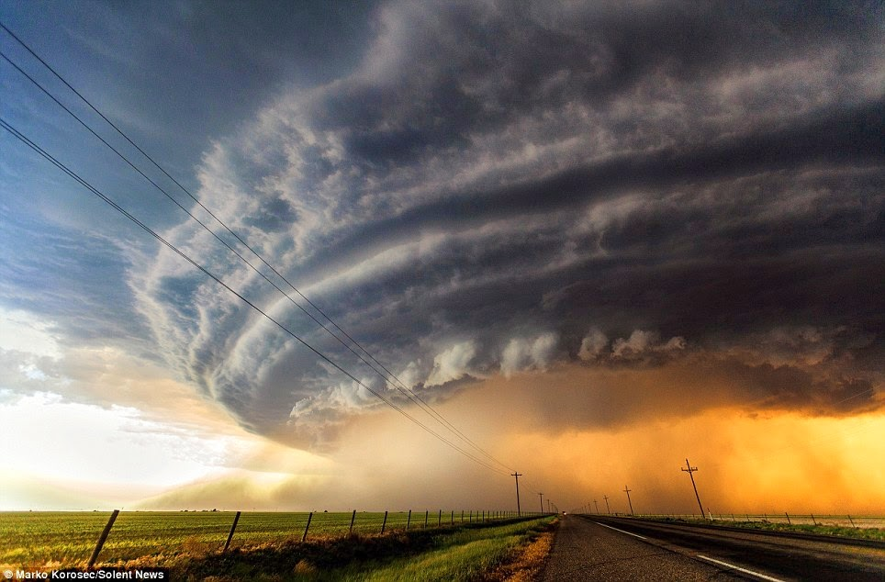
MINIMAL REQUIREMENTS
The Appeal MUST:
Be in writing,
In response to an appealable determination,
Filed with applicable recipient,
Contain documented justification supporting your position,
Specify the monetary figure in dispute,
State the provisions of Federal law, regulation, or policy with which you believe FEMA’s initial action was inconsistent, and
Filed within 60 days of receipt of denial.

Slide 27
PROCESS AND DEADLINES ARE CRITICAL
“According to the Administrative Record, the Applicant filed its first appeal on July 30, 2020. However, the Minnesota Division of Homeland Security and Emergency Management did not transmit the appeal until September 30, 2020. This was after the 60-day timeframe required by FEMA’s regulations, making the first appeal untimely. Therefore, this appeal is denied.” (Martin County Drainage Authority, May 2021)
“FEMA has requested that we dismiss this arbitration matter as untimely filed because the Board did not receive the arbitration request until more than sixty days after the Town had received FEMA’s decision denying the Town’s first-level appeal. For the reasons explained below, we grant FEMA’s request.” (CBCA 7064-FEMA, Town of Elizabethtown, April 2021)
“The Recipient forwarded the Applicant’s first appeal outside of the regulatory 60-day timeframe; therefore, the appeal was untimely. Additionally, the direct submission of an appeal by the Applicant to FEMA does not comply with the proper appeal procedures and cannot be considered a timely appeal. Thus, the appeal is denied.” (City of White Sulphur Springs, Jan. 2019)
“According to the Administrative Record, the Applicant received notice of the first appeal decision by way of a certified letter on October 15, 2018. However, it did not submit its second appeal until December 20, 2018. This was after the 60-day timeframe required by FEMA’s regulations, making the Applicant’s second appeal untimely. For this reason, I am denying this appeal.” (YMCA of the Capital Area, April 2019)

Slide 28
DRAFTING THE APPEAL: SUPPORTING YOUR POSITION
Resources:
  FEMA Second Appeal Database
  DHS OIG reports
  Case law (but note there are only a few FEMA PA court cases)
  Legislative intent
  Other Federal Agency decisions
  CBCA Decisions
  Affidavits
  Statements included in Grants Portal
The Administrative Record:
  “If an applicant requests the entire record or portion of the record, it shall be provided.”
  Ask for it; build on it
Notes:
AR: is all documents and materials directly or indirectly considered by FEMA and relied upon in making a PA eligibility determination and subsequent first appeal decisions.
FEMA will only initially provide the Administrative Record Index (Recovery Directorate Appeals Manual, p. 15).

Slide 29
AFTER SUBMITTAL: THE RFI PROCESS
Issued when FEMA thinks the Record is insufficient to support granting the Appeal
Response deadlines can vary
If FEMA identifies a *new issue* - deadline to respond should be 60 days
FEMA’s 90-day review and determination period resets upon receipt of the information or passing of the deadline to respond
What are my options if FEMA has missed its deadline?
Notes:
Delete or consolidate with 42

Slide 30
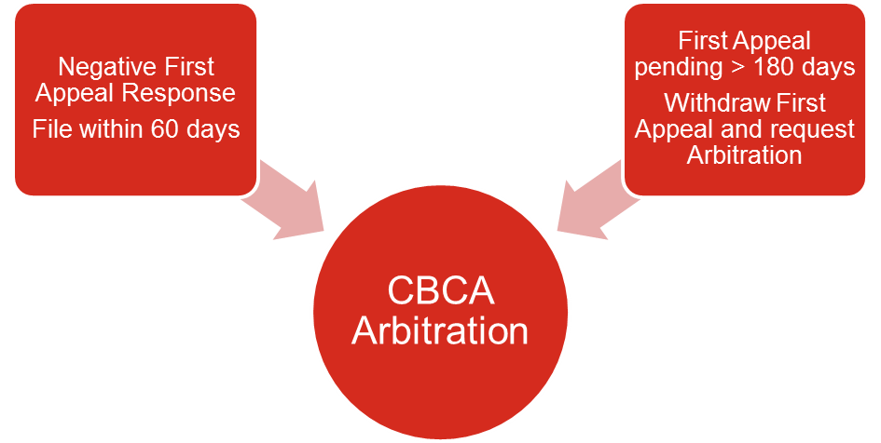
POST FIRST APPEAL: OPTIONS
For disasters declared January 1, 2016 and forward.
A subrecipient may choose to arbitrate in accordance with the Disaster Recovery Reform Act of 2018 (DRRA) (Pub. L. 115-254).
The amount at issue must be more than $500,000 (or more than $100,000 for rural areas).

Slide 31
ARBITRATION
THE HIGHLIGHTS
Parties may conclude arbitration by presenting their positions in a hearing.
A hearing may be live or, if agreed by all parties, on a written record (a ‘‘paper hearing’’) or a combination of the two.
The panel will begin a hearing within 60 calendar days after the Initial Conference.
All panel members will attend a live hearing in Washington, D.C. A single panel member may conduct a live hearing elsewhere.
Consideration/standard of review is “de novo.”
More on rules and process at www.CBCA.gov.

Slide 32
FINAL THOUGHTS
TIPS FOR WORKING WITH FEMA
Maintain good working relationships with your FEMA/Grantee assigned personnel.
FEMA's Public Assistance Program is complicated; know what to expect. Understand FEMA lingo and use to your advantage.
DO NOT IGNORE PROCUREMENT REQUIREMENTS
Document everything: damage assessments, procurement compliance, costs.
Keep records of meetings. Prepare minutes and submit to FEMA/Grantee personnel to confirm or correct.
If told “no” – be aware of appeals process. Meet all regulatory deadlines.

Slide 33


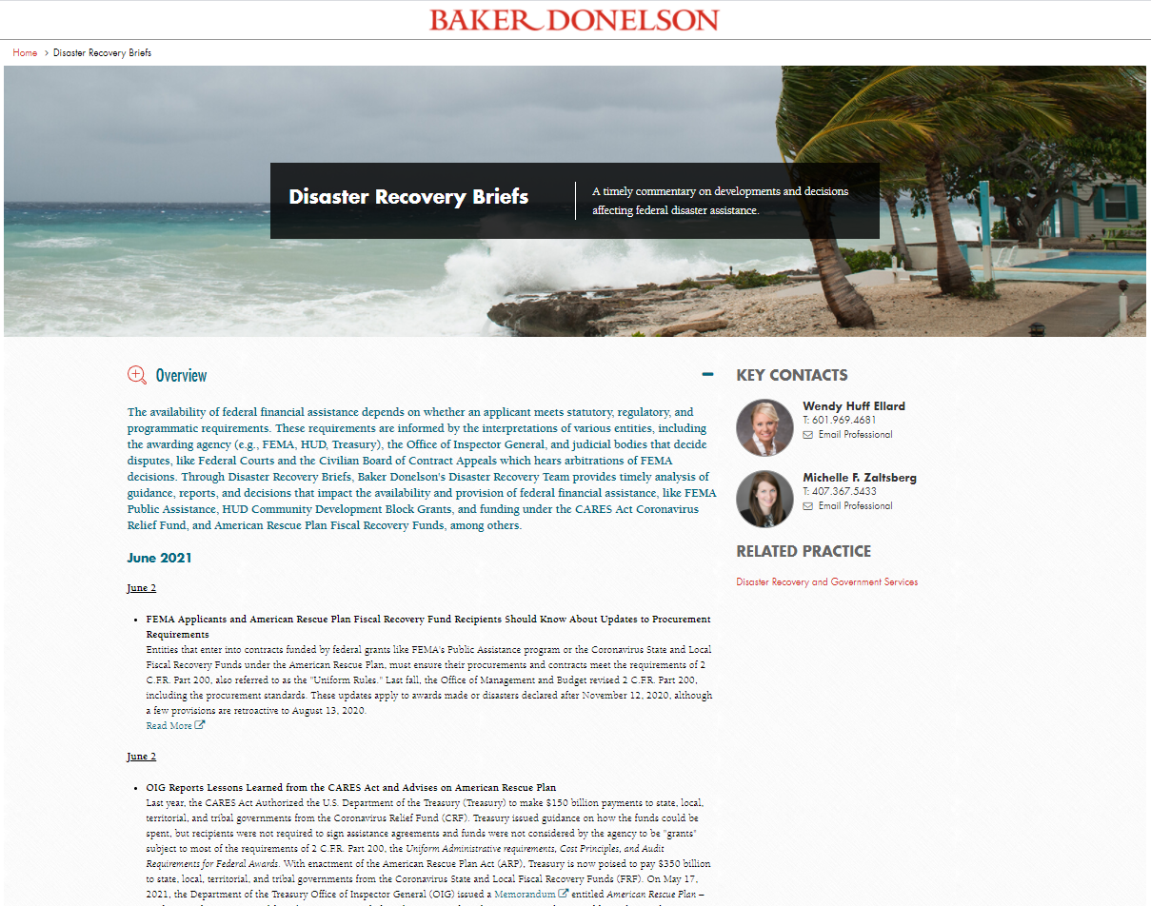
AT YOUR SERVICE
Ernie Abbott
Of Counsel
Washington, DC
Wendy Huff Ellard
Shareholder
Jackson
Danielle Aymond
Of Counsel
Baton Rouge
Erin Greten
Of Counsel
Washington, DC
Chris Bomhoff
Disaster Policy Specialist
Ft. Lauderdale
Parker Wiseman
Of Counsel
Jackson
Jordan Corbitt
Associate
Houston
Michelle Zaltsberg
Shareholder
Orlando
www.bakerdonelson.com/disaster-recovery-briefs

Slide 34
www.bakerdonelson.com
@BakerDonelson
@Baker-Donelson
@Baker_Donelson

