Slide 1
PREPARING FOR HURRICANE SEASON
UPDATES TO FEMA'S PROGRAM AND PROCUREMENT RULES
FLORIDA ELECTRIC COOPERATIVE ASSOCIATION
JUNE 2021
WENDY HUFF ELLARD
SHAREHOLDER
601.969.4681
wellard@bakerdonelson.com
JORDAN CORBITT
ASSOCIATE
713.210.7405
jcorbitt@bakerdonelson.com

Slide 2
TODAY’S AGENDA
Importance of Compliance – What You Can Do NOW
Procurement Requirements *Revised in 2020*
Documentation Requirements

Slide 3
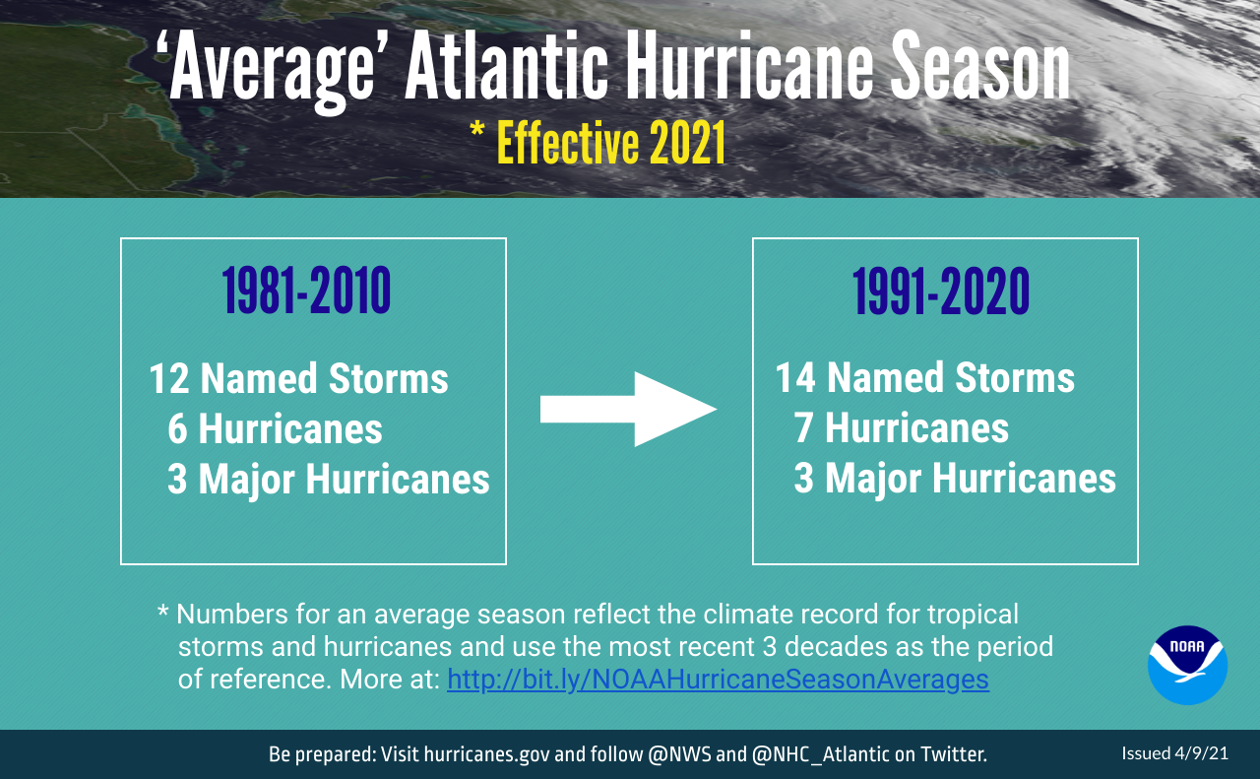

Slide 4
What You Need to Know: Basics of FEMA's Public Assistance Program
Governed by the Robert T. Stafford Disaster Relief and Emergency Assistance Act (The Stafford Act)
Implemented by Title 44 of the Code of Federal Regulations
Also subject to the Uniform Grant Requirements in 2 C.F.R. Part 200 (including procurement standards) *Revised in 2020
FEMA Public Assistance Program and Policy Guide – PAPPG or “Pappa-G” *V4 Eff. June 1, 2020
Grants are administered by state recipients/grantees
Large projects audited by Federal, State, OIG

Slide 5
WHY SHOULD YOU CARE ABOUT ALL OF THESE RULES?
FEMA can deny funding but can also take back money already spent
improper procurement
unreasonable cost
work beyond approved scope
FEMA’s own mistakes
unsupported costs (i.e., inadequate documentation)
Success in retaining funds depends on
pre-disaster policies and procedures
compliance with rules and policies during performance
documentation of procurements and expenditures segregated by FEMA grants

Slide 6
TOP FIVE ISSUES – 2020-2021 EVENTS
Procurement Non-Compliance
Reasonableness of Costs
2. Documentation of Costs
4. Causation – Direct Result
of Event
X Duplication of Benefits
Codes and Standards

Slide 7
PROCUREMENT STANDARDS & THE OIG
Procurement Standards are located in the Code of Federal Regulations
2 C.F.R. Part 200 – a.k.a. the “Uniform Rules”
Revised in 2020
By far the largest single target area for DHS-OIG
In the 6 years ending September 30, 2014, OIG questioned $352.3 million in costs due to procurement issues
2021 OIG Report:
“Noncompliance with procurement regulations was among the three findings OIG identified most often.”
“FEMA should not allow procurement-related questioned costs based solely on its determination of reasonableness.”
Notes:
Full name: Uniform Administrative Requirements, Cost Principles, And Audit Requirements For Federal Awards
In 2016, OIG questioned $155.6 million (23%)

Slide 8
FEDERAL PROCUREMENT REQUIREMENTS
Procurement Standards – 2 C.F.R. §§ 200.317-327
200.317 – Procurements by states.
200.318 – General procurement standards.
200.319 – Competition.
200.320 – Methods of procurement to be followed. *REVISED*
200.321 – Contracting with small and minority businesses, women's business enterprises, and labor surplus area firms.
200.322 – Domestic preferences for procurements. *NEW*
200.323 – Procurement of recovered materials.
200.324 – Contract cost and price.
200.325 – Federal awarding agency or pass-through entity review.
200.326 – Bonding requirements.
200.327 – Contract provisions. *REVISED*

Slide 9
10 MOST COMMON PROCUREMENT MISTAKES
Sole-sourcing without adequate documentation of situation
Continuing the noncompetitive contract after emergency
Piggybacking
Failing to follow rules for T&M contracts
Use of cost-plus-percentage-of-cost contracting
Awarding contracts without the required contract clauses
Use of geographic preferences
Failing to take (or documenting) affirmative steps to solicit disadvantaged firms
Failing to conduct a cost or price analysis where required
Lack of documentation

Slide 10
GENERAL PROCUREMENT STANDARDS (2 C.F.R. § 200.318)
Two foundational documents required:
Procurement Procedures | Standards of Conduct (Conflict of Interest)
Must be compliant with federal/state/local rules. Must be in writing and must be followed. Must exist pre-disaster. | Must govern action of employees/officers/agents engaged in selection, award, and administration of contract. Must cover personal and organizational conflicts of interest. Must prohibit employees from soliciting/accepting gifts. Must provide for disciplinary actions. Must cover organizational conflicts of interest among contractors. Must prohibit contractors that develop/draft solicitations from competing for that work.
Must maintain records sufficient to detail the history of each procurement.
Notes:
Focus is top 5 general standards

Slide 11
GENERAL PROCUREMENT STANDARDS (2 C.F.R. § 200.318)
CONTINUED
Award contracts to only responsible contractors
Document procedures for checking qualifications
Contractors must certify they and subcontractors are not debarred or suspended
Check SAM.gov website – no reimbursement for work awarded to debarred or suspended contractor
Check state-specific naughty list
Also consider history of past performance

Slide 12
GENERAL PROCUREMENT STANDARDS (2 C.F.R. § 200.318)
CONTINUED
Time and Material/Time and Equipment Contracts permissible only:
after a determination that no other contract is suitable;
if the contract includes a ceiling price that the contractor exceeds at its own risk (2 C.F.R. 200.318(j)); and
the applicant maintains a high degree of oversight to ensure efficient methods and cost controls.
Notes:
Tip: create a checklist to document reasons for determination of suitability, cost analysis, development of ceiling price
Tip: document monitoring of performance of work

Slide 13
FULL AND OPEN COMPETITION REQUIRED (2 C.F.R. § 200.319)
Full and open competition means NO:
Unreasonable requirements to qualify
Unnecessary experience or excessive bonding requirements
Noncompetitive pricing practices
Noncompetitive contracts to existing consultants/contractors
Specifying brand names
Imposing geographic preferences

Slide 14
METHODS OF COMPETITION (2 C.F.R. § 200.320)
Micro-Purchases (</= $10,000) *REVISED*
Entities may annually self-certify up to $50,000 if they:
Document the amount;
Document a justification; and
Can demonstrate low risk or, for public institutions, if consistent with state law.
Higher thresholds are also possible, but only with federal agency approval.
Now considered an acceptable “non-competitive” procurement method.
Small Purchase Procedures (>$10,000 and </=$250,000)
Sealed Bids – price determines winner
Proposals – price and other factors determine winner

Slide 15
METHODS OF COMPETITION (2 C.F.R. § 200.320)
CONTINUED
Noncompetitive Procurement
Micro-Purchases
Available only from a single source
Public exigency/emergency will not permit delay required for competitive solicitation
FEMA or state approves in response to written request
After solicitation, competition is inadequate

Slide 16
SOCIOECONOMIC CONTRACTING (2 C.F.R. § 200.321)
Required “Affirmative Steps”
Placing qualified small and minority firms on solicitation lists
Soliciting small/minority/women’s businesses whenever they are potential sources
When economically feasible, dividing total requirements into smaller tasks to permit maximum participation
Establishing delivery schedules which encourage participation
As appropriate, using the SBA and MBDA
Requiring prime contractor to take affirmative steps as to subs
Notes:
Regulation lists six specific affirmative steps
OIG recommends deobligation if not taken
Tip: establish a documented affirmative outreach program for minority contractors prior to disaster
Tip: use a template memorandum to document compliance with each affirmative step.

Slide 17
DOMESTIC PREFERENCES (2 C.F.R. § 200.322) *NEW*
Requires preference for “purchase, acquisition, or use” of “goods, products, or materials” produced in the U.S.
Requires preference inserted into all contracts and POs.
Includes iron, aluminum, steel, cement, and other manufactured products.
“Produced in the United States” means, for iron and steel products, all manufacturing processes, from initial melting stage through application of coatings, occurred in the United States.
“Manufactured products” means items and construction materials composed in whole or in part of non-ferrous metals such as aluminum; plastics and polymer-based products such as polyvinyl chloride pipe; aggregates such as concrete; glass, including optical fiber; and lumber.

Slide 18
CONTRACT COST AND PRICE (2 C.F.R. § 200.324)
Cost or Price Analysis = required
For every procurement above the “Simplified Acquisition Threshold” – $250,000
Document the cost analysis in procurement file
If you don’t determine the contract price is fair and reasonable, FEMA will (or may not)
Cost-plus-a-percentage-of-cost = FEMA cannot pay

Slide 19
BONDING (2 C.F.R. § 200.326)
Bonding requirements are applicable “when awarding construction or facility improvement contracts” over $250,000.
But what constitutes construction work or a facility improvement project?
The construction, rehabilitation, alteration, conversion, extension, demolition or repair of buildings, highways, or other changes or improvements to real property, including facilities providing utility services
Watch out! FEMA guidance states that “construction work” also includes the supervision, inspection, and other onsite functions incidental to the actual construction.
Better to be on the compliant side of the issue.

Slide 20
CONTRACT PROVISIONS (2 C.F.R. § 200.327)
Required | Recommended
Remedies Termination for Cause Termination for Convenience Equal Employment Opportunity Davis-Bacon Act* Copeland Anti-Kickback Act* Contract Work Hours and Safety Standards Right to Inventions* Clean Air Act Federal Water Pollution Control Act Debarment & Suspension Byrd Anti-Lobbying Act Procurement of Recovered Materials** Domestic Preferences *NEW* Prohibition on Certain Telecom and Video Surveillance Services or Equipment *NEW* Affirmative Steps for Solicitation of Disadvantaged Firms | Changes Access to Records Non-Use of DHS Seal, Logo, and Flags Compliance with Federal Law, Regulations, and Executive Orders No Obligation by Federal Government Program Fraud and False or Fraudulent Statements or Related Acts
* Not applicable to FEMA Public Assistance program
** Not applicable to private non-profits

Slide 21
WHAT YOU CAN DO NOW…PROPER RECORD KEEPING
Requirement: Must maintain records to detail the history of procurement. 2 C.F.R. § 200.318(i)
Have a policy for contractor evaluation and keep all procurement records
Develop a Procurement File Checklist
Maintain record of determination that the chosen vendor is a "responsible contractor." 2 C.F.R. § 200.318(h)
Document cost analysis and all pricing determinations. 2 C.F.R. § 200.324
T&E Contracts – Create a form to document rationale for determination of suitability, cost analysis, development of ceiling price. 2 C.F.R. § 200.318(j)

Slide 22
COST REASONABLENESS
Evaluation Factors:
Generally recognized as ordinary/necessary
Comparable to market price based on:
Historical documentation
Average cost in area
Published prices
Special circumstances (e.g., supply shortages, project-specific complexities)
Conflicts of Interest
Procurement Compliance
Robust competition is the best evidence of cost reasonableness.

Slide 23
DOCUMENTING REASONABLE COSTS CASE STUDY: LOGISTICS/BASE CAMP COSTS
Major Current Issue: Logistics / Base Camps
Ensure that you document the nature of the restoration work / need
Document Anticipated Use
Document Support for Location, Configuration, Alternatives
Consider your procurement, is it compliant?
Must have a NTE for Time and Materials Contract
Must have a Termination for Convenience Clause
NOTE: Minimums are a current high risk area
Document a Cost or Price Analysis
Compile and Keep Documentation of Reach-outs / Rates
Document Actual Use

Slide 24
PRE-STORM/NON-EMERGENCY PROCUREMENT PROCESS
Evaluate/anticipate your needs:
Debris Removal
Debris Monitoring
Power Restoration
Base Camp and Related Services
Materials
Develop Scopes of Work to encompass “reasonably expected needs”
Draft FEMA-compliant RFPs and ITBs
RFQs may be used to prepare a pre-qualified list, but limited use
Conduct FEMA-compliant competitive procurement
Independent cost estimate
Cost analysis
Solicit disadvantaged firms
Award FEMA-compliant pre-positioned contracts
Reasonable cost based on need

Slide 25
EMERGENCY PROCUREMENT PROCESS
Evaluate your needs
Develop Scopes of Work to encompass “reasonably expected needs”
Document emergency/exigent circumstances justifying noncompetitive contracting
Develop independent cost estimate to ensure cost reasonableness
Solicit available contractors
Pre-qualified lists may help in this scenario
Perform cost analysis to ensure cost reasonableness
Award FEMA-compliant contracts
Cancel contracts at earliest opportunity and conduct competitive procurement for remaining work

Slide 26
EMERGENCY CONTRACTING REQUIREMENTS
Required contract clauses at 2 C.F.R. § 200.327 & Appendix II
Applicable bonding requirements at 2 C.F.R. § 200.326
Responsible contractors only
Cost or price analysis to demonstrate cost is fair and reasonable
No cost-plus-percentage-of-cost contracting
T&M contracts may only be used if:
Documented determination that no other contract type is suitable
Not-to-exceed amount
High degree of contractor oversight
Applicants must follow documentation, oversight, and conflict of interest requirements
Bottom Line: emergency contracting is not a free pass

Slide 27
JOINT PROCUREMENTS
Inter-entity agreements for use of common or shared goods or services are encouraged.
Entities “are encouraged to collaborate on procurement actions for goods and services where the result will lead to cost savings.”
Joint Procurement is OK, Piggybacking is NOT:
Piggybacking: using another entity’s contract
Joint Procurement: multiple entities use a single solicitation and enter into a single contract
FEMA Guidance:
“each party acting under a joint procurement must ensure that all applicable federal procurement under grant rules are met”

Slide 28
PURCHASING AGENTS
FEMA’s guidance allows the use of Purchasing Agents
But, Applicants must:
have procurement procedures allow for use of purchasing agents.
have written standards of conduct covering conflicts of interest—these will apply to both the applicant and the purchasing agent.
maintain oversight to ensure that contractors perform in accordance with the terms, conditions, and specifications of their contracts or purchase orders.
remain responsible for the settlement and satisfaction of all contractual and administrative issues arising out of the procurement (e.g., disputes, claims, protests of award, source evaluation, or other matters of a contractual nature).

Slide 29
DOCUMENTATION REQUIREMENTS
Costs must be:
Required as a result of the disaster
Necessary and reasonable
Legal responsibility of applicant
Reduced by all other available resources
Adequately documented

Slide 30
WHAT YOU CAN DO NOW… SUPPORT CAUSATION
Documentation is key throughout the recovery process
Nothing is too small or too big to document
Damages that are apparent to the Applicant may not be so apparent to FEMA without DOCUMENTATION
Work and costs must be required as a result of the disaster
Document condition of your system NOW
Keep maintenance records, policies, photos
Notes:
Will add to this.

Slide 31
UNDERSTANDING DOCUMENTATION REQUIREMENTS
Familiarize yourself with the documentation required for:
Force account labor
Force account equipment
Rented or purchased equipment
Supplies from stock
Purchased supplies
Contracts
Mutual Aid
Some grantee/recipients (including FDEM) do not disburse FEMA-obligated funding until their auditors have validated 100% of project costs.
We will provide a reference sheet describing required documentation for each of these categories of costs with the presentation materials.

Slide 32
COMPLIANCE TIPS
Use a procurement file checklist
Create forms to use with each procurement for:
Independent cost estimate
Cost analysis
T&M contract compliance; justification to increase T&M cap
Justification for noncompetitive contracts
Responsible contractor determination
Affirmative steps compliance
Contract Addendum
Read your contracts to ensure:
No cost-plus-percentage-of-cost
FEMA-required contract provisions
Invoiced costs are in accordance with contracts terms

Slide 33
COMPLIANCE TIPS
CONTINUED
Keep copies of all invoices and proof of payment
Keep records of your review process, including contractor oversight
Keep detailed records of work performed
Location of work completed, including GPS coordinates
Before and after photographs
Keep information for any ground disturbed and disposal of materials
If there are any special circumstances or unforeseeable needs that increase costs – DOCUMENT DOCUMENT DOCUMENT
Meetings – keep records of attendees
Remember – the confirming CYA email
Memorialize all conversations with FEMA

Slide 34
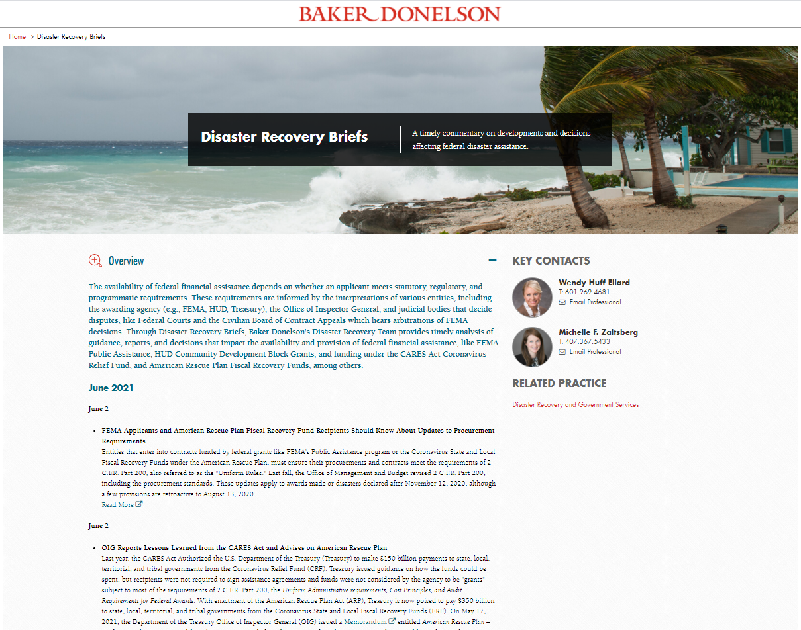
AT YOUR SERVICE
Ernie Abbott
Of Counsel
Washington, DC
Wendy Huff Ellard
Shareholder
Jackson
Danielle Aymond
Of Counsel
Baton Rouge
Erin Greten
Of Counsel
Washington, DC
Chris Bomhoff
Disaster Policy Specialist
Ft. Lauderdale
Parker Wiseman
Of Counsel
Jackson
Jordan Corbitt
Associate
Houston
Michelle Zaltsberg
Shareholder
Orlando
www.bakerdonelson.com/disaster-recovery-briefs

Slide 35
www.bakerdonelson.com
@BakerDonelson
@Baker-Donelson
@Baker_Donelson

